Slide 1


CLUBS AND SOCIETIES COMMUNICATIONS, SOCIAL MEDIA & WEBSITE TRAINING
2023/24
Alex Redwood
Student Activities Co-ordinator
Hannah Mortier
Student Activities Co-ordinator
blades@essex.ac.uk
susocs@essex.ac.uk

Slide 2


SESSION FORMAT
Take notes.
Ask questions at any point – just pop a message in the chat.
There will be an opportunity at the end of the session to ask questions.
Relay this information back to your club committee.

Slide 3
WHAT IS YOUR ROLE?
Communications/Publicity/Media Officers all have a big role to play in the promotion of your Sports Clubs and Societies.
Your role will help with recruitment, awareness and may even assist in gaining of sponsorships or donations.
Whilst your roles will differ from person to person, you are all essentially in the position to let everyone know how great your Sports Club or Society is.

Slide 4






SOCIAL MEDIA

Slide 5
BUILDING YOUR ‘BRAND’
Branding can be the deciding factor for consumers when they make a purchase decision. In a 2015 global Nielsen survey, almost 60% of shoppers said they actively buy from brands they know, and 21% said they bought a product because they liked the brand.
Although members don’t often buy products from you, it’s important that to stand out, your society or club should have its own clear branding.
Your ‘brand’ will be key to catching the eye of new students, or perhaps returning students who haven’t engaged with societies or clubs yet.

Slide 6
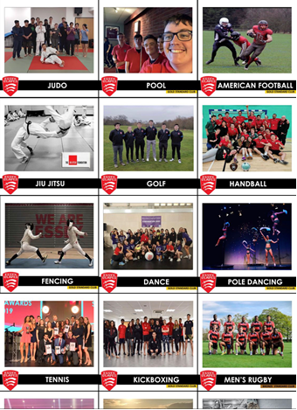
BUILDING YOUR ‘BRAND’
5
When establishing your branding, you’ll want to consider a number of things:
Are you using clear colour schemes and templates across your social media platforms?
It is really important to not sacrifice photos of your Club/Society and what you have been up to just for clear branding. It is all about finding the perfect balance between the two.
People are more likely to engage with photos of their peers than just an infographic with text on it.
By putting your logo in the corner of any pictures it can promote the brand whilst still achieving this.
(More on logos in a second)

Slide 7
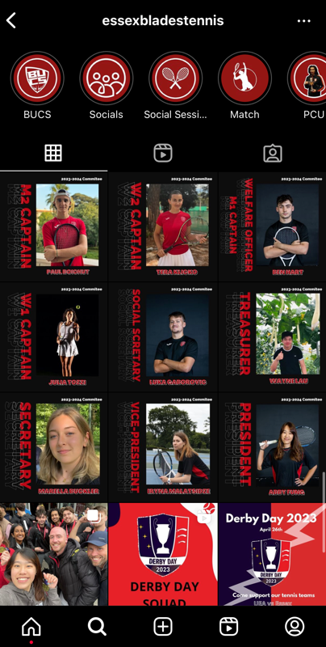
BUILDING YOUR ‘BRAND’
7
Taglines – using a tagline can be another way to create
identity and community.
You can even think of different slogans/taglines for specific campaigns – think about things
like the Go Compare or Compare the Market adverts.
Keep your content ‘clean’ and consider using different
templates/colour schemes for different campaigns.

Slide 8




BUILDING YOUR ‘BRAND’
6
Establishing a font – the SU team use ‘Century Gothic’ across all platforms as part of our brand identity.
Using the same font everywhere keeps your image clean and identifiable.
Logo – how old is your society/club logo? Does it look clean? Does it need updating? Involve your members in creating a new logo – make them feel proud of the group they’re involved in.
An easy tool you can use to create a new logo is an app / website called ‘Canva’.
Please note that all Blades teams are encouraged to use the Essex Blades brand as much as possible on their social media.

Slide 9


WEBSITES TO HELP YOU
6
Hootsuite is a website that allows you to pre-schedule social media posts. It is amazing for saving time and ensuring you have content going out when you need it to.
Canva is great for creating content for social media. It can also be used to make posters and design anything needed for your club/society.

Slide 10
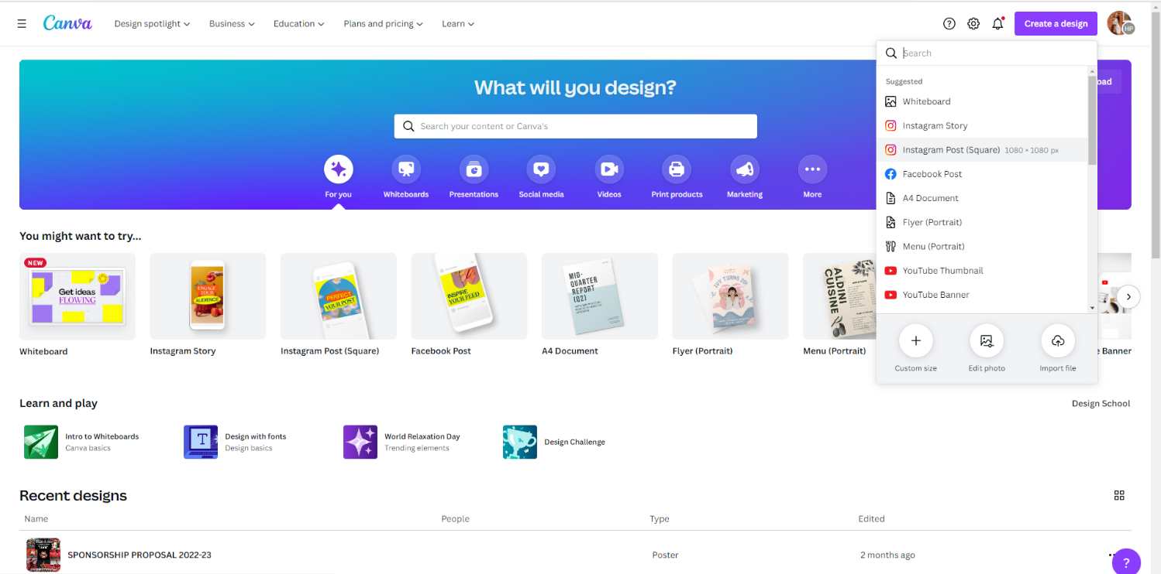

CANVA
6
Canva can be a great tool to create social media posts with cohesion and help establish a brand for your page.
It is free and simple to use, you can pay for a premium account if you wish but it is not vital.
You can choose what size/style of post you want to make.

Slide 11
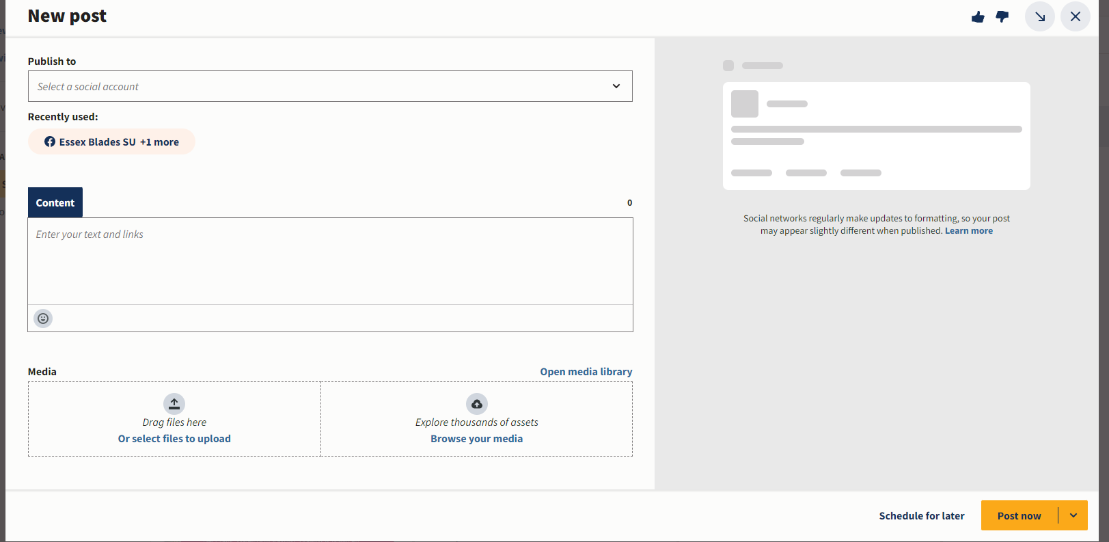
HOOTSUITE
6
It is really easy to use, you just follow these steps…

Slide 12
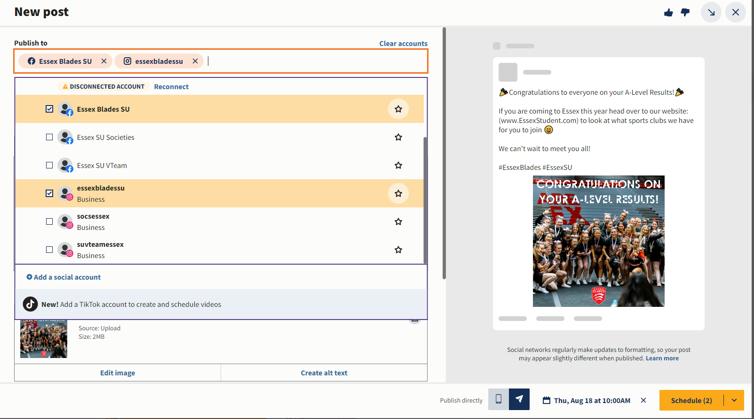
HOOTSUITE
6

Slide 13
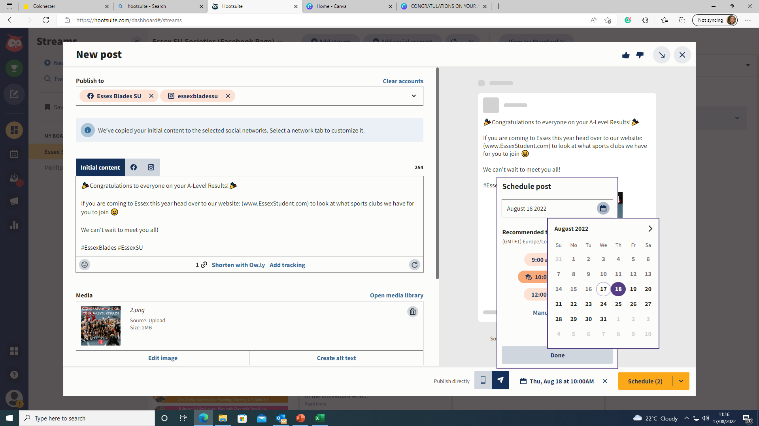
HOOTSUITE
6

Slide 14
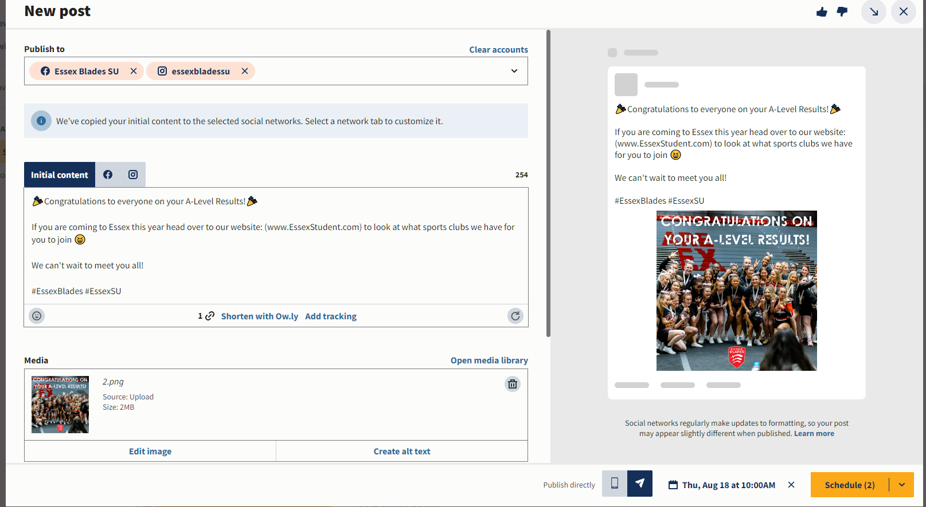
HOOTSUITE
6

Slide 15




TYPES OF SOCIAL MEDIA
6
Key types of social media:
Facebook
X (Formerly Twitter)
Instagram
TikTok
Others that can be relevant to your club/society:
Discord
YouTube
Pinterest
Redditt
LinkedIn
Notes:
Facebook and twitter are less popular with current generations, but it is still encouraged to have them for those who do not have Instagram / twitter.

Slide 16

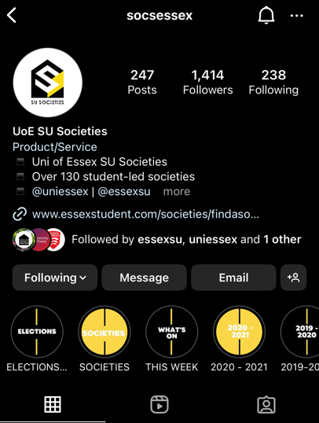
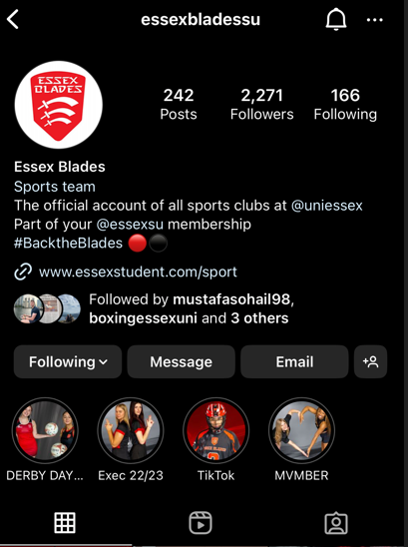
INSTAGRAM
6
Instagram is a great primary source for social media. You can see what other University clubs and Societies are doing.
I recommend if you are only going to choose one type of social media, it is Instagram.
Follow Blades and Societies on Instagram and tag us in your posts for us to repost them on our accounts too!
You can also use the hashtags :
#EssexSU #SocsEssex #EssexBlades #BackTheBlades

Slide 17

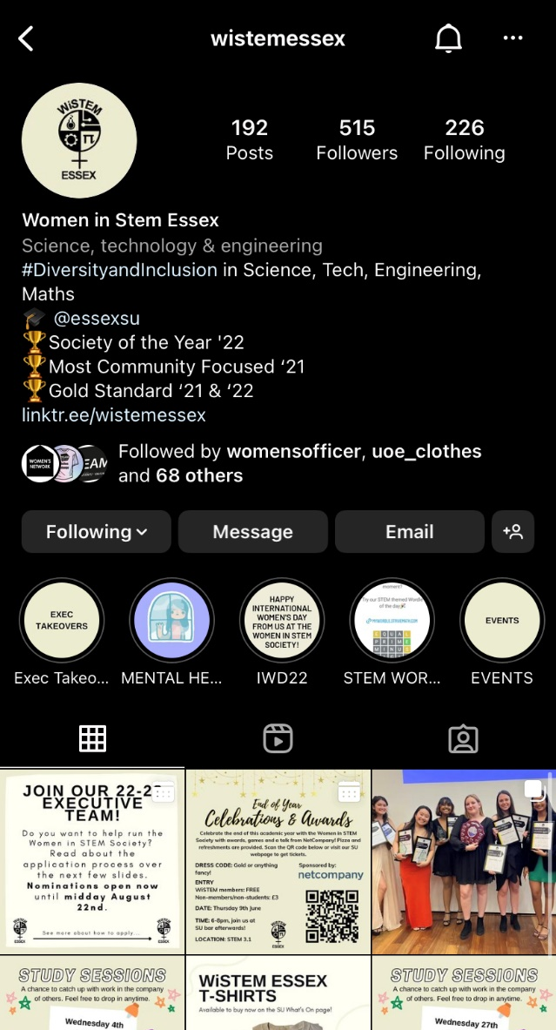
INSTAGRAM
Signs of a good profile
6
Logo as Profile Picture
Full Society Name
Categorised
Tagging the SU
Recent Awards Won
Link to their Linktree
Option to email them
Highlights
Cohesive branding

Slide 18

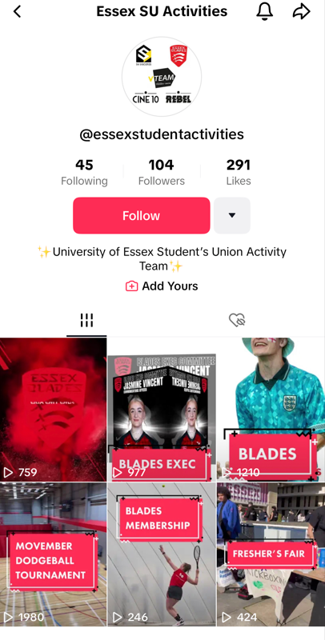
TIKTOK
6
TikTok has been the most popular social media platform in 2023 so far.
It is the social media with the quickest growth rate. Making growing an audience a fast and easy process.

Slide 19

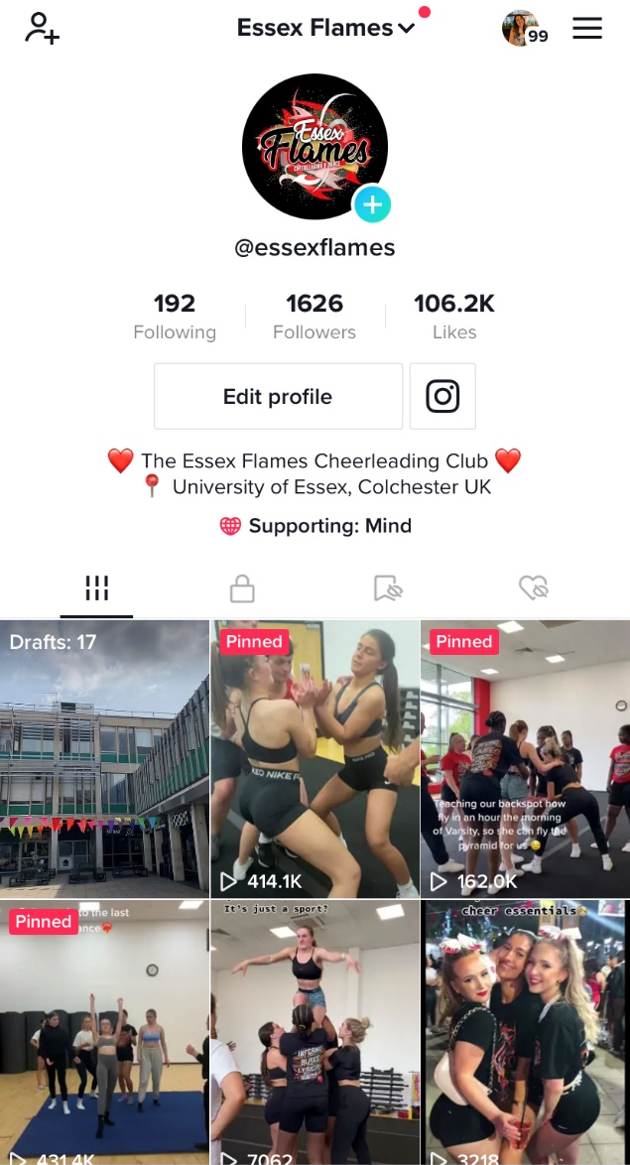
TIKTOK
Signs of a good profile
6
Easy non-complicated username
Logo as the profile picture
Instagram linked
Supporting a charity
Description says who they are / where they are based
Premade videos in the drafts
Pinned videos

Slide 20
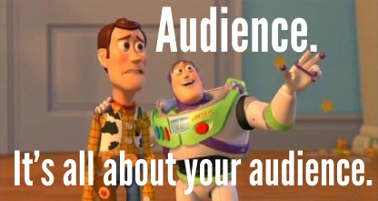
HOW TO REACH YOUR AUDIENCE
11
YOUR TARGET AUDIENCE IS YOUR FELLOW STUDENTS
THINK ABOUT WHAT THAT MEANS
You want to entice your fellow students to read your articles, support your fixtures and be in the know about any events your club or society has coming up - and to do that, you’ll need to keep their attention. Think about how you like to be spoken to on social media and what keeps you engaged.

Slide 21
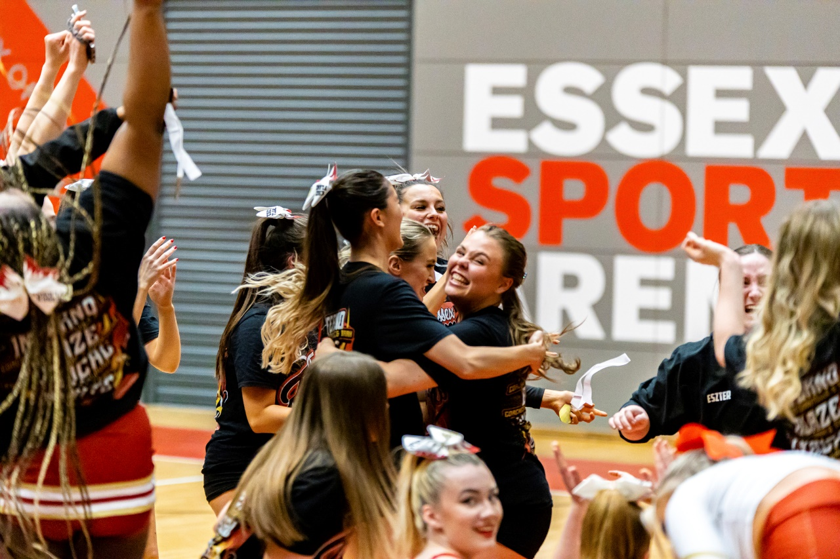
WRITING FOR YOUR TEAM
Being an SU member means being part of a family. This means, that all students past and present want to be kept up to date with your achievements.

Slide 22
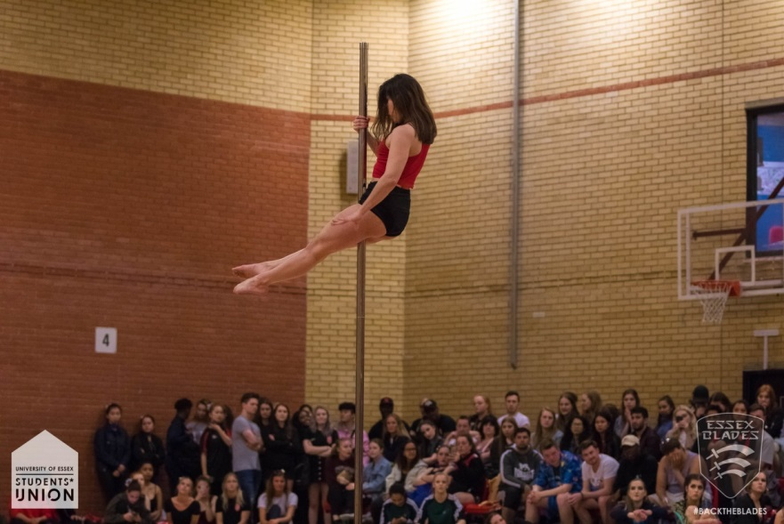
HOW TO WRITE A BALANCED ARTICLE
BE PROUD OF YOUR TEAM, BUT HAVE RESPECT FOR YOUR OPPONENTS
Without your opponents, you wouldn’t have a competition. Be proud to #BackTheBlades, but don’t report about the other team in a negative way
(even if they are UEA)

Slide 23
RUNNING YOUR SOCIAL MEDIA
BASIC STARTER TIPS
Make sure your profiles are up to date and exciting.
Link your socials to each other – if possible, having the same username or a Linktree is a brilliant way to connect all of your accounts.
Send out your social media links via the email function on essexstudent.com.
Know when to make your social media posts – think about when people are coming out of a class, or posting more frequently in the build-up to an event.
Choose colour schemes and keep this consistent across all platforms.
Hashtags aren’t overrated for reaching a wider audience (especially on TikTok!). Utilise them!

Slide 24
RUNNING YOUR SOCIAL MEDIA
STICK TO WHAT YOU CAN MANAGE
IT’S BETTER TO HAVE ONE ACTIVE ACCOUNT THAN THREE INACTIVE ONES
THINK ABOUT WHAT WILL BE FEASIBLE FOR YOU

Slide 25
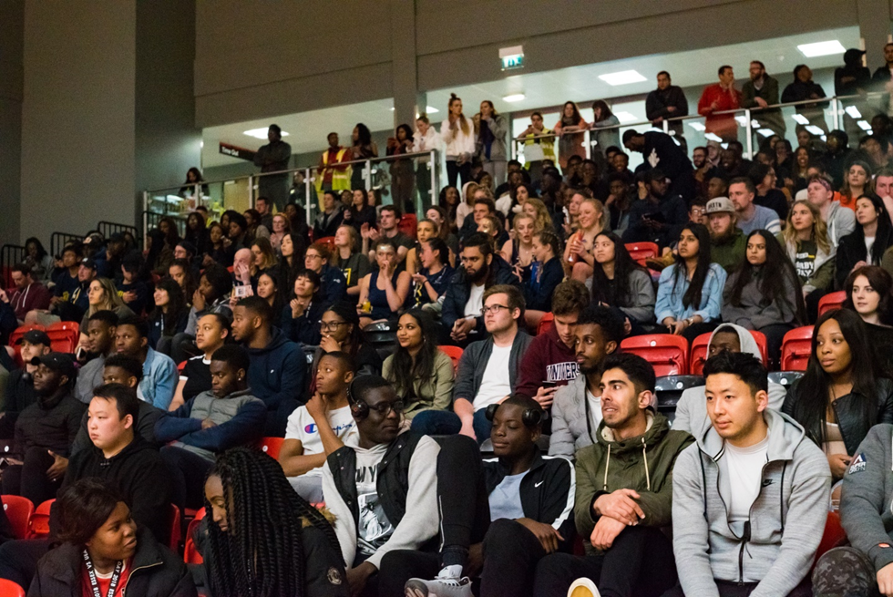
RUNNING YOUR SOCIAL MEDIA
WRITE POSTS THAT WILL ENGAGE
KEEP MATCH REPORTS INTERESTING, MAKE EVENT ANNOUNCEMENTS PUNCHY, AND INCLUDE MEDIA ALONGSIDE TEXT.
No one wants to read a 5000-word essay in the picture description, people will simply not read it.

Slide 26
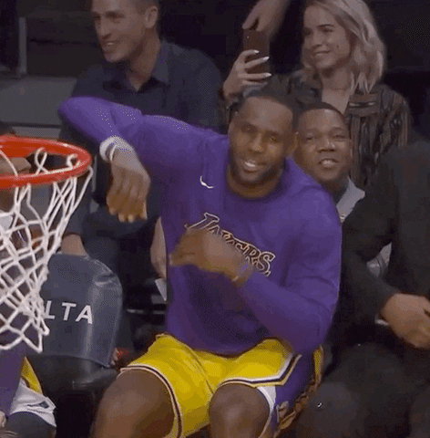
RUNNING YOUR SOCIAL MEDIA
HOW DO I HOOK AN AUDIENCE?
The best way to attract an audience is by using the first line of every post as bait.
“Don’t forget!”
“Guess what!...”
“WE WON!...”
Keep up to date with social media trends.
Remember to use
Puns
Emojis
GIFs (Us after beating UEA)
Memes
Music
Reels
Most importantly use pictures - To improve engagement and boost your
account and content in the algorithm.

Slide 27


RUNNING YOUR SOCIAL MEDIA
HASHTAGS & TRENDS
THIS IS ONE OF THE BEST WAYS TO BUILD YOUR AUDIENCE
Utilising hashtags on Twitter, TikTok and Instagram is so important as it gets your content out to a wider audience. Don’t use hashtags like #life #love or ones with millions of posts attached as it will get lost in the algorithm. Use sector-specific hashtags.
On Instagram, you have 30 hashtags to use – make the most of them but don’t use the same ones all the time or you will get shadow-banned!
Make a hashtag for your club / society and use it across all of your posts on all social media accounts.

Slide 28
RUNNING YOUR SOCIAL MEDIA
HASHTAGS & TRENDS
THIS IS ONE OF THE BEST WAYS TO BUILD YOUR AUDIENCE
Are people talking about the Football World Cup? Are you one of our Football clubs? Use that!
Is it Throwback Thursday or Flashback Friday? Put out a throwback post about a social event you held last year.
Trending Tiktok sounds/videos are the best way to grow your account organically. Show yourself as well as the club. Accounts with a face/faces tied to them perform better as the viewer is familiar with them and then builds a relationship with the account and the content.

Slide 29

ESSEX SU BRANDING
& TONE OF VOICE
SU BRANDING
DON’T WORRY ABOUT SU BRANDING TOO MUCH,
BUT ADJUST YOUR TONE OF VOICE.
Writing with an SU tone of voice might take some getting used to at first, but it comes with practice. Just remember your page is a representative of the organisation.
WHAT WE STAND FOR
We are humans, that like to come across as human. We put students at the heart of every single thing we say, so think about what you want to write, and how you want it to come across.

Slide 30
ESSEX SU BRANDING
& TONE OF VOICE
23
SOCIAL MEDIA
Think about each post you write, why you are writing it, and what you hope to gain from it.
Social media is a form of connection, and it’s our way to connect to our members directly. Every post should be student-focused, clear and direct.
SHORT
INFORMATIVE
SNAPPY

Slide 31
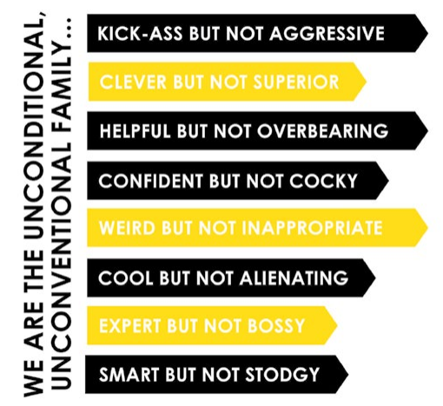
ESSEX SU BRANDING
& TONE OF VOICE

Slide 32
SOCIAL MEDIA
27
Whilst numbers don’t always mean everything, having a boost from an account with larger numbers can sometimes be a big help when promoting an event or celebrating achievements.
If you have anything that you’d like us to promote, then all you need to do is complete the Societies or Blades social media request form that can be found in your exec member resources – make sure to include the pictures and videos that you want included!
Similarly, reach out to other companies or organisations that have similar interests to you to see if they will promote your content – e.g. the Show Choir society could reach out to the Colchester Operatic Society.

Slide 33
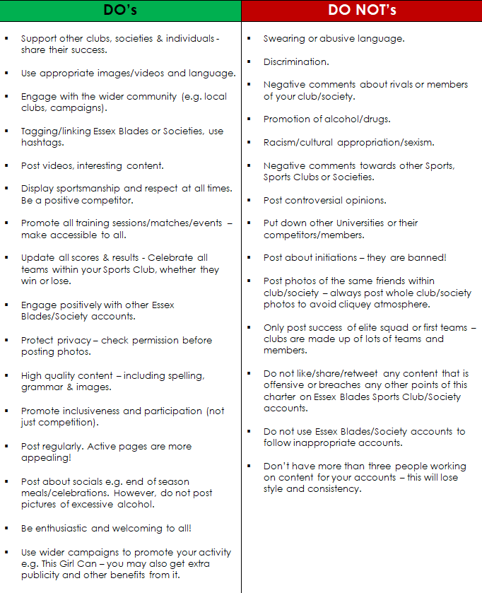

SOCIAL MEDIA CHARTER
28
Signed by Presidents at the start of the academic year.
A guide of Do’s and Do Not’s for Sports Clubs and Societies to follow.
We will send this form out to be signed in the near future.
We don’t consistently monitor your society/club pages but will step in to ask something to be removed if necessary. Remember - you represent the club, SU and University at all times.

Slide 34
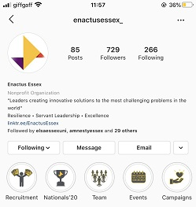
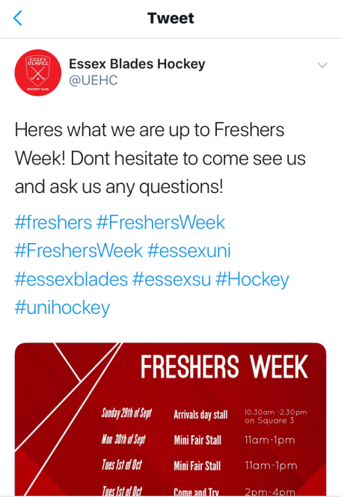
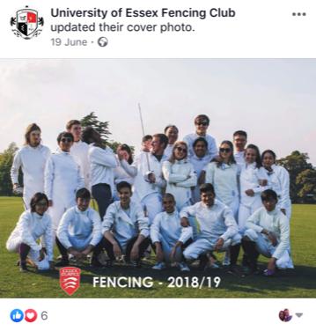
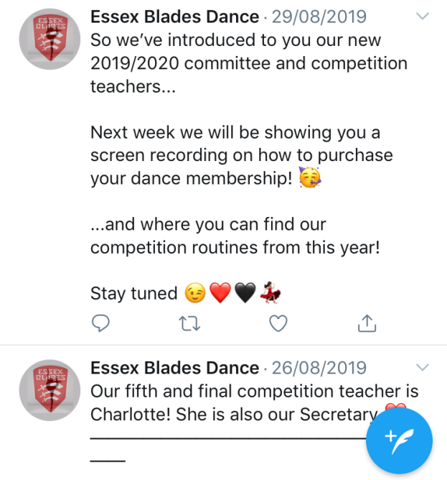

GOOD SOCIAL MEDIA PRACTICE
Highlights / Stories
Hashtags
Up-to-date photos
Promo videos

Slide 35
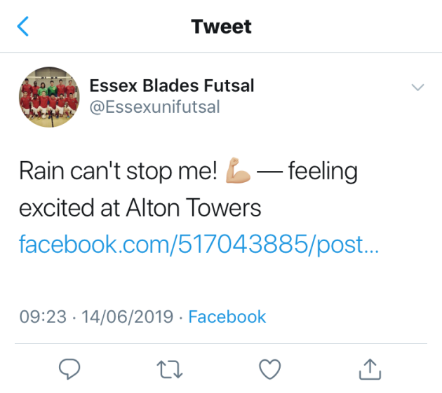
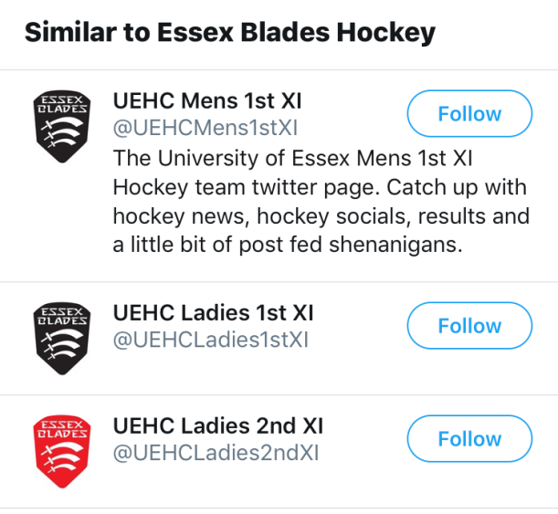

SOCIAL MEDIA TO AVOID…
Abusive or discriminatory language, inappropriate content (includes sharing)
Linked to personal accounts
Multiple accounts for one club

Slide 36
WEBSITE TRAINING

Slide 37
WEBSITE TRAINING
All committee members will have admin rights to your page on the website.
If your club/society committee have no admin rights at all, please email us and let us know which position you hold in your club/society. You need to have bought your club/society membership in order to be granted admin rights.
We are working through this manually so please be patient with us!

Slide 38
HOW TO USE MESSAGING ADMIN
Messaging admin will be one of your key tools for communicating with members of your clubs and societies during the year.
It is an internal email system that contacts all members of your Sports Clubs and Societies via the website, without the need for you to type in everyone’s email addresses.
Limited to 3 committee members per sports clubs club – communications/publicity officer should be one of them! All executive members of societies have the administrative rights to send these emails, but we’d suggest for the Secretary to send emails.

Slide 39
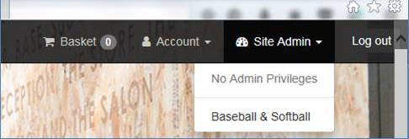
HOW TO USE MESSAGING ADMIN
Log into the SU Website as you would to buy a club/society membership or purchase a night out ticket.
The relevant committee members will now have an option in the top right corner called ‘Site Admin’. Click this, and your club/society should appear – if it doesn’t, then admin privileges have not been applied to your profile. This will either be because we have not updated your profile yet (we have to do this manually), or because you haven’t yet bought your club/society membership and therefore the system will not allow us to do so. If you have bought your membership but don’t have admin rights, then email us and we will fix that for you.

Slide 40
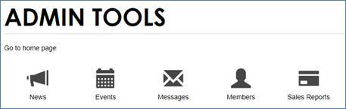
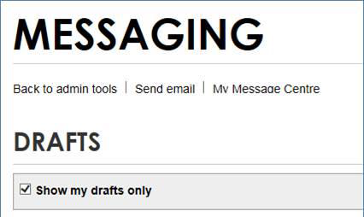
HOW TO USE MESSAGING ADMIN
3) Click the name of your Sports Club or Society. The following dashboard will appear. Click ‘Messages’
4) Choose ‘Send email’. You can also check your drafts and sent items from this main ‘Messages’ page.

Slide 41
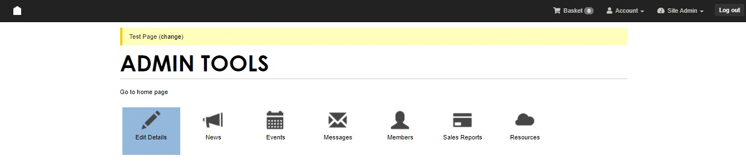
EDITING YOUR OWN PAGES
Editing your individual club or society page is important because it creates a more inviting and professional look. To do this, you need to go back to the same control panel as if you were going to send an email – but instead click on ‘Edit Details’.

Slide 42
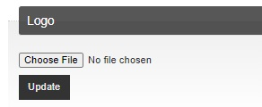
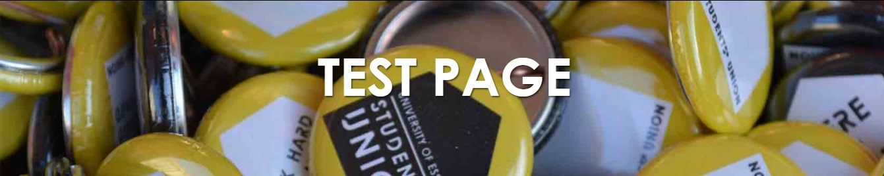
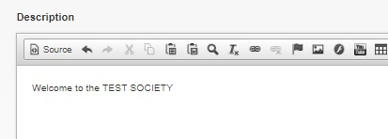
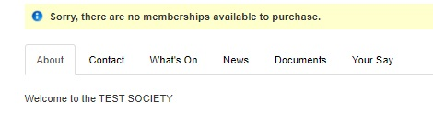
EDITING YOUR OWN PAGES
Once you are at this page, you can then shape the page to how you want it to look.
When setting this all up, make sure to have a play around with adding pictures or
perhaps links to your social media feeds by using the buttons on this tab.
(Our best bet for this would be to use a solid colour fill as the specs needed for the picture will often make the final picture come out stretched… unless you’re a whizz with this kind of thing and know how to make it work!)

Slide 43
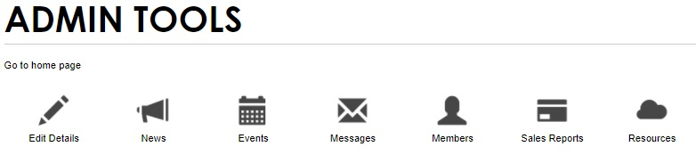
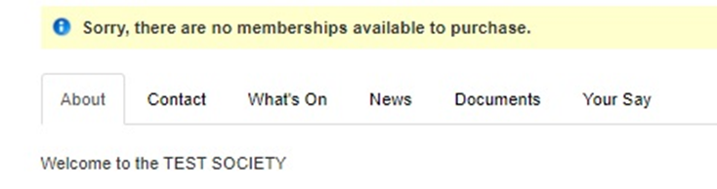
EDITING YOUR OWN PAGES
You can also add events, news and documents to your page if you wish to, by again going back to where you’d go to send an email but instead clicking on one of the other buttons.
The ‘Your Say’ tab is where any elections that you run will appear, including the general elections, so make sure to direct your members to here when they are needed to vote.

Slide 44
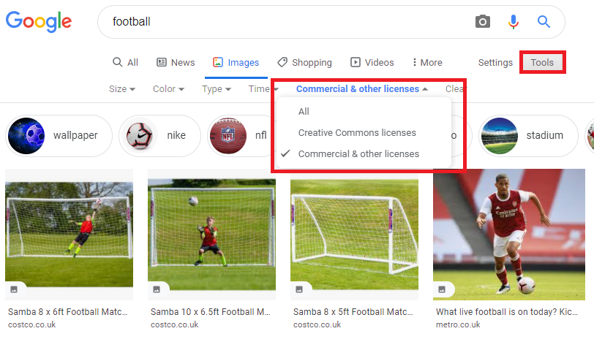
EDITING YOUR OWN PAGES
Where possible, use your own images when creating an event/uploading something to your page to avoid copyright issues. If you want to use one from a different website, you will need to either:
- Pay for the image rights.
- Contact the owner of the
photo you want to use and
ask for their permission.
- Use the correct filters as
shown here.

Slide 45
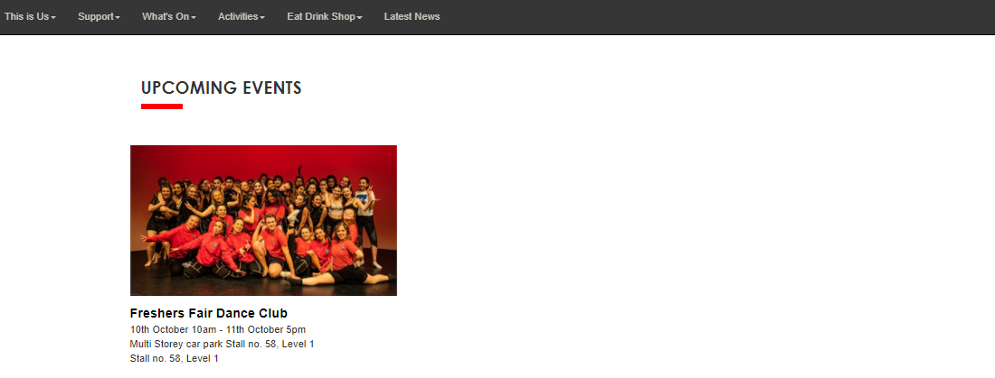
EDITING YOUR OWN PAGES
All clubs have an ‘Upcoming Events’ section on their webpage – any event you create will appear and are public!

Slide 46
MORE GOOD PRACTICE
Familiarise yourself with your SU Webpages – some members may not know about bits of information on the SU Website, including your individual club/society page, the What’s On page, and more – so refresh your memory once every so often so that you can point someone in the direction of an answer to their question.
Reply to all enquiries – there may be a lot of them, so consider spreading the workload.
Set up a Gmail (other providers are available…) for your social media pages so that they can be passed onto next year’s committees. Essex emails expire!

Slide 47
IN-PERSON PROMO
Stall in Squares – Liaise with the SU Reception (su@essex.ac.uk) and you can book a table free of charge to do some promotion in Squares.
Attending SU/University events– Keep an eye out for any events that require stall holders or demonstrations.
Open Days/Arrivals – as above, but also provides potential long-term club and society benefits. If the friendly face a prospective student spoke to on an open day was from your club or society, they might just join you.
Freshers Fair – Friday 6th October

Slide 48
ANY QUESTIONS?
These slides will be available online soon at:
https://www.essexstudent.com/activities/studentactivitiesexechelp/
Alex Redwood
Student Activities Coordinator
suscos@essex.ac.uk
Hannah Mortier
Student Activities Coordinator
blades@essex.ac.uk
Ashleigh Belson (ab22499@essex.ac.uk)
Blades Exec Communications Officer

