Slide 1
Societies & Sports Core Officer Training 2023/24
1
Picture?
Session Format:
Presentation followed by Q & A.
Ask questions at any point though – someone will answer you in the chat!
This is being recorded – turn your camera off if you do not want to be in any published recordings!

Slide 2
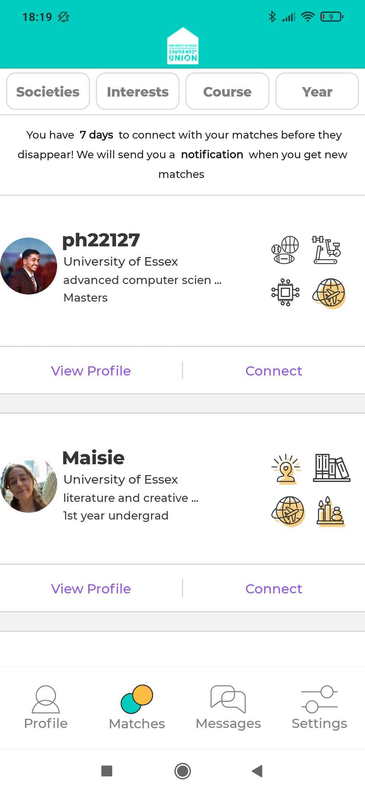

Slide 3
Who We Are
2
We are the Students’ Union Student Activities team, responsible for helping you lead our Sports Clubs and Societies.
Chris Moore Student Volunteering Manager
Alex Redwood
Student Activities Coordinator
Joar Blume-Robertson
VP Student Experience
Dominic King Student Activities Manager
Nichola Dyer Reception Manager
Picture?

Slide 4
Who We Are
3
Joar Blume-Robertson VP Student Experience vpexperience@essex.ac.uk
Representing Blades, Societies, Volunteering, Rebel and RAG.
Work with the SU Activities team, the Sabbatical team and as a Trustee for the SU.
Work with university staff such as the Essex Sport board and the Student Experience committee.
President of the Blades Exec, Chair of the Volunteering Exec.
You can run for this role next Spring – any questions you have about the role throughout the year, feel free to drop me an email!
If you have any big events coming up, then let me know!
Picture?

Slide 5
Who Are We?
4
We help to enable you to put on events, compete in competitions, carry out volunteering opportunities and much more.
This training is aimed at ensuring you have the info you need to be able to run your societies & clubs effectively.
Feel free to take notes and if you have any questions while we’re going along note them down and we can answer them at the end.
A lot of the questions we get asked by exec members (especially in the first few weeks of term) can be answered by these training sessions, so make sure to attend as many as you can.
Picture?

Slide 6
What Are Your Roles?
5
President, Vice-President (Sports), Secretary, Treasurer and Welfare Officer
Ultimately you are responsible for running your club/society.
You must attend Executive Committee meetings (ones you organise) and Student Activities General Meetings (ones we organise).
You must attend any meetings called by the Student Activities Team, together with any training the role requires.
Picture?

Slide 7
President
6
You are the main point of contact within your society or club.
Members will expect to receive regular updates from you about all types of information regarding your club/society.
You will usually be the first point of contact if the activities team need to contact the society or club. This means you MUST regularly check your emails.
You are responsible for making calls on bigger decisions in the event of exec deadlocks. Most decisions should be made collectively by members of the society or club - an executive team is mainly in place to help carry out the requests of the members.
You are jointly responsible, along with the Treasurer, for the society/club finances.
You are responsible for ensuring that the society/club does not break any laws.
Picture?

Slide 8
Vice-President/Secretary
7
You are responsible for taking notes at events and meetings and ensuring this info is relayed to all members.
Your minute-taking will be crucial for things such as event planning.
You will usually be the person in charge of making standards and awards applications, if your society/club chooses to do so.
You will play a crucial role in making sure your fellow executive members are supported and have carried out tasks/training that they need to.
You will need to be liaising whoever is in charge of your social media to make sure any relevant updates are being relayed to all members.
Picture?
Notes:
where you can keep track of who has to complete certain actions and by what date.

Slide 9
Treasurer
8
You are responsible along with the President for budgeting and spending your society/club money.
We Strongly recommend creating a budget proposal for your society/club and presenting this to your members as early as possible so that they can query any projected spending or suggest other ways for your money to be spent.
You are responsible for making sure that the society/club carefully plans things such as events (to ensure adequate funding).
You will be responsible for paying in money to the SU for your society/club as well as signing off on expense claims from members (unless the claim is yours, in which case the President will sign it).
Picture?
Notes:
Treasurers can sign off on amounts up to £50

Slide 10
Welfare Officer
9
Your role is to help ensure that your society/club is a safe and welcoming space for anyone – regardless of age, race, sexuality, gender or disability.
It is important that you familiarise yourself with the different services that can help with supporting students such as Student Support and SU Advice – please always remember that you are not counsellors and should never seek to give professional advice.
You will be the main point of contact should anyone wish to make complaints about your society/club or individuals within it.
Your role should have a focus on helping to create de-stress events or supporting ones that the SU and University create.
It is good practice to have ‘mentors’ in place to help with students who may have anxiety about starting university.

Slide 11
Documentation
16
This year, we will be grouping together all of the documents you need to read and sign into an online form to make things easier. The forms are:
Code of Conduct (to be signed)
Declaration of Financial Responsibility (to be signed)
Alcohol Policy (to be signed)
Social Media Charter (to be signed)
Societies Terms of Reference
Blades Constitutions
These forms help to ensure you understand the correct policies you need to follow so that all activity is on the right side of the law, as well as ensuring fair and safe practice across everything you do.
Picture?

Slide 12
Disciplinary Proceedings
17
When there is any conflict, our first piece of advice would be to reach out to the individuals for mediation, whether on a 1-to-1 basis or with another executive member that they may feel open to talk to or in a more informal setting as a team. During this meeting, we would recommend you refrain from using any accusatory language but try to fact-find and see if there may be any challenges that the individual may be facing that would lead to the issue.
Following this informal meeting, if you still feel that no positive changes has been made to improve the situation then you should call a formal meeting with a member of the Student Activities staff by emailing us.
If any issue within a society or club involves bullying or harassment of any kind, then you need to go straight to SU Advice/Student Support.
Picture?

Slide 13
Legal Information
18
If you are ever unsure whether something you are doing is on the right side of the law, please contact the Student Activities staff and ask.
Societies or clubs can never open their own bank accounts.
You also cannot agree to sponsorships and/or contracts without them being agreed to by the Student Activities staff first – this applies to any form of agreement, including verbally even if you have not physically or digitally signed anything. An agreement can even be in the form of a Facebook message so always be mindful when discussing contracts/sponsorships with anyone.

Slide 14
Elections
19
Elections can happen at any point during the year if you decide to create a new position or if an existing executive leaves their role. Refer to the Terms of Reference (on the Societies FAQ’s page) to see the ways in which you can hold these elections.
General elections happen every academic year around February/March – it is compulsory for every society and club to take part. If the core positions are not occupied after two rounds, your society or club will be made dormant.
Elections for the core officer roles must be held on the essexstudent.com website – the Student Activities staff will help you to set this up.
Within your role, it is key to promote the elections, to ensure people vote for the elections to be valid. You are allowed to endorse candidates, but it is usually advised not to so as to avoid conflict.
Please note, the position you hold will last until 31st July unless all incumbent and newly-elected executives agree to handover earlier.
Picture?

Slide 15
Societies & Clubs Resources Page
20
Picture?
https://www.essexstudent.com/activities/studentactivitiesexechelp/
This is where you can find lots of useful tools as well as all training sessions, if you’d like to look over them again.

Slide 16
Societies & Club Event Toolkit
Anything to do with events, room bookings, external speakers and risk assessments:
https://www.essexstudent.com/toolkit/

Slide 17
Welcoming 1st Years
21
As I’m sure many of you agree, your club/society has been a major part of your university experience so far.
‘Students are significantly more likely to drop out of university if they do not engage with a society or club.’ (Lehmann, 2007).
It’s time to start thinking about your first socials of the year - socials are a great way to engage new students and make them feel welcome here at Essex.
Mixers (Non alcohol)
Umii
Mentors
Initiations and Hazing are BANNED – There will be disciplinary action taken against any Clubs or Societies who do so.
Picture?

Slide 18
Fresher’s Fair
22
Friday 6th October – On the Squares
If your club or society has said yes on the Typeform to having a stall at Fresher’s Fair, you will need to fill out the Stallholder Agreement form which has been sent to you via email – please email susocs@essex.ac.uk or blades@essex.ac.uk if you haven’t received this.
If you haven’t yet confirmed whether your club/society is attending Fresher’s Fair but you would like to, then please do so ASAP using the Typeform that was sent out through email a while back. We cannot guarantee at this point that you’ll be able to have a stall, but we’ll do our best to accommodate. The typeform can be found here: https://essexsu.typeform.com/to/gjcXD39G
If there are any specific ‘bigger’ activities you want to do at Fresher’s Fair (ones that you think will probably need a separate risk assessment) then please let us know ASAP (we cannot guarantee that we will be able to accommodate your request).Please be aware that there will be no available sources of power for clubs or societies and you will also not be permitted to play music, unless given specific permission to.
Make sure to attend the Fresher’s Fair info session on 16/09/2022 at 13:00.
Picture?

Slide 19
Other Training Sessions
24
Comms, Social Media & Website Training – 22/09/2022 – 13:00 – LTB1 – Anyone, at least one member. If you have a Social Media Officer/Communications Officer then they should attend.
Clubs Risk Assessment Training – 26/09/2022 – 13:00 – LTB4 – Anyone, at least one member, ideally Secretary.
First Aid Training - 27/09/2022 – 9:00 & 15:00 – 1N1.4.1– All Captains
First Aid training 2 – 29/09/2022 – 10:00 & 13:00 – Ivor Crewe Seminar Hall – All Captains
Captain’s Training (Clubs) – 28/09/2022 – 14:00 – Insert Location – Captain & President.
Societies Risk Assessment Training – 29/09/2022 – 11:00 – 1N1.4.1 – Anyone, at least one member, ideally Secretary.
If a session is being run more than once, you only have to attend one of the sessions – they will be the same session.
Picture?

Slide 20
Other Optional Sessions
24
Banner Making Workshop - 23/09/2022 – 11:00
Banner Making Workshop 2 - 26/09/2022 – 11:00
Banner Making Workshop 3 - 27/09/2022 – 11:00
If a session is being run more than once, you only have to attend one of the sessions – they will be the same session. All sessions will be recorded. If you cannot attend either of the Finance training sessions, you will be required to complete a Typeform quiz at a later date – just because we need to be sure that you’ve read the training and understand some of the legal elements involved in running a society/club.
Picture?

Slide 21
Any Questions?
26
Ask now!
Email - susocs@essex.ac.uk, blades@essex.ac.uk
Join the Facebook exec group - https://www.facebook.com/groups/suactivitiesleaders21 if you need to ask a question, chances are someone on this page will know the answer and may be able to help you quicker than we can, especially during busier periods of terms!
The other Core Officer training is exactly the same as this one so you do not need to attend both.

