Slide 1
Events Training 2023/24
Picture?
susocs@essex.ac.uk
blades@essex.ac.uk
vteam@essex.ac.uk
rebel@essex.ac.uk
1

Slide 2
Session Format
2
Take notes.
If you have any questions take note of them and we will answer them at the end of the session.
Relay this information back to your, club, society or project committee, team.
This session is being recorded and will be uploaded online – make sure to turn your camera off if you do not want to be in the video!
Picture?
susocs@essex.ac.uk
blades@essex.ac.uk
vteam@essex.ac.uk
rebel@essex.ac.uk

Slide 3
Who We Are
3
We help to enable you to put on events, compete in competitions, carry out volunteering opportunities and much more
This training is aimed at ensuring you have the info you need to be able to run your societies effectively
Feel free to take notes and if you have any questions while we’re going along note them down and we can answer them at the end
A lot of the questions we get asked by exec members (especially in the first few weeks of term) can be answered by these training sessions, so make sure to attend as many as you can.
Picture?
susocs@essex.ac.uk
blades@essex.ac.uk
vteam@essex.ac.uk
rebel@essex.ac.uk

Slide 4
Events Toolkit
4
We have created an events toolkit to hopefully make creating an event easier for you. This will include information and links to everything that you’ll need to know and everything you’ll need to complete to be able to put on an event.
Picture?
https://www.essexstudent.com/toolkit/
susocs@essex.ac.uk
blades@essex.ac.uk
vteam@essex.ac.uk
rebel@essex.ac.uk

Slide 5
5
SU Venue events (SU Bar, Top Bar, Sub Zero etc)
Contact susocs@essex.ac.uk directly
We will ask for details regarding your event.
Info will be passed on to Venues team if the event is deemed suitable.
BBQ
Fill in BBQ Form on https://www.essexstudent.com/toolkit/
Submit your risk assessment either before or at the same time as submitting your room booking request.
Larger Room Booking
E.g. Ivor Crewe Lecture Hall
Book a room via https://www.essexstudent.com/toolkit/
Submit your risk assessment either before or at the same time as submitting your room booking request.
You will be asked extra questions as to details of your event.
Your Club/Society/Project want to host an event
(On Campus)
Events on the Squares
Fill in event permission form on
https://www.essexstudent.com/toolkit/
then email to susocs@essex.ac.uk
(If chairs or Gazebos are needed this can be indicated here also)
Book a table
Use the link below
https://www.essexstudent.com/toolkit/
General teaching room
Book a room via https://www.essexstudent.com/toolkit/
Submit your risk assessment either before or at the same time as submitting your room booking request.

Slide 6
Your Club/Society/Project wants to host an event (Off Campus)
6
Off Campus Event
You discuss price and conditions with venue – but do not agree or sign a contract.
2. Venue send contract/agreement to susocs@essex.ac.uk or blades@essex.ac.uk we will check the contract/agreement then send back to you to give to the venue for signing.
3. Once a contract/agreement is signed by the SU and venue, you conduct a risk assessment with the venue and send this back to us.
4. You report to us ASAP if there were any incidents that we’ll need to be aware of.
If you’re ever attempting to book a venue off campus, make sure to give at least 3 weeks notice for us to review any contracts/agreements – often we need time to liaise with the external company to iron out any clauses in contracts that we don’t or can’t agree with. If we do not have adequate time to check/amend this, then your event may not happen and you may have already spent money on certain things for your event.
As a general rule – if a company is offering you a deal that seems too good to be true, then it probably is.

Slide 7
Room Bookings
7
When you complete the online room booking form it will be forwarded to us in the Student Activities team, and we will then either sponsor the event or email you for more information, and then it will be sent to Central Room Bookings automatically who will allocate a room for you. Please keep the following in mind when completing this form:
As stated, we will not authorise a room booking if you haven’t sent in a completed risk assessment.
Use your University of Essex email address.
If you are inviting external speakers to your event you must notify us of this at least three weeks in advance through the external speakers form as mentioned, so that the necessary approval can be obtained.
Please try to make your room bookings at least two weeks in advance - any bookings made less than three working days prior to the event will not be processed).
susocs@essex.ac.uk
blades@essex.ac.uk
vteam@essex.ac.uk
rebel@essex.ac.uk

Slide 8
Room Bookings
8
You cannot book a room for before 6pm on a weekday, unless:
you have external speakers who cannot make the evening
you have commuting students who need the event earlier for travel arrangements
student parents who need the event earlier because of childcare reasons
These are some reasons if you have another legitimate reason please state this in your booking.
these reasons need to be stated in your booking form or else the request will be rejected.
Please leave all rooms clean and in the same layout as you found the room or else your society/club may face a ban on making room bookings.
Please do not contact Central room bookings directly - all communication must come through the Student Activities department.
susocs@essex.ac.uk
blades@essex.ac.uk
vteam@essex.ac.uk
rebel@essex.ac.uk

Slide 9
Booking Larger Rooms
9
If you are wanting to book the Ivor Crewe Lecture Hall and potentially some other larger, more desirable rooms on campus, then you will be asked to respond to the following questions:
1 - When is this event? The day of the week and point in term is crucial in working out whether or not this is possible.
2 - What time is it?
3 - How many people are expected to attend the event?
4 - What is the setup they require? Would they need the bleachers to be set back? If so, 2 hours are needed beforehand for the porters team to set this up and an additional cost may need to be paid by your society/club to cover this.
5 - Why is it absolutely crucial that you have this in the Ivor Crewe and not, for example, in LTB06?
These questions may also be asked for booking requests in The Hex or any EBS room.
Picture?
susocs@essex.ac.uk
blades@essex.ac.uk
vteam@essex.ac.uk
rebel@essex.ac.uk

Slide 10
Risk Assessments
10
You must fill out a risk assessment for all events. This must be signed off by a full time member of the student activities team.
Much more info will be given with regards to this in Risk Assessment training.
susocs@essex.ac.uk
blades@essex.ac.uk
vteam@essex.ac.uk
rebel@essex.ac.uk

Slide 11
External Speakers
11
Societies and clubs can invite external speakers to their events, so long as you fill out an external speaker submission form - https://www.essex.ac.uk/student/event/external-speaker
Most requests are processed with minimal background checks on the attendee but please be aware that some requests may take longer to process – for example, inviting a controversial political figure will require at least 15 working days - this is to allow for thorough background checks, communications with the attendee and the society/club, and safety procedures to be put in place.
The University and the SU supports freedom of speech so we aim to make every request happen, but certain instances can potentially be rejected if the proposed attendee or event falls out of line with the University’s or SU’s policies.
You cannot advertise your event at all until an external speaker request has been approved.
An external speaker request will still need to be completed even if the event is a virtual one.
Alumni count as external speakers, so you will still need to complete this form in this instance.
Picture?
susocs@essex.ac.uk
blades@essex.ac.uk
vteam@essex.ac.uk
rebel@essex.ac.uk

Slide 12
External Speakers
11
You must check that any external speakers or organisations you invite to speak are not included in the proscribed organisation list here:
Proscribed terrorist groups or organisations - GOV.UK (www.gov.uk)
This can be found on the events toolkit under external speakers here: Event Toolkit (essexstudent.com)
Picture?
susocs@essex.ac.uk
blades@essex.ac.uk
vteam@essex.ac.uk
rebel@essex.ac.uk

Slide 13
Freedom of Speech
11
As of the 11th of may 2023 a new Freedom of Speech Bill came into affect.
The idea of the Bill is to ensure an individual or group of individuals are able to express their right to freedom of speech and are not silenced.
To be put simply:
You Cannot, prevent someone from their right to speak about a topic as long as this topic is not deemed as hate speech.
Trigger warnings are still advised for sensitive topics to give individuals the opportunity to choose to attend or not.
You can express ideas, beliefs and views without being denied the ability or space to do so (as long as correct procedures have been followed).
External speakers will still follow the same procedure as before but it is your choice to invite them or not.
Picture?
susocs@essex.ac.uk
blades@essex.ac.uk
vteam@essex.ac.uk
rebel@essex.ac.uk

Slide 14
Event Permission Form
12
If you are doing something outside on campus (especially if it involves music, electricity, food & drink or just something a bit more out of the ordinary), then you will need to fill in this Estates form and send it to us for signing. Once we’ve signed it, we’ll email you to let you know it’s ready to be collected, and then you will need to send this to estates@essex.ac.uk Three weeks' notice will be required.
Music can only be played between 12.00pm and 2.00pm and after 5.30pm because of teaching times.
https://www.essex.ac.uk/-/media/documents/directories/estates-and-campus-services/event-permission-form.pdf
Insert photo here
Picture?
susocs@essex.ac.uk
blades@essex.ac.uk
vteam@essex.ac.uk
rebel@essex.ac.uk

Slide 15
Food and Drink at Events
13
If you are having food & drink at your events, you need to make sure that is has been cooked, stored, handled and served safely.
If you wish to cook something yourself (e.g. a cake for a bake sale) you will need to have at least a Level 2 Food Hygiene Certificate and provide a copy of this to us before you hold your event. There is a link to a course you can take on the Student Activities Exec resources page and you can get reimbursed for this through your club/society funds.
All food and drink items must be labelled with their ingredients, any possible allergens and if they are vegetarian, vegan or gluten free items (Natasha's Law.)
Food must be stored at a suitable temperature.
Alcohol will only be permitted at events such as socials if a society/club adheres to the alcohol policy (this can be found on the FAQ’s page) – your funds cannot be spent on alcohol however unless except in certain circumstances please talk to the Student Activities Team.
Picture?
susocs@essex.ac.uk
blades@essex.ac.uk
vteam@essex.ac.uk
rebel@essex.ac.uk

Slide 16
Table and Venue Bookings
14
Table bookings - https://www.essexstudent.com/toolkit/
Please use this form to book tables and gazebos for use on the squares.
Venue booking form – https://www.essexstudent.com/toolkit/
If you want to hold an event in one of the following venues: SU Bar, Top Bar, The Atrium or Sub Zero please complete the above form with as much information as possible.
Picture?
susocs@essex.ac.uk
blades@essex.ac.uk
vteam@essex.ac.uk
rebel@essex.ac.uk

Slide 17
Funding Events
15
Before you plan an event, make sure you have an estimated cost and that the President and Treasurer are in agreement that there are sufficient funds available and the money can be used for this purpose
Make sure to gauge interest from your members before you start making purchases –may sell less tickets than you anticipate
Societies and Clubs do not have any restrictions when spending whatever money is in their account (other than alcohol, illegal substances, purchases that only benefit certain members)
You cannot use expected income to buy things – so for example if you know you’ve already sold 10 tickets at £10 each for an event, you cannot use this £100 (minus VAT) to buy anything until the money has cleared and is displayed in your weekly finance report
All web sales are processed at the end of each month – for example any money made from tickets at an event on the 6th October wouldn’t be processed and accessible to use until the start of November.
Picture?
susocs@essex.ac.uk
blades@essex.ac.uk
vteam@essex.ac.uk
rebel@essex.ac.uk

Slide 18
Ticketing Events
16
The Student Activities team can create tickets that can be bought by members and non-members online.
Create an event on your society/club web page and then use the form on the ‘Ticket Request’ button on the Student Activities executive resources page to submit details of the event, including the ticket prices and any capacity limits. Please allow adequate time for us to set it up but also for members to buy their tickets. Ticket income from web sales goes straight into your society/club account - please note that VAT will be deducted.
https://www.essexstudent.com/activities/studentactivitiesexechelp/
susocs@essex.ac.uk
blades@essex.ac.uk
vteam@essex.ac.uk
rebel@essex.ac.uk

Slide 19
Ticketing Events
17
If there is more than one society/club collaborating in this event, we can add different ticket types so that members of specific societies/clubs can buy the right ticket and make sure their society receives the income from this. This doesn’t stop people buying the wrong ticket however so our advice would be to agree profit share percentages, run all ticket sales through to one society/club, and then ask us to split this after the event.
Do not use third- sites to sell tickets (e.g. Eventbrite). They will very likely take a cut. and you will be liable for ensuring you follow VAT laws yourselves.
Selling tickets through the SU website allows us to ensure 100% of the income goes to your society/club/project (minus VAT). Our finance team will automatically handle the VAT for you.
susocs@essex.ac.uk
blades@essex.ac.uk
vteam@essex.ac.uk
rebel@essex.ac.uk

Slide 20
Fundraising
18
You can hold fundraising events for your society/club or for charities
When starting your fundraising event, make sure you take a cash float with you – the SU cannot provide one
Make sure another executive member checks the amount before starting so that there are no disputes at the end of your event
The treasurer is responsible for taking this money and paying it in to the account.
You can pay in cash that you have raised at the Students’ Union Reception using a paying in slip
If the money raised is for a charity (other than the SU), please complete a RAG form.
Picture?
susocs@essex.ac.uk
blades@essex.ac.uk
vteam@essex.ac.uk
rebel@essex.ac.uk

Slide 21
Click Funding – Clubs and Societies
19
https://click.hubbub.net/
Click will match fund you 50% of the minimum project target up to a total match fund value of £250!
Make sure to give yourselves plenty of time to start a Click funding page – you won’t receive the money raised until after the Click project has finished
Once it’s finished, allow four weeks for the funding to show in your club/society account
You have to set a minimum target for a project – if you do not hit this minimum target then no pledges will be taken from donors’ accounts and you will receive nothing
The Click team will also generally ask you to make slight changes to your project before it can go live, so allow more time for this too.
Picture?
susocs@essex.ac.uk
blades@essex.ac.uk
vteam@essex.ac.uk
rebel@essex.ac.uk
Notes:
You cannot repeat a click project with the same aims in a year.

Slide 22
Sponsors
20
We encourage you to look for companies to sponsor your events, as long as they do not clash with any SU outlets or policies. NEVER sign any contract or personally agree to anything – this can happen in the form of an email, social media message or even speaking to someone face to face – companies sometimes view these agreements as a form of contract.
It is up to you to search for these sponsors – be proactive and ask around! Some tips we’d give would be to visit shops in town and email departments across the University.
Picture?
susocs@essex.ac.uk
blades@essex.ac.uk
vteam@essex.ac.uk
rebel@essex.ac.uk

Slide 23
Sponsors
21
Do not approach companies that fall under the following categories:
Pizzerias
Estate agents
Any food delivery company e.g. Deliveroo
Leisure Centres
Theatres
Supermarkets
Nightclubs/Bars/Pubs
Cinemas
Social Networking apps or platforms
This is because the SU has its own facilities and contracts in these areas.
Picture?
susocs@essex.ac.uk
blades@essex.ac.uk
vteam@essex.ac.uk
rebel@essex.ac.uk

Slide 24
Promotion Requests
22
We are always happy to help to promote your events across our social media platforms.
All you need to do is use the ‘Social Media Request’ form on the Student Activities Executive Help page to let us know what you’d like
We aim to log into our social media sites a few times a week (this can change during busy periods) so please feel free to tag us or send a private message if you want something shared.
Picture?
susocs@essex.ac.uk
blades@essex.ac.uk
vteam@essex.ac.uk
rebel@essex.ac.uk

Slide 25
Consent & Bystander Training
26
The Demand for Change group at the University have arranged Consent and Bystander Intervention workshops with Essex Police, helping to equip you with the skills needed to help those around you who may be being sexually harassed.
Not only do the workshops teach people the skills to help diffuse situations of sexual harassment, but also aims to give you the confidence to speak up if someone uses victim-blaming language, or racist, sexist, or homophobic language.
Presidents, Welfare Officers and Social Secretaries of each Sports Club and Society are expected to complete this training.
Once we have confirmation of dates, we will send these out to you.
Picture?
susocs@essex.ac.uk
blades@essex.ac.uk
vteam@essex.ac.uk

Slide 26
Socials
23
Socials are one of the best parts of being part of a club or society, so make sure everyone feels welcome and enjoys them.
Do’s
Non alcoholic socials and activities
Games Nights
Adequate venues e.g. SU Bar, Top Bar, Teaching Rooms
Events - FED/Milk it
Mixers
Encourage Active Bystanding
Don’ts
Flat Socials/Parties
Hazing/Initiations
Offensive costume parties
Peer pressured attendance or participation
Forced alcohol drinking
Drugs
White T-Shirt parties
Picture?
Picture?
susocs@essex.ac.uk
blades@essex.ac.uk
vteam@essex.ac.uk
rebel@essex.ac.uk

Slide 27
Socials
24
As per the Students’ Union Alcohol Policy, agreed to by all Club/Society execs, the following events and behaviour is not endorsed or condoned by the Students’ Union:
An initiation and/or Mothers and Daughters/Fathers and Sons are events in which members (often new members) of the club/society are expected to perform any activity as a means of gaining credibility, status or entry into that club/society.
Any event where peer pressure is placed upon members of a particular club and may involve the consumption of alcohol, drinking/eating concoctions of various food or drink, nudity, any behaviour that may be deemed humiliating and any activity which includes physical violence.
Picture?
susocs@essex.ac.uk
blades@essex.ac.uk
vteam@essex.ac.uk
rebel@essex.ac.uk

Slide 28
Socials
31
Although we strongly do not condone initiations and hazing, we are aware that these activities can still happen ‘underground’.
It is important that as committee members you understand why such activities are not endorsed and should not be conducted. You may see it as a harmless welcome for new members, a bit of fun, but that’s not how everyone sees it.
Initiations and hazing can put off potential members/players, create uncomfortable or intimidating atmospheres and ruin someone's experience of that sport or even the University. It can be seen as bullying or abuse, and have serious consequences.
Picture?
susocs@essex.ac.uk
blades@essex.ac.uk
vteam@essex.ac.uk

Slide 29
Socials
25
There have been cases of students who have been subjected to initiations or hazing leaving University, being arrested/given a criminal record, and in some tragic cases, losing their lives.
The majority of students that arrive at Essex will be 18 years old (or some even younger), just out of full-time education and living away from home for the first time. They may be impressionable and want to show off to senior members of a sports club/society. It is therefore vital that you as senior and committee members are respectful, responsible and welcoming to all.
Please don’t feel the need to conform to ‘tradition’ and hold initiations for new members. It doesn’t matter if you think an initiation has always happened in your club/society and you think it’s normal, it isn’t.
Picture?
susocs@essex.ac.uk
blades@essex.ac.uk
vteam@essex.ac.uk
rebel@essex.ac.uk

Slide 30
Zero Tolerance Policy
26
A zero tolerance approach to harassment including sexual harassment meaning that the Students' Union will take action and that action taken will be proportionate to the circumstances. - https://reportandsupport.essex.ac.uk/
Staff and students are expected to be treated and to treat each other with dignity and respect regardless of:
Gender expression, identity, affirmation or reassignment Race, ethnic origin or national origin Age Socio-economic background Disability Religious beliefs or affiliations, or absence of religious beliefs or affiliations | Political beliefs or affiliations Family circumstances, including maternity and paternity Marital or civil partnership status Pregnancy and maternity Sexual orientation Sex
Picture?
susocs@essex.ac.uk
blades@essex.ac.uk
vteam@essex.ac.uk
rebel@essex.ac.uk

Slide 31
Signposting
27
‘Ask for Angela’ - a phrase aimed at alerting bar staff discretely to an issue on a date, a night out etc. so they can help defuse the situation.
Nightline - https://www1.essex.ac.uk/students/health-and-wellbeing/nightline.aspx
Security Desk – Square 3
SU Advice
University anonymous reporting system - https://reportandsupport.essex.ac.uk/
Picture?
susocs@essex.ac.uk
blades@essex.ac.uk
vteam@essex.ac.uk
rebel@essex.ac.uk

Slide 32
FED NIGHTS!!!
28
Every Wednesday night in Sub Zero, open to all students (not just Blades players). However, if you are a Blades member you will be able to get discounted tickets to FED nights!
Picture?
susocs@essex.ac.uk
blades@essex.ac.uk
vteam@essex.ac.uk
rebel@essex.ac.uk

Slide 33
TOUR!!!
29
Tour is 4 nights in Croatia/Italy with 2 days of sport and competitions, and a different party everyday and night.
Some of you may have seen an email from ILOVETOUR recently releasing their tour dates for next year!
The zero-tolerance policy and best practice at socials still applies when you’re on Tour so please have fun but please do not do anything stupid unless you want to cut your trip short!
Picture?
susocs@essex.ac.uk
blades@essex.ac.uk
vteam@essex.ac.uk
rebel@essex.ac.uk

Slide 34
Notes:
JBR

Slide 35
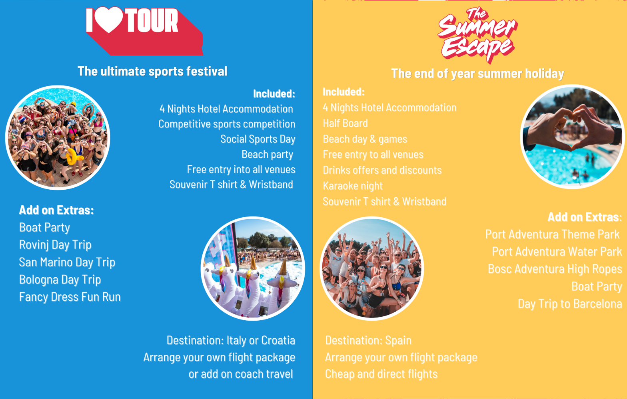
Notes:
JBR

Slide 36
Tour 2024
ILT 2024 Tours
Porec, Croatia (Easter only)
Rimini, Italy (Easter only)
Salou, Spain (Summer only)
EASTER
Week 1: 23rd – 29th March 2024
Week 2: 1st – 7th April 2024
SUMMER
The Summer Escape 7th – 11th June 2024
More info linktr.ee/ILOVETOUR
Notes:
JBR

Slide 37
Tour 2024
Prices TBC but 2023 prices were:
£235* arrange your own flight travel
£389* Italy Coach Package
£399* Croatia Coach Package
* £50 refundable damage deposit on top
2023 Deposit was £39 (this year TBC)
Deposit deadline: 24th November
Final Balance Deadline: 26th January
Special discount event on 1st-3rd October £30/£20/£10 off
Contact Charlotte@ilovetour.co.uk for more information/questions.
Notes:
JBR

Slide 38
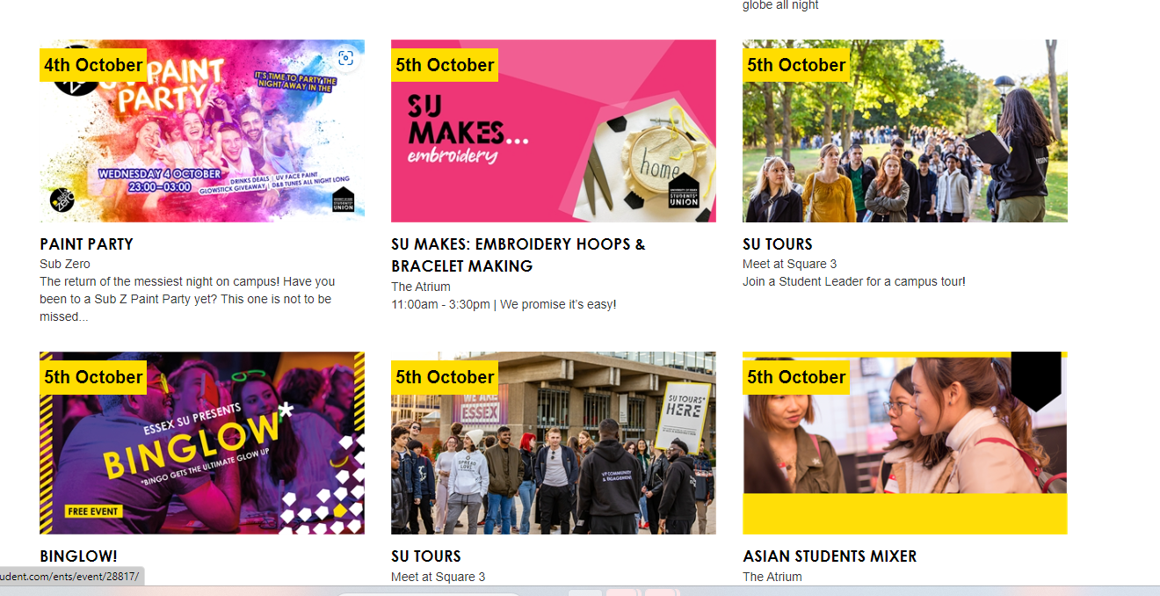
SU EVENTS
30
Also make sure to keep an eye on the SU’s What’s On page for things you can do - as these are organised by the SU, you will not need to complete a risk assessment. Guidance on how to safely attend will also be included.
Picture?
susocs@essex.ac.uk
blades@essex.ac.uk
vteam@essex.ac.uk
rebel@essex.ac.uk

Slide 39
Other Training Sessions
Finance Training - 04/09/2023 – 15:00 – Zoom – President & Treasurer (others welcome if they wish to).
Comms, Social Media & Website Training – 05/09/2023 – 16:00 – Zoom – Anyone, at least one member. If you have a Social Media Officer/Communications Officer then they should attend.
If a session is being run more than once, you only have to attend one of the sessions – they will be the same session.
There will be more sessions available later on in the month before term starts if you have missed any of these.
Picture?
Notes:
Re-check slide information

Slide 40
Any Questions?
32
Ask now!
Email - susocs@essex.ac.uk blades@essex.ac.uk vteam@essex.ac.uk
Find this training session video, presentation and Q&A’s at: https://www.essexstudent.com/activities/studentactivitiesexechelp/ tomorrow afternoon along with the other training sessions!
susocs@essex.ac.uk
blades@essex.ac.uk
vteam@essex.ac.uk
rebel@essex.ac.uk

