Slide 1

Society Core Exec
Training 2024-25

Slide 2
The Team
Kirsty Matthew
Head of Southend Students Union
India Berry
Engagement Coordinator
Rebecca Fernando
VP Southend
To get hold of any of us, please email susouthend@essex.ac.uk or come down to the SU office (2nd Floor of The Forum) during working hours.
Notes:
Emma and Lydia

Slide 3
What is this training about ?
Agenda
What is an exec role
Societies Toolkit
Society membership
Constitution
Elections
Society group chats
Messaging admin
Marketing supporting and website
Open days
Fresher's Fair
Q&A
This training is a chance for you to understand some of the basic processes and opportunities that you will encounter as a society.
Notes:
Lydia – They will be sent the slides and recordings so they can take notes but will also have this as a resource after the training

Slide 4
What is an exec?
They are responsible for the day to day running of the society
An exec must:
Check emails and respond to the Societies team
Deliver the aims as set out in the societies constitution
Provide members activities and events as set out in the societies constitution
Ensure all activities adhere to the SU policies and procedures
Notes:
Emma

Slide 5
What is an exec role?
It's a voluntary position to help run a society
There are currently 2 required exec roles to be a recognised society in Southend:
President
Treasurer
These roles must be elected through an official online election,
held by current students and they are volunteer roles.
Notes:
Emma

Slide 6
President
The president leads their society and oversees all society activity.
They provide guidance and support to the rest of the executive committee, and ensure that the society has a clear direction and sticks to its objectives.
Responsibilities include, but are not limited to:
Scheduling regular executive committee meetings, for which the president would act as Chair unless otherwise delegated to another exec member.
Ensuring that the rest of your executive committee are supported and are fulfilling their roles.
Ensuring that the Society is following the Student Union’s Terms of Reference and Society Constitution.
Being primarily responsible for representing the Society at all Meetings with the SU.
Representing the Society in all matters affecting its interests, including but not limited to communicating with the Students’ Union, University or relevant external organisations
Being responsible, alongside the society’s Treasurer, for the finances of the Society and being accountable in respect of those finances to all Members of the Society and to the Student Activities department.
Notes:
Emma

Slide 7
Vice President
The Vice-President primarily supports the President and ensures that everything within the society is running smoothly, especially when it comes to communication with members and administrative processes.
Responsibilities include, but are not limited to:
Attending additional training provided by the Students’ Union.
Creating clear agendas for Committee Meetings.
Minuting all Committee Meetings and circulating these to members of the committee.
Coordinating the administration of the society and raising any questions or concerns with the Students’ Union.
Communicating on behalf of the Society and with Society members.
Informing the Student Activities department staff of any proposed amendments to the society constitution.
Stepping up to take on the responsibilities of the president when necessary.
Notes:
Emma

Slide 8
Treasurer
The Treasurer manages the society’s finances. This includes overall financial planning, being transparent and accountable with the Society finances, and ensuring that the Society generates enough income throughout the year to cover its costs.
Responsibilities include, but are not limited to:
Ensuring that members have paid their membership fees.
Attending mandatory training provided by the SU throughout the year.
Reviewing the Society’s finance reports to keep track of all income and expenditure and providing regular updates to the committee.
Working closely with other members of the committee when planning events to create budgets and keep track of spending.
Reviewing and signing off society expense claims of under £50 in a timely manner.
Working with the Student’s Union with regard to any potential sponsorship agreements for your society.
Ensuring that the society adheres to the financial policies and procedures
Notes:
Emma

Slide 9
Welfare Officer
The Welfare Officer is responsible for the safety and welfare of the society. They provide guidance, support and signposting to their society members, responding to welfare queries and conflicts, within agreed boundaries.
Responsibilities include, but are not limited to:
Attending or familiarising themselves with the relevant Student Activities welfare training, in order to know how to best support members of the society who are in need
Signposting members of the society to the correct services (across campus/online etc) in respect of their need
Ensuring that the society’s activities are welcoming, accessible and inclusive for members
Acting as the point of contact for any conflicts within the society and deal with issues with the support of the Executive committee, or escalate the matter(s) to the Student Activities Department if a resolution cannot be agreed upon internally within the society
Notes:
Emma

Slide 10
Non-required exec roles
Additional volunteer roles required to support the societies functions and activities
These roles can be tailored to your society's needs
If you need extra roles at any point, discuss as an exec, write a description and email susouthend@essex.ac.uk with your request and the details.

Slide 11
Elections and changes to your exec
If at any point in the year you wish to add an exec role, you must contact us susouthend@essex.ac.uk so that we can set up an official byelection for that role.
Hopefully you will all feel supported in your roles, but if an exec steps down from their role, that person must notify us of their decision in writing. We would then set up a byelection to fill that vacant role.
You may not hold your own internal elections or simply choose someone to fill a vacant exec role.

Slide 12
Benefits of being an exec
Being part of an executive committee brings benefits both short and long term. In terms of running events, you are allowed to:
• Book rooms
• Borrow equipment
• Have access to your society's admin page and edit your website
• Monitor and access the Society's finance account Additionally, it helps to:
• Build your CV
• Get endorsements
• Accumulate hours for the Big Essex Award
Notes:
Emma

Slide 13
Constitution
A constitution is a document all Societies must submit at the beginning of the year stating what the Society’s aims are, how much should the membership cost, the responsibilities allocated to each executive member and any affiliations the Society might have. We will use this document for reference throughout the year, to ensure the aims of each Society are being met and everyone is playing their part.
Notes:
Emma

Slide 14
Constitution
If you decide to add an additional role that has not been elected yet, tell us so we can run a byelection in October.
We will be uploading your constitution to the resources tab on your society page so that members are able to see it.
If you do not send us your constitution, your membership will not be on sale. As soon as we receive it, we will put your society membership on sale.
Notes:
Emma

Slide 15


Society memberships
Once training is completed and your constitution has been received.
You can find your membership by going to your society page and clicking the 'Join' tab. Find a Society (essexstudent.com/southend)
Go buy your membership now (even if the membership is free)! Once you have your membership, we can grant you with admin rights.
If your membership is not showing, it is because you have not sent us your society constitution.
Notes:
Lydia- Make them go buy their membership now! Even if their membership is free. Please bear with us while we grant you admin rights. It is quite a manual process and it can take some time, we are working on it. Promote it to people, not everyone will realise this is when the membership renews so they may be keen to be a member but they just haven't purchased it yet.

Slide 16
Society memberships
Benefits of charging a membership:
• Building your finances to create better events for your members.
• Be able to have member vs non-member tickets at events.
• Have backup funds if equipment is needed
• Be able to afford more elaborate events
Notes:
Lydia- Make them go buy their membership now! Even if their membership is free. Please bear with us while we grant you admin rights. It is quite a manual process and it can take some time, we are working on it. Promote it to people, not everyone will realise this is when the membership renews so they may be keen to be a member but they just haven't purchased it yet.

Slide 17

Marketing support
Notes:
Ellie

Slide 18
Su marketing
  SU Marketing manage:
    Website
    Social media – Tag @essexsusouthend in stories and we will reshare
    Email – weekly all student email
  To be featured on any of these areas, please send your request into susouthend@essex.ac.uk with at least one month's notice.
  We will provide support dependent on relevancy and capacity
Notes:
Ellie

Slide 19
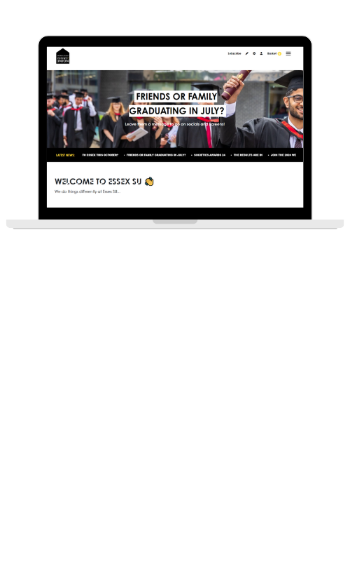
WEBSITE
Notes:
Ellie

Slide 20
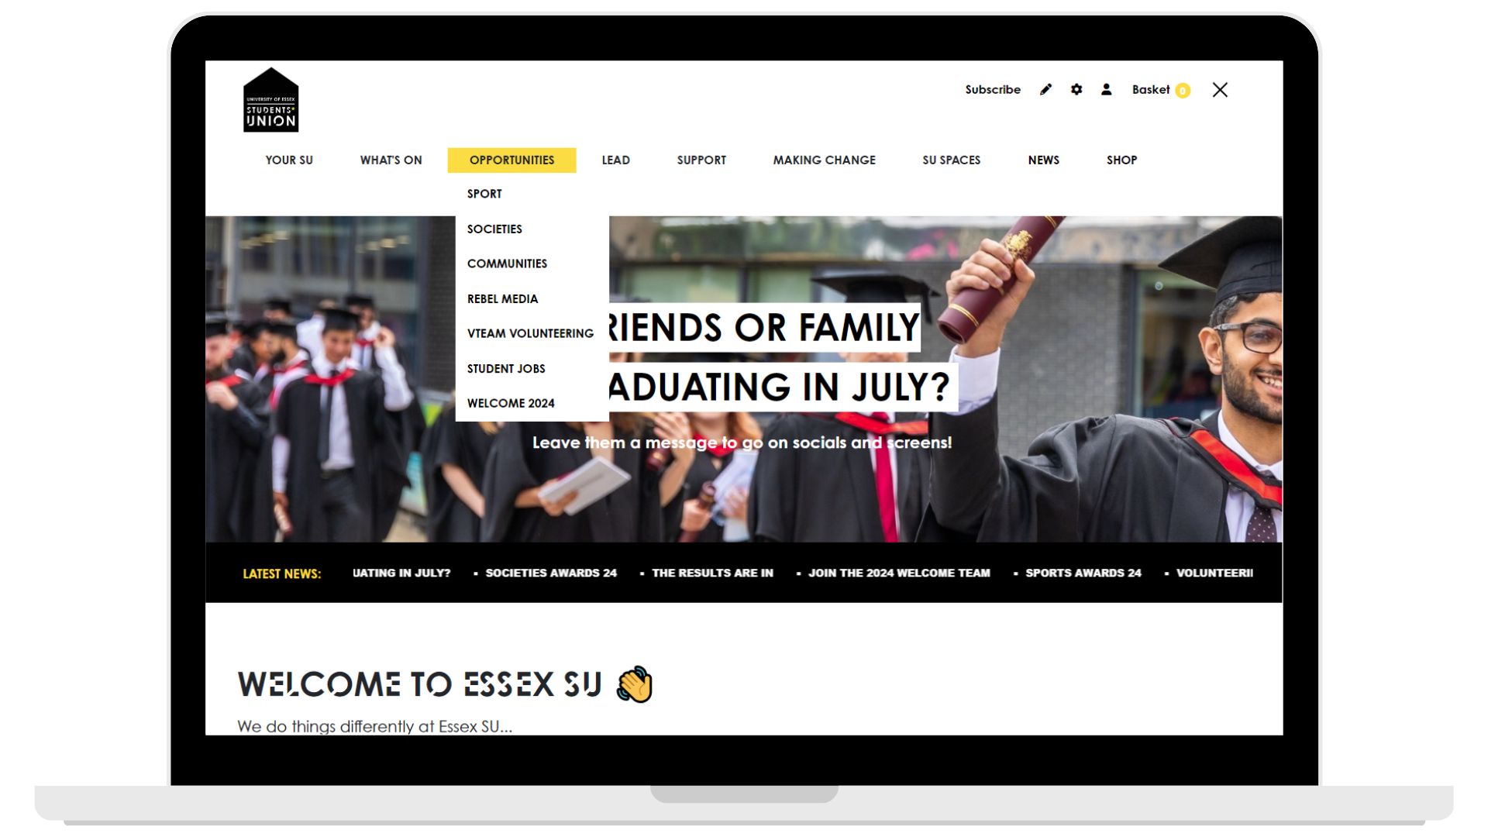
The main hub page Sport/Societies lives under the Opportunities tab
Execs have access to:
• Edit details on your group's page
• Add events to your group's page
• Add events to the What's On page
Notes:
Ellie

Slide 21
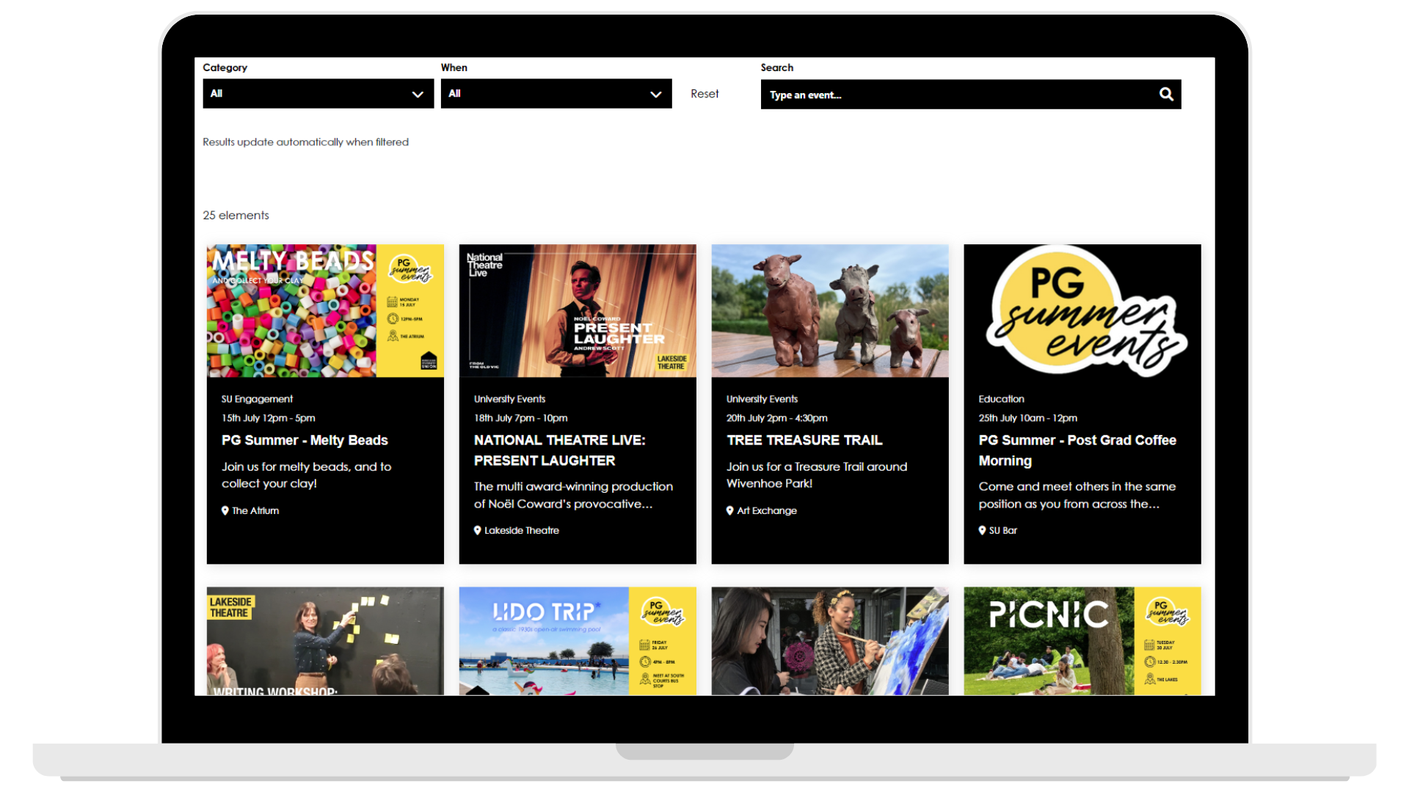
WHY ADD TO THE WEBSITE?
What's On page is always in top 5 viewed pages
Best platform for getting seen by the most students
Staff browse this page to find events to help promote
Notes:
Ellie

Slide 22
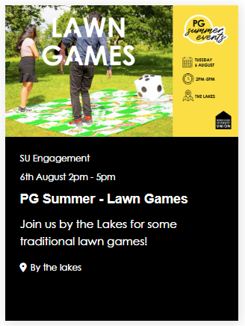
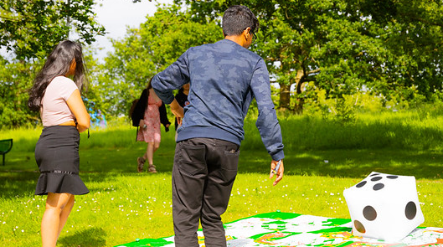
Event listings
You need to provide us with the following information:
  Name
  Dates
  Short description
  Location
  Always tick society event/sport - ignore all other options
  Image
  Event description
Notes:
Ellie

Slide 23

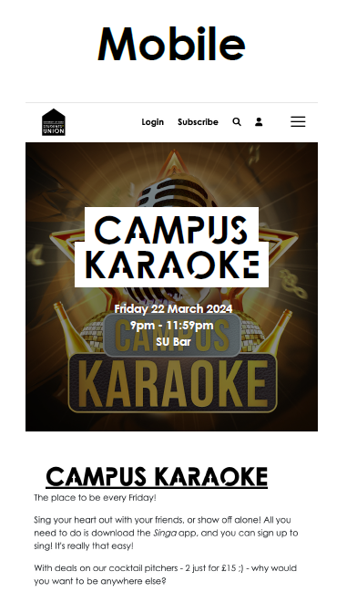
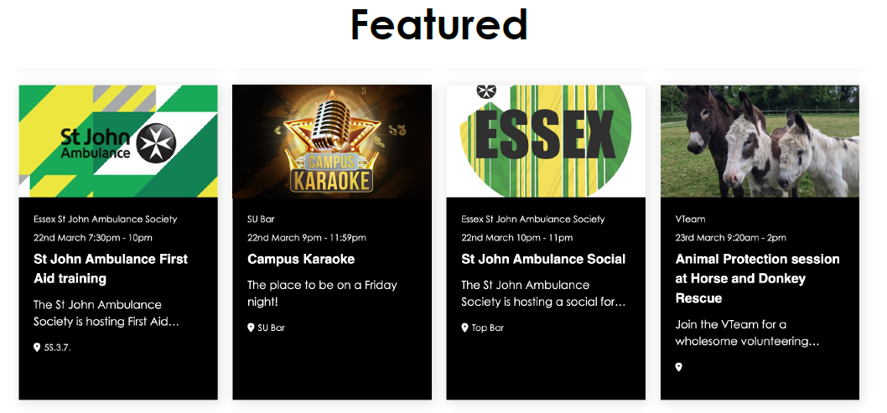
Event images
2000px wide x 500px tall
Best practice is to make sure the most important part of your image is centered
Event information doesn't need to be in the image as it is displayed underneath the image on all views
Notes:
Ellie

Slide 24
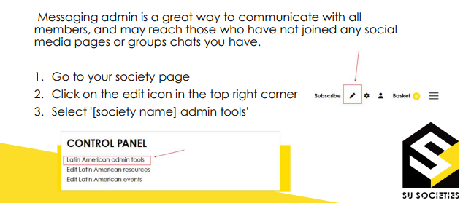
How to use messaging admin
Notes:
Ellie

Slide 25

How to use messaging admin
Notes:
Ellie

Slide 26
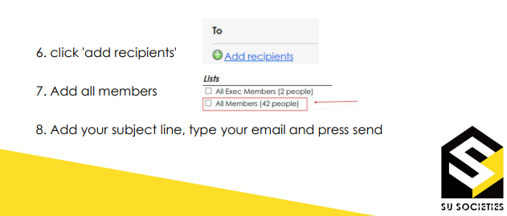
How to use messaging admin
Notes:
Ellie

Slide 27
Society group chats
It is up to you whether you have a society group chat and where you host this (e.g. WhatsApp, Discord etc).
Having a group chat is a really good way to communicate with members and promote events and opportunities.
If you do set up society group chats, we expect the exec to moderate their group chats and be admins.
We recommend you have a separate chat for exec only and an additional members chat so that planning can be kept separate.
Notes:
Lydia – totally up to them if they want to have a group chat

Slide 28
Open Days
Open days come up throughout the year.
These are for prospective students to see what the uni has on offer.
Sometimes we get asked if societies can attend and run a stall, the Uni have offered money to be paid into the societies account in the past for this.
Notes:
Connor

Slide 29
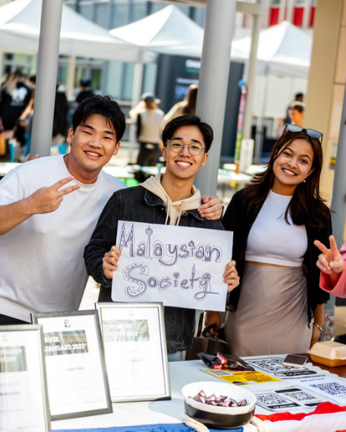
Fresher's Fair
Fresher's Fair takes place throughout welcome in Southend.
This is a great opportunity to promote your society to new and existing students, and encourage them to become members.
If you know what events you have coming up, this is also a chance to promote those events.
Notes:
Emma

Slide 30
Q&A
We now have time for some questions.
If your question is very specific to your society, please email us or come see us in TF.2.43
These slides will be sent out after the meeting and will eventually be available at Societies Toolkit (essexstudent.com/southend)
Notes:
Lydia

Slide 31
Thank you!

