Slide 1

Society Events Training 2025-26

Slide 2
What is this training about ?
Agenda
Toolkit
Events booking form
External speakers
Booking rooms
Booking other venues
Food and drinks rules
Borrowing equipment
Promoting your events
Funding your events
Examples of events
Freshers Fair
Q&A
This training will familiarise you with the various options and processes involved in booking and putting on events. By the end, we aim for you to feel confident in throwing a successful event.
Slides will be sent out after the training.
Notes:
Laura

Slide 3
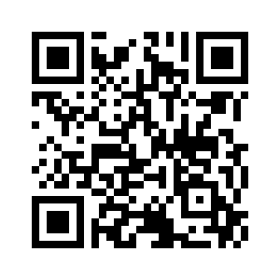


Societies Toolkit
On essexstudent.com, you have access to our Societies Toolkit.
This toolkit has lots of useful resources and forms which will help you put on successful events.
Scan here to visit the societies toolkit
Notes:
Laura

Slide 4
External Speakers at events
Societies can invite external speakers to their events, so long as you let us know in advance and fill out an external speaker submission form.
External Speaker requests can be made here: Inviting an external speaker to an event | University of Essex
Please ensure you have put your room booking request in before you submit the external speaker form.
You must give us at least 15 working days' notice when you request an external speaker
Notes:
Talia

Slide 5
External Speakers at events
Training: complete the Moodle module- Course: Speaker Protocol | Moodle
The speaker notification and risk review process : include all information about the speaker, their organisation and the topic of their speech and think about risks including:
  whether you or others have concerns about whether the speaker or others involved in the event might contravene University policy or the law
  is the speaker in the speaker a celebrity, an MP or in the public eye
  is the event likely to draw a protest?
Your external speaker notification might be referred to the University
Notes:
Talia

Slide 6
Booking a room on campus
Society exec members can request a room by completing this form: Clubs and societies room booking form - Forms - University of Essex
Please give at least 5 working days' notice of your event. This is to give our team and the Room Bookings team enough time to process the request. If it is submitted with less notice, we cannot guarantee it will be processed and approved on time.
Notes:
Sarah – rooms assigned based on capacity – book what's appropriate for audience size (e.g. don't book ICLH for 50 people)

Slide 7
Room booking availability
Rooms are allocated on a first come, first served basis and may not always be available. During exams or graduation, many rooms are already booked out.
Notes:
Sarah

Slide 8
Booking for a more complex outdoor events
If you are doing something outside on campus, then you will need to fill in an Event Permission form from Southend City Council. We advise you speak to us first to help you plan it.
Once this form has been filled in by the exec, you must send it to susouthend@essex.ac.uk to be approved and we will also seek approval from the Estates team.
This process can take some time, and Southend City Council ask that we send them any Event Permission Forms with 8 weeks' notice.
Notes:
Emma

Slide 9
Protests/demonstrations
Share your plans/ideas with the SU who can run you through the process
To have read and understood the responsibilities as an organiser of a protest as per the Protest and Demonstration Management Protocol
Complete the Protest and Demonstration Notification Form (submit to susouthend@essex.ac.uk 5 working days prior to the date of the activity)
Protest and Demonstration Operational Group will review the forms and resolve any queries.
You will also need to complete an additional risk assessment for this type of event, we can help guide you on this and the associated risks to mitigate.
Notes:
Emma – we're here to support you and your right to have your say. We understand the nature of these events can be reactive to live situations, so let us know asap and we will prioritise the time to support you through the process.

Slide 10
Booking SU venues
SU Lounge
The Mezz
Notes:
Cam

Slide 11
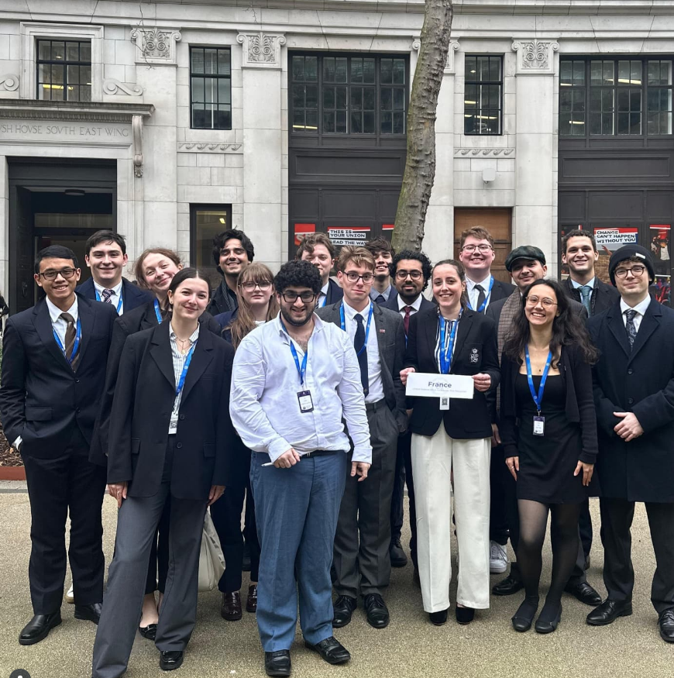
Events off campus
You may wish to host events that are not on campus, such as visiting other universities, attending conferences or competitions or visiting external venues.
If you want any support in planning this, let us know. We can support in various ways:
Helping you to book group train tickets/accommodation/coaches etc.​
Helping you claim back mileage expenses​
Setting up online tickets, even if the event is off campus
Notes:
Laura
-MUN competition
Kpop competition
Public speaking competition
Mileage is in finance training
Support: in town events such as bowling or escape rooms. Want to buy beforehand. Sell tickets online

Slide 12
Food and drink at events
Food:
If you wish to have homemade food at your event, you will need to have at least a Level 2 Food Hygiene Certificate and provide a copy of this to us before you hold your event. Follow this link to register your interest in completing this course https://essexsu.typeform.com/to/GudabCmg Once completed, we will send you an access code to complete the course (one food hygiene certificate free for every society).
  If you are unsure if your society has a certificate, send us an email.
All homemade and shop bought food items must be labelled with their ingredients, any possible allergens and if they are vegetarian, vegan or gluten free items (Natasha's Law.)
You must provide us with a risk assessment/general risk assessment which includes food related risks and mitigations.
Notes:
Laura
-you might have had one in the past but the person holding it might have left of not be part of the society anymore
-Natasha's Law

Slide 13
Food and drink at events
Food:
If you wish to bring an external caterer to your event, we require certain documentation from the company before they can come on campus to serve food:
Copy of the Food Hygiene Certificate
Copy of their Public Liability Insurance (at least £5million)
Copy of their own risk assessment
Once you obtain these documents, you must send them to our team to review. Leave yourself enough time to get these documents and have them checked by us.
Notes:
Laura
Hot food vs

Slide 14
Food and drink at events
Drink:
Alcoholic drinks are not permitted in any of the rooms on campus. If you are found to have consumed alcohol in the rooms, you will be in breach of the Room Bookings agreement and may not be allowed to book rooms in future.
Notes:
laura

Slide 15
Borrowing items for events
There may be equipment that we can lend you to support your events:
Email susouthend@essex.ac.uk to request to borrow something
Notes:
Laura

Slide 16
Showing film and TV at events
The rooms on campus are not licensed for showing films and TV shows. If you wish to show something, we have to ensure you are covered by a license.
Dos | Don'ts
Tell us what film you wish to watch and we can get you a quote for a single title license. This must be shown using a physical copy of the film. Licenses start at about £87. You can show films/shows that are available for free on YouTube. You can show films/shows that are available for free on catchup services like ITVX and All4. Any sports matches have to be watched on catchup for this we’d recommend going to a local bar. | You cannot show films/shows on streaming subscription services such as Netflix or Amazon Prime. This breeches their terms and conditions as this is for personal viewing only. You cannot show films/shows on BBC iPlayer, as we are not covered to do so by a TV license.
Notes:
Emma

Slide 17
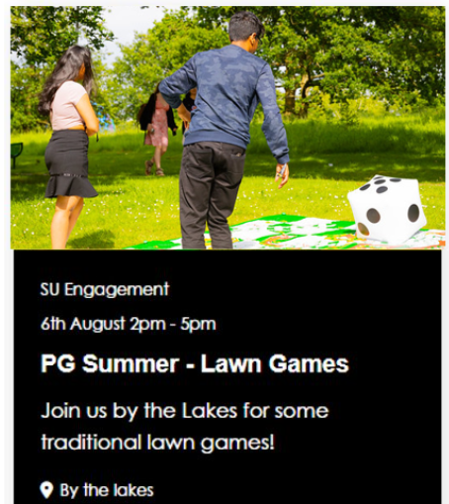
Promoting your events
One of the most effective ways of promoting your event is to add it to What's On page of the SU website.
You need to add the following information:
  Name
  Dates
  Short description
  Location
  Always tick society event- ignore all other options
  Image
  Event description
For tickets, complete the Ticket
request form: https://essexsu.typeform.com/to/hxZtqlmH
Notes:
Emma

Slide 18
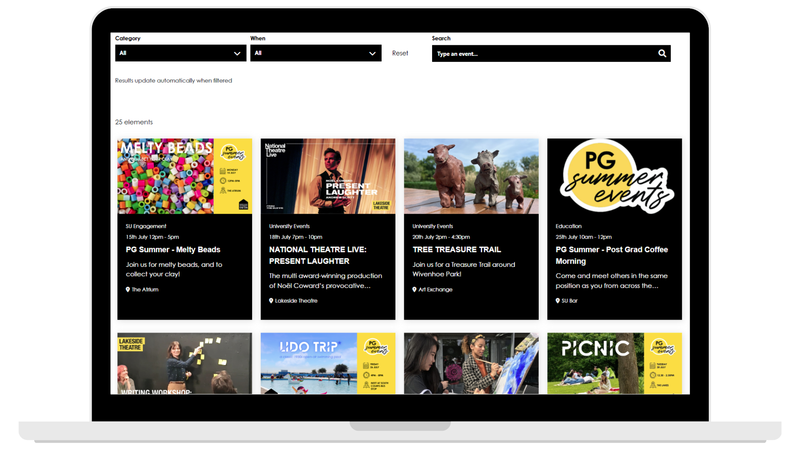
Why add to the SU website?
What's On page is always in top 5 viewed pages
Best platform for getting seen by the most students
Staff browse this page to find events to help promote
Notes:
Emma

Slide 19


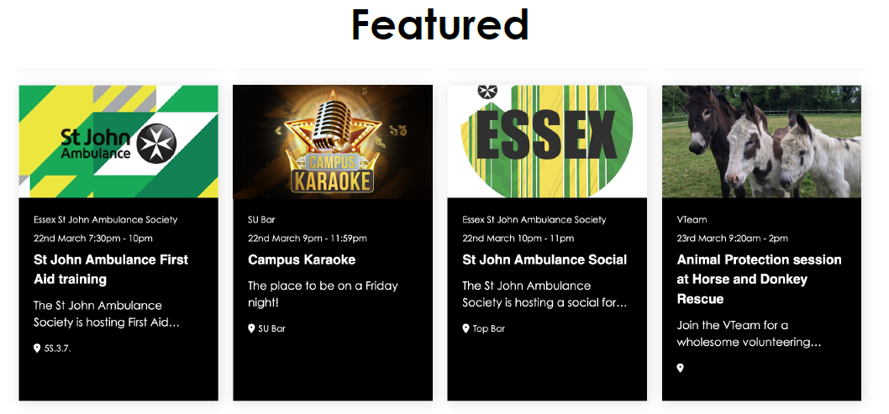
Event images
2000px wide x 500px tall
Best practice is to make sure the most important part of your image is centered
Event information doesn't need to be in the image as it is displayed underneath the image on all views
Notes:
Emma

Slide 20
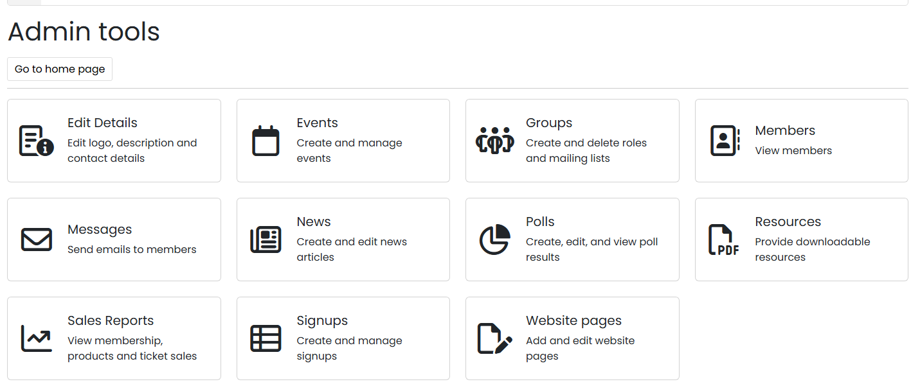



How to add events
Notes:
Emma

Slide 21
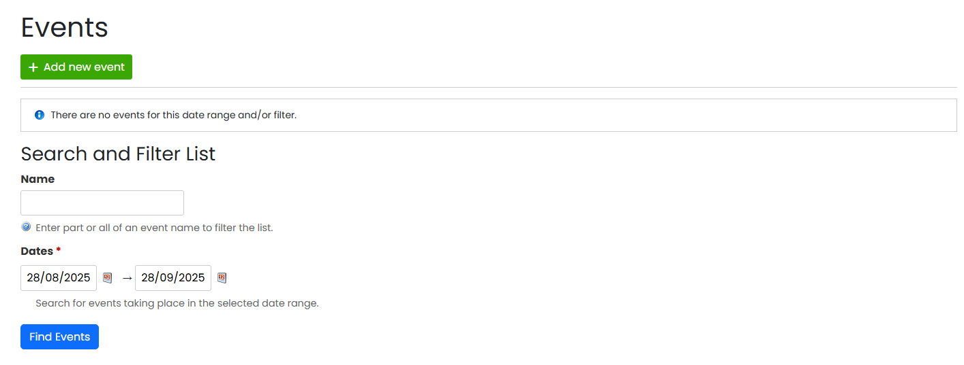





how to add events
Notes:
Emma

Slide 22
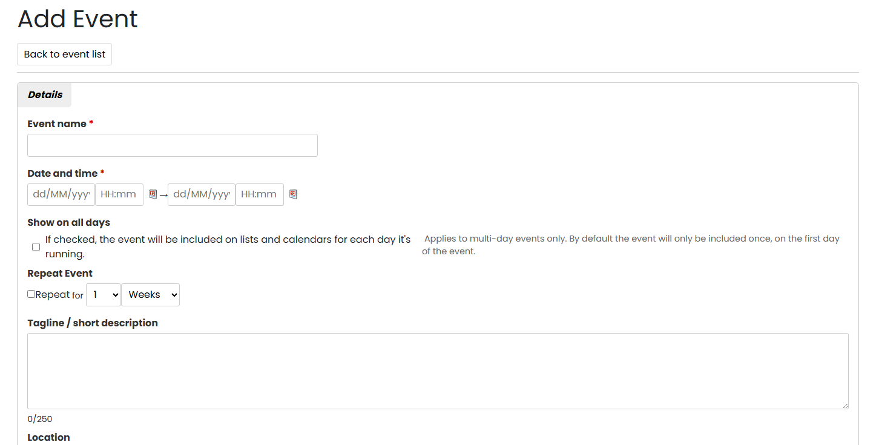
how to add events
Notes:
Emma

Slide 23
Trigger warnings
You may wish to debate or discuss important topics at events that could be distressing or upsetting for people. In this scenario, we advise you include trigger warnings.
Trigger warnings can be included in your What's On event description and they can also be given at the start of the event.
We would encourage the welfare officer to attend these types of events and be available if people need signposting to additional support on campus.
We have also put together a support slide that we can share with you to display at the start or end of your event (see next slide)
Notes:
Emma

Slide 24
If you have been affected by anything discussed during this event, the following support is available:
The Student Wellbeing and Inclusivity Service (SWIS)
Wellbeing@essex.ac.uk | 01206 873133
SU Advice
SUAdvice@essex.ac.uk | 01206 863211
If out of hours service is required:
Student Wellbeing Support Line: A 24/7 phone line for students, provided by Health Assured. The number is 0800 028 3766.
SHOUT: A free, confidential text service available 24/7. Text "SHOUT" to 85258.
Student Space/Student Minds: Online support resources offering advice and information on a range of topics.
www.studentspace.org.uk
Notes:
Emma

Slide 25
Funding your events
Before you plan an event, make sure you have an estimated cost and that the President and Treasurer are in agreement that there are sufficient funds available and the money can be used for this purpose.
If you are relying on selling tickets to cover the event costs, make sure to gauge interest from your members before you start making purchases –you may sell fewer tickets than you anticipate.
You cannot use expected income to buy things, wait until you have sold sufficient tickets in order to make your purchase, or claim back this cost.
All web sales are processed at the end of each month – for example any money made from tickets at an event on the 6th October wouldn’t be processed and accessible to view in your account until the start of November.
Notes:
Laura

Slide 26
Ticketing your events
We can create tickets that can be added to your event online and purchased by students. The income from ticket sales goes straight into your society account at the end of each month.
We can add requirements on tickets, for example if it is a members only event, we can set a ticket requirement so only members can buy them.
To request tickets to be added to your event, please fill in this form Society Ticket Request Current (typeform.com)
Be mindful that 20% VAT will be taken off any ticket income, which is handled by our Finance team.
Do not use third-party sites to sell tickets (e.g. Eventbrite or Fatsoma). They will very likely take a cut and you will be liable for ensuring you follow VAT laws yourselves.
Notes:
Laura

Slide 27
Collaborations
We strongly encourage you to collaborate with other societies. It is a nice way to do events you may not have considered doing before, meet new people, reach new audiences and share resources/funding to put on a bigger event
If you are a departmental society, you can also reach out to your department to see if they will collaborate on an event with you. This is a good way to get their expertise, and departments can often help with promoting events or supporting with some funding (such as supplying snacks)
Notes:
Sarah
Can also collab with sports, VTeam, student leaders etc. Contact details should be on Essex SU website

Slide 28
How we can help promote your events
Email susouthend@essex.ac.uk to request that we promote it as a story on our Instagram, please include an image or any information you want us to include.
You can tag @essexsusouthend in your stories that promote events and Marketing may repost your story.
To be featured on the @essexsu Instagram or on the digital screens, email your request to susouthend@essex.ac.uk with at least 1 months' notice. We will pass this onto the Marketing team who will provide support dependent on relevancy and staff capacity.
Notes:
Sarah – use their accounts but tag us/SU for a boost

Slide 29
Q&A
We now have time for some questions.
These slides will be sent out after the meeting
Notes:
Emma

Slide 30
Thank you!

