Slide 1

Finance Training 2024/25
Picture?
susocs@essex.ac.uk

Slide 2

Staff Introduction
Societies Team
Emma Sainty
Student Activities Manager
Laura Toncel Parrado
Societies Coordinator
Finance Team
Joe Giles
Assistant Accountant
Becca Macleanan
Trainee Assistant Accountant
sufinance@essex.ac.uk
Picture?
susocs@essex.ac.uk

Slide 3

What Are Your Roles?
Treasurer
You have primary responsibility for all your society or club finances, alongside the President.
You are responsible for paying in money received through events and fundraising
For approving expenses (except your own expenses)
You must attend meetings called by the Student Activities Team, together with any training which the role requires.
Picture?
susocs@essex.ac.uk
Notes:
Laura

Slide 4
Your ‘Account’
Everything should go through your official society account.
When you start receiving your weekly finance reports, it’ll look a bit like you have your own bank account.
However, societies do not actually have their own bank account – just a sub section within the SU’s account.
Societies are strictly prohibited to open external bank account – all income and expenditure must pass through the SU bank account. This policy ensures that society funds are used appropriately to meet the needs of the members. If a society does this, there will be consequences and you could potentially face closure.
Each society will be assigned their own unique 3 digit finance code. E.g. Italian society is ITA to identify your account.
This is not a formal bank account so does not provide a card, chip & pin etc, but allows societies to pay in and pay out.
Picture?
Notes:
Emma - i.e you cannot access that money by using a card or making withdrawals/transfers like you would with your own card

Slide 5
Weekly Finance Reports
These reports are sent to the listed President and Treasurer only.
If you aren’t receiving these updates, check we have the right details for your society.
The are automatically sent out end of every week via email.
It’s the responsibility of the treasurer to check these weekly reports and flag any issues – email suexpenses@essex.ac.uk if you notice any concerns. Please note that income and expenses will likely not show in your reports until the following month (by 15th).
Any member of your society has the right to view the finance report. They can request to view the weekly finance report by submitting a request in writing (email) to susocs@essex.ac.uk.
Picture?
susocs@essex.ac.uk
Notes:
Emma - Note – they are not currently being sent due to an error that we needed to fix, but we are working to get them set up asap. If you need your report, email susocs and we will send you a copy.

Slide 6
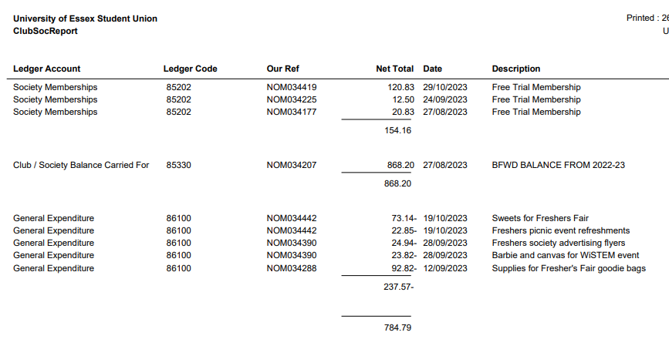
Understanding Your Account
Picture?
Total amount in the account available
Income/fundraising is all positive
Expenditure/spending is all negative
susocs@essex.ac.uk
Notes:
Emma - The previous balance is carried forward from the previous year.

Slide 7
What’s in Your Account?
Membership Funds – When people buy a membership for your society, the money (after VAT has been deducted) will display in your weekly finance report.
Other Funds – Any other funds will usually come from the following:
if you’ve paid money in that you’ve raised at an event
money from ticket sales through the website (ticket/website sales aren’t processed till the end of that month. Therefore, ticket income won’t show till a month after).
Both will have VAT deducted before going into your account.
External organisations can also make donations or sponsorships to your society, but please speak to the Societies team before arranging this.
Picture?
susocs@essex.ac.uk
Notes:
Emma - These reports are a great way to track how much ticket income you have made, but we know sometimes you need to know this sooner. Ticket and membership income gets processed at the ened of every month so will have a delay before shwoing up on your report. You can track your ticket sales through the website – on admin tools, so you will know roughly what to expect. it will show up what membership income you have, what ticket income, any donations that have been made or expenses that have been paid.

Slide 8
Value Added Tax (VAT)
Societies will pay VAT at a rate of 20% on any income they receive (unless it is a donation), so make sure you factor this into spending and decision making with your money.
You can claim back any VAT you pay when you buy goods or pay for travel but only if you ask for a VAT receipt when you pay. This must show the VAT registration number and a breakdown of the VAT.
Please note that not all companies are VAT registered
susocs@essex.ac.uk
Notes:
Emma

Slide 9
Value Added Tax (VAT)
How to calculate VAT:
It is very important to allow for VAT when calculating your income versus costs, or you may make a loss.
*To calculate the VAT, just divide by 1.2 *
For example, if you charge £15 for an event.
£15 divided by 1.2 is £12.50, so this is the amount that would go into your society fund as income from a ticket.
You can also multiply by 1.2 to calculate how much money you need to make before VAT to cover your costs.
Remember to add 20% onto your costs to cover VAT
susocs@essex.ac.uk
Notes:
Emma

Slide 10
Spending money
30
Ways to pay/purchase:
Ask for an invoice where possible – most companies will invoice if you email and ask them
Speak to the societies team if it is a large expense and an invoice isn’t possible – potential to pay via a department card in certain circumstances.
Individual members pay for the products and claim back expenses afterwards (if they can afford to do so)
Before any purchase, check with the Treasurer/President that there are sufficient funds to make the purchase and they agree to what is being purchased.
All purchases should benefit the society as a whole and not a particular individual.
susocs@essex.ac.uk
Notes:
Emma

Slide 11
Invoices
Invoices are the easiest way for us to make payments directly from your society fund and means you do not have to make large payments from your own personal bank account and wait to be refunded.
Most companies will provide invoices, although some may seem reluctant. Just email or call to explain you are a society and ask to pay via invoice.
Examples of when to use an invoice:
Coach transport to a trip (the SU have an account with Roman Coaches, so please ask us for a quote in first instance).
Entry fees for a competition
Accommodation costs
Equipment purchase
Payment for an instructor, performer or host
Picture?
susocs@essex.ac.uk
Notes:
Emma
We can always help support you to contact the company and see if they raise invoice

Slide 12
Invoices
Please ask the Societies team for advice before agreeing to any invoices you are unsure of.
The Societies team has the right to reject any invoice or expense claim (e.g. you cannot claim back the cost of alcohol).
Please check with us before you purchase, if you are unsure whether you will be refunded, or have sufficient funds.
Picture?
susocs@essex.ac.uk
Notes:
Emma

Slide 13
Invoices
Email to suinvoices@essex.ac.uk and cc in susocs@essex.ac.uk
It should be the society’s Treasurer who deals with invoices and emails them.
Must be addressed as follows:
​
University of Essex Students Union (insert your society)​
Wivenhoe Park ​
Colchester ​
Essex ​
CO4 3SQ
Failure to address correctly, will result in a delay of payment, whilst we wait for a corrected invoice to be sent over.
Picture?
susocs@essex.ac.uk
Notes:
Lydia – we ask to be cc's in because otherwise we cannot be sure if you have approved this invoice payment with a supplier. By going via the treasurer, you can make sure that you are happy with what has been laid out in the invoice and that the details are correct to what you agreed.

Slide 14
Invoices
Invoices need to clearly state:
The bank details of who the money will be sent to
The date upon which they provided a service (if applicable)
A good description of what the service was/product list.
If an invoice includes any incorrect details, we have to wait for the supplier to amend the details before processing, which slows down the approval process.
Please make sure to look over these slides again when getting an invoice from someone, so that everything is done as smoothly as possible.
Picture?
susocs@essex.ac.uk
Notes:
Emma – the supplier or company providing an invoice will probably be practiced in doing invoices and it will be up to them to create this document. However, here is a guide of what should be included.

Slide 15
Invoice deadlines
Invoice should be emailed to suinvoices@essex.ac.uk and susocs@essex.ac.uk in order for this to be processed.
Our payment terms for invoices is 30 days, in exceptional circumstances these can be processed quicker, please note our payment runs are Wednesday only. Many suppliers will require payment upfront, so leave yourselves enough time for invoices to be processed.
Wednesdays – Only authorised Invoices are processed for payment on this day (there is one payment day per week only)
Invoices are classed as authorised once the Treasurer & Societies team signs them off, not once you have submitted it.
Fridays – Recipient will receive their payment in their account.
Picture?
susocs@essex.ac.uk
Notes:
Emma

Slide 16
Invoice reminders
Allow lots of time to receive an invoice and ensure it is paid before the deadline.
If you have a strict deadline to meet e.g. for an event, make the Societies team aware and ensure you have followed the timeline for approval.
Please also be mindful of sending invoices and expense claims over periods where there may not be staff in, for example between Christmas and new year. Payments will not be made during this period.
Picture?
susocs@essex.ac.uk
Notes:
Emma

Slide 17
Claiming expenses
For small amounts, individual members might pay for items upfront, then claim back expenses so long as the expense benefits the whole society.
Please check with Treasurers before purchasing any items.
For larger amounts, we encourage you to ask the company for an invoice or we can purchase items on your behalf in some circumstances with a department charge card.
All invoices need to be address to the Students Union and sent to suinvoices@essex.ac.uk
Picture?
susocs@essex.ac.uk
Notes:
Emma – e.g if you buy lunch while having a committee planning meeting, this does not benefit or is not open to the whole society to benefit from so it should not be claimed back.

Slide 18
Expensein
  Since last Academic year, we have moved over to a new system for processing expenses, called Expensein.
  All Students claiming an expense will need an submitting account. In order to get this set up, you will need to fill in the below Typeform (it can take up to 4 workings days to receive your invite once doing this)
  Link to request an Expensein account:
  https://essexsu.typeform.com/to/TEQyMIBH?typeform-source=www.essexstudent.com
  Once your account has been set up, you will receive an email invite from Notifications@expensein (please check your Spam/Junk folders as well)
  Presidents & members: Will just have the one claiming account for submitting expenses.
Picture?
susocs@essex.ac.uk
Notes:
Becca

Slide 19
Expensein
Account types:
Treasurers: Will have two accounts:
One for submitting: https://essexstudent.expenses.org.uk/signin?returnUrl=%2F
One for approving: Awaiting Approval - ExpenseIn
Treasurers should automatically receive an email invite to both accounts (one to claim, one to approve). If you do not receive these, please check your Spam/Junk folder before contacting suexpenses@essex.ac.uk
Treasurers will receive an email when you have an expense you need to approve
Treasurers are only able to approve expenses up to the value of £50. Anything higher, will be sent to the Societies team for their approval.
After this meeting we will send out an email guide on creating your account/submitting expenses.
Picture?
susocs@essex.ac.uk
Notes:
Becca

Slide 20

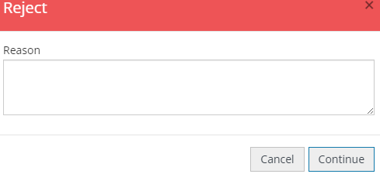
Expensein Approving
You will receive an email when you have an expense to approve.
1, Check that the coding is 'General Expenditure' and that it shows your Society name
2, Check to ensure the receipt matches the claim amount, look out for the Policy Issue warnings as well.
3, If you have any queries about a claim or wish to reject a claim, press reject and fill in the text box (this will then go back to the person claiming)
4, Make sure the expense benefits the whole society before approving, if in doubt always speak to the Society team.
Picture?
susocs@essex.ac.uk
Notes:
Becca

Slide 21
Expensein
The new system does mean there is a quicker turnaround for expenses being paid.
We would still recommend getting all expenses submitted by a Monday morning to better your chances of getting payment the same week. (In busier periods this may be longer)
You will receive email updates on the status of your claim, you will also receive an email if your expense is rejected. If your Expense is rejected it will give you the opportunity to adjust the claim and re-submit.
Picture?
susocs@essex.ac.uk
Notes:
Becca

Slide 22
Expensein
19
Things to remember when claiming for an expense:
You can only claim an expense for yourself, the Bank account details on your account must be your own.
Upload all evidence to support the claim. Must have a receipt for refund. Try to get a VAT receipt where possible.
Brief but clear description on what the expense claim is for.
Please note, just because you have submitted your claim this does not guarantee reimbursement. Check with your Treasurer before purchasing anything.
Picture?
susocs@essex.ac.uk
Notes:
Becca

Slide 23
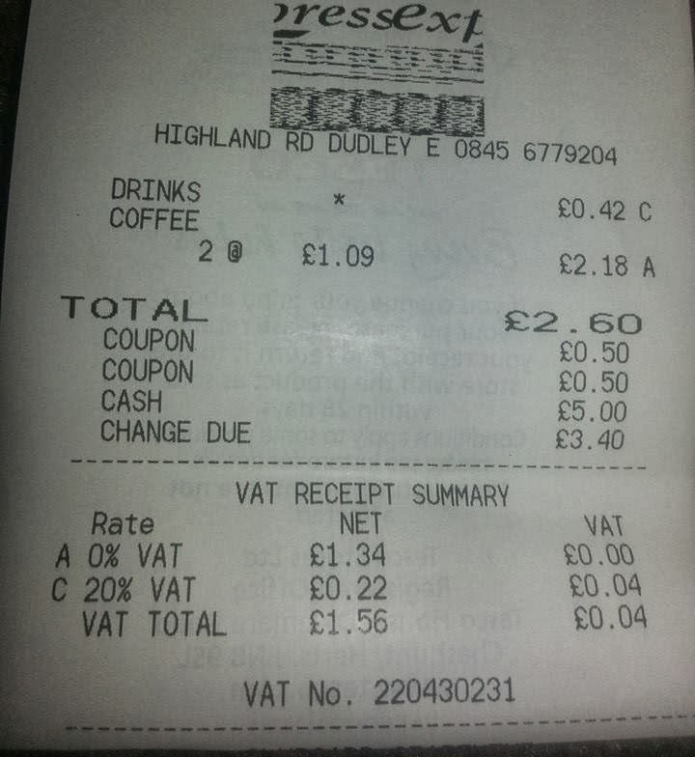
VAT receipt
Always ask for a VAT receipt, not everywhere will be VAT registered, but ask.
The receipt needs to show the
VAT registration number and a
breakdown of VAT.
The items with a * will identify the items that are VATable. No starred items, mean that nothing is VATable.
susocs@essex.ac.uk
Notes:
Becca - A standard receipt might not show the VAT breakdown, so if you are purchasing items from a supermarket for example, go to a physical cashier so you can ask for the correct receipt to be printed out.

Slide 24
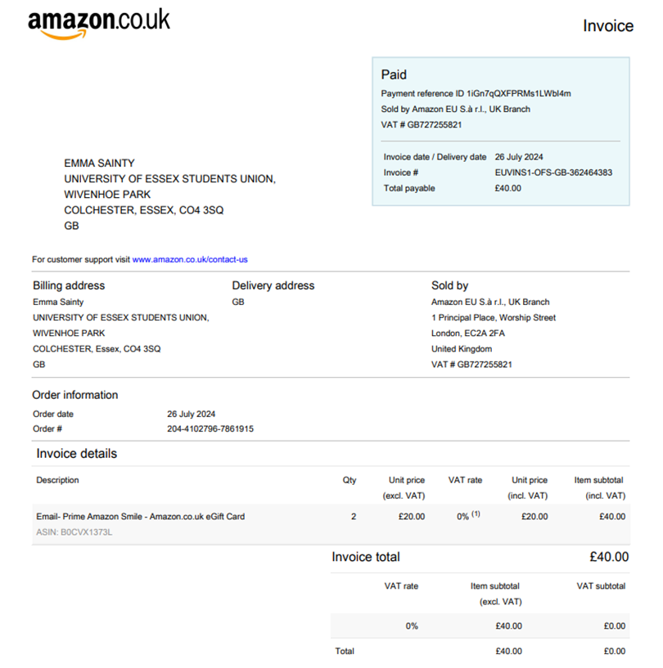
VAT receipt (Amazon)
susocs@essex.ac.uk
Notes:
Becca

Slide 25
RAG (Raise and Give)
The SU is a registered charity, and so cannot make direct payments to other charities in the ‘normal’ way
The RAG account is another branch of the SU’s bank account.
If you are fundraising for an external charity, your money must go into the RAG account and not your own society fund.
Whether you are fundraising online, through a card machine, or taking cash, you have to complete the RAG form before your event. RAG-Form-Template-with-amendments.xlsx (live.com)
You will fill in which society has carried out the fundraising, which charity the money should be paid to and then the address & bank details of that charity.
Note that if you wish to donate to an international charity, there may be additional fees to transfer the donation.
susocs@essex.ac.uk
Notes:
Laura

Slide 26
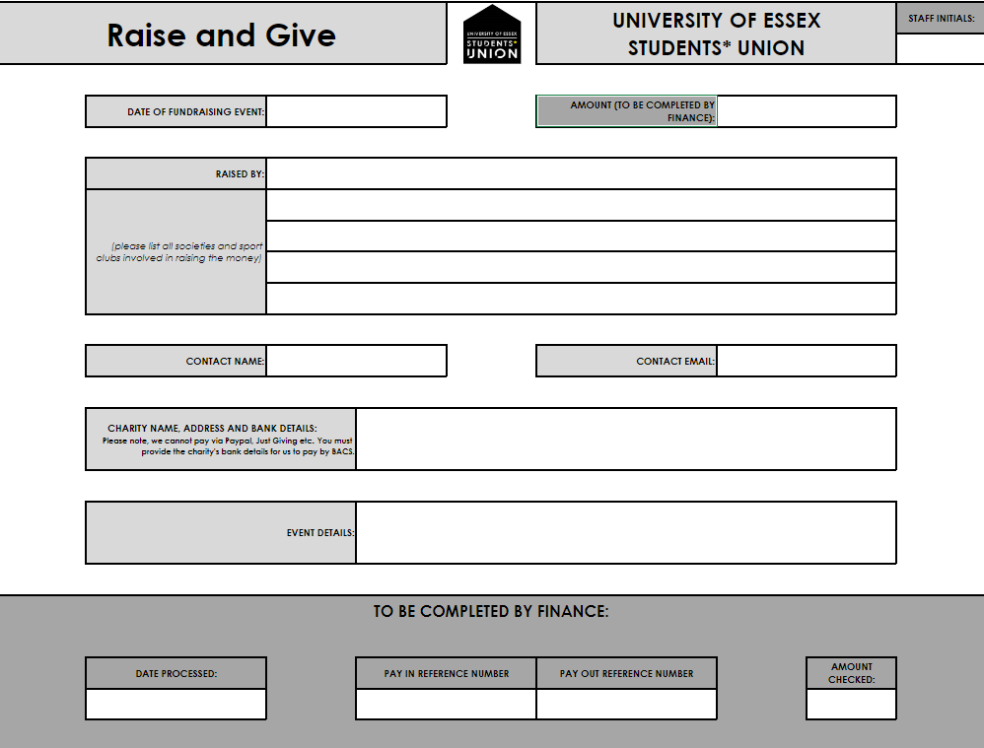
RAG (Raise and Give)
susocs@essex.ac.uk
Notes:
Becca

Slide 27
Online tickets
If you have added an event to the What's On page, the Societies team can add tickets to this event.
You can email the Societies team or complete this form to request tickets. Society Ticket Request Current (typeform.com)
Ensure you tell us what types of tickets you want (e.g. member only, non-member, non-student). Also tell us prices and quantities for each ticket type and the date by which they need to come off sale.
Any ticket income will go directly into your society account and is usually processed at the end of each month (unless you are fundraising for an external charity).
Don't forget that 20% VAT will be taken off ticket income.
susocs@essex.ac.uk
Notes:
Laura

Slide 28


Online tickets
These tickets can be purchased through the What's On page or at SU Reception.
You can run reports yourselves to see how many tickets have sold and who has purchased them: events admin --> your event --> reports --> ticket holders.
If you wish to add tickets to fundraise for an external charity, you must make this clear when you request your tickets. You must also send us a completed RAG form before your event takes place. We cannot add your tickets until we have received the RAG form.
susocs@essex.ac.uk
Notes:
Laura

Slide 29
Cash Payments to your society
To take cash payments, you will require a cash float (loose change) to be able to give people change. Get at least one other member of your society or club to check the amount in the float before you start selling anything so there won’t be any disputes at the end of the day.
If you need help arranging a cash float, email sufinance@essex.ac.uk . This must be arranged 1 week before your event.
Cash raised for your society must be paid in as follows:
Funds for your society is taken to SU Reception and paid via a paying in slip
Funds to go directly to an external charity must be taken to the SU finance office to process through the RAG account (located on the SU corridor).
susocs@essex.ac.uk
Notes:
Emma

Slide 30
Cash Payments to your society
All income and expenses for your society must go through the society’s account.
Never offset expenses against income and pay in the difference. This avoids VAT and therefore would be illegal.
Always pay everything fundraised into the account and then claim back any expenses afterwards. Never pay any income into your own personal account.
Example:
You raise £100 for your society through a bake sale but paid £20 of that is your own money towards ingredients – you need to pay all the £100 in before claiming any expenses. You cannot take £20 out of the £100 raised and then pay £80 in.
susocs@essex.ac.uk
Notes:
Emma

Slide 31
Card Machines
If you wish to use a card machine for an event, you must book to borrow one from the Societies team by submitting a card machine booking form. Card-Machine-Hire-form-new.docx (live.com)
You cannot use your own card machine under any circumstance.
The SU's card machines are directly linked to the SU society accounts.
Societies Office has 2 types of card machines to borrow:
SU machines - set up for society's own fundraising (adding money to your own account). VAT will be taken off.
RAG machines - set up for external charity fundraising (giving money to another charity). VAT won't be taken off.
Please be clear on your card machine booking form where your income is going, so the correct one can be booked out.
susocs@essex.ac.uk
Notes:
Laura

Slide 32
Card Machines
How to book a card machine:
Fill out the card machine hire typeform. Card Machine Hire form.docx | Powered by Box (Make sure to also fill out the RAG form if you are raising for charity)
Societies team to check availability for the date asked and book in a card machine for the society if available.
You will be informed by email if the card machine has been successfully booked for your event and also arrange collection with the societies team for the day of hire. If borrowing over the weekend, collect Friday and return first thing Monday.
If fundraising for an external charity, you must also send us a completed RAG form before your event takes place. We cannot book a card machine until we have the RAG form. RAG-Form-Template-with-amendments.xlsx (live.com)
susocs@essex.ac.uk
Notes:
Laura

Slide 33
Mileage expenses
On some occasions you may need to drive to an event or trip.
Mileage claims are always sent to the Society team for approval.
For an expense to be approved the student must have provided a copy of their Driving License (photo of license front and back) and a copy of their Insurance document.
When submitting a Millage Expense claim, please state the postcode of where your journey started and where it ended, we also need full names of all passengers.
Use this to work out total number of miles travelled: http://www.theaa.com/route-planner/index.jsp
Picture?
susocs@essex.ac.uk
Notes:
Emma

Slide 34
Working out mileage claims
Use the table below to work out how much Mileage you can claim for.
Number of Passengers | Amount per mile
1 Person in car | 25p per mile
2 People in car | 30p per mile
3 People in car | 35p per mile
4 People in car | 40p per mile
5 People in car | 45p per mile
Picture?
For example, if you drove 2 people to an event and travelled 25 miles you would use the below workings out
0.35 (3 people in car per) x 25 miles = £8.75.
susocs@essex.ac.uk
Notes:
Emma

Slide 35
Sponsorship
Societies are allowed to seek sponsorships from external organisations, so long as:
The sponsor’s aims do not conflict with Students’ Union policy.
The agreement is approved by the Student Activities team and signed by the Finance Director of the Students’ Union.
Society representatives are not permitted to enter into any form of contract on behalf of their society, without approval.
Remember – not all contracts are formal, signed documents. many are established by a conversation, text or social media message, or email – so never agree to anything before consulting with us.
susocs@essex.ac.uk
Notes:
Emma

Slide 36
Sponsorship
We encourage you to seek sponsorships from wherever possible, just as long as you never enter an official agreement with anyone before speaking with us.
When approaching us to discuss the potential agreement, you need to email us with the following details:
- The name of the organisation you want to enter an agreement with.
- The organisation’s address.
- What the organisation wants to give you.
- What you will give the organisation in return.
- When the agreement will start and end.
For example:
The Hockey club have received a sponsorship offer from:
El Guaca Mexican Grill
118 High St, Colchester, Essex, CO1 1SZ.
El Guaca Mexican Grill would like to sponsor us £100 to make 3 Instagram posts (1 per week for 3 weeks) about their restaurant. We would like to start the agreement now and the agreement will end once the final Instagram post has been made.
susocs@essex.ac.uk
Notes:
Emma

Slide 37
Click Funding
Click Funding is another way you can fundraise money for your society: https://click.hubbub.net/
Click is the University of Essex crowdfunding platform. Crowdfunding is funding a project or venture by raising lots of small amounts of money from a large number of people.
Click will match donations up to £250 – so if you raise £250, you will get £500 – this can change each year though however so make sure to check this before you start.
You have to set a minimum amount to be raised and if this is not raised, you will get no money and people who pledged won’t have the money taken from their bank accounts.
The money is only available to use AFTER the projected has reached its completion date so make sure your Click project finishes a good time before your event takes place or before you need to purchase something.
Book an individual appointment by emailing click@essex.ac.uk to ask any questions. Click crowdfunding | University of Essex
susocs@essex.ac.uk
Notes:
Emma

Slide 38
Donations
An individual or organisation, may just wish to offer a donation to your society. All they need to do it make the payment into the SU’s bank account (details on next slide).
When paying into the SU’s account, please make sure the person/organisation uses a reference that includes: Society/Society finance code (E.g. TVL for Travel society), the First Name Initial and Surname, state that it is a donation.
Example: TVL/T.Smith/donation
Email suexpenses@essex.ac.uk and susocs@essex.ac.uk to state who has donated, what organisation they’re from, how much they have donated, and that it is a ‘charitable donation’. By stating that it is a charitable donation, the money will not be subject to VAT and the person/organisation donating is acknowledging that they do not want anything in return.
susocs@essex.ac.uk
Notes:
Laura

Slide 39
Donations
The SU’s bank details are:
LLoyds
Sort Code: 30-92-16
Account Number: 00379913
Remember to include the following reference: (insert society finance code)/ (insert initial.surname)/Donation
susocs@essex.ac.uk
Notes:
Laura

Slide 40
Donations from departments
There may be opportunities for University departments to support your society via a donation, which is something you can discuss with them.
If a department wishes to donate, there is a slightly different process. The department would need to raise a purchase order (PO) and send this to susocs@essex.ac.uk. Our team would then raise an invoice to get the money paid into your society account.
Most departments will already know the process for this, but if anyone is unsure then please get in touch with us.
The department would need to clearly state on the purchase order that it is a donation to make sure VAT is not taken off. ​
susocs@essex.ac.uk
Notes:
Emma

Slide 41
Final Tips/Reminders
Stay on top of the finances. Find out what people are claiming money for and why.
Read your weekly finance reports. Ask questions if you think something’s wrong – there’s no such thing as a silly question.
Make sure your members are aware of the financial processes for your society. Including the timeline for expenses to be approved and paid into their accounts.
Pay via invoice where possible. There is one payment run made per week for invoices (Wednesday mornings) and payment should reach accounts by the Friday if all has been processed correctly.
International payments may take longer, and have additional charges added to them. These charges are not put on by the SU. Avoid where possible.
Fill out expense forms correctly with descriptions of what expense is for and attach all receipts.
No receipt, no refund.
Picture?
susocs@essex.ac.uk
Notes:
Emma

Slide 42
Final Tips/Reminders
Regularly check your inbox for any expense claims to sign – Anything under £50 it is down to treasurers to approve. Approve as quick as possible.
Expenses over £50 will be sent to the societies team for approval
Be proactive. If your club/society needs something and you don’t have the money, fundraise.
Do not keep money that has been fundraised in cash in a ‘safe’ place. It’s probably not safe, pay it in to the SU Reception as soon as possible.
Do not open any other bank accounts relating to the society or in the society name. It’s illegal.
If your committee does not complete it’s obligations, payments will be withheld and society activity may be suspended.
Picture?
susocs@essex.ac.uk
Notes:
Emma

Slide 43
Q&A
We now have time for some questions.
If your question is very specific to your society, please email us or come see us in 5.01.
These slides will be sent out after the meeting and will be available at Societies Toolkit (essexstudent.com)
Picture?
susocs@essex.ac.uk
Notes:
All

