Slide 1

Finance Training 2025/26
Picture?
susocs@essex.ac.uk

Slide 2
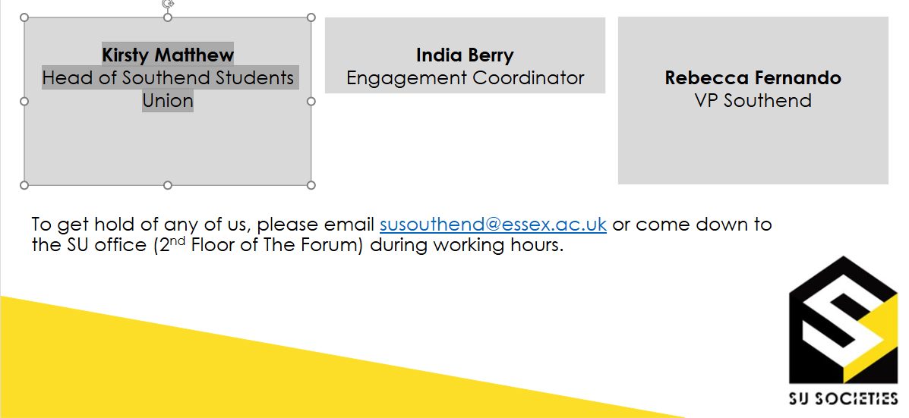
The Team

Slide 3
What Are Your Roles?
Treasurer
You have primary responsibility for all your society or club finances, alongside the President.
You are responsible for paying in money received through events and fundraising
For approving expenses (except your own expenses)
You must attend meetings called by the Southend team, together with any training which the role requires.
You are responsible for making sure the society doesn't go into a negative balance.
Picture?
Notes:
Laura

Slide 4
Your ‘Account’
Everything should go through your official society account.
When you start receiving your weekly finance reports, it’ll look a bit like you have your own bank account.
However, societies do not actually have their own bank account – just a sub section within the SU’s account.
Societies are strictly prohibited to open external bank account – all income and expenditure must pass through the SU bank account. This policy ensures that society funds are used appropriately to meet the needs of the members. If a society does this, there will be consequences and you could potentially face closure.
Each society will be assigned their own unique 3 digit finance code. E.g. Italian society is ITA to identify your account.
Picture?
Notes:
Laura

Slide 5
Weekly Finance Reports
These reports are sent to the listed President and Treasurer only.
If you aren’t receiving these updates, check we have the right details for your society.
They are automatically sent out end of every week via email.
It’s the responsibility of the treasurer to check these weekly reports and flag any issues – email suexpenses@essex.ac.uk if you notice any concerns. Please note that income and expenses will likely not show in your reports until the following month (by 15th).
Any member of your society has the right to view the finance report. They can request to view the weekly finance report by submitting a request in writing (email) to susouthend@essex.ac.uk
.
Picture?
Notes:
Laura

Slide 6
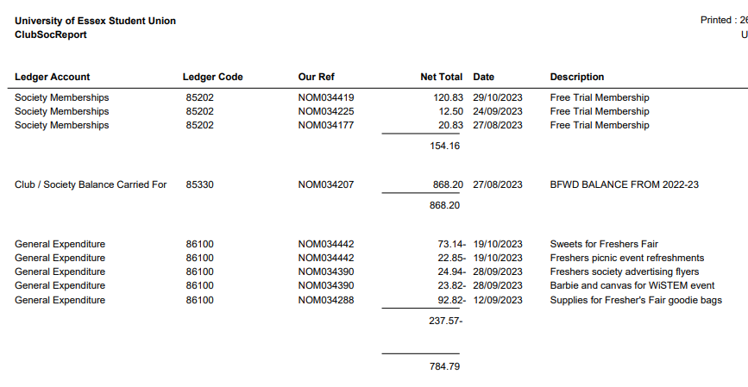
Understanding Your Account
Picture?
Total amount in the account available
Income/fundraising is all positive
Expenditure/spending is all negative
susocs@essex.ac.uk
Notes:
Laura

Slide 7
What’s in Your Account?
Membership Funds – When people buy a membership for your society, the money (after VAT has been deducted) will display in your weekly finance report.
Other Funds – Any other funds will usually come from the following:
if you’ve paid money in that you’ve raised at an event
money from ticket sales through the website (ticket/website sales aren’t processed till the end of that month. Therefore, ticket income won’t show till a month after).
Both will have VAT deducted before going into your account.
External organisations can also make donations or sponsorships to your society, but please speak to the Societies team before arranging this.
Picture?
Notes:
Emma - These reports are a great way to track how much ticket income you have made, but we know sometimes you need to know this sooner. Ticket and membership income gets processed at the ened of every month so will have a delay before shwoing up on your report. You can track your ticket sales through the website – on admin tools, so you will know roughly what to expect. it will show up what membership income you have, what ticket income, any donations that have been made or expenses that have been paid.

Slide 8
Value Added Tax (VAT)
Societies will pay VAT at a rate of 20% on any income they receive (unless it is a donation), so make sure you factor this into spending and decision making with your money.
You can claim back any VAT you pay when you buy goods or pay for travel but only if you ask for a VAT receipt when you pay. This must show the VAT registration number and a breakdown of the VAT.
Please note that not all companies are VAT registered
Notes:
Emma

Slide 9
Value Added Tax (VAT)
How to calculate VAT:
It is very important to allow for VAT when calculating your income versus costs, or you may make a loss.
*To calculate the VAT, just divide by 1.2 *
For example, if you charge £15 for an event.
£15 divided by 1.2 is £12.50, so this is the amount that would go into your society fund as income from a ticket.
You can also multiply by 1.2 to calculate how much money you need to make before VAT to cover your costs.
Remember to add 20% onto your costs to cover VAT
Notes:
Emma

Slide 10
Spending money
30
Ways to pay/purchase:
Ask for an invoice where possible – most companies will invoice if you email and ask them
Speak to the societies team if it is a large expense and an invoice isn’t possible – potential to pay via a department card in certain circumstances.
Individual members pay for the products and claim back expenses afterwards (if they can afford to do so)
Before any purchase, check with the Treasurer/President that there are sufficient funds to make the purchase and they agree to what is being purchased.
All purchases should benefit the society as a whole and not a particular individual.
susocs@essex.ac.uk
Notes:
Emma

Slide 11
Invoices
Invoices are the easiest way for us to make payments directly from your society fund and means you do not have to make large payments from your own personal bank account and wait to be refunded.
Most companies will provide invoices, although some may seem reluctant. Just email or call to explain you are a society and ask to pay via invoice.
Examples of when to use an invoice:
Coach transport to a trip (the SU have an account with Roman Coaches, so please ask us for a quote in first instance).
Entry fees for a competition
Accommodation costs
Equipment purchase
Payment for an instructor, performer or host
Picture?
Notes:
Emma
We can always help support you to contact the company and see if they raise invoice

Slide 12
Invoices
Please ask the Societies team for advice before agreeing to any invoices you are unsure of.
The Societies team has the right to reject any invoice or expense claim (e.g. you cannot claim back the cost of alcohol).
Please check with us before you purchase, if you are unsure whether you will be refunded, or have sufficient funds.
Picture?
Notes:
Emma

Slide 13
Invoices
Email to sussouthend@essex.ac.uk
It should be the society’s Treasurer who deals with invoices and emails them.
Must be addressed as follows:
​
University of Essex Students Union (insert your society)​
Wivenhoe Park ​
Colchester ​
Essex ​
CO4 3SQ
Failure to address correctly, will result in a delay of payment, whilst we wait for a corrected invoice to be sent over.
Picture?
Notes:
Emma we ask to be cc's in because otherwise we cannot be sure if you have approved this invoice payment with a supplier. By going via the treasurer, you can make sure that you are happy with what has been laid out in the invoice and that the details are correct to what you agreed.

Slide 14
Invoices
Invoices need to clearly state:
•The bank details of who the money will be sent to
•The date upon which they provided a service (if applicable)
•A good description of what the service was/product list.
•Need to be addressed to “The University of Essex Student’s Union” – Cannot be paid otherwise.
If an invoice includes any incorrect details, we have to wait for the supplier to amend the details before processing, which slows down the approval process.
Please make sure to look over these slides again when getting an invoice from someone, so that everything is done as smoothly as possible.
Picture?
susocs@essex.ac.uk
Notes:
Emma – the supplier or company providing an invoice will probably be practiced in doing invoices and it will be up to them to create this document. However, here is a guide of what should be included.

Slide 15
Invoice deadlines
Invoice should be emailed to suinvoices@essex.ac.uk and susocs@essex.ac.uk in order for this to be processed.
Our payment terms for invoices is 30 days, in exceptional circumstances these can be processed quicker, please note our payment runs are Wednesday only. Many suppliers will require payment upfront, so leave yourselves enough time for invoices to be processed.
Wednesdays – Only authorised Invoices are processed for payment on this day (there is one payment day per week only)
Invoices are classed as authorised once the Treasurer & Societies team signs them off, not once you have submitted it.
Fridays – Recipient will receive their payment in their account.
Picture?
susocs@essex.ac.uk
Notes:
Emma

Slide 16
Invoice reminders
Allow lots of time to receive an invoice and ensure it is paid before the deadline.
If you have a strict deadline to meet e.g. for an event, make the Societies team aware and ensure you have followed the timeline for approval.
Please also be mindful of sending invoices and expense claims over periods where there may not be staff in, for example between Christmas and new year. Payments will not be made during this period.
Picture?
Notes:
Emma

Slide 17
Claiming expenses
•For small amounts, individual members might pay for items upfront, then claim back expenses so long as the expense benefits the whole society.
•For larger amounts, we encourage you to ask the company for an invoice or we can purchase items on your behalf in some circumstances with a department charge card.
•It is a treasurers responsibility, using the weekly reports, to keep an eye on the society finances and make sure there is enough funds to cover upcoming expenses.
All invoices need to be address to the Students Union and sent to suinvoices@essex.ac.uk
Picture?
Notes:
Emma – e.g if you buy lunch while having a committee planning meeting, this does not benefit or is not open to the whole society to benefit from so it should not be claimed back.

Slide 18
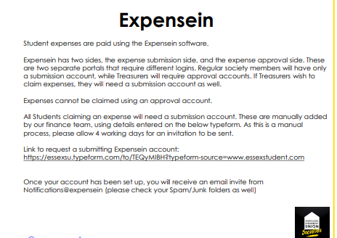

Slide 19
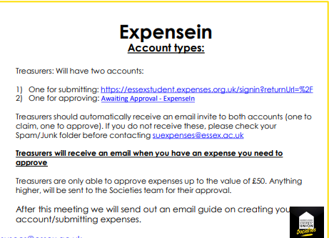

Slide 20
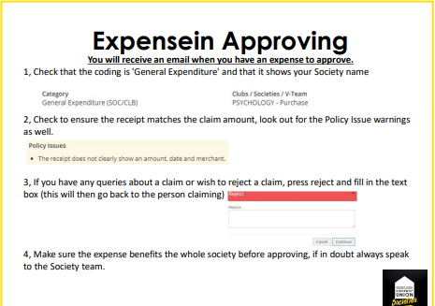

Slide 21
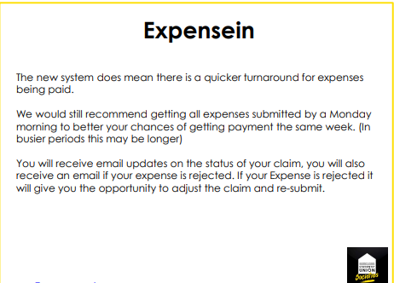

Slide 22
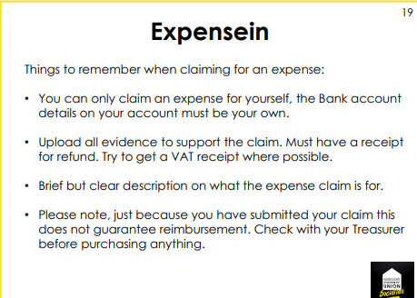

Slide 23
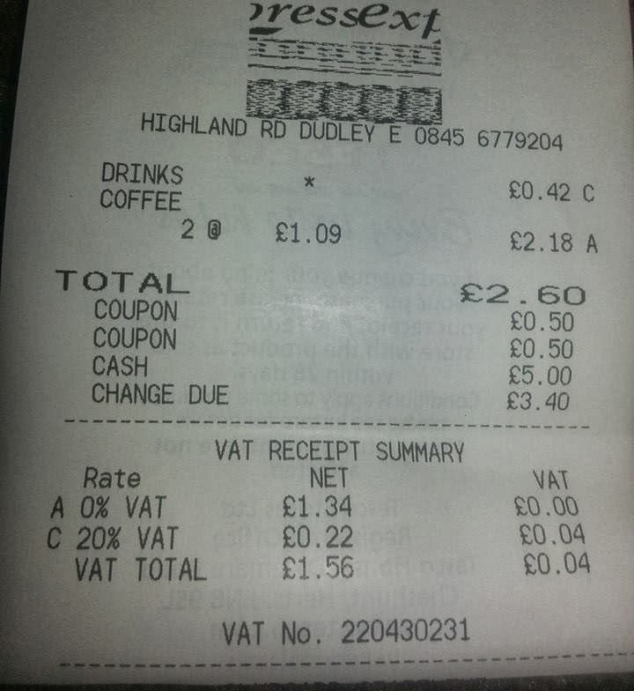
VAT receipt
Always ask for a VAT receipt, not everywhere will be VAT registered, but ask.
The receipt needs to show the
VAT registration number and a
breakdown of VAT.
The items with a * will identify the items that are VATable. No starred items, mean that nothing is VATable.
Notes:
Elena/Emma

Slide 24
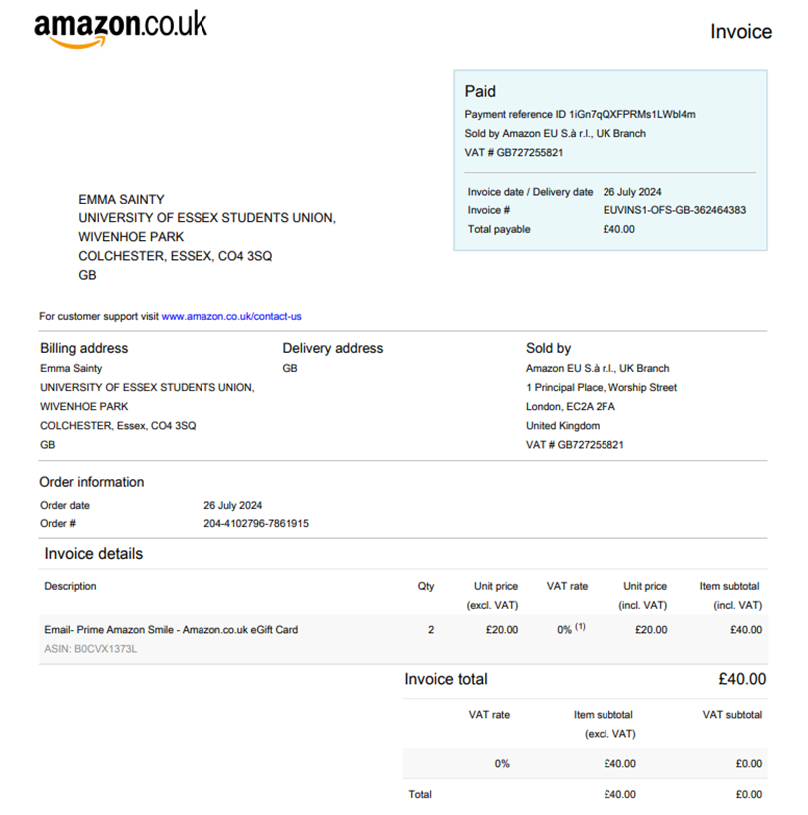
VAT receipt (Amazon)
susocs@essex.ac.uk
Notes:
Elena/Emma

Slide 25
RAG (Raise and Give)
The SU is a registered charity, and so cannot make direct payments to other charities in the ‘normal’ way
The RAG account is another branch of the SU’s bank account.
If you are fundraising for an external charity, your money must go into the RAG account and not your own society fund.
Whether you are fundraising online, through a card machine, or taking cash, you have to complete the RAG form before your event. RAG-Form-Template-with-amendments.xlsx (live.com)
You will fill in which society has carried out the fundraising, which charity the money should be paid to and then the address & bank details of that charity.
Note that if you wish to donate to an international charity, there may be additional fees to transfer the donation.
Notes:
Laura

Slide 26
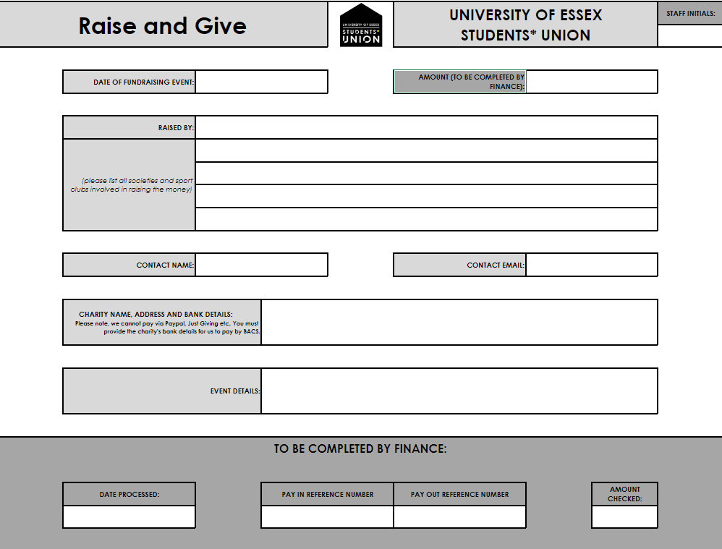
RAG (Raise and Give)
Notes:
Laura

Slide 27
Online tickets
If you have added an event to the What's On page, the Societies team can add tickets to this event.
You can email the Societies team or complete this form to request tickets. Society Ticket Request Current (typeform.com)
Ensure you tell us what types of tickets you want (e.g. member only, non-member, non-student). Also tell us prices and quantities for each ticket type and the date by which they need to come off sale.
Any ticket income will go directly into your society account and is usually processed at the end of each month (unless you are fundraising for an external charity).
Don't forget that 20% VAT will be taken off ticket income.
Notes:
Laura

Slide 28
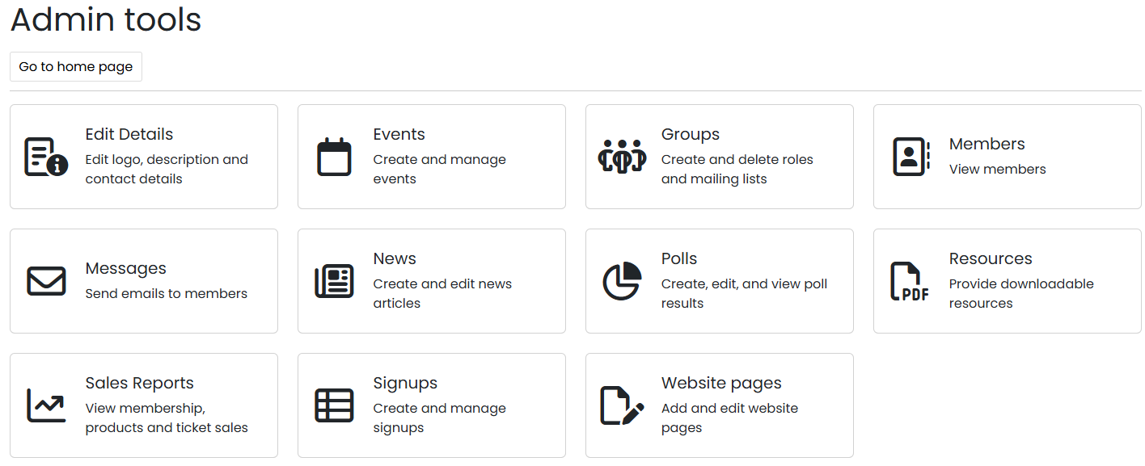


Online tickets
These tickets can be purchased through the What's On page or at SU Reception.
You can run reports yourselves to see how many tickets have sold and who has purchased them: events admin --> your event --> reports --> ticket holders.
If you wish to add tickets to fundraise for an external charity, you must make this clear when you request your tickets. You must also send us a completed RAG form before your event takes place. We cannot add your tickets until we have received the RAG form.
Notes:
Laura

Slide 29
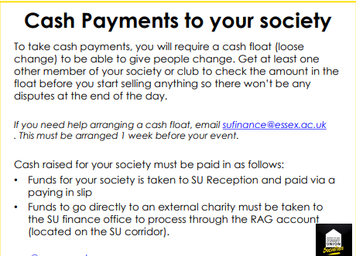

Slide 30
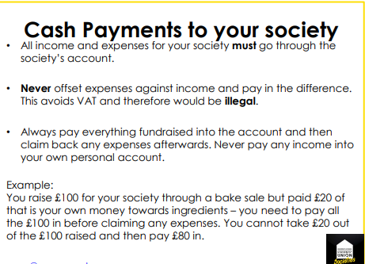

Slide 31
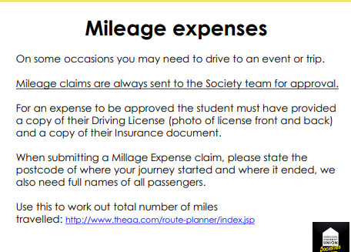

Slide 32
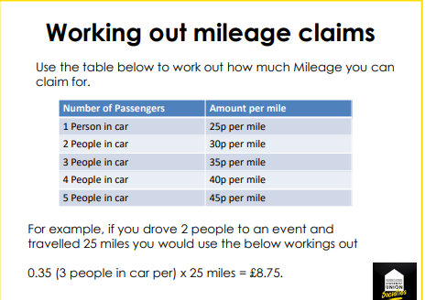

Slide 33
Sponsorship
Societies are allowed to seek sponsorships from external organisations, so long as:
The sponsor’s aims do not conflict with Students’ Union policy.
The agreement is approved by the Student Activities team and signed by the Finance Director of the Students’ Union.
Society representatives are not permitted to enter into any form of contract on behalf of their society, without approval.
Remember – not all contracts are formal, signed documents. many are established by a conversation, text or social media message, or email – so never agree to anything before consulting with us.
Notes:
Emma

Slide 34
Sponsorship
We encourage you to seek sponsorships from wherever possible, just as long as you never enter an official agreement with anyone before speaking with us.
When approaching us to discuss the potential agreement, you need to email us with the following details:
- The name of the organisation you want to enter an agreement with.
- The organisation’s address.
- What the organisation wants to give you.
- What you will give the organisation in return.
- When the agreement will start and end.
For example:
The Hockey club have received a sponsorship offer from:
El Guaca Mexican Grill
118 High St, Colchester, Essex, CO1 1SZ.
El Guaca Mexican Grill would like to sponsor us £100 to make 3 Instagram posts (1 per week for 3 weeks) about their restaurant. We would like to start the agreement now and the agreement will end once the final Instagram post has been made.
Notes:
Emma

Slide 35
Click Funding
Click Funding is another way you can fundraise money for your society: https://click.hubbub.net/
Click is the University of Essex crowdfunding platform. Crowdfunding is funding a project or venture by raising lots of small amounts of money from a large number of people.
Click will match donations up to £250 – so if you raise £250, you will get £500 – this can change each year though however so make sure to check this before you start.
You have to set a minimum amount to be raised and if this is not raised, you will get no money and people who pledged won’t have the money taken from their bank accounts.
The money is only available to use AFTER the projected has reached its completion date so make sure your Click project finishes a good time before your event takes place or before you need to purchase something.
Book an individual appointment by emailing click@essex.ac.uk to ask any questions. Click crowdfunding | University of Essex
Notes:
Emma

Slide 36
Donations
An individual or organisation, may just wish to offer a donation to your society. All they need to do it make the payment into the SU’s bank account (details on next slide).
When paying into the SU’s account, please make sure the person/organisation uses a reference that includes: Society/Society finance code (E.g. TVL for Travel society), the First Name Initial and Surname, state that it is a donation.
Example: TVL/T.Smith/donation
Email suexpenses@essex.ac.uk and susouthend@essex.ac.uk to state who has donated, what organisation they’re from, how much they have donated, and that it is a ‘charitable donation’. By stating that it is a charitable donation, the money will not be subject to VAT and the person/organisation donating is acknowledging that they do not want anything in return.
Notes:
Laura

Slide 37
Donations
The SU’s bank details are:
LLoyds
Sort Code: 30-92-16
Account Number: 00379913
Remember to include the following reference: (insert society finance code)/ (insert initial.surname)/Donation
Notes:
Laura

Slide 38
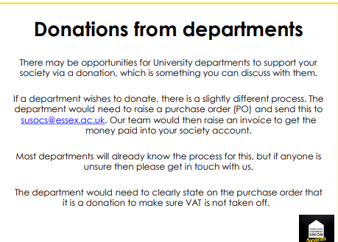

Slide 39
Final Tips/Reminders
Stay on top of the finances. Find out what people are claiming money for and why.
Read your weekly finance reports. Ask questions if you think something’s wrong – there’s no such thing as a silly question.
Make sure your members are aware of the financial processes for your society. Including the timeline for expenses to be approved and paid into their accounts.
Pay via invoice where possible. There is one payment run made per week for invoices (Wednesday mornings) and payment should reach accounts by the Friday if all has been processed correctly.
International payments may take longer, and have additional charges added to them. These charges are not put on by the SU. Avoid where possible.
Fill out expense forms correctly with descriptions of what expense is for and attach all receipts.
No receipt, no refund.
Picture?
Notes:
Emma

Slide 40
Final Tips/Reminders
Regularly check your inbox for any expense claims to sign – Anything under £50 it is down to treasurers to approve. Approve as quick as possible.
Expenses over £50 will be sent to the societies team for approval
Be proactive. If your club/society needs something and you don’t have the money, fundraise.
Do not keep money that has been fundraised in cash in a ‘safe’ place. It’s probably not safe, pay it in to the SU Reception as soon as possible.
Do not open any other bank accounts relating to the society or in the society name. It’s illegal.
If your committee does not complete it’s obligations, payments will be withheld and society activity may be suspended.
Picture?
Notes:
Emma

Slide 41
Q&A
We now have time for some questions.
If your question is very specific to your society, please email us or come see us in The Communities Hub (Located in sq 4 inside reception).
These slides will be sent out after the meeting
Picture?
Notes:
All

