Slide 1

Society Risk Assessment Training 2024-25

Slide 2
Why you’re here...
Empowering you to make your events safe
To give you valuable professional skills
To comply with the law
Notes:
This is a great skill to learn as likely you will need an understanding of risk assessments in a future career

Slide 3
What is a Risk Assessment?
Risk assessments are a legal document required under Health and Safety law.
It is a document that evaluates the potential risks that may be involved in an activity
Thinking about what might harm people
Identifying any necessary steps to take to keep people safe

Slide 4
Why do I need to complete a Risk Assessment?
A core risk assessment is a requirement for each society to have in order to proceed with room bookings and your activity.
Societies are required to complete, understand and adhere to your risk assessment to ensure your student group is covered on our insurance policy.
This process shows that your society have put controls in place to ensure the safety of your members and participants and anyone else around your event and that you have taken reasonable steps to make your activity safe for all involved.

Slide 5
DEFINITIONS
Hazard
Anything with the potential to cause harm
Risk
The likelihood of that hazard causing harm
Notes:
Hazard examples include: Electrical equipment, overcrowding, food poisoning

Slide 6
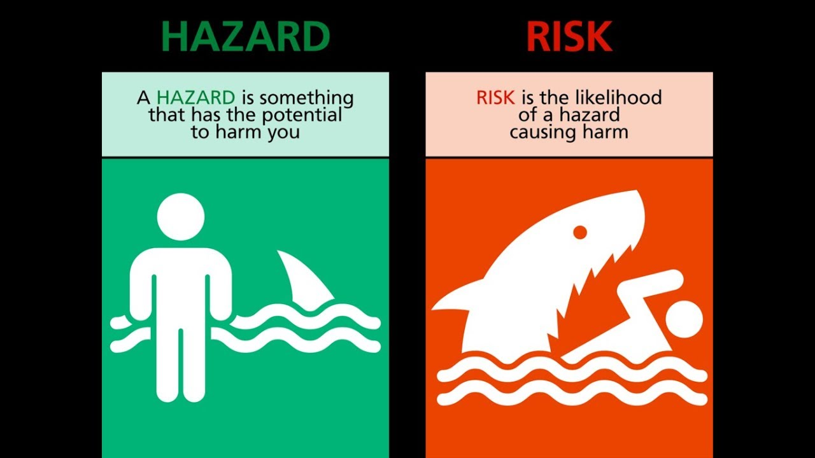
Notes:
Here is an example of how to understand the difference.
Photo 1) The shark has been identified as a hazard and has the potential to cause harm.
Photo 2) The risk changes based on circumstances and how likely something is to happen
In this situation the likelihood of the hazard causing harm to an individual is high once the individual enters the water. Whereas the risk would be low if they are out the water.

Slide 7
Why do we carry out Risk Assessments?
To identify what risks there are
To determine how the risks arise and the impact on those affected.
To aid decisions on how to manage the risk.
To ensure that action taken is proportionate to the risk.

Slide 8
What is a core Risk Assessment?
Assesses the risks of your regular activity as a society
You only need to complete this once for the year (unless your activity significantly changes)
This saves you having to complete numerous documents throughout the year
Compulsory for each society to complete
submit your society core risk assessment to susouthend@essex.ac.uk you will need to do this in order to book
Rooms with the university.
Notes:
This year we are asking each society to complete one main risk assessment that covers all their regular activity to reduce the amount of admin that needs to be done. If each society has a strong risk assessment as a foundation, then moving forward the new exec each year can review and update.
You would need to identify all risks that are involved in your usual activity and that looks very different depending on what your society is running. Some of you may simply need to identify the risks of hosting workshops in a teaching room, whilst others who may already know they wish to have bake sales for fundraisers will need to include all the catering and food risks. Each risk assessment will be bespoke to your activity, please use your constitution to help remind you of what you plan to do over the year.
We are asking for one core assessment for the year. Deadline is 3rd September where possible as this aligns with room bookings opening and if you want to get your bookings approved early, we need your risk assessment first.

Slide 9
5 Steps to complete a Risk Assessment
1. Identify the Hazard.
2. Decide who might be harmed and how.
3. Evaluate the risks.
4. Record your findings and implement
any control measures.
5. Review and update when necessary.

Slide 10
Identify the hazards
Common examples include:
Manual handling (lifting/moving equipment)
Electronic equipment
Wires (trip hazards)
Crowds
Food poisoning
Food allergy
Excessive alcohol consumption
Slips, trips and falls
Equipment (e.g. broken tables or chairs)
Dancing or sports activities
Aggressive behaviour
Offensive or sensitive content
Face paint
Henna
Travel
Safeguarding concerns
Fire
Notes:
This is a list of some common hazards that you might need to consider as part of your regular activity Use these examples to help think about potential risks.
T

Slide 11
2) Decide who might be harmed and how
Consider where your event is taking place e.g. is this a closed space or public setting?
Consider when your event is taking place e.g. if lunchtime on squares there will be lots more people around
Review who might be affected by each hazard you have listed.
An activity may impact only members/participants, or it could affect a wider audience and members of the public.
For example, a craft activity may only impact the participants that attend the session, whereas a bake sale on squares could impact students, staff or members of the public.
Notes:
Think about who might come into contact with the hazard, might not just be those attending the event. Is your event open to just members, or other students as well.

Slide 12
3) Evaluate the risks
Identify whether each hazard is a low, medium or high risk based on the likelihood and severity of any given risk.
Risk =
Likelihood
How likely is it that the hazard might
cause harm?
x
Severity
How severe are the implications is the hazard does occur?

Slide 13
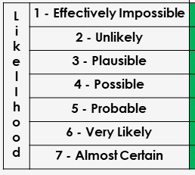
Evaluating the Risk - Likelihood
Likelihood - How likely is it that the hazard might cause harm?
Use the scoring matrix below to decide on a score for likelihood (1-7):
When evaluating the risk, it's important to remember this is the likelihood of the hazard causing harm without any control measures.
Notes:
Use your own judgement to decide how likely the hazard could cause harm. There isn't a right or wrong answer, use common sense to evaluate.
When evaluating the risk, it's important to remember this is the likelihood of the hazard causing harm without any control measures.
e.g. Tripping over an electrical cable is very likely if no control measures are put in place, so would give that a score of 6. Once you have put control measures in place e.g. cable cover which secures the cable and makes it visibly identifiable, this likelihood would reduce to a

Slide 14
Likelihood example
Hazard: Trailing cable
Likelihood score pre-control measure: 6
Control measure: place a cable cover over the cable to secure it and make this visible to participants with hazard tape.
New likelihood score post control measure: 2
By putting control measures in place, the hazard is still there, but the likelihood of it causing harm has been reduced.
Notes:
Use your own judgement to decide how likely the hazard could cause harm. There isn't a right or wrong answer, use common sense to evaluate.
When evaluating the risk, it's important to remember this is the likelihood of the hazard causing harm without any control measures.
e.g. Tripping over an electrical cable is very likely if no control measures are put in place, so would give that a score of 6. Once you have put control measures in place e.g. cable cover which secures the cable and makes it visibly identifiable, this likelihood would reduce to a

Slide 15
Evaluating the Risk - Severity
Severity - How severe are the implications if the hazard does occur?
Use the scoring matrix below to decide on a score for severity (1-7):
Notes:
Again use your collective judgement to think about if the hazard happened, how serious could the outcome be?
e.g. Hazard of fire would be 7 without any control measures

Slide 16
Severity Example
Hazard: Fire
Severity score pre-control measure: 7
Control measures: Fire exits will be clearly marked, fire detection system regularly checked, fire extinguishers in the venues.
Severity score post-control measure: 7
Most often the control measures will reduce the likelihood of the hazard causing harm, but the severity won't change.
In this example, despite all measures, if there is a fire and someone got trapped the outcome/severity of the incident would still be the same, but the chance of them getting trapped has been reduced.
Notes:
Again use your collective judgement to think about if the hazard happened, how serious could the outcome be?
There are some examples where severity decreases, for example where the hazard has been isolated or eliminated, but often the harm will be the same, but measures reduce the chance of this happening.

Slide 17
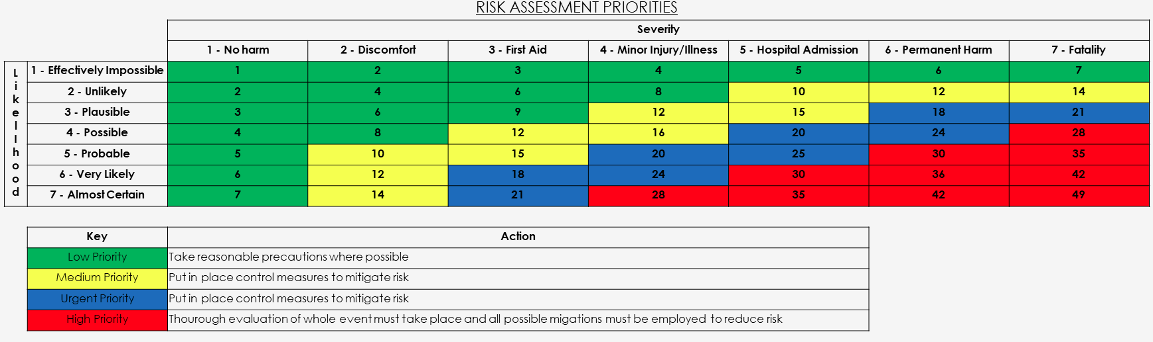
Evaluating the Risk
The colour signifies the action required
Use this matrix grid to work out the overall risk of that hazard.
Risk = Likelihood x Severity
Example: likelihood of 4 and severity of 3 = a risk score of 12 (3 x 4 = 12)
Notes:
Once you have decided on the likelihood and severity of a hazard, you can use this matrix grid to establish the overall risk.
Each score will give you a number which is color coded to show the priority to take action

Slide 18
3) Evaluate the risks
Risk is part of everyday life and you won't be able to eliminate all hazards, but the aim is to reduce them where possible.
Identify any significant risks using the scoring matrix (those scoring red or blue need urgent attention) and review control measures to reduce those risks.
Notes:
Examples on next slide

Slide 19
4) Record and implement control measures
Record the steps you will take to reduce the risk of hazards to the lowest level possible.
Consider the following:
Can the hazard be removed?
Can the hazard be isolated?
Are participants experience/trained?
Emergency procedures in place e.g. knowing the contact details for security to call them for first aid emergencies
Notes:
Isolated – think back to the shark example. You can't remove the shark, but you can put warning signs in place to alert people there may be sharks

Slide 20
Recording the Assessment
The record should show the significant findings of the assessment and should lead you to taking action to correct the situation.
The significant findings of the assessment that need to be recorded are:
The control measures that are in place
Further action that is needed
Proof that a suitable and sufficient assessment has been made

Slide 21
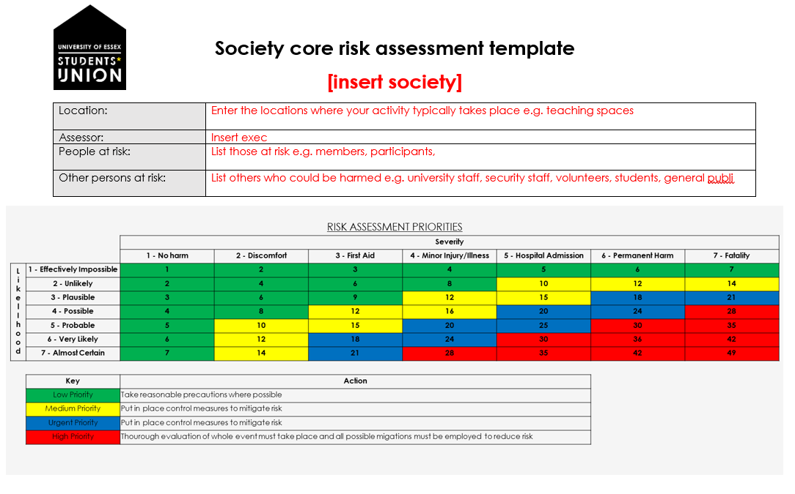
How to fill out a risk assessment
For location, you can just enter teaching rooms on campus, rather than specific rooms
Notes:
This is what the template will look like for you to complete. This will be sent to you all tomorrow with these slides for you to make a start
All the parts in red are what you need to fill out. For location, you won't know exact room locations, so just say teaching rooms on campus.

Slide 22
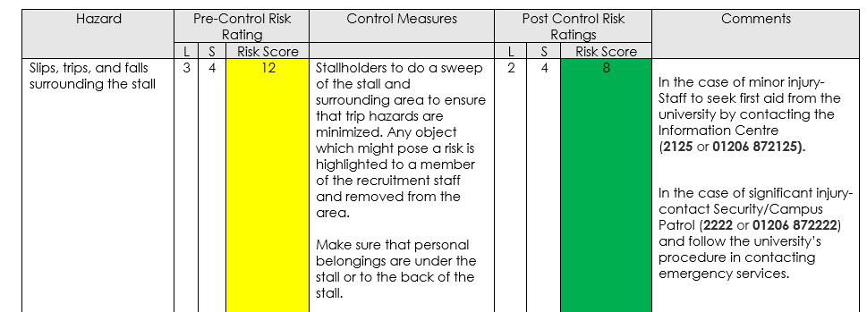
Pre-control measures we have evaluated that slips, trips and falls for this event would be a risk score of 12.
After putting control measures in place, re-evaluate the likelihood score and severity.
Now the risk score has been reduced to 8 as the likelihood of tripping has now been reduced by making sure personal belongings are out the way.

Slide 23
Risk scores
After control measures are in place, the risk score should reduce. The aim is to always have a lower risk score post control measures.
However, just because the risk score has changed, it does not mean that the risk category (colour of risk) has changed. That's okay and the colour won't always change.
Example, the risk score could drop from a 16 (yellow) to 12 (yellow), but the most important thing is the risk has reduced.
Risk scores should not be red post control measures

Slide 24
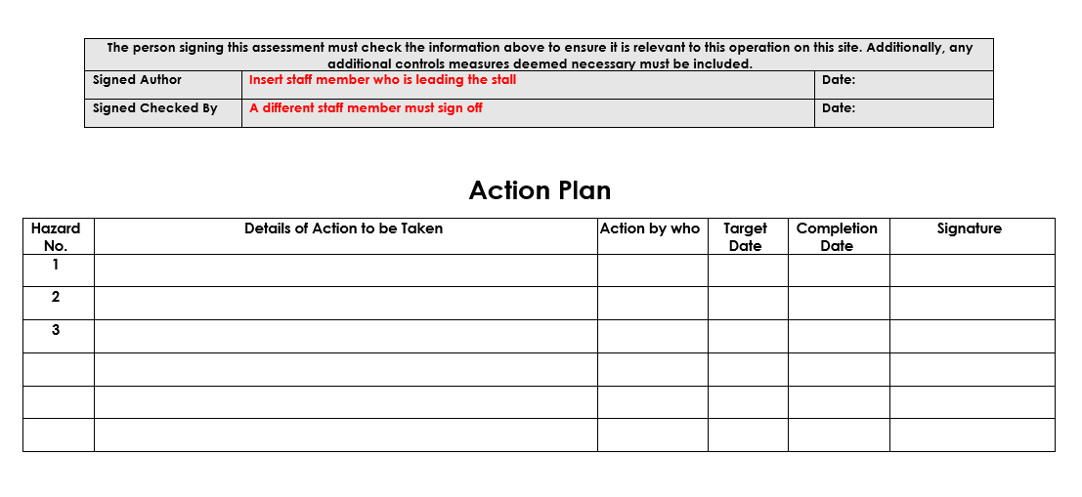
How to fill out a risk assessment
At the end of the document, two different execs need to sign off the risk assessment
Action plan is optional to allocate out tasks. For example, Vice President to ensure all electrical equipment has been PAT tested before the start of term.
Notes:
Action plan is useful to make sure your control measures are in place

Slide 25
What is an additional Risk Assessment?
This is for anything that isn't covered in your core risk assessment and regular activity.
An additional risk assessment is necessary to cover any one off events you organise, and is specific to the space you wish to hold this.
Notes:
Examples on next slide

Slide 26
Examples of additional Risk Assessments
Depending on your regular activity, but additional risk assessments may be required for the following:
Travel (any one off trips your society wishes to organise)
Henna or face paint
Any events held in the Ivor Crewe (specific to the space)
Events on squares that aren't stall bookings, such as musical performances, protests or vigils
Bake sales (if this is something your society does not usually plan as part of their activity)

Slide 27

Manual Handling Training
Notes:
Manual handling is a hazard and improper lifting technique can cause harm. I would like you all to watch this video to get a better understanding of manual handling

Slide 28
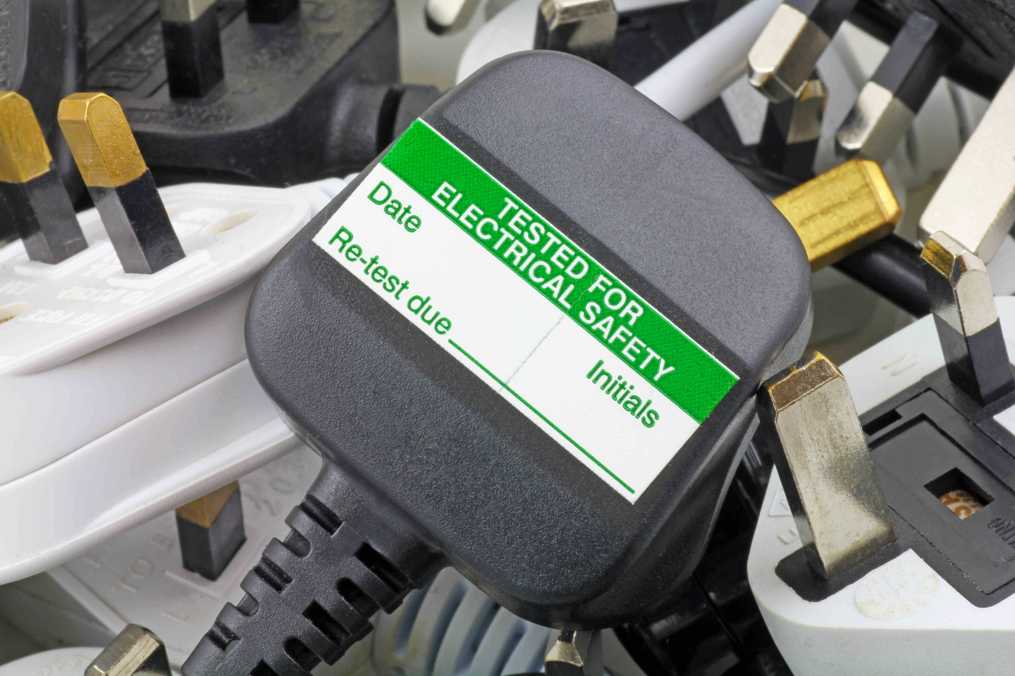
Electrical items
PAT (portable appliance testing) is the examination of portable electrical equipment to ensure they are safe to use.
Portable electrical devices (anything with a plug and lead) must be tested every year.
The only exception is brand new equipment, which doesn't need to be tested until it's 12months old (from purchase).
If you society owns any electrical items, please get in touch and we can arrange a time for one of our PAT testers at the SU to inspect and test the equipment before you need to use this. Items must have an up to date PAT sticker to be used.
Notes:
Faulty electrical equipment is a hazard and to ensure the risk is reduced we PAT test.

Slide 29
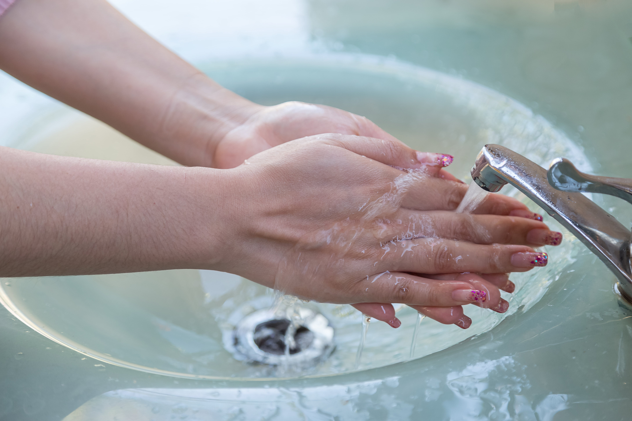
Food hygiene certification
If you wish to have homemade food at your event, you will need to have at least a Level 2 Food Hygiene Certificate and provide a copy of this to us before you hold your event.
Each society can sign an exec member up to the short course for FREE. Follow this link to register your interest in completing this course. https://essexsu.typeform.com/to/GudabCmg Once completed, we will send you an access code to complete the course.
All homemade and shop bought food items must be labelled with their ingredients, any possible allergens and if they are vegetarian, vegan or gluten free items (Natasha's Law.)
Notes:
If your society is ever likely to have bake sales or have home made food, please ensure you get someone on the food hygiene course. It will take a couple of hours to complete and you can keep re-doing the quiz until you reach the pass rate. We are funding each society to have 1 x certificate, but if you wish to have more this will need to be funded out of your society account and would cost approx. £7.50 for the additional courses.
Regardless of whether you wish to serve shop brought food or homemade, you should all include food hygiene risks in your core risk assessment. As even with serving shop brought food, you will need to put in a control measure that states that packaging will be available to view if anyone asks and the main allergens should be clearly displayed at all times.

Slide 30
Next steps
Create a core risk assessment that covers all your society's regular activity for the year
We advise the Vice President and Welfare Officer (or whoever else has attended this training) to take a lead on this document.
We will send you all the blank risk assessment with a list of example hazards and control measures to help you out.
2) Once complete, send to susouthend@essex.ac.uk for review/approval
Notes:
We are happy to book out meetings with any of you who need support with their risk assessment, or submit what you have worked on so far and we can review and give guidance. Remember each risk assessment is bespoke to your society and each of you will have different risks depending on your level of activity.

Slide 31
Q&A
We now have time for some questions.
If your question is very specific to your society, please email us or come see us.
These slides will be sent out after the meeting via email to all exec

Slide 32
Thank you!

