Slide 1

SOCIETIES WELFARE TRAINING 2025/26

Slide 2

The Team
Kirsty Matthew​
Head of Southend Students Union​
​
​
​
India Berry​
Engagement Coordinator
​
Rebecca Fernando​
VP Southend​
​
To get hold of any of us, please email susouthend@essex.ac.uk or come down to the SU office (2nd Floor of The Forum) during working hours.

Slide 3
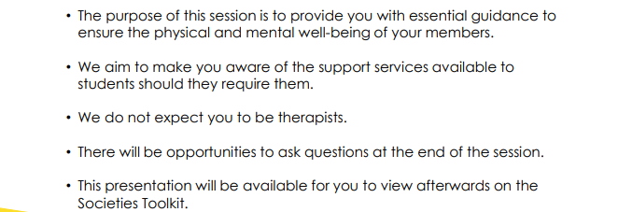
Training aims

Slide 4
If you have been affected by anything discussed during this event, the following support is available: ​
​
The Student Wellbeing and Inclusivity Service (SWIS) ​
Wellbeing@essex.ac.uk | 01206 873133 ​
​
SU Advice ​
SUacsou@essex.ac.uk | 01702 328235 ​
​
If out of hours service is required:​
​
Student Wellbeing Support Line: A 24/7 phone line for students, provided by Health Assured. The number is 0800 028 3766.​
​
SHOUT: A free, confidential text service available 24/7. Text "SHOUT" to 85258.​
​
Student Space/Student Minds: Online support resources offering advice and information on a range of topics.​
www.studentspace.org.uk​

Slide 5
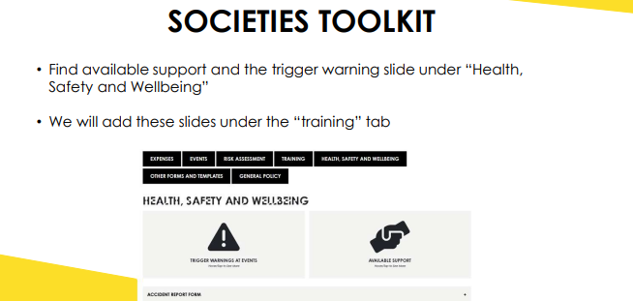

Slide 6
WHAT IS A WELFARE OFFICER?
  A CORE COMMITTEE POSITION FOR ALL SOCIETIES
The Welfare Officer is responsible for the safety and welfare of the society. They
  provide guidance, support and signposting to their society members,
  responding to welfare queries and conflicts, within agreed boundaries.
  Responsibilities include, but are not limited to:
  Attending welfare training
  Signposting members to the correct services
  Ensuring that the society’s activities are welcoming, accessible and inclusive for members
  Acting as the point of contact for any conflicts within the society

Slide 7
Zero tolerance policy
The Students' Union has a zero-tolerance policy including sexual harassment meaning that the Students' Union will take action. Please familiarise yourself with the document below.
Zero-tolerance-policy-V2.pdf
Staff and students are expected to be treated and to treat each other with dignity and respect regardless of:
Gender expression, identity, affirmation or reassignment
Race, ethnic origin or national origin
Age
Socio-economic background
Disability
Religious beliefs or affiliations, or absence of religious beliefs or affiliations
Political beliefs or affiliations
Family circumstances, including maternity and paternity
Marital or civil partnership status
Pregnancy and maternity
Sexual orientation
Sex

Slide 8
RISK ASSESSMENTS
  Essential to ensuring the safety of your members. No risk assessment = no activity.
  Take a copy of your risk assessment to your come & try/trial sessions, as well as sending it to all members to ensure they have read it.
  If you are performing away from your usual location (e.g. on Squares) you must complete an additional risk assessment for this activity. Be sure to consider additional risk such as members of the public, buildings etc.
  Additional events will also require a risk assessment submitted to staff with sufficient notice, which for large events should be a minimum of 4 weeks before.

Slide 9

RISK ASSESSMENTS – support
  Lots of helpful information about how to complete a risk assessment, and some blank risk assessments can be found on the Sports Toolkit.
  If you ever need help email susouthend@essex.ac.uk

Slide 10
Knowing your members!
  Due to GDPR (General Data Protection Regulation) regulations, we are no longer permitted to collect certain personal information from members after they have purchased a membership (such as allergies, medications, emergency contacts, etc.).
  We strongly encourage Welfare Officers and Presidents to request that members voluntarily disclose any relevant medical conditions, allergies, or medications—especially those that may be impacted by physical activities or events.

Slide 11

FIRST AID TRAINING
Make sure there is no immediate danger to yourself or the casualty.
Ensure the casualty is comfortable and safe, but do not attempt to move them.
You can access first aid advice from ST John Ambulance (sja.org.uk)

Slide 12
ON-CAMPUS EMERGENCIES
  If you feel you are in immediate danger and are on-campus, you should contact Campus security
  Do not call '999' directly - security will liaise with emergency services
  Contact Campus security 01702 328208

Slide 13
OFF-CAMPUS EMERGENCIES
In life-threatening emergencies off-campus, you should contact 999
If you're not sure whether to call 999, you can help from NHS 111first
999 won't always mean an ambulance is sent – they may suggest that you make your own way to A&E, or be seen elsewhere
You can read more about when to call 999 on the NHS website

Slide 14

MENTAL HEALTH SUPPORT
If you are worried about someone’s mental health, you can apply MHFA England’s 5 step action plan – ALGEE Mental Health Awareness training opportunities may become available – you will be notified when we are running these sessions if you want to book on.

Slide 15
MENTAL HEALTH SUPPORT – EMERGENCY CONTACTS
If someone is at urgent risk of harm to themselves or others the following services can be contacted
• 01702 328208 – Campus Security staff (always ring this if you are on campus as they will be able to organise Emergency service support)
• 999 – Ask for Mental Health crisis support (Police or Ambulance)
• 111 – then select option 2 – NHS Urgent Mental Health Helpline

Slide 16
MENTAL HEALTH SUPPORT –
OUT OF HOURS
You can refer students to the following support services outside of usual business hours
• 24 Hour Student Support Wellbeing Support line – 0800 028 3766
• Samaritans – call 116 123
• Papyrus (Prevention of Young Suicide) HOPELINE – call 0800 068 4141
• SHOUT text support – text SHOUT to 85258
• Togetherall – digital peer support platform • Wisdom App – includes live chat and video call options

Slide 17
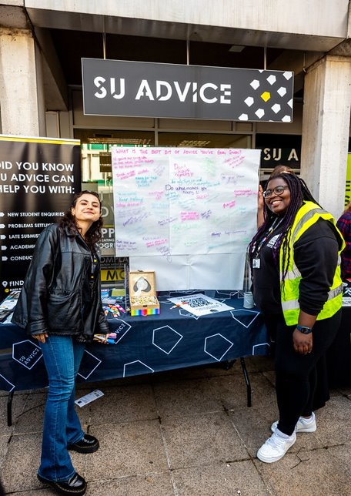
SU advice
SU Advice is a free, confidential, and impartial service available to all students.
They offer guidance and support on a wide range of issues that may impact a student’s welfare, such as academic stress, housing concerns, health and well-being, and cases of bullying or harassment.
While they are not trained counselors, they provide a supportive listening ear and can refer students to the appropriate campus or local services.
If you're concerned about a society member’s well-being and are unsure of the best course of action, SU Advice is available to discuss your concerns with you.

Slide 18
Contact SU advice
Contact suacsou@essex.ac.uk with the email subject “Concerns from a Society Welfare Exec” and we will be in contact as soon as possible to arrange for an adviser to speak with you
You can now book an appointment by visiting the SU Advice page on the Essex Student website https://www.essexstudent.com/southend/advice/

Slide 19

MIND
Mind is a mental health charity in England and Wales that offers information and advice to people with mental health problems and lobbies government and local authorities on their behalf.
They have an Infoline, which offers callers confidential help for the price of a local call – 01206 764600 for the Mid and North East Essex line.
They also have a Legal Line, which provides information on mental health related law to the public, service users, family members/carers, mental health professionals and mental health advocates – 0300 466 6463.
Home - Mind

Slide 20

SAMARTIANS
Samaritans is a registered charity aimed at providing emotional support to anyone in emotional distress, struggling to cope, or at risk of suicide throughout the United Kingdom and Ireland, often through their telephone helpline – 116 123.
Volunteers give up their time 24/7 to listen, be open minded and be non-judgmental to people going through a tough time.
They are not required to give advice to anyone, so this can be really valuable for anyone struggling who simply just wants to talk to someone impartial.
Website: Samaritans | Every life lost to suicide is a tragedy | Here to listen
Email: jo@samaritans.org
Phone: 116 123

Slide 21

CARA (Centre for Action on Rape and Abuse)
CARA (Centre for Action on Rape and Abuse) works with victims and survivors of sexual violence and child sexual abuse.
CARA provide independent, specialist support and promotes and represents the rights and needs of victims and survivors.
They work with adult women and men, young people (aged 13-19) and children aged 12 and under from across the UK and north Essex, they have a head office in Colchester.
Website: Centre for Action on Rape and Abuse in Essex - CARA (caraessex.org.uk)
Phone: 01206 367881
Email: info@caraessex.org.uk
Online Self-Referral Form: VisiaCloud

Slide 22

OPEN ROAD
The University and SU work in partnership with Open Road a specialist support services for Drugs and Alcohol issues.
Ellie Bland is a dedicated support worker who offers 1 to 1 appointments in person or online to students at the Colchester Campus.
Ellie offers:
• a confidential service
• personalised support
• ways to look after yourself
• referrals to other support if needed
To book an appointment, email Ellie Bland: ellie.bland@openroad.org.uk

Slide 23
Conflicts within the society
• If any conflicts or disagreements arise between society members and/or exec members, we encourage internal mediation as a first resort
• Advice for mediation:
• Lead with compassion – check in to see how people are doing, signpost to additional support if needed
• Be respectful and open-minded to people’s situations when discussing concerns
• Avoid accusatory language or placing blame – focus on active listening and problem-solving
• If there are concerns about how someone is performing in their exec role, discuss expectations and mutually work out a plan to improve
• If internal mediation is ineffective, those with the conflict can go to the VP Welfare, VP Student Experience and/or the Societies team to try and resolve the issue or escalate if needed

Slide 24
COMPLAINTS PROCEDURE
If you have been made aware of any internal issues or complaints within your society that you feel cannot be addressed by the committee, please email susouthend@essex.ac.uk and we will deal with the issue in confidence.
Please ensure that your members know they can also contact us/ the VP welfare or the VP experience directly if they would like to make a complaint or report an issue.
If you wish to complain about the behaviour of another student that may be in breach of the University’s Code of Student Conduct you can either:
• Report a concern through Report & Support
• Complete a Student Conduct Incident Report
SU Advice (suadvice@essex.ac.uk) can help with either of these options
Complaints about the SU can also be raised through the SU Complaints ProcedureSee
something, say something!

Slide 25
LOOK OUT FOR YOUR MEMBERS
Ensure everyone feels welcome and included in your club. Make a big effort at the start of the year to integrate new members and include them in training/activities and events.
Identify changes in the behaviour of your members. If you notice your members are acting differently or becoming withdrawn, check-in with them. Ask them if they are ok and offer them support.
Encourage your members to use free, confidential support services.
Share your knowledge of the University and local area! Particularly helpful to new students. Show them SU Advice, Student Support, good study spaces, where the launderette is and how to use it, nice places to eat/drink, things to see.

Slide 26
LOOK OUT FOR YOUR MEMBERS
International students – They may still be learning the language or feeling homesick. Sport activity can be a huge comfort for them.
Under 18’s – Some students at the University under 18 years old. Be considerate that they are very young and away from home. Remember legally they may not be able to do things everyone else can! University safeguarding practice applies to under 18’s.
All departments at the University have Designated Safeguarding Officers (DSO’s) as part of University Safeguarding measures. This includes the Students’ Union. If you are ever concerned about one of your members, you can also contact th DSO'S: Sian Lovesy, Chris Moore.

Slide 27
SOCIAL MEDIA AND GROUP CHAT MODERATION
All group chats and Social Media are created and moderated my members of the committee and should abide by the following:
  Respect for All
  We treat each other with repect at all times
  Confidentiality
  Any personal information shared within the group, such as phone numbers, must remain private and not be shared with anyone outside the group.
  Unacceptable behaviour
  The following actions are not tolerated and may result in removal from the group:
    Making fun or embarrassing each other
    Using offensive, insulting, or abusive language
    Disrespecting other members (including the execs)
    Engaging in bullying, either individually or as a group, including:
      Verbal: name calling, spreading rumours, teasing, or sarcasm
      Emotional: ridiculing, humiliating, or excluding others.
      Sexual: unwanted physical contact or verbal sexual abuse
      Digital: sending unwelcome texts, calls, or online messages.
  No advertising or spamming
  The group chat is a space for community and support, not for promotion. Advertising external events, businesses, or services,
  as well as excessive promotion, is strictly prohibited.

Slide 28
Socials
Socials are one of the best parts of being part of a Society, so make sure everyone feels welcome and enjoys themselves.
Ensure socials are conducted in a positive, safe and equal environment.
Avoid any controversial and/or possibly offensive games, language and activities.
Ensure that nobody feels forced or pressured into an activity, and that everybody should have the ability to say no to anything, without any consequence.

Slide 29
SOCIALS CONTINUED
• There have been cases of students who have been subjected to initiations or hazing leaving University, being arrested/given a criminal record, and in some tragic cases, losing their lives.
• The majority of students that arrive at Essex will be 18 years old (or some even younger), just out of full-time education and living away from home for the first time. They may be impressionable and want to show off to senior members of a Society. It is therefore vital that you as senior and committee members are respectful, responsible and welcoming to all.
• Please don’t feel the need to conform to ‘tradition’ and hold initiations for new members. It doesn’t matter if you think an initiation has always happened in your society and you think it’s normal, it isn’t.

Slide 30
THE LAW (SEXAL OFFENCES ACT)
It is important that you understand the Sexual Offences Act to ensure that all club activities fall within safe settings to prevent any risk to members.
Understanding Coercion and Controlling Behavior
Coercive Behavior: This involves a persistent pattern of actions or threats aimed at assaulting, intimidating, humiliating, or otherwise abusing someone. These behaviors are designed to harm, punish, or instill fear in the victim.
Controlling Behavior: This includes a series of actions intended to make someone dependent or submissive. It often involves isolating the person from support systems, exploiting them for personal gain, stripping them of independence, and regulating their daily activities to maintain control.
If you witness any of these behaviors, please report them immediately. If you are experiencing them, support services are available to help you.

Slide 31
Additional Support
‘Ask for Angela’ - Anyone who is feeling unsafe, vulnerable or threatened can discreetly seek help by approaching staff in venues and asking them for ‘Angela’. This code-phrase will indicate to staff that they require help. This might be through reuniting them with a friend, seeing them to a taxi, or calling campus security.
University anonymous reporting system – You can report things to the University using the anonymous reporting system. All information is treated in the strictest confidence. https://reportandsupport.essex.ac.uk/

Slide 32
ANY QUESTIONS?
• We now have an opportunity for any questions should you have any.

Slide 33
SCENARIO
You are at a society event, and you notice a member is acting differently. They are usually friendly and confident and make an effort to socialise. During the event, they appear quiet, withdrawn and not like their usual self. What would you do?

Slide 34
SUGGESTED APPROACH
• Initiate a conversation – think about a quiet location without interruptions if possible
•Ask how they are – you can say you have noticed they don’t seem to be quite themselves and state any specific behaviours you have observed
• Listen with empathy and without judgement
• Respect that they may not want to talk or disclose – don’t push but reassure you are their if they want to chat
• Make some suggestions for other support services and maybe give some info for them to take away – SWIS, SU Advice, 24 Hour Support line etc
• If you are still concerned, consider ‘Report a concern about a student’ form

Slide 35
SCENARIO
A society member reports to you as Welfare Exec that they have concerns about another members behaviour – they say they have a friend who’s told them they have been harassed/victimised by the other society member. The society member asks you to ban them from the society.
What would you do?

Slide 36
SUGGESTED APPROACH
• Make them aware that banning a member may not be possible without going through the appropriate process
• Encourage the student (and their friend) to speak to someone about what they have experienced (SWIS, SU Advice etc)
• Encourage the student (and their friend) to report behaviour that might be a breach of student conduct (Report & Support or Student Conduct Incident form). The Exec member could also lodge an anonymous report and support if they have enough information to do so but this is unlikely to result in any investigatory action being taken
• Speak to SU Socs team/VP Welfare – might not be able to ban but can any adjustments be put in place to minimise potentially difficult situations
• Try to avoid rumours or gossip about the situation and warn the society member who is speaking to you that they should try to avoid this too

