Slide 1
Communications, social media and website training
24/25
Please can all individuals put their name, club and committee position in the chat before we start.

Slide 2
Introduction – who are we?
Hannah Mortier
Sports Coordinator
blades@essex.ac.uk
Ellie Shackell
Digital Marketing Manager
sumarketing@essex.ac.uk

Slide 3
Session format and aims
Take notes (please!).​
Ask any questions in the chat, otherwise there will be the opportunity to ask at the end.​
This session is being recorded so please turn your camera off if you do not wish to be in the video. ​
You will be required to complete a Moodle test at the end of this presentation to mark your training as completed.​
This presentation and recording will be available for you to view afterwards on the Sports Toolkit.​
Aim: To ensure that you are equipped with all of the knowledge/resources to effectively communicate with members, run social media channels and ensure your webpage is up to date and relevant.

Slide 4
Building your brand
Establishing a font – the SU team use ‘Century Gothic’ across all platforms as part of our brand identity.
Using the same font everywhere keeps your image clean and identifiable.
Logo – How old is your club logo? Does it look clean? Does it need updating?
Colours – Ensure you are using the same colour schemes for social media, otherwise it can start to look disjointed.
We encourage all clubs to use the Essex Blades and Students’ Union Brand as much as possible.

Slide 5
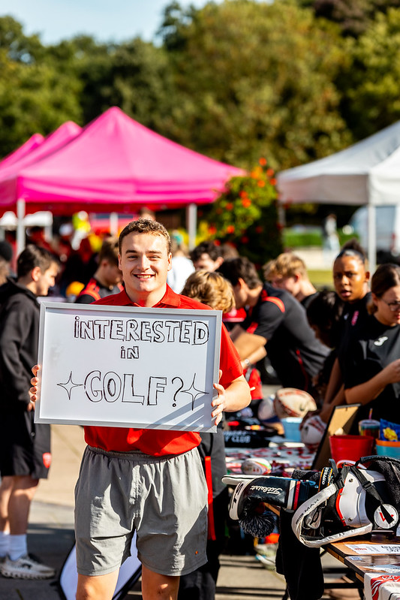
Running your social media
Make sure your profiles are up to date, exciting and engaging.
Link your socials to each other – Linktree.
Send out your social media links to members via the message function on essexstudent.com.
Consider the timing of your social media posts – think about when people will be checking social media, 2 am probably isn’t your best bet!
Keep colour schemes consistent across all platforms.
Use hashtags to reach a wider audience especially on TikTok!
Stick to what you can manage, it is better to have one active account rather than three inactive ones, think about what will be feasible for you and your committee members hat are running the pages.
Keep up to date with social media trends.

Slide 6
What are your roles?
Social Media Officer - Club promotion through social media, ensure that you are engaging with members on social media and creating engaging content, sharing any necessary messages through social media.
Publicity/Communications Officer – Ensure all relevant messages and conveyed to members and you are in consistent communication with members.
Social Secretaries – Event planning and organisation along with events officers, promoting upcoming events through liaising with other members of the committee or through social media channels. Ensure that members are informed of various events. Also ensuring member engagement at events.

Slide 7
Websites to assist you
Canva is great for creating content for social media. It can also be used to make posters and design anything needed for your club.
Cap Cut is free to use and is good for video editing (Reels and TikTok's).

Slide 8
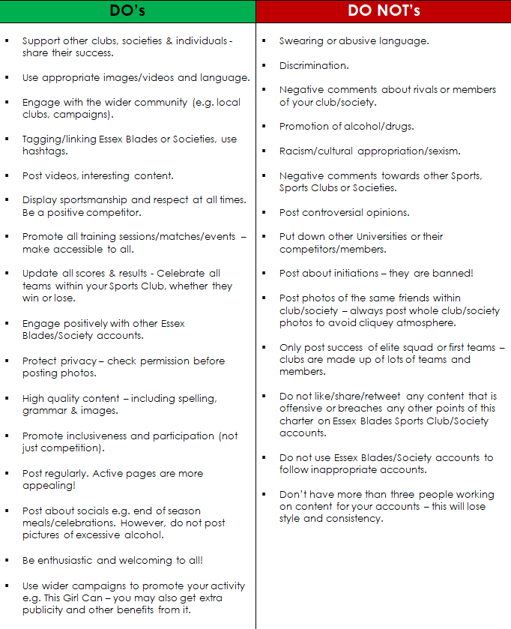
Social Media charter
To be signed by all Presidents at the start of the academic year.
A guide of Do’s and Do Not’s for Sports Clubs to follow.
We don’t consistently monitor your club pages but will step in to ask for something to be removed if necessary.
Remember - you represent the club, SU and University at all times.

Slide 9
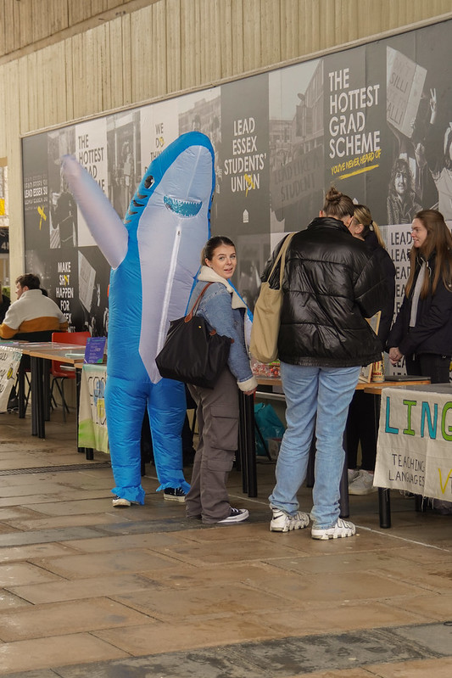
In person
Stall in Squares – Liaise with the SU Reception (su@essex.ac.uk) and you can book a table (free) to promote your club on Square 3.
Attending SU/University events– Keep an eye out for any events that require stall holders or demonstrations.
Open Days – Potentially up to £150 donation from the University if you run a stall and activity on a University open day, Keep an eye out for Typeform interest forms.
Freshers Fair – Friday 4th October 2024 – PLEASE COMPLETE STALL HOLDER AGREEMENT FORM AND RETURN TO dsking@essex.ac.uk asap.

Slide 10
Message Centre
On the essexstudent.com page under your relevant sports club there is a message centre in which you can send an email to all of your current members. We recommend that you utilise this function too as sometimes not all of your members will be in the group chats you have.
Steps to send an email to all members
1 – Go to your club and select the pencil icon in the top right corner
2 – Select admin tools
3 – Select messages
4 – Choose send email
5 – Add your recipients, and compose your email.
6 – Send your email to members!

Slide 11
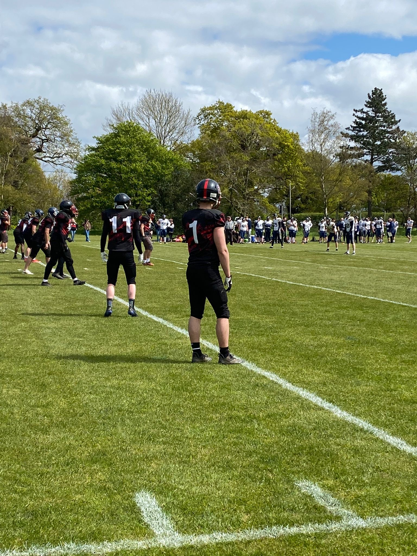
Photos
Try to use up to date and recent photos.
You should ensure that any individuals that are in the photos are happy for these to be posted on social media.
You obtain the photographers permission before using or sharing their photos online.

Slide 12
Passwords
You should ensure that passwords are updated regularly and stored securely.
These should be included within your handover to the next committee
Feel free to share passwords with us to avoid locked accounts.

Slide 13
Marketing support

Slide 14
Su marketing
SU Marketing manage:
Website
Social media – all essexsu accounts plus some sub-accounts
Tag @essexsu in instagram stories and we will reshare
Email – weekly all student email
Digital screens – stairs between square 3 & 4
Poster sites
To be featured on any of these areas, please send your request into susocs/blades at least a month before the event
SU Marketing will provide support dependent on relevancy and capacity

Slide 15
Get featured
Tag @essexsu in instagram stories and we will reshare
To be more heavily featured on essexsu weekly email and socials, please send your request into susocs/blades at least a month before the event
SU Marketing will provide support dependent on relevancy and capacity

Slide 16
WEBSITE

Slide 17
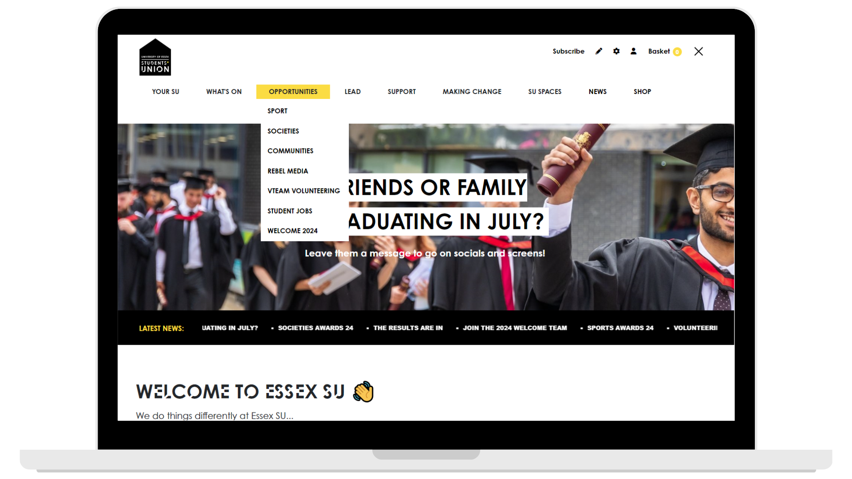
New website launched February 2024​
The main hub page Sport/Societies lives under the Opportunities tab
Exec members have access to:​
Edit details on your group's page​
Add events to your group's page​
Add events to the What's On page​

Slide 18
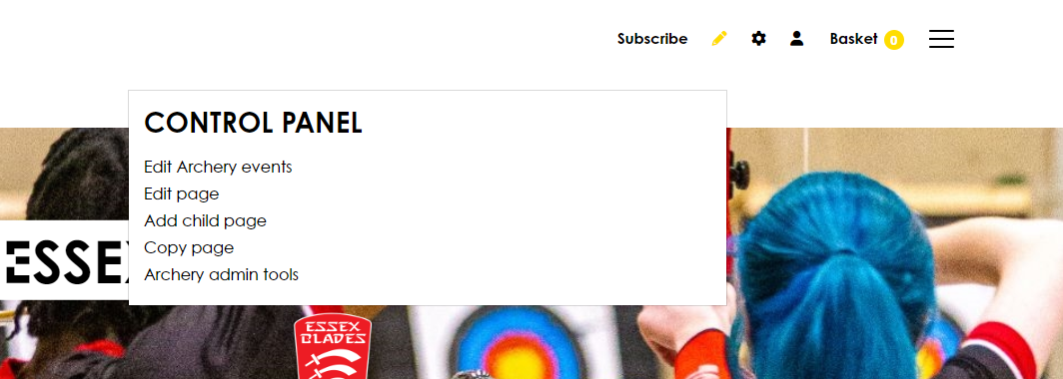
Webpage editing
All committee members should have admin rights to edit your club's webpage
If you do not have these admin rights, please email us – this is a manual process so please be patient.

Slide 19
HOW TO EDIT YOUR WEBPAGE

Slide 20
HOW TO EDIT YOUR WEBPAGE

Slide 21
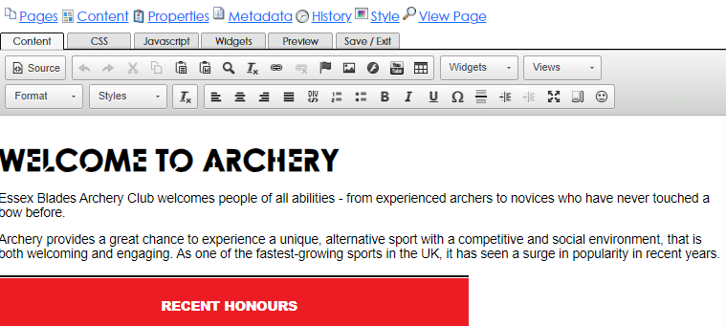
HOW TO EDIT YOUR WEBPAGE

Slide 22
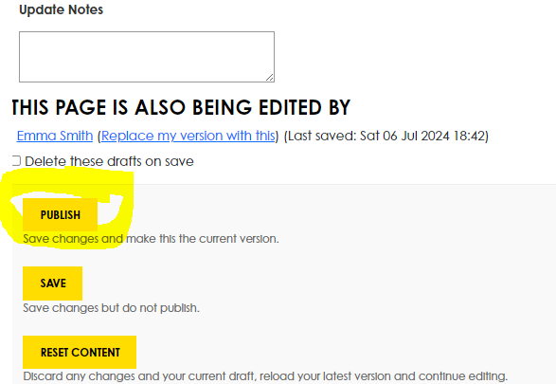
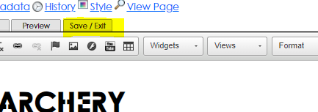
HOW TO EDIT YOUR WEBPAGE
Always make sure you that select save and exit and publish too, or your work will not be saved.

Slide 23
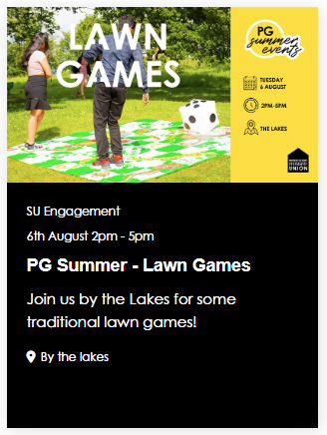
Event listings
You need to add the following information:
Name
Dates
Short description
Location
Always tick sport - ignore all other options
Image
Event description
For tickets, please email susocs/blades

Slide 24
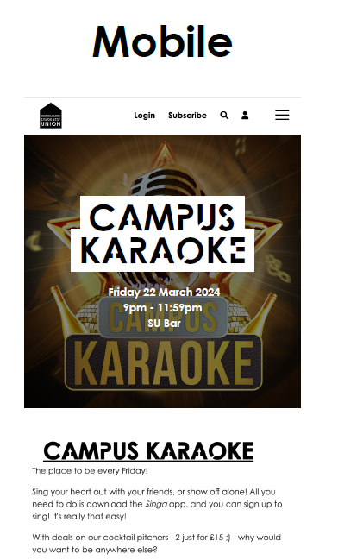
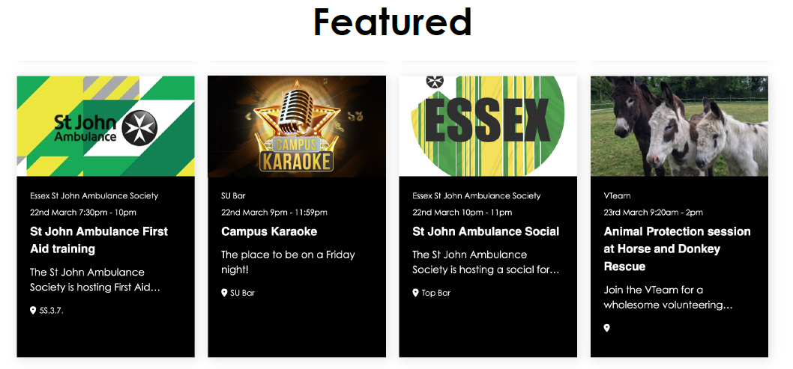
Event images
2000px wide x 500px tall
Best practice is to make sure the most important part of your image is centered
Event information doesn't need to be in the image as it is displayed underneath the image on all views

Slide 25
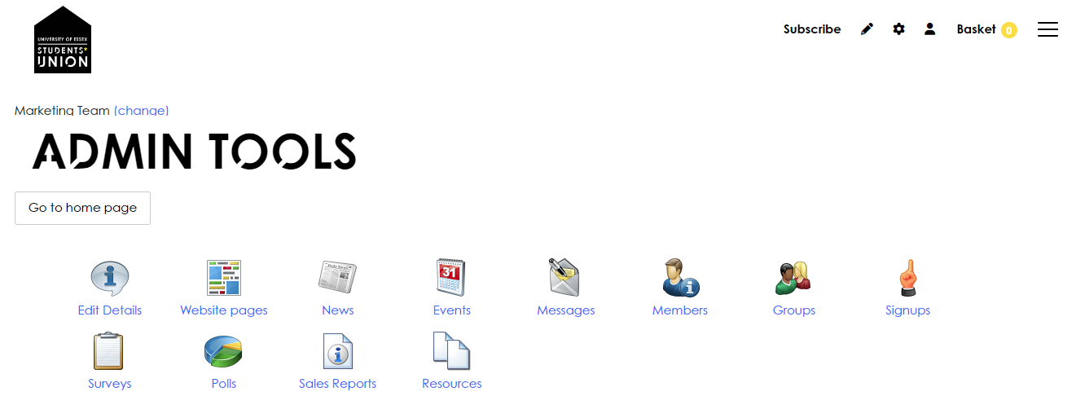
how to add events

Slide 26
how to add events

Slide 27
how to add events

Slide 28
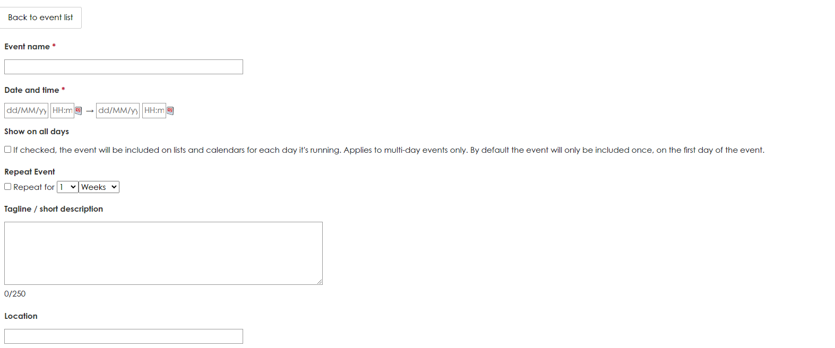
how to add events

Slide 29
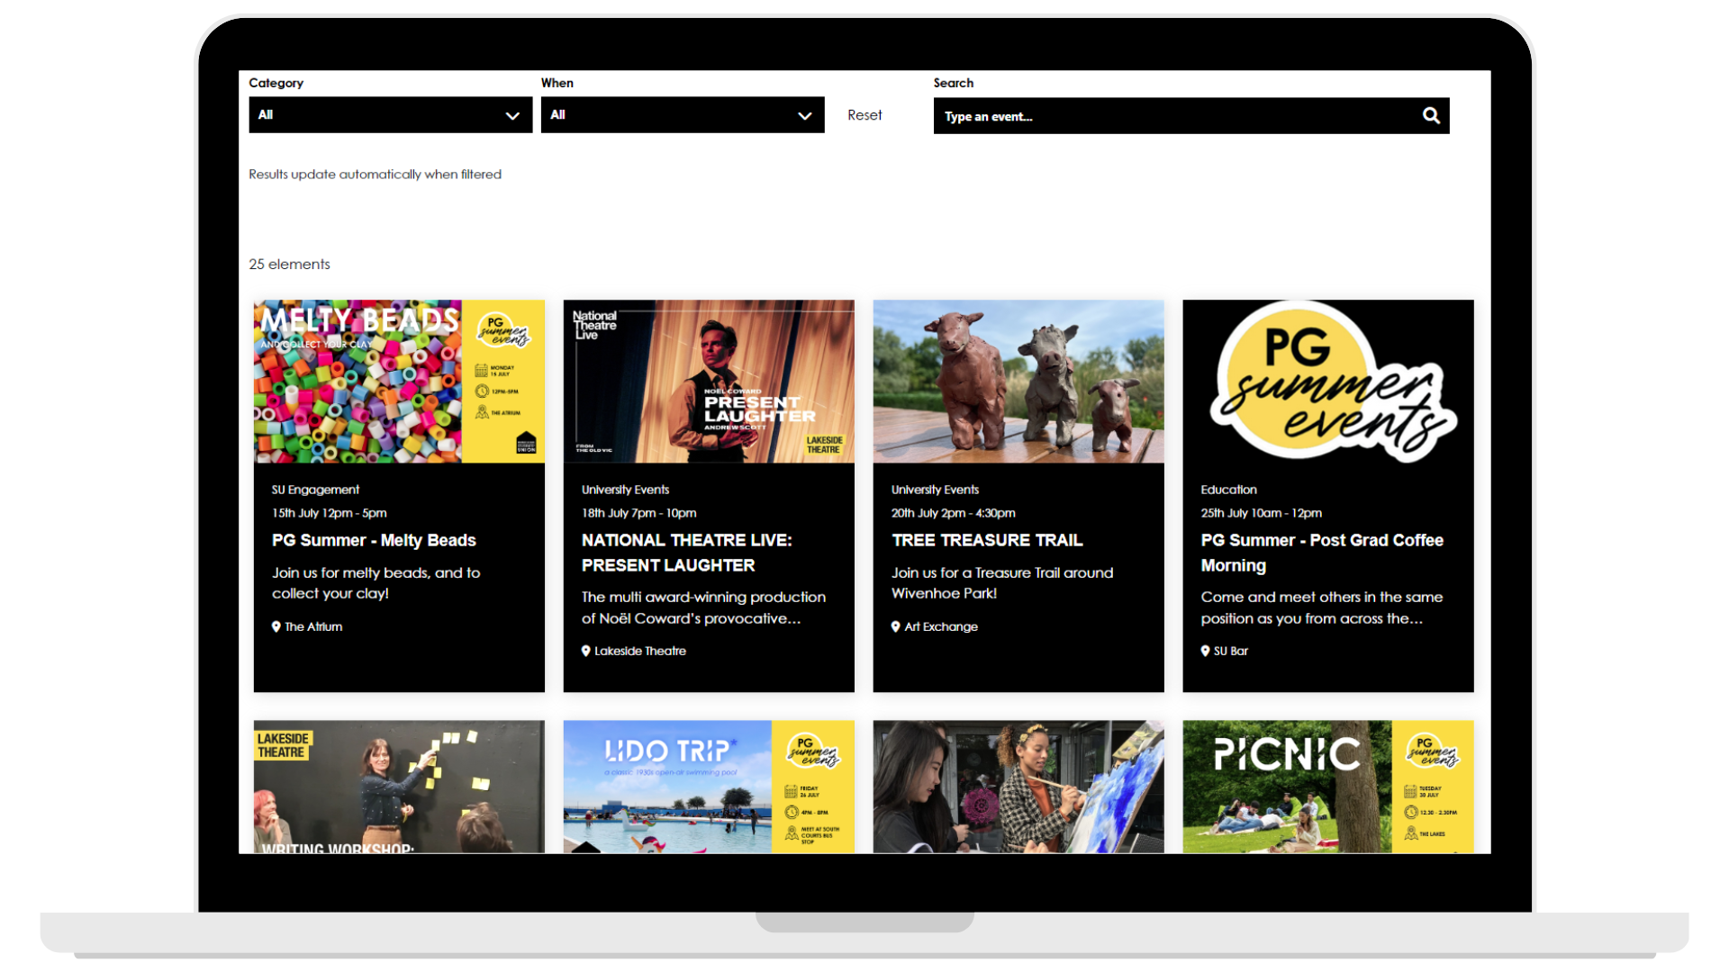
WHY ADD TO THE WEBSITE?
What's On page is always in top 5 viewed pages
Best platform for getting seen by the most students
Staff browse this page to find events to help promote

Slide 30
Thank you for listening!
Please use this time to ask any questions should you have them*
*Don’t leave yet we still have a Moodle test for you to complete!

Slide 31
Moodle test
Link for test in chat.
12 questions (9/12 pass mark).
Any accessing issue please let us know.
Once you have access to the quiz please leave the call.

