Slide 1
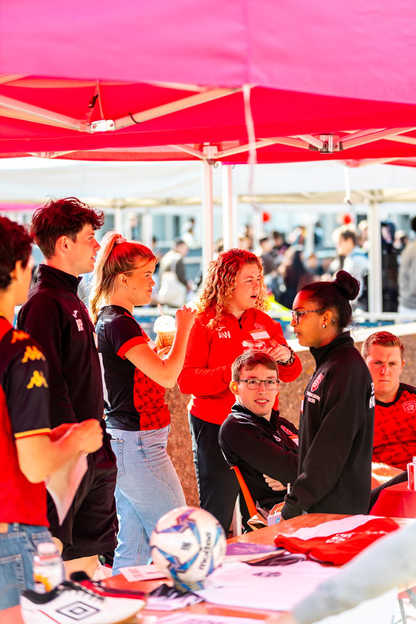
CORE OFFICER TRAINING 24/25
Sports Clubs' core officer training 24/25
Please take a minute to type your name, club, and exec role in the chat box. This helps us to track attendance.

Slide 2
SESSION FORMAT
Take notes (please!)
Ask any questions in the chat, otherwise there will be the opportunity to ask at the end.
This session is being recorded so please turn your camera off if you do not wish to be in the video.
You will be required to complete a Moodle test at the end of this presentation to mark your training as completed.
This presentation and recording will be available for you to view afterwards on the Sports Toolkit we will also email you recording/slides and link to the Moodle quiz.
CORE OFFICER TRAINING 24/25

Slide 3
THE BLADES TEAM
DOMINIC KING
HEAD OF STUDENT SPORT
SU SPORTS ASSISTANTS
DHYANA STORY
KATIE GIESS
ABBY FUNG
IAN LAU
VP STUDENT EXPERIENCE
HANNAH MORTIER
SPORTS COORDINATOR
To get in touch with us :
Email blades@essex.ac.uk
WhatsApp 07935 134538 (this is the blades phone)
or pop by the Sports Office (room 5.02) during working hours
CORE OFFICER TRAINING 24/25

Slide 4
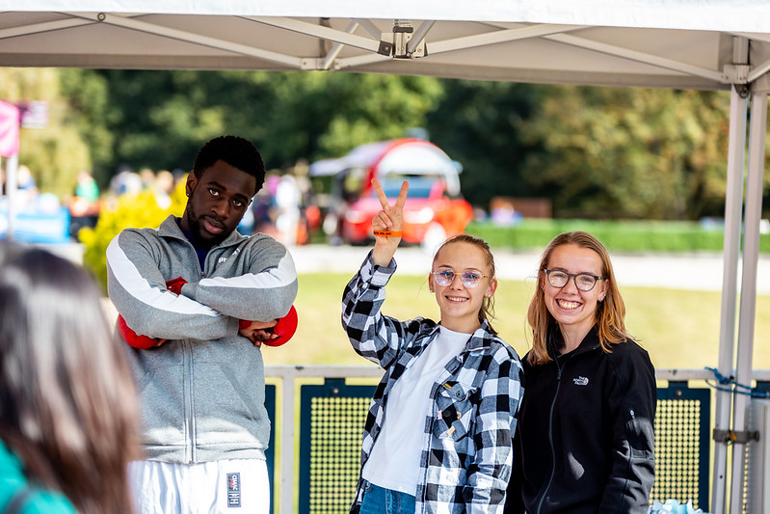
Training aims
What is the point?
To ensure you are fully equipped with all of the knowledge and tools to run your sports club effectively and offer the best possible experience to your members.
CORE OFFICER TRAINING 24/25

Slide 5
5 KEY PRIORITIES
To increase the quality of sports provision (clubs and activities)
To deliver the relevant parts of the sport sub strategy (including BUCS)
To develop and fair and sustainable funding model for sport
To understand more about our membership
Understand more about how our clubs can be supportive and/or could get support from local sports clubs
CORE OFFICER TRAINING 24/25
Focus Groups

Slide 6
What is a committee member / core exec member?
Your club is run by a committee, and it has 4 Core Exec members. They are responsible for the overall running of a sports club (with our support of course!)
4 Main Core Roles – these must all be fulfilled for your club to continue running
President, Vice President, Treasurer and Welfare Officers
Your main responsibilities include:
Check and respond to emails/messages from us – please check regularly.
Provide members of your club the best experience possible.
Attend Blades General Meetings (2 per term – 10/10, 26/11, 13/01, 13/03).
Ensure all activities adhere to Essex Blades and Students' Union policies and procedures.
CORE OFFICER TRAINING 24/25

Slide 7
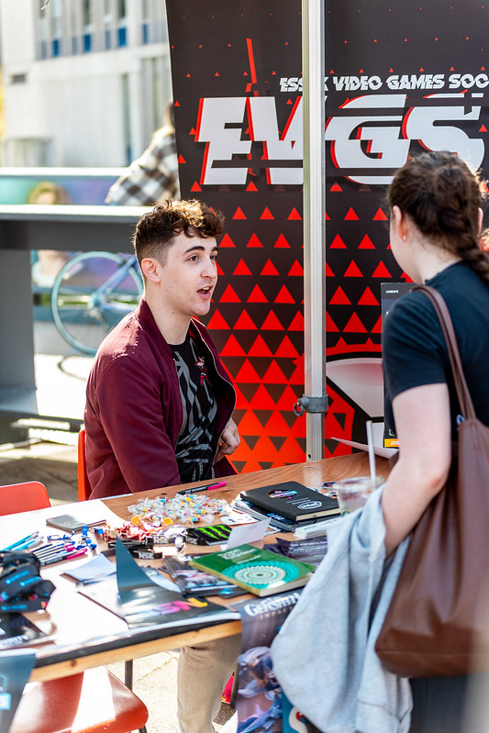
CORE OFFICER TRAINING 24/25
The core roles – president
The President leads their club and oversees all club activity. They are there to offer advice and support to the rest of the committee and ensure that overall the club runs smoothly
Responsibilities include, but are not limited to:
Main point of contact within the club.
Members will expect regular club updates from you.
Responsible for making decisions in the case of committee deadlock (lack of agreement) – Most decisions should be made collectively by members, the committee is in place to deliver the request of members.
Jointly responsible along with the Treasurer for club finances.
Responsible for ensuring the club does not break any laws.
Notes:
see a substantial increase in first time su engagement
have at least 25 individuals register interest to be trained to be group leaders for following year

Slide 8
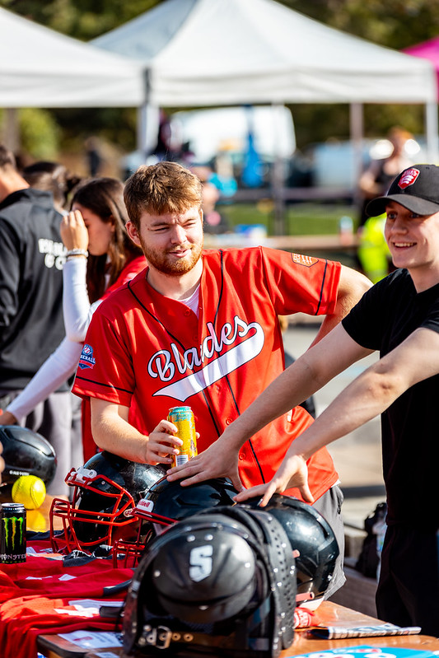
CORE OFFICER TRAINING 24/25
The core roles – Vice-President
The Vice-President supports the president in the running of the club and ensures everything runs smoothly.
Responsibilities include, but are not limited to:
Setting Agendas for committee meetings
Minute taking at meetings – ensuring the information is relayed to members
Usually will be responsible for creating standards and awards application.
Will need to liaise with whoever runs the social media to ensure updates are relayed to members.
Taking on responsibilities of the President when necessary.
Notes:
see a substantial increase in first time su engagement
have at least 25 individuals register interest to be trained to be group leaders for following year

Slide 9
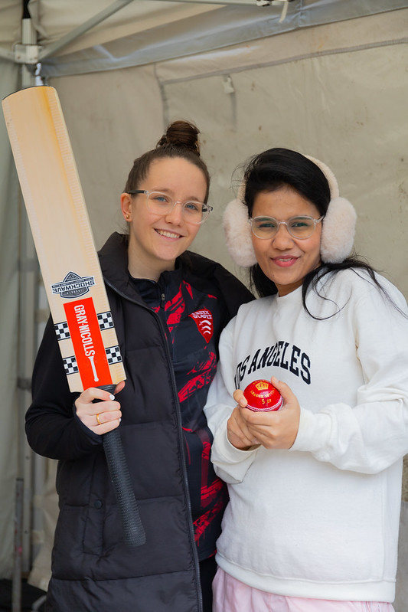
CORE OFFICER TRAINING 24/25
The core roles – Treasurer
The Treasurer is responsible for managing the clubs finances. This includes the overall financial planning, being transparent and accountable with the clubs funds and ensuring that the club generates enough income throughout the year to cover all costs. They must ensure that the club does not run at a loss.
Responsibilities include, but are not limited to:
Ensuring that members have paid their membership fees.
Attending mandatory training provided by the SU throughout the year.
Reviewing the Club's finance reports to keep track of all income and expenditure and providing regular updates to the committee.
Working closely with other members of the committee to create budgets and keep track of spending.
Reviewing and signing off club member expense claims of under £50 in a timely manner.
Working with the Student’s Union with regard to any potential sponsorship agreements for your club.
Ensuring that the club adheres to the financial policies and procedures.
Notes:
see a substantial increase in first time su engagement
have at least 25 individuals register interest to be trained to be group leaders for following year

Slide 10
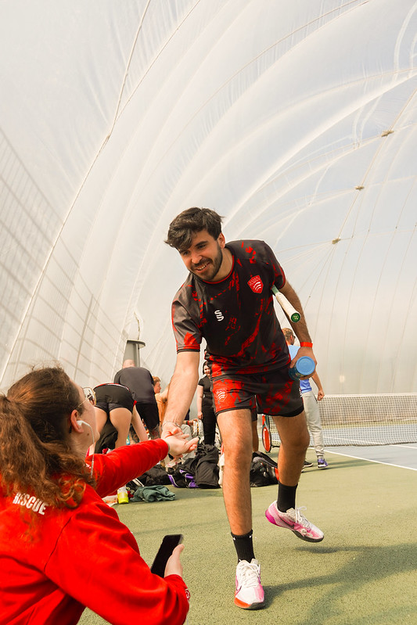
CORE OFFICER TRAINING 24/25
The core roles – Welfare Officer
The Welfare Officer is responsible for the safety and welfare of club members. They provide guidance, support and signposting to members, responding to welfare queries and conflicts, within agreed boundaries.
Responsibilities include, but are not limited to:
Attending or familiarising themselves with the relevant Student Activities welfare training, in order to know how to best support members of the club.
Signposting members of the club to the correct services (across campus/online etc) in respect of their need.
Ensuring that the clubs training sessions/socials/activities are welcoming, accessible and inclusive for members.
Acting as the point of contact for any conflicts within the club and deal with issues with the support of the committee, or escalate the matter(s) to the Student Activities Department if a resolution cannot be agreed upon internally within the club.
Notes:
see a substantial increase in first time su engagement
have at least 25 individuals register interest to be trained to be group leaders for following year

Slide 11
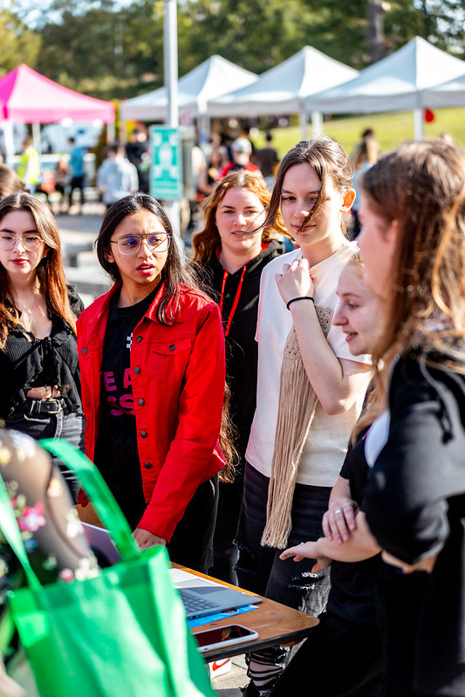
CORE OFFICER TRAINING 24/25
Non-core roles
Additional volunteer roles are required to support with the running of the club.
These roles may vary for each club and can certainly be tailored to your club's needs.
If you require extra roles at any point, please discuss this with us via blades@essex.ac.uk and we can make this happen for you.
Some examples may include
Fixtures Secretary
Kit Manger
Social Media Secretary
Notes:
see a substantial increase in first time su engagement
have at least 25 individuals register interest to be trained to be group leaders for following year

Slide 12
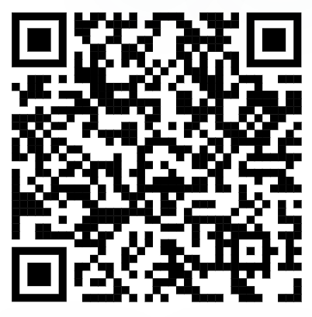
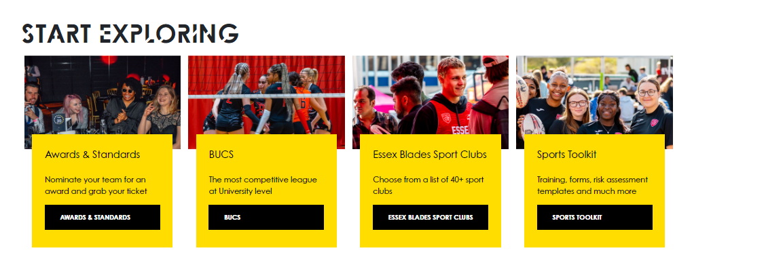
CORE OFFICER TRAINING 24/25
SPORTS TOOLKIT
Access the Sports Toolkit here
(bookmark it!)
On the essexstudent.com webpage, you will have access to the Sports Toolkit, which contains lots of helpful resources that will assist you in the coordination and running of your club (including a copy of this slideshow).
On the website go to opportunities on the main menu, and then to Essex Blades Sport.
Notes:
see a substantial increase in first time su engagement
have at least 25 individuals register interest to be trained to be group leaders for following year

Slide 13
CORE OFFICER TRAINING 24/25
SPORTS TOOLKIT
What does it actually contain?
Start A New Sports Club
Events
Risk Assessments
Training Material and Resources
Wellbeing Support
Health and Saftey
Expense form
Awards and Standards
BUCS
Key Policies and Forms
FAQ'S
Notes:
see a substantial increase in first time su engagement
have at least 25 individuals register interest to be trained to be group leaders for following year

Slide 14
CORE OFFICER TRAINING 24/25
Club memberships
Essex Blades Membership – free for all – discount on FED tickets, and discount in SU bar.
Memberships are a point of income for clubs – So you need to make sure it is covering any costs you have. Clubs will need to budget their estimated cost throughout the year and that ensures these estimations are realistic i.e. if you had 20 members last year do not expect you will have 50 this year.
Transport
Facility use
Equipment
Costs for socials!
Social Membership – Free member to the club, a social membership allows the individual to do the following - Vote in club elections, be added to the club mailing list, able to attend come and try sessions, and access to club social activities.
Each Club has playing/competitive membership but these will vary.
Full year memberships vs Termly memberships
Per Session Payments (some clubs choose to charge per sessions – especially good if you use an outside facility that costs to hire)
Collaborations with other clubs! (eg a deal where a much smaller additional cost allows people with an MMA membership access to Kickboxing as an add on)
The playing/competitive memberships also cover insurance for those sessions, so it is important to make sure the people attending training have bought their memberships!
Notes:
see a substantial increase in first time su engagement
have at least 25 individuals register interest to be trained to be group leaders for following year

Slide 15
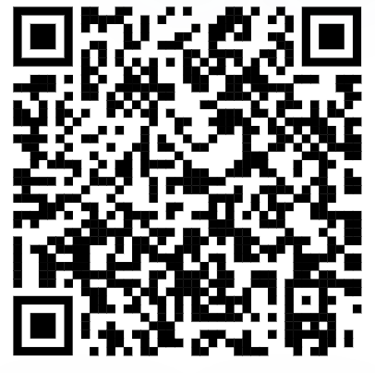
CORE OFFICER TRAINING 24/25
Group Chats
IMPORTANT – Please make sure all of your committee members are in the Blades 24/25 WhatsApp Community.
WhatsApp Community Links
Essex Blades Presidents 24/25 - Essex Blades Whatsapp Group (Presidents)
Essex Blades Vice Presidents 24/25 - Essex Blades Whatsapp Group (Vice-Presidents)
Essex Blades Secretaries 24/25 - Essex Blades Whatsapp Group (Secretaries)
Essex Blades Treasurers 24/25 - Essex Blades Whatsapp (Treasurers)
Essex Blades Welfare Officers 24/25 - Essex Blades Whatsapp Group (Welfare Officers)
Essex Blades Captains 24/25 - Essex Blades Whatsapp Group (Captains)
Essex Blades Coaches 24/25 - Essex Blades Whatsapp (Coaches)
Essex Blades Social Secretaries 24/25 - Essex Blades Whatsapp (Social Secretaries)
Essex Blades Communications Officers 24/25 - Essex Blades Whatsapp (Comms Officers)
Essex Blades General (all other positions that aren’t listed above). - Essex Blades Whatsapp Group (General)
Access to Blades General Community
Access to role-specific group chats
Notes:
see a substantial increase in first time su engagement
have at least 25 individuals register interest to be trained to be group leaders for following year

Slide 16
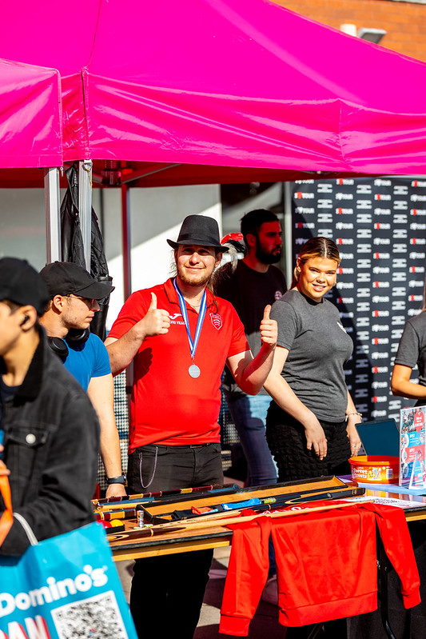
CORE OFFICER TRAINING 24/25
Contacting your Members -
Group Chats
We would strongly encourage all clubs to create a group chat which includes all members of your club and any other relevant personnel.
Having a group chat is a great way to communicate with members.
We expect the committee members to moderate these group chats and be the admins of them
We also recommend that you also have a committee group chat in which the members are not included so you can communicate effectively as a committee
This will help you to smoothly coordinate between committee members, especially useful for things like running a stall at freshers fair or organising items for a social
Notes:
see a substantial increase in first time su engagement
have at least 25 individuals register interest to be trained to be group leaders for following year

Slide 17
CORE OFFICER TRAINING 24/25
Contacting your Members – Message Centre
On the essexstudent.com page under your relevant sports club there is a message centre in which you can send an email to all of your current members. We recommend that you utilise this function too as sometimes not all of your members will be in the group chats you have.
Steps to send an email to all members
1 – Go to your club and select the pencil icon in the top right corner
2 – Select admin tools
3 – Select messages
4 – Choose send email
5 – Add your recipients, and compose your email.
6 – Send your email to members!
Notes:
see a substantial increase in first time su engagement
have at least 25 individuals register interest to be trained to be group leaders for following year

Slide 18
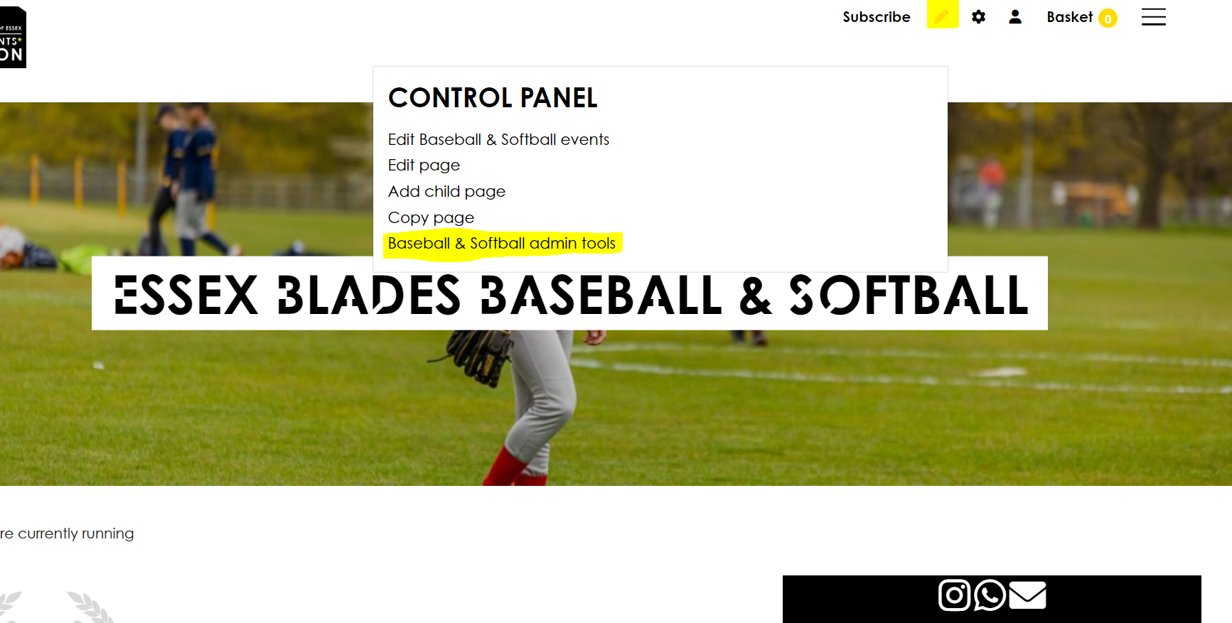
EVENTS TRAINING 24/25
How to add EVENTS

Slide 19
EVENTS TRAINING 24/25
How to add EVENTS

Slide 20
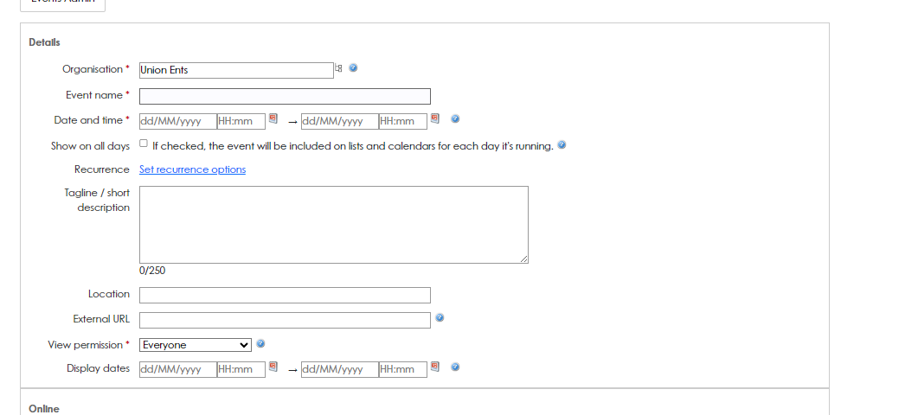
EVENTS TRAINING 24/25
How to add EVENTS
Complete all the information.

Slide 21
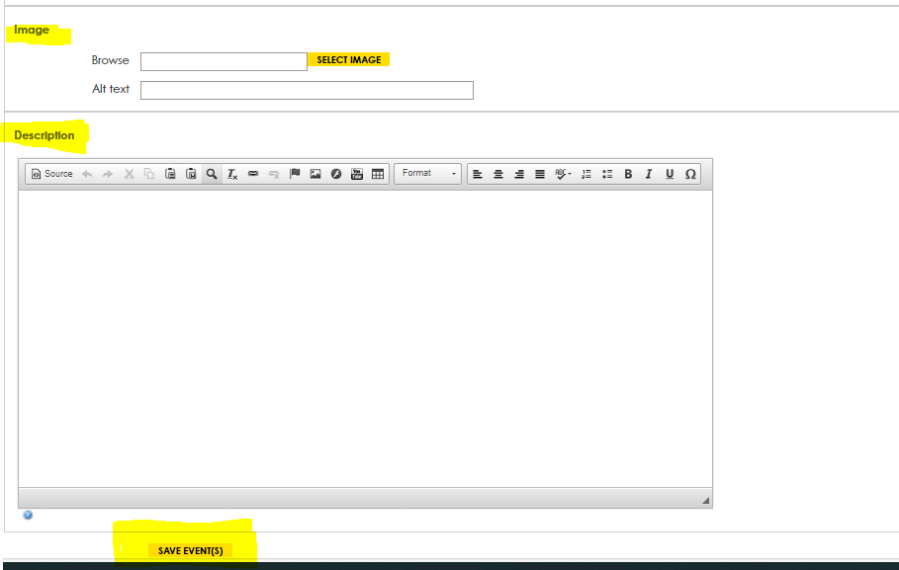
EVENTS TRAINING 24/25
How to add EVENTS
Add your image, description and make sure you save the event.

Slide 22
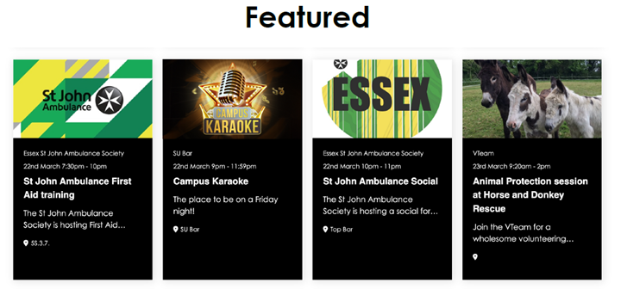
EVENTS TRAINING 24/25
IMAGES – EVENTS
Event Images need to be 200px wide and 500px tall
Best practice is to ensure the most important part of your image is centred.
The Event information does not need to be on the image

Slide 23
EVENTS TRAINING 24/25
Why include your event on the what's on page?
What's On page is always in top 5 viewed pages.
Best platform for viewer attention.
Staff browse this page to find events to assist with promotion.

Slide 24
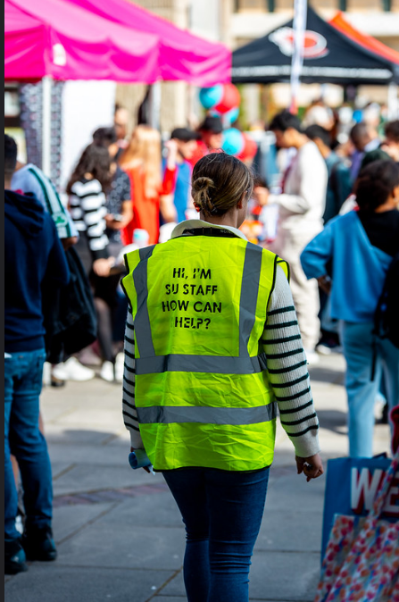
CORE OFFICER TRAINING 24/25
SU marketing
SU Marketing is in charge of:
Website
Social Media (all essexsu accounts and some sub accounts)
Can tag @essexsu in Instagram stories and they may reshare
Email – weekly student email
Digital screens on the stairs between squares 3&4
Poster Sites
To be featured on any of these spaces, please send a request into blades@essex.ac.uk at least a month before the event
SU Marketing will provide support dependent on relevancy and capacity
Opportunity for Clubs to promote activies/events and temelsves, template that clubs can utilise. In SU reception.
Notes:
see a substantial increase in first time su engagement
have at least 25 individuals register interest to be trained to be group leaders for following year

Slide 25
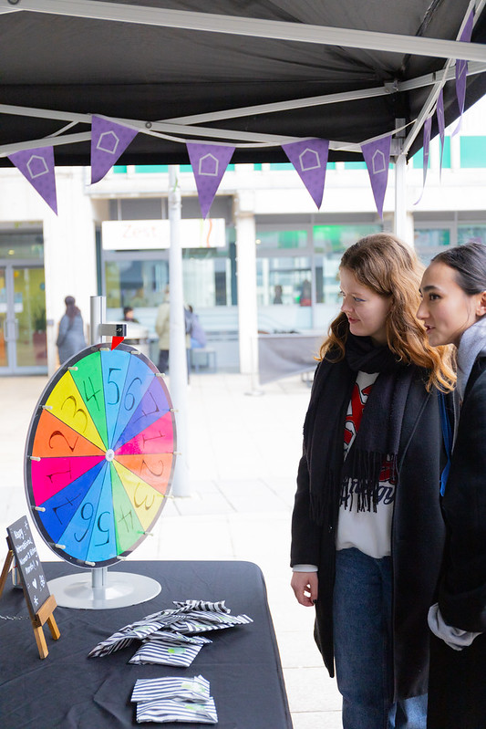
CORE OFFICER TRAINING 24/25
Open days
Open days at the University occur quite regularly!
These provide a chance for prospective students to see what life is like here at Essex and to showcase the clubs they can join.
1000-2000 guests attend.
Guests can speak with academics, attend talks, go on campus and
accommodation tours and take part in fun activities across the squares.
We usually look for a mix of 8 societies and clubs to come and run a stall on the day.
Clubs can receive a donation of £150 if they are successful in their application in running a stall at open day.
You will be sent an email when one of these opportunities arises – they choose the clubs with activities they think will do well! So choose your activity wisely.
Notes:
see a substantial increase in first time su engagement
have at least 25 individuals register interest to be trained to be group leaders for following year

Slide 26
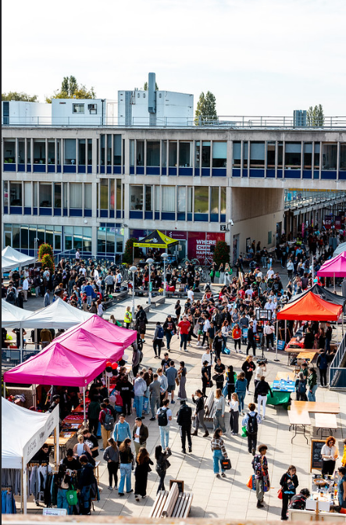
CORE OFFICER TRAINING 24/25
Fresher's fair
Friday 4th October
Set up from 10am
Quiet Hour 11 am – 12pm
Main Fair – 12 pm – 4 pm
This is a great opportunity to promote your sports club to new and existing students, and encourage them to play and join your sports clubs.
Chance to promote try-outs and trial sessions.
Make your stalls engaging.
ALL STUDENTS CAN ATTEND SPORTS CLUBS FOR FREE FOR THE WHOLE MONTH OF OCOTOBER – they should still be booking on for sports that use the Essex Sport App!
Notes:
see a substantial increase in first time su engagement
have at least 25 individuals register interest to be trained to be group leaders for following year

Slide 27
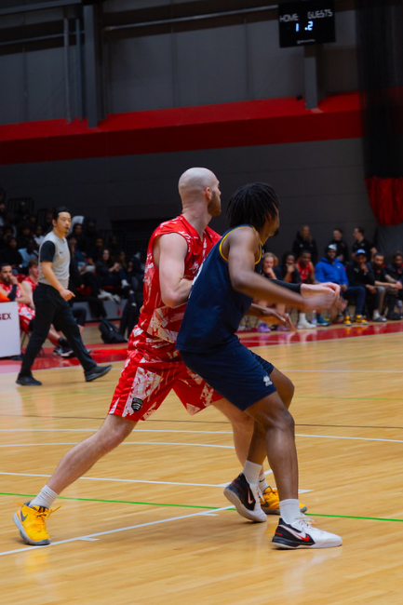
CORE OFFICER TRAINING 24/25
Come & try Sessions and trials
Free "Come & Try" sessions are a good way to promote your sport by allowing people to try it for free – please note all of October is automatically a trial period.
In order to organise free trial sessions for your sport, email us at blades@essex.ac.uk and ask us to make a specific date open to everyone so they will not need a membership to book on
We need at least 3 weeks notice for this change
Once it has gone through we will let you know
Once you have this confirmed it would be a good idea to promote it through social media, the whats on page, etc!
For clubs holding free "come & try" sessions, as well as clubs holding trials for places on their teams, please fill in this Typeform – we want to promote your sports, so please tell us when these are!
We will be putting your "come & try" sessions and your trials on the Whats On page
"Come & Try" and Trials Typeform
Notes:
see a substantial increase in first time su engagement
have at least 25 individuals register interest to be trained to be group leaders for following year

Slide 28
CORE OFFICER TRAINING 24/25
Standards and awards
Every bronze per section is worth 100 points
Every silver level is worth 200 points
Every gold level is worth 300 points
You will not earn one on top of the other – if you achieve gold, you get 300 points only (not adding the silver and bronze on top)
Final standard points totals
Bronze between 800 and 1199 points
Silver between 1100 and 1799 points
Gold is anything above 1800 points
You will need to complete certain milestones
Filling all roles earns points (filling less will earn silver or bronze depending).
Having exec meetings earns points
Logging volunteering hours on GradIntel earns points (with proof)
Volunteering & fundraising earns points (only 50% of your membership money counts towards fundraising)
Social events earn points
Having an active social media earns points
For gold, each committee must have at least 2 members present at every General Meeting
Clubs found guilty of any disciplinary offences will not be awarded a Gold Club Standard.
Notes:
see a substantial increase in first time su engagement
have at least 25 individuals register interest to be trained to be group leaders for following year

Slide 29
CORE OFFICER TRAINING 24/25
General MEETINGS
The Blades General Meetings are twice a term and will be at 17:15 on
October 10th
November 26th
January 13th
March 13th
You will be sent an email when these are confirmed to put in your diaries
You may submit agenda items to these meetings if you would like something to be discussed across the whole of Blades – email blades@essex.ac.uk
The meetings cover a variety of topics, including
Relevant information for that term (eg Derby Day info in March)
Relevant updates on training or facilities
Notes:
see a substantial increase in first time su engagement
have at least 25 individuals register interest to be trained to be group leaders for following year

Slide 30
CORE OFFICER TRAINING 24/25
Committee meetings
Committee meetings are important in order to stay connected to your committee and to keep communication flowing smoothly
This will help you to run your club effectively throughout the year and to divide responsibilities in ways that suit each committee member while still benefitting the club
To achieve a club standard you must have a certain number of meetings (Gold is 10)
Committee meetings do not have to be long, and could cover:
The finances report that you receive weekly
Making sure your members are buying their memberships and booking onto sessions
Talking about social media plans and strategies
Planning socials and further meetings
Delegating training times, who does the register weekly, etc
Notes:
see a substantial increase in first time su engagement
have at least 25 individuals register interest to be trained to be group leaders for following year

Slide 31
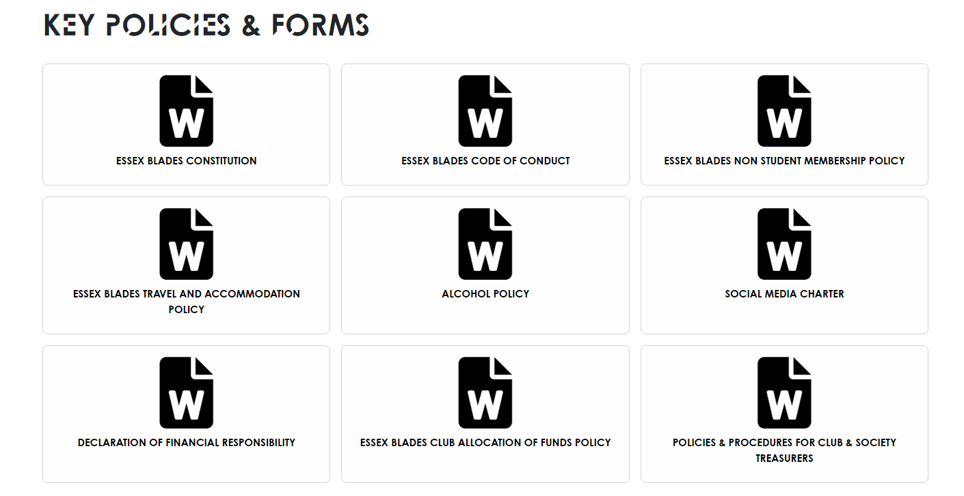
CORE OFFICER TRAINING 24/25
Documentation
There is a set of documents that each club must sign before the beginning of the year, which will be sent out to you
To be read:
Essex Blades Constitution
Essex Blades Code of Conduct
Essex Blades Non Student Membership Policy
Essex Blades Travel and Accommodation Policy
Essex Blades Allocation of Funds Policy
Policies and Procedures for Club & Society Treasurers (this has the sponsorship form blank in it at the bottom)
Alcohol Policy
To be signed:
Alcohol Policy must be signed by the President
Social Media Charter signed by Social Media / Publicity & Communications
Declaration of Financial Responsibility signed by Treasurer and President
Notes:
see a substantial increase in first time su engagement
have at least 25 individuals register interest to be trained to be group leaders for following year

Slide 32
CORE OFFICER TRAINING 24/25
Legal info
If you are unsure – ASK US (blades@essex.ac.uk)
Clubs can never open their own bank accounts
You cannot agree to sponsorships or contracts without them being agreed to by the Head of Student Sport first
This applies to any form of agreement – even verbal or online messaging
Be careful when discussing contracts with anyone
Contracts with outside venues, sponsors, etc, must be send to blades@essex.ac.uk to be agreed to before the club can agree to it
Notes:
see a substantial increase in first time su engagement
have at least 25 individuals register interest to be trained to be group leaders for following year

Slide 33
CORE OFFICER TRAINING 24/25
Disciplinary proceedings
When there is any conflict, our first piece of advice would be to reach out to the individuals for mediation, whether on a one-to-one basis or with another executive member that they may feel open to talk to or in a more informal setting as a team
During this meeting, we would recommend you refrain from using any accusatory language but try to fact-find and see if there may be any challenges that the individual may be facing that could be the cause of the issue
Following this, if you still feel that no positive changes have been made to improve the situation then you should call a formal meeting with a member of the Blades Staff by emailing us at blades@essex.ac.uk
If any issue within a society or club involves bullying or harassment of any kind, then you need to go directly to SU Advice / Student Support
Notes:
see a substantial increase in first time su engagement
have at least 25 individuals register interest to be trained to be group leaders for following year

Slide 34
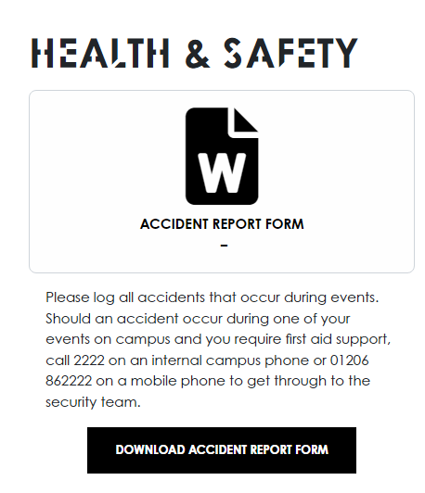
CORE OFFICER TRAINING 24/25
Accident Report Form
Any accidents that occur during a club event must be reported using an Accident Report Form which you can find in the Sports Toolkit
Club events mean any training, any club social or club meeting – anything organised by the club
Fill it out as soon as possible after the accident
Send it to blades@essex.ac.uk and dsking@essex.ac.uk
Notes:
see a substantial increase in first time su engagement
have at least 25 individuals register interest to be trained to be group leaders for following year

Slide 35
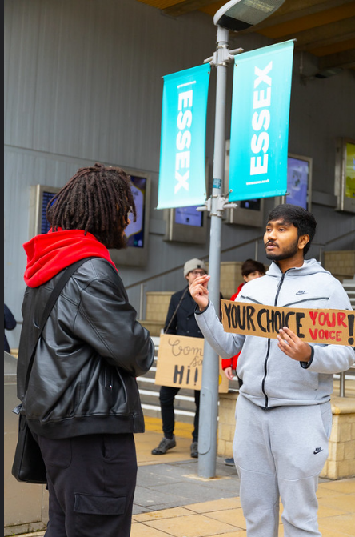
CORE OFFICER TRAINING 24/25
elections
Committee positions are filled by election process using the essexstudent.com website
We will be holding the elections for the 25/26 academic year in early 2025, around February / March time
When you open your elections, you should advertise it to your club members in order to try to fulfil the committee for the next year
Process:
Identify roles that need filling – let us know the names
Nominations Open
People nominate themselves for positions within the committee
Nominations Close
Voting Opens
All Club Members are able to vote in the election
Voting Closes
Winning Candidates are announced
If there are empty positions, the club may run a by-election to fill the positions
Notes:
see a substantial increase in first time su engagement
have at least 25 individuals register interest to be trained to be group leaders for following year

Slide 36
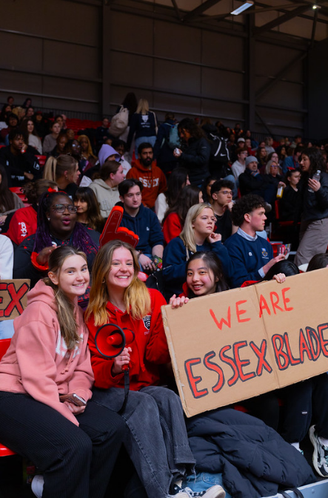
CORE OFFICER TRAINING 24/25
Derby Day
This year Derby Day will be at UEA on April 30 - SAVE THE DATE !
Pre warn your teams to keep that day free
You have the date – please plan accordingly
Send in extra training requests ahead of time (a month)
Make sure your teams are ready!!
We will distribute more information closer to the date
We would like to support, not just those that are participating. Great opportunity for a social (criteria for standards)
Notes:
see a substantial increase in first time su engagement
have at least 25 individuals register interest to be trained to be group leaders for following year

Slide 37
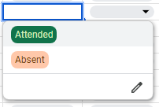
CORE OFFICER TRAINING 24/25
Training Registers
We have sent each committee a Google Sheets which is already formatted to track your training registers
Write the date and start time of the session in the top row (you can write it as 8 Oct 5pm and it will automatically format)
Write the full name of your member in the column on the left
For each session, click on the drop down and select "attended" or "absent"
We ask that you update this weekly – you will be chased if you do not do so
It may be best to give this responsibility to one person to avoid confusion
Important - please enter people's names as they appear on their student cards!
Notes:
see a substantial increase in first time su engagement
have at least 25 individuals register interest to be trained to be group leaders for following year

Slide 38
CORE OFFICER TRAINING 24/25
Essex sport INDEMNITY LIST
Essex Sport will only give keys to people on the indemnity list
Automatically on the list:
Presidents
Vice Presidents
Treasurers
Welfare Officer
Captains
If you need anyone else on the list, you must inform us via email by Friday 13 September at blades@essex.ac.uk
The above date is next week Friday. Do not miss this deadline.
You can add people to the indemnity list, but they must already be committee members
IF YOU ARE NOT ON THE LIST, YOU WILL NOT BE ALLOWED KEYS
Notes:
see a substantial increase in first time su engagement
have at least 25 individuals register interest to be trained to be group leaders for following year

Slide 39
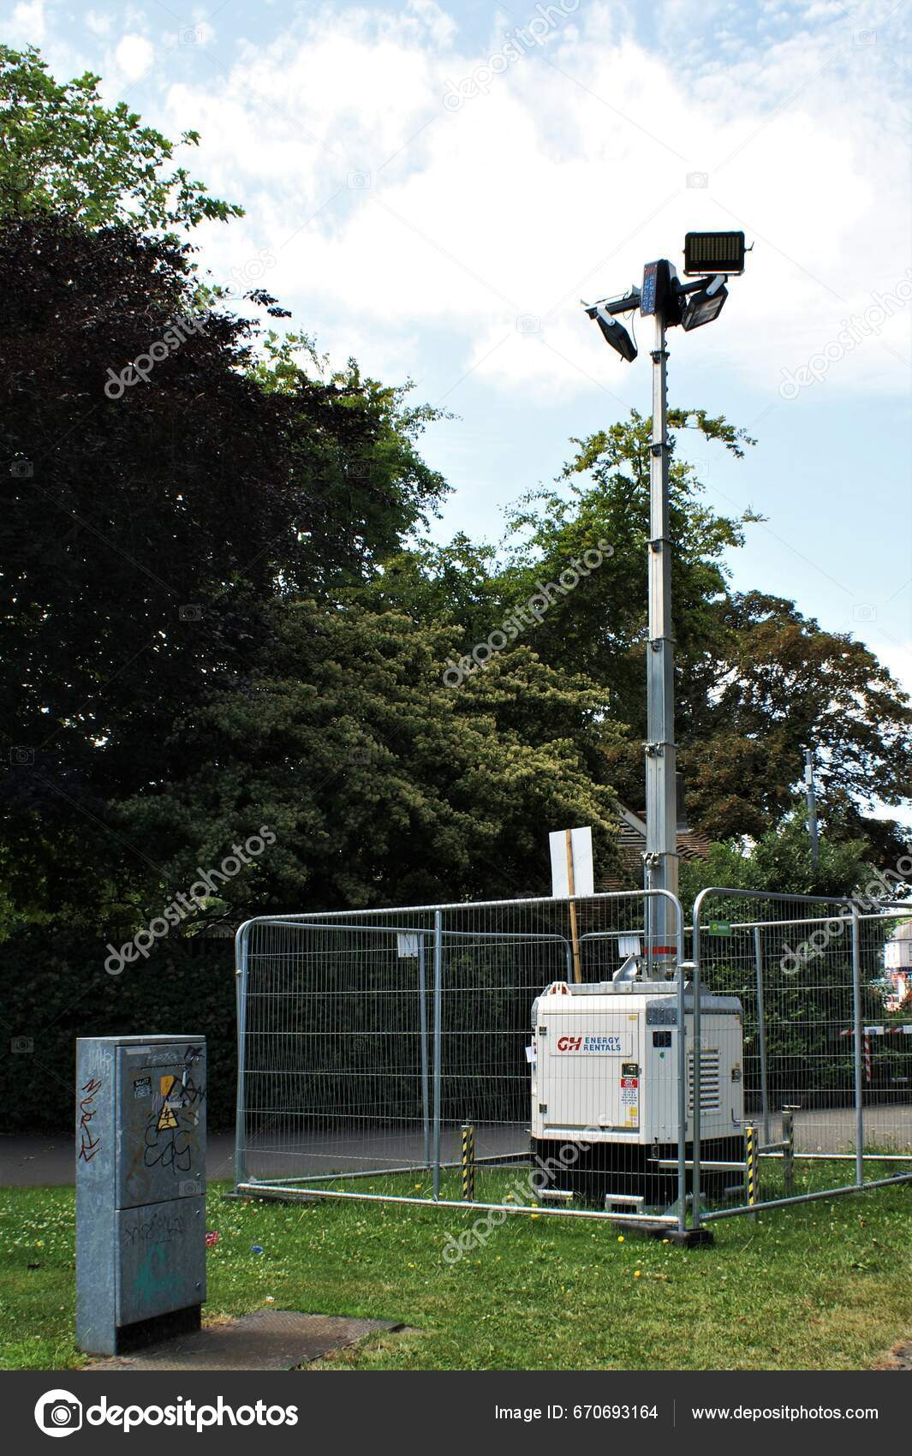
CORE OFFICER TRAINING 24/25
Essex Sport/ Floodlight Training for outdoor Facility Use
For sports who train in spaces that use the floodlights, you will be asked at some point to attend and complete an introduction / training for operating the floodlights.
More information will be circulated with you.
Notes:
see a substantial increase in first time su engagement
have at least 25 individuals register interest to be trained to be group leaders for following year

Slide 40
CORE OFFICER TRAINING 24/25
Booking travel
We usually cover the cost of travel to BUCS league/cup matches – trains and coaches, fuel reimbursements etc
For BUCS, we know when your fixtures are and will generally have your transport already organised as long as we know how many people are going. We encourage all teams to travel by car where possible, By car pool this is a much more cost effective way of travelling. Up to 45p per mile reimbursement for drivers.
Due to significant budget cuts this year, we cannot guarantee that the Essex Blades officer will cover all transport costs, therefore your club funds may be required to cover any excesses.
Please note, we do not cover transport to and from events which are non-BUCS
We can still make the booking for you, since we can book a large number of train tickets on Trainline and we have an agreement with Roman Coaches, but the cost will come out of your club fund
If you are considering travel with an outside company – be careful! There are a lot of scams where they will take your money and your transport will never show up – better to go with the reliable company
No expenses approved unless agreed prior with us.
Notes:
see a substantial increase in first time su engagement
have at least 25 individuals register interest to be trained to be group leaders for following year

Slide 41
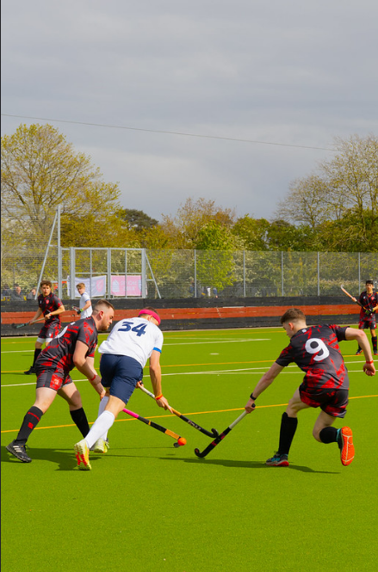
CORE OFFICER TRAINING 24/25
Ordering clothes and equipment
Your BUCS Playing Kit is supplied by Essex Sport
This is NOT replaced each year
The club is expected to keep BUCS Playing Kit to pass on to players every year
Captains responsibility to ensure that all kit is kept safe clean and is accounted for. We will supply clubs with laundry cards.
If you want to order things like hoodies or shirts that have names on them etc, this comes out of your own money. The funds should be paid into the club account with a clear description – we can set up tickets if need be. Surridge can then raise an invoice and finance will charge this to your clubs account.
If you want to order from Surridge, the email is jimmy@sdlgroupltd.com
You can liaise with us about your Surridge orders and feel free to cc us in any emails to Surridge.
If you would like new equipment (boxing gloves, hockey sticks, etc) you send an order request email to Dominic King, at dsking@essex.ac.uk - This will need to be approved by your Treasurer
THIS COMES OUT OF YOUR CLUB FUND!
Notes:
see a substantial increase in first time su engagement
have at least 25 individuals register interest to be trained to be group leaders for following year

Slide 42
CORE OFFICER TRAINING 24/25
THE BLADES EXECUTIVE COMMITTEE
The Blades Executive Committee is the same as one of your committees, but they run the Blades overall
They still have a President, Vice President, so on
Your Blades President this year is Ian Lau!
The rest of the committee is currently empty – which could be an opportunity for you!
The open positions are:
Vice President
Welfare Officer
Communications Officer
Events Officer
Club Development Officer
Treasurer
Community and Volunteering
General Representative
Nominations open next week, Monday 9th September- Sunday 22nd September nominations will close. Will have to be a Essex Blades member to nominate.
Monday 23rd September 12:00 and will close on Monday 30th September at 12:00.
Notes:
see a substantial increase in first time su engagement
have at least 25 individuals register interest to be trained to be group leaders for following year

Slide 43
CORE OFFICER TRAINING 24/25
Opportunity to ask any questions you may have
We now have a few minutes to answer any questions you may have!
Please do not go anywhere yet as we still have a Moodle quiz for you to complete.
Notes:
see a substantial increase in first time su engagement
have at least 25 individuals register interest to be trained to be group leaders for following year

Slide 44
CORE OFFICER TRAINING 24/25
Moodle Quiz
20 Questions
Pass Mark 16/20
Link in the chat
Once you have accessed to the quiz and can see it feel free to leave the call, if not we will be ending the call in 5 minutes.
Notes:
see a substantial increase in first time su engagement
have at least 25 individuals register interest to be trained to be group leaders for following year

Slide 45
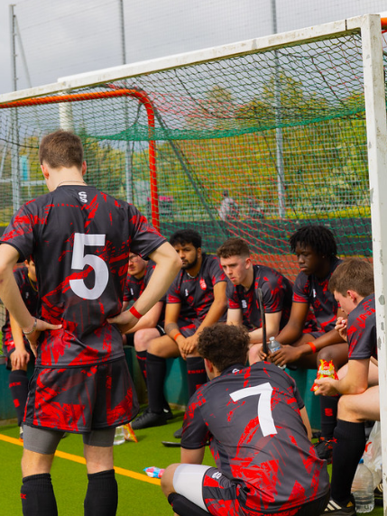
HEADING
thank you
for LISTENING*
Got Questions?
Email us at blades@essex.ac.uk
Or send us a WhatsApp on 07935134538
*mostly

