Slide 1



CORE OFFICER TRAINING 25/26
Sports Clubs' core officer training 25/26
Please take a minute to type your name, club, and exec role in the chat box. This helps us to track attendance.

Slide 2

SESSION FORMAT
Take notes
Ask any questions in the chat, otherwise there will be the opportunity to ask at the end.
This session is being recorded so please turn your camera off if you do not wish to be in the video.
You will be required to complete a Moodle test at the end of this presentation to mark your training as completed.
This presentation and recording will be available for you to view afterwards on the Sports Toolkit.
The recording and slides and link to the Moodle quiz will be emailed to you.
CORE OFFICER TRAINING 25/26

Slide 3
THE BLADES TEAM
Emma Sainty
Head of Membership Communities
SU SPORTS ASSISTANTS
Jessica Vassena
Yoyo Tang
Hannah Binti Rashidi
Abby Fung
Ata Rahoojo
VP Student Activities
Hannah Mortier
Sports Manager
Rob Neale
Sports Coordinator
To get in touch with us :
Email blades@essex.ac.uk
WhatsApp 07935 134538 (this is the blades phone)
or pop by the Sports Office, behind SU Reception on Square 4.
CORE OFFICER TRAINING 25/26

Slide 4
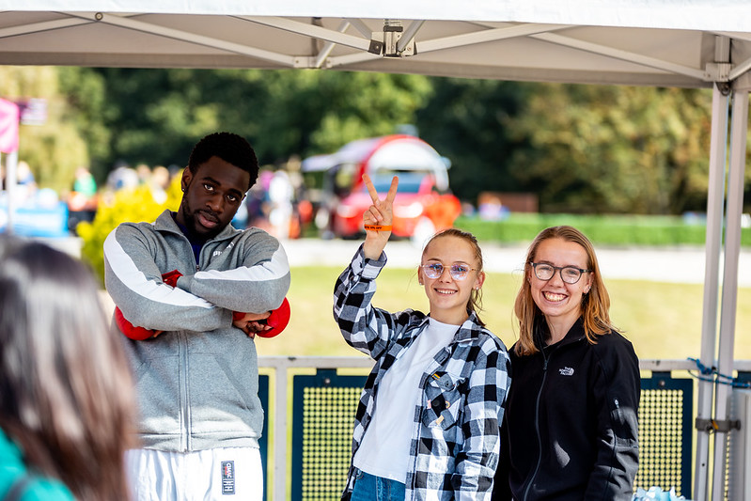
Training aim
What is the point?
To equip you with the knowledge and tools to run your sports club effectively and offer the best possible experience to your members.
CORE OFFICER TRAINING 25/26

Slide 5
What is a committee member / core exec member?
Your club is managed by a committee, which includes 4 Core Executive members.
These individuals oversee the overall running of the sports club, with support from us along the way.
The 4 Core Executive Roles – all positions must be filled for the club to operate:
President
Vice President
Treasurer
Welfare Officer
Key Responsibilities:
Regularly check and respond to emails and messages from us.
Ensure club members have a positive and engaging experience.
Attend Blades General Meetings (2 per term, 2 committee members per meeting).
Make sure all club activities comply with Essex Blades and Students' Union policies and procedures.
CORE OFFICER TRAINING 25/26

Slide 6
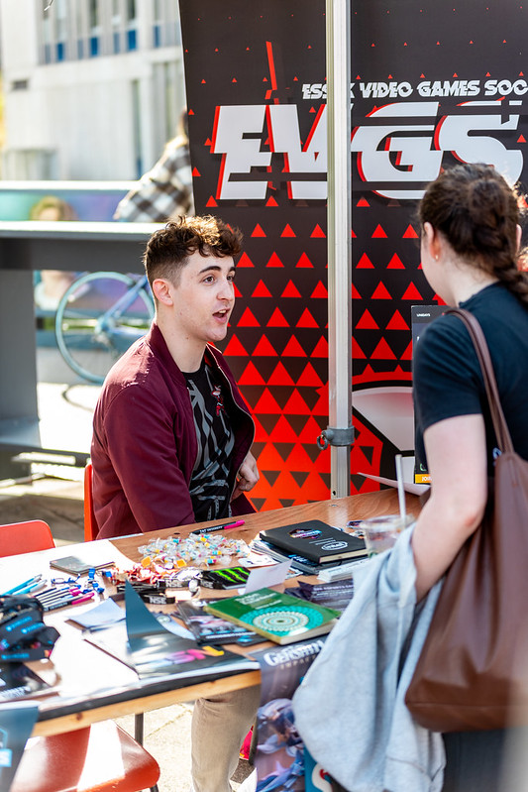
CORE OFFICER TRAINING 25/26
The core roles – president
President
The President leads the club and oversees all activities, providing guidance and support to the committee to ensure the smooth running of the club.
Key Responsibilities:
Lead with professionalism and respect, setting a positive example as ambassadors for their club, the Students' Union, and the University.
Serve as the main point of contact for the club.
Make decisions in cases of committee deadlock, while ensuring most decisions reflect the collective wishes of all club members.
Share responsibility with the Treasurer for managing club finances.
Ensure the club operates within the law and adheres to all relevant regulations.
Notes:
see a substantial increase in first time su engagement
have at least 25 individuals register interest to be trained to be group leaders for following year

Slide 7
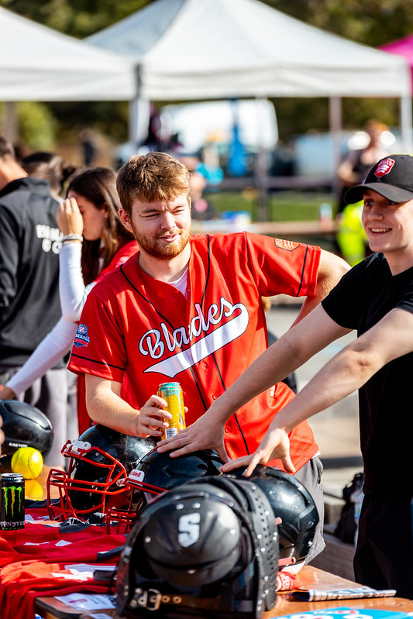
CORE OFFICER TRAINING 25/26
The core roles – Vice-President
The Vice-President supports the President in managing the club and helps ensure that everything runs smoothly.
Key Responsibilities:
Step in to fulfill the President’s duties when required.
Prepare agendas for committee meetings.
Take minutes during meetings and ensure important information is communicated to members.
Typically oversee the creation of standards and awards applications.
Notes:
see a substantial increase in first time su engagement
have at least 25 individuals register interest to be trained to be group leaders for following year

Slide 8
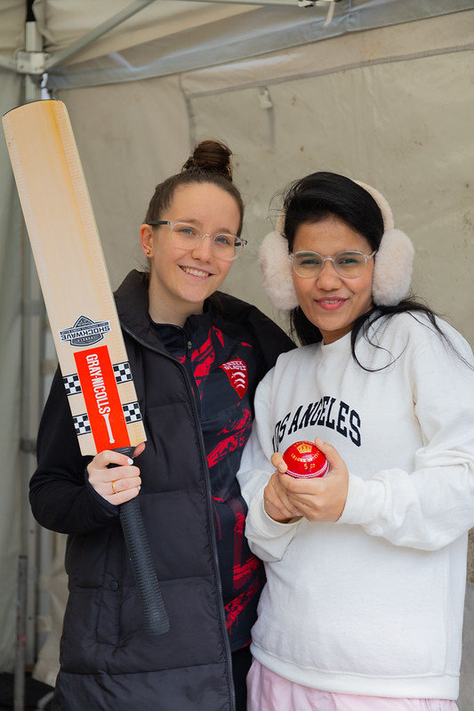
CORE OFFICER TRAINING 25/26
The core roles – Treasurer
The Treasurer manages the club’s finances, ensuring transparency, accountability, and that the club remains financially sustainable.
Key Responsibilities:
Monitor income and expenditure through the club's weekly finance report, providing regular updates to the committee.
Ensure members have paid their membership fees.
Collaborate with the committee to create and manage budgets.
Approve member expense claims under £50 promptly.
Work with the Students’ Union on potential sponsorships.
Ensure the club complies with all financial policies and procedures.
Notes:
see a substantial increase in first time su engagement
have at least 25 individuals register interest to be trained to be group leaders for following year

Slide 9
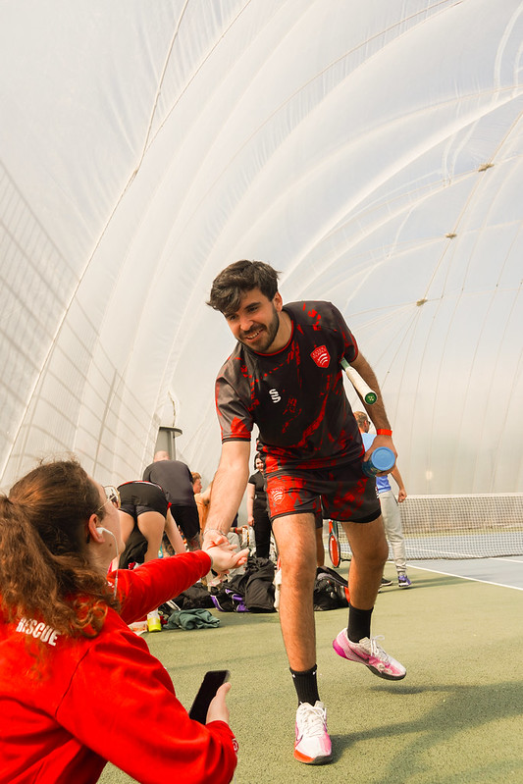
CORE OFFICER TRAINING 25/26
The core roles – Welfare Officer
The Welfare Officer is responsible for the safety and well-being of club members, providing guidance, support, and signposting where needed.
Key Responsibilities:
Complete relevant welfare training to effectively support members (Session on 24/09 – 14:00).
If required, direct members to appropriate support services on campus or online.
Ensure that all aspects of the club, including club activities, training sessions, and socials are welcoming, accessible, and inclusive.
Serve as the main contact for conflicts, resolving issues with the committee or escalating to the Essex Blades Sports Staff Team if necessary.
Notes:
see a substantial increase in first time su engagement
have at least 25 individuals register interest to be trained to be group leaders for following year

Slide 10
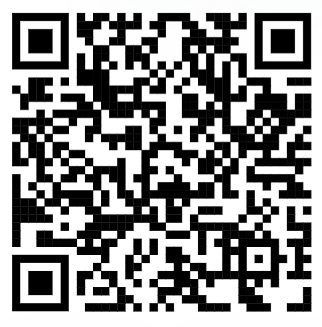

CORE OFFICER TRAINING 25/26
SPORTS TOOLKIT
Access the Sports Toolkit here
On the essexstudent.com webpage, you will have access to the Sports Toolkit, which contains lots of helpful resources that will assist you in the coordination and running of your club (including a copy of this slideshow).
Go to the main menu on the website, choose 'Opportunities', then select 'Sport'.
Notes:
see a substantial increase in first time su engagement
have at least 25 individuals register interest to be trained to be group leaders for following year

Slide 11

CORE OFFICER TRAINING 25/26
SPORTS TOOLKIT
What’s Included in the Sports Toolkit?
The toolkit provides resources and guidance on a wide range of areas, including:
Starting a new sports club
Planning and running events
Completing risk assessments
Committee training materials and resources
Wellbeing support for members
Health and safety guidance
Expense submission procedures
BUCS-related documentation (including lecture absence forms)
Key policies and essential forms
Frequently Asked Questions (FAQs)
Notes:
see a substantial increase in first time su engagement
have at least 25 individuals register interest to be trained to be group leaders for following year

Slide 12
CORE OFFICER TRAINING 25/26
Memberships and Budgeting
Memberships are a key income source for clubs and should cover annual costs. Budget realistically - base estimates on previous years (e.g. don’t expect 50 members if you had 20 last year). Consider costs such as:
Transport
Facility hire
Equipment
Social events
Types of Membership
Social Membership (Free): Includes voting rights, mailing list access, "come and try" sessions, and social events.
Playing/Competitive Membership: Varies by club. Typically includes insurance for training and competition.
Payment Options
Full-year or termly memberships
Pay-per-session (ideal if using hired facilities)
Cross-club deals (e.g. small add-on fee for access to another club like MMA + Kickboxing)
Important: Only those with valid playing/competitive memberships should attend training sessions, for insurance reasons.
Notes:
see a substantial increase in first time su engagement
have at least 25 individuals register interest to be trained to be group leaders for following year

Slide 13

CORE OFFICER TRAINING 25/26
Group Chats
IMPORTANT – Please make sure all of your committee members are in the Blades 25/26 WhatsApp Community.
Essex Blades Presidents and VPs 25-26
Essex Blades Captains 25-26 (Important all captains are in this)
Essex Blades General 25-26
Essex Blades Welfare Officers 25-26
Essex Blades Social Secretaries 25-26
Access the Blades General Community Here
Notes:
see a substantial increase in first time su engagement
have at least 25 individuals register interest to be trained to be group leaders for following year

Slide 14
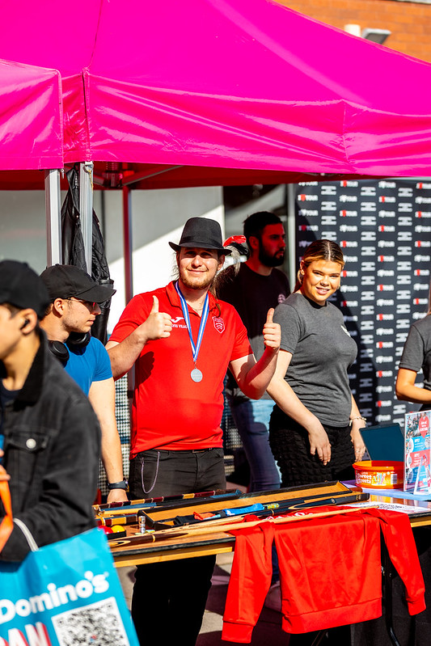
CORE OFFICER TRAINING 25/26
Contacting your Members -
Group Chats
We would strongly encourage all clubs to create a group chat which includes all members of your club and any other relevant individuals.
Having a group chat is a great way to communicate with members.
We expect the committee members to moderate these group chats and be the admins of them.
We also recommend that you have a committee group chat in which the members are not included so you can communicate effectively as a committee. This will help you coordinate effectively with your committee, making tasks like running a stall at Freshers’ Fair or organising a social much easier.
Notes:
see a substantial increase in first time su engagement
have at least 25 individuals register interest to be trained to be group leaders for following year

Slide 15
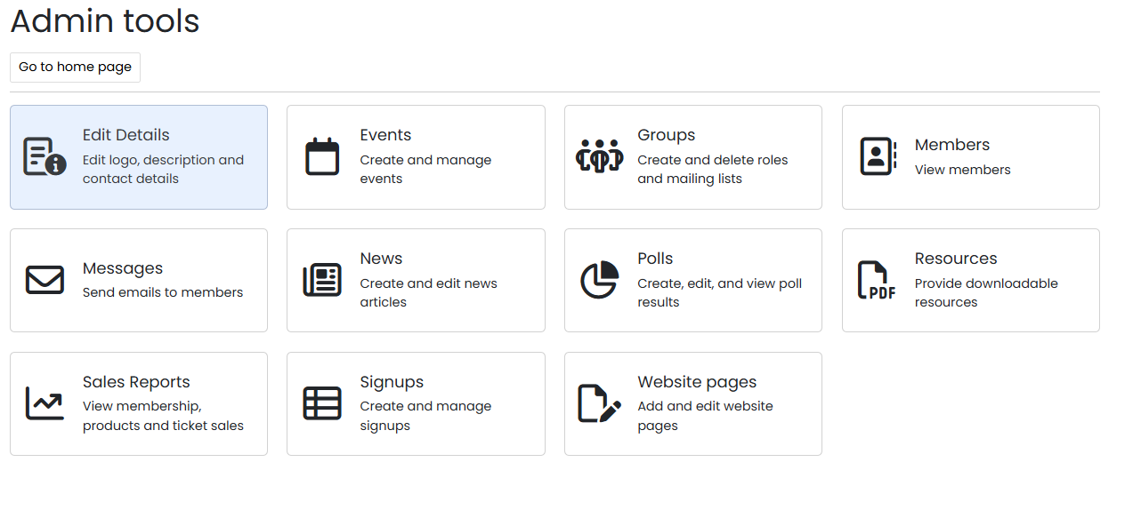
CORE OFFICER TRAINING 25/26
Contacting your Members – Message Centre
On the essexstudent.com page under your relevant sports club there is a message centre in which you can send an email to all of your current members. We recommend that you utilise this function too as sometimes not all of your members will be in the group chats you have.
Steps to send an email to all members
1 – Go to your club and select the pencil icon in the top right corner
2 – Select admin tools
3 – Select messages
4 – Choose send email
5 – Add your recipients, and compose your email.
6 – Send your email to members!
Notes:
see a substantial increase in first time su engagement
have at least 25 individuals register interest to be trained to be group leaders for following year

Slide 16
Archery Come and Try Session
CORE OFFICER TRAINING 25/26
How to add EVENTS – What's On/Club Page
Video guide on how to do this on sports toolkit
Steps Below
Go to pencil icon on essexstudent.com
Select events
Select add new event
Complete all details (make sure sport is selected under 'event type')
Add image
Select save at the bottom
Check the What's On page/Club page to ensure it has been uploaded!
Event Images need to be 200px wide and 500px tall
Benefits of adding to the What's On Page
The “What’s On” page consistently ranks among the top 5 most viewed pages.
It’s the best platform for capturing audience attention.
Staff also use this page to discover events and support the promotion of them, E.g. SU Marketing.

Slide 17
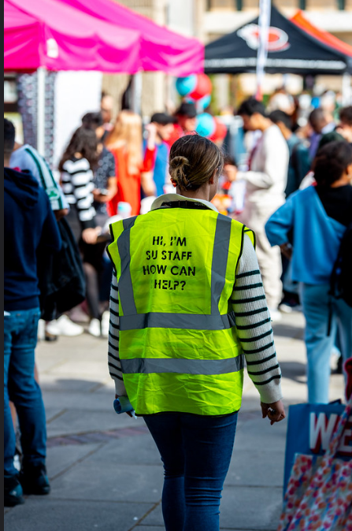
CORE OFFICER TRAINING 25/26
SU marketing
SU Marketing manages the following promotional channels:
Website
Social Media (All @essexsu accounts and some sub-accounts)
You can tag @essexsu in Instagram Stories — they may reshare your content
Weekly Student Email
Digital Screens (located on the stairs between Squares 3 & 4)
Poster Sites
Want to Be Featured?
To request promotion via any of these channels, email blades@essex.ac.uk at least 3 weeks in advance.
Support is provided based on relevance and available capacity.
Notes:
see a substantial increase in first time su engagement
have at least 25 individuals register interest to be trained to be group leaders for following year

Slide 18
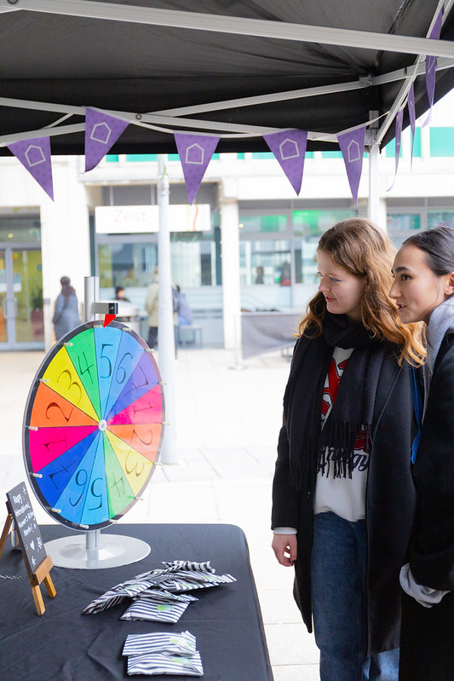
CORE OFFICER TRAINING 25/26
Open days
Open days at the University occur quite regularly!
These provide a chance for prospective students to see what life is like here at Essex and to showcase the clubs they can join.
1000-2000 guests attend.
Guests can speak with academics, attend talks, go on campus and
accommodation tours and take part in fun activities across the squares.
We usually look for a mix of 8 societies and clubs to come and run a stall on the day.
Clubs can receive a donation of £150 if they are successful in their application in running a stall at open day.
You will be sent an email when one of these opportunities arises – they choose the clubs with activities they think will do well! So choose your activity wisely.
Notes:
see a substantial increase in first time su engagement
have at least 25 individuals register interest to be trained to be group leaders for following year

Slide 19
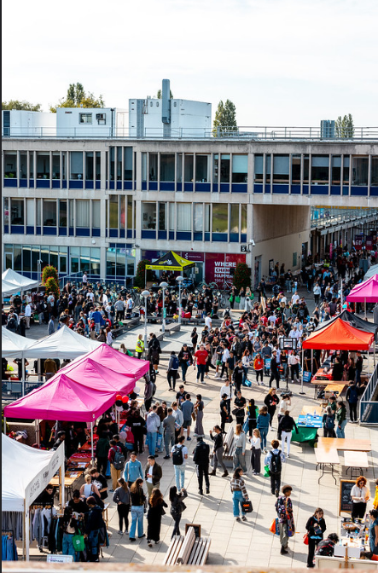
CORE OFFICER TRAINING 25/26
Freshers' fair
Friday 3rd October 2025
Set-up: From 10:00 AM
Quiet Hour: 11:00 AM – 12:00 PM
Main Fair: 12:00 PM – 4:00 PM
This is a fantastic opportunity to promote your sports club to both new and returning students. Use the event to:
Advertise your club and teams
Promote try-outs and “Come & Try” and Tryout sessions
Grow your membership
Make your stall engaging and welcoming — the more interactive, the better!
Please ensure you have signed the Freshers' Fair agreement form.
Opportunity to sign up for performances/demonstrations, please complete the typeform by the end of today!
Notes:
see a substantial increase in first time su engagement
have at least 25 individuals register interest to be trained to be group leaders for following year

Slide 20
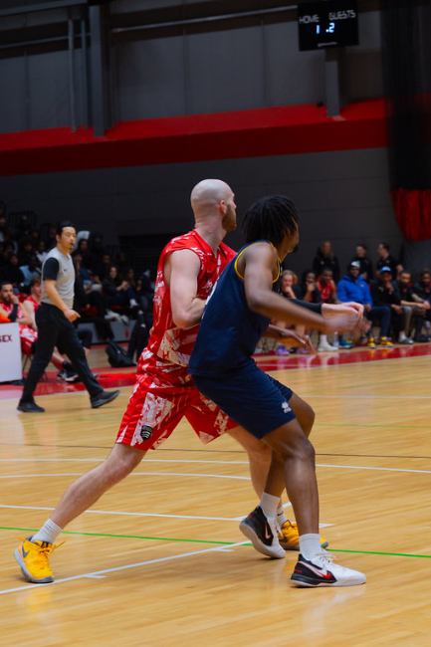
CORE OFFICER TRAINING 25/26
Come & try Sessions and tryouts
We have uploaded all Come & Try and Tryout sessions on the What's On page.
Please promote your sessions on social media.
We will also be promoting them on the digital screens between squares 3&4.
All students will need to make sure they are booked onto the Essex Sport app.
All students can attend club sessions for free throughout October (unless you've told us otherwise)(Must still book onto Essex Sport).
These are so super important for attracting new members!
Notes:
see a substantial increase in first time su engagement
have at least 25 individuals register interest to be trained to be group leaders for following year

Slide 21

CORE OFFICER TRAINING 25/26
Standards and awards
We are in the process of reviewing club standards and awards, and looking at splitting standards between BUCS and Non-BUCS clubs.
We are also in the process of reviewing the awards categories, as well as they awards ceremony itself. We will be sending out a typeform to gather some feedback, but any initial feedback you have would be good.
The following things will still be assessed in Club Standards
Volunteering
Committee Meeting Attendance
Fundraising
Socials
Training Register Completition
BUCS (If Applicable)
Notes:
see a substantial increase in first time su engagement
have at least 25 individuals register interest to be trained to be group leaders for following year

Slide 22
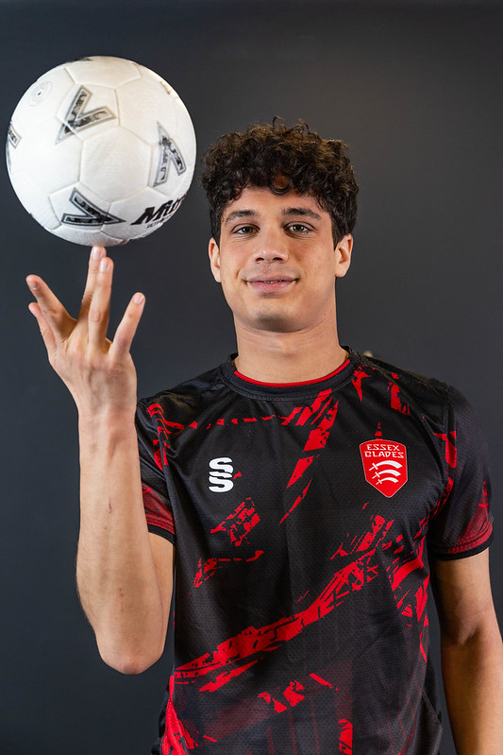
CORE OFFICER TRAINING 25/26
Elections
Elections usually take place in term 2 and determine who will be running the sports club for the next academic year.
We are changing when Sports Club Committee Elections will take place. Sports Clubs elections for Core roles (President, Vice-President, Welfare Officers, Treasurers) will now run alongside the student leadership elections, the aim of this is to increase the promotion of the elections!
All non-core roles will then be elected in May.
Notes:
see a substantial increase in first time su engagement
have at least 25 individuals register interest to be trained to be group leaders for following year

Slide 23
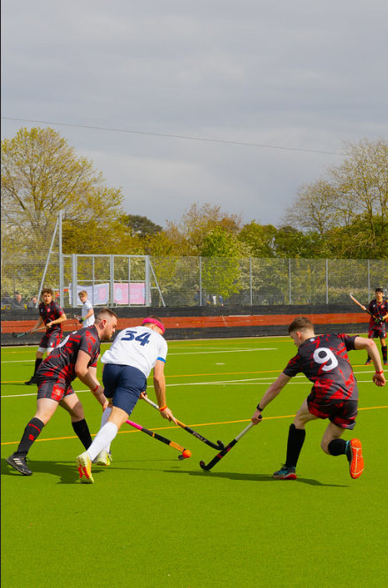
CORE OFFICER TRAINING 25/26
Ordering clothes and equipment
BUCS Playing Kit & Equipment
BUCS Playing Kit is provided by Essex Sport and is not replaced annually.
Clubs must maintain and pass on the kit each year.
Captains are responsible for keeping kit clean, safe, and accounted for.
Ordering Additional Gear
Personalised items (e.g. hoodies, named shirts) must be paid for by the members and purchased through the club.
Payments should be made to the club account with a clear description. We can help set up payment tickets if needed.
Orders through Surridge: contact jimmy@sdlgroupltd.com and feel free to CC us.
New Equipment Requests
For new equipment (boxing gloves, hockey sticks, etc), email Hannah Mortier at hannah.mortier@essex.ac.uk.
Requests must be approved by your Treasurer.
All new equipment costs come from your club funds.
Notes:
see a substantial increase in first time su engagement
have at least 25 individuals register interest to be trained to be group leaders for following year

Slide 24
CORE OFFICER TRAINING 25/26
THE BLADES EXECUTIVE COMMITTEE
The Blades Executive Committee is the same as one of your committees, but they run Essex Blades overall
They still have a President, Vice President, so on
Your Blades President this year is Ata!
The rest of the committee is currently empty – which could be an opportunity for you!
The open positions are:
Vice President
Welfare Officer
Club Development Officer
Treasurer
Community and Volunteering
Social Media Officer
Applications for these positions will be open soon!
Notes:
see a substantial increase in first time su engagement
have at least 25 individuals register interest to be trained to be group leaders for following year

Slide 25
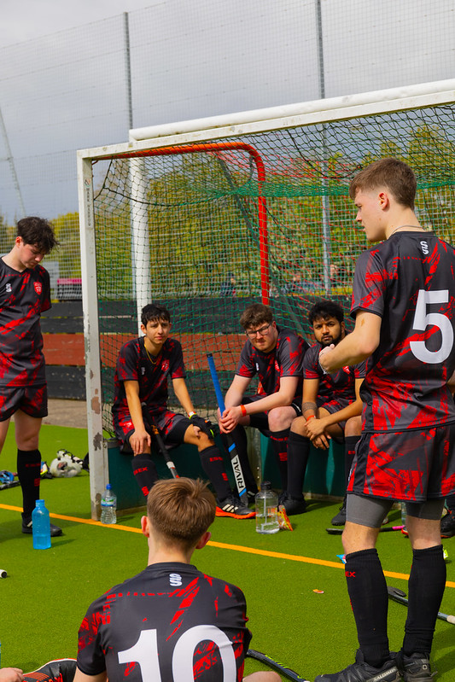
CORE OFFICER TRAINING 25/26
General MEETINGS
Blades General Meetings
Blades General Meetings are held twice per term, at least two committee members per club must attend.
You’ll receive a calendar invitation for the General Meetings. They will occur on the below dates.
Thursday 9th October
Monday 24th November
Tuesday 20th January
Thursday 19th March
Tuesday 21st April (Pre Derby Day Meet)
If you’d like to add an item to the agenda, please email blades@essex.ac.uk in advance.
What’s Covered?
Meetings include updates and discussions on topics such as:
Key term-specific information (e.g. Sports Awards details in March)
Training and facility updates
Other important club-related news
Your input is always welcome - these meetings are a great opportunity to stay informed and have your say.
Notes:
see a substantial increase in first time su engagement
have at least 25 individuals register interest to be trained to be group leaders for following year

Slide 26
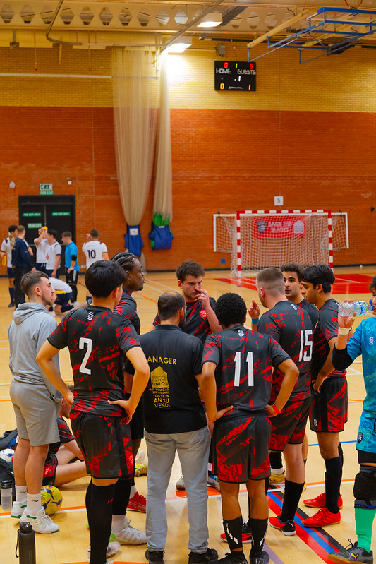
CORE OFFICER TRAINING 25/26
Committee meetings
Committee meetings are essential for staying connected, maintaining smooth communication, and ensuring the effective running of your club throughout the year.
They allow you to divide responsibilities in a way that suits each committee member while benefiting the club as a whole.
Meetings don’t have to be long and could include discussions such as:
Reviewing the weekly finance report
Ensuring members are paying their fees and booking sessions
Planning social media content and strategies
Organising socials and future meetings
Delegating tasks such as training times and weekly registers
Notes:
see a substantial increase in first time su engagement
have at least 25 individuals register interest to be trained to be group leaders for following year

Slide 27
CORE OFFICER TRAINING 25/26
MANAGING CONFLICTS
If a conflict arises between club members, start by speaking directly with the individuals involved, either one-on-one, with a supportive executive member, or in an informal team setting. Focus on fact-finding rather than using accusatory language, and consider any challenges the person may be facing.
If the issue persists, arrange a formal meeting with Blades Staff by emailing blades@essex.ac.uk.
For any cases involving bullying or harassment, contact SU Advice / Student Support immediately.
Notes:
see a substantial increase in first time su engagement
have at least 25 individuals register interest to be trained to be group leaders for following year

Slide 28
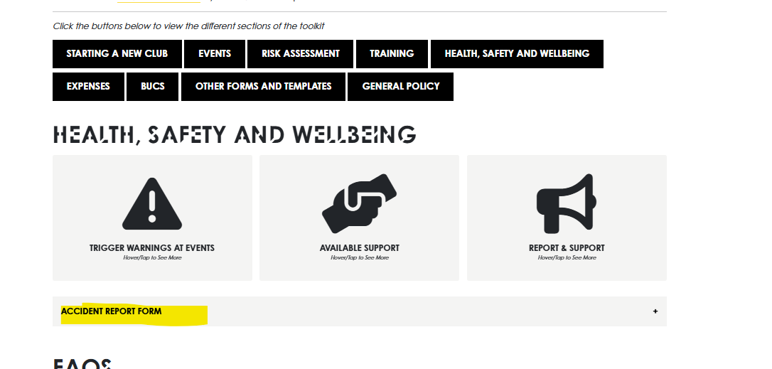
CORE OFFICER TRAINING 25/26
Accident Report Form
We have now created an online version of the Accident/Incident report form which can be found here, and on the Sports Toolkit under 'Health, Safety and Wellbeing'.
For health and safety and insurance purposes, it is super important that this is completed after any sports club related accidents.
Notes:
see a substantial increase in first time su engagement
have at least 25 individuals register interest to be trained to be group leaders for following year

Slide 29
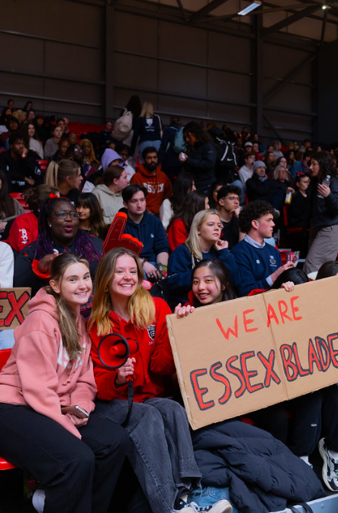
CORE OFFICER TRAINING 25/26
Derby Day
Derby Day will be at Essex on 22nd April - SAVE THE DATE !
Pre warn your teams to keep that day free
You have the date – please plan accordingly
Send in extra training requests ahead of time (a month.
This is only 2 days after term, so please consider your teams coming back early from easter to prepare
Make sure your teams are ready!!
We will distribute more information closer to the date.
We would like to support, not just those that are participating. Great opportunity for a social (criteria for standards)
Notes:
see a substantial increase in first time su engagement
have at least 25 individuals register interest to be trained to be group leaders for following year

Slide 30
CORE OFFICER TRAINING 25/26
Training Registers
Each committee will be sent an excel sheet with a specific password to their sheet.
Enter the session date and start time in the top row (e.g. "8 Oct 17:00")
List members' full names in the left-hand column - please use the exact name as shown on their student ID cards.
For each session, use the dropdown menu to select either "1" for attended or "0" if they did not attend.
The register should be updated weekly — reminders will be sent if it’s not kept up to date.
To avoid confusion, it’s best to assign this responsibility to one committee member.
Notes:
see a substantial increase in first time su engagement
have at least 25 individuals register interest to be trained to be group leaders for following year

Slide 31
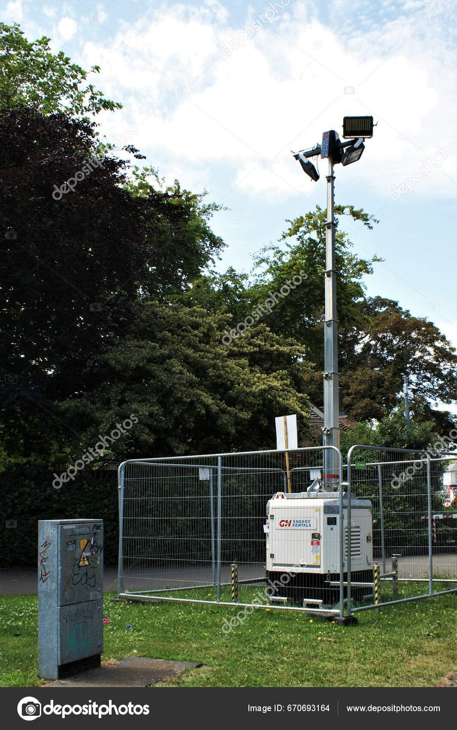
CORE OFFICER TRAINING 25/26
Essex Sport Floodlight Training
If your club trains in facilities that require floodlights, you will be required to attend a brief training session on how to operate them.
Further details will be shared with you in due course.
Notes:
see a substantial increase in first time su engagement
have at least 25 individuals register interest to be trained to be group leaders for following year

Slide 32
CORE OFFICER TRAINING 25/26
Booking travel
Please note, we do not cover transport to and from events which are non-BUCS
We can still make the booking for you, since we can book a large number of train tickets on Trainline and we have an agreement with Roman Coaches, but the cost will come out of your club fund
If you are considering travel with an outside company – be careful! There are a lot of scams where they will take your money and your transport will never show up – better to go with the reliable company
No expenses are approved unless agreed prior with us.
Notes:
see a substantial increase in first time su engagement
have at least 25 individuals register interest to be trained to be group leaders for following year

Slide 33
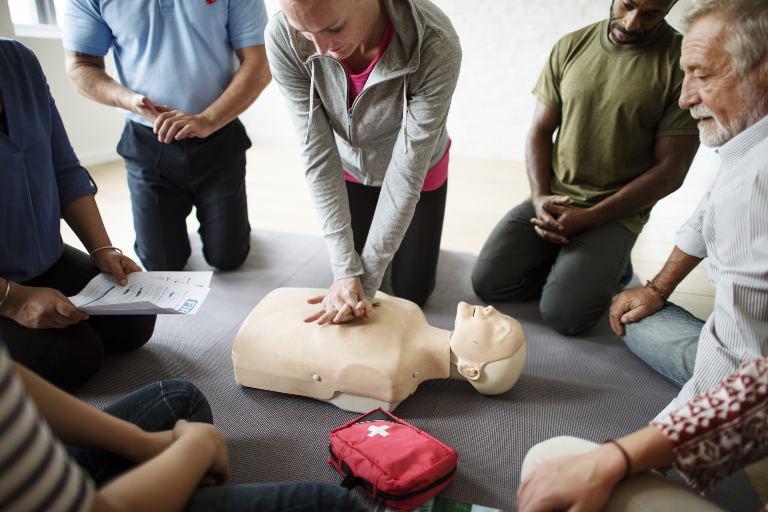
CORE OFFICER TRAINING 25/26
FIRST AID TRAINING
All club Committees are required to have at least 2 individuals on the committee trained in first aid, if anyone already has the certification please let us know so we can update our records.
We are holding three sessions on the following dates, you can book your tickets through What's On.
Wednesday 1st October (16:30-18:30)
Tuesday 7th October (16:30-18:30)
Thursday 16th October (16:30-18:30)
All attendees will be awarded with a certificate.
Notes:
see a substantial increase in first time su engagement
have at least 25 individuals register interest to be trained to be group leaders for following year

Slide 34
CORE OFFICER TRAINING 25/26
Opportunity to ask any questions you may have
We now have a few minutes to answer any questions you may have!
Please do not go anywhere yet as we still have a Video for you to watch and a Moodle quiz for you to complete.
Notes:
see a substantial increase in first time su engagement
have at least 25 individuals register interest to be trained to be group leaders for following year

Slide 35
CORE OFFICER TRAINING 25/26
Moodle Quiz
Please watch the manual handling video before you complete the Moodle Quiz.
19 Questions
Pass Mark 16/19
Link in the chat
Once you have accessed to the quiz and can see it feel free to leave the call, if not we will be ending the call in 5 minutes.
Notes:
see a substantial increase in first time su engagement
have at least 25 individuals register interest to be trained to be group leaders for following year

Slide 36
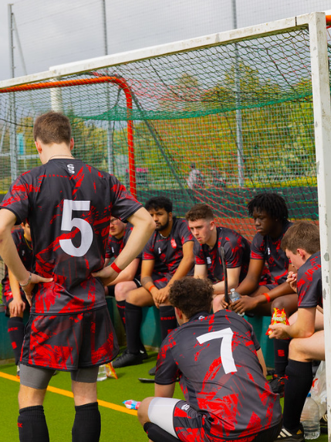

CORE OFFICER TRAINING 25/26
thank you
for LISTENING*
Got Questions?
Email us at blades@essex.ac.uk
Or send us a WhatsApp on 07935134538
*mostly

