Slide 1
FINANCE TRAINING 24/25
Finance Training 24/25
Please take a minute to type your name, club, and exec role in the chat box. This helps us to track attendance.

Slide 2
introduction
BECCA MACLEANAN
TRAINEE ASSISTANT ACCOUNTANT
DOMINIC KING
HEAD OF STUDENT SPORT
IAN LAU
VP STUDENT EXPERIENCE
HANNAH MORTIER
SPORTS COORDINATOR
SU SPORTS ASSISTANTS
DHYANA STORY
KATIE GIESS
ABBY FUNG
FINANCE TRAINING 24/25
To get in touch with us :
Email blades@essex.ac.uk
WhatsApp 07935 134538 (this is the blades phone)
or pop by the Sports Office (room 5.02) during working hours

Slide 3
SESSION FORMAT
Take notes (please!)
Ask any questions in the chat, otherwise there will be the opportunity to ask at the end.
This session is being recorded so please turn your camera off if you do not wish to be in the video.
You will be required to complete a Moodle test at the end of this presentation to mark your training as completed.
This presentation and recording will be available for you to view afterwards on the Sports Toolkit.
FINANCE TRAINING 24/25

Slide 4
Training aims
The purpose of this session is to provide you with essential guidance to ensure the smooth running of your club, specifically financially
and legally.
We will share these slides and the recording with you all afterwards.
Please ask the Societies team for advice before agreeing to any invoices you afore you purchase, if you are unsure whether you will be refunded.
FINANCE TRAINING 24/25

Slide 5
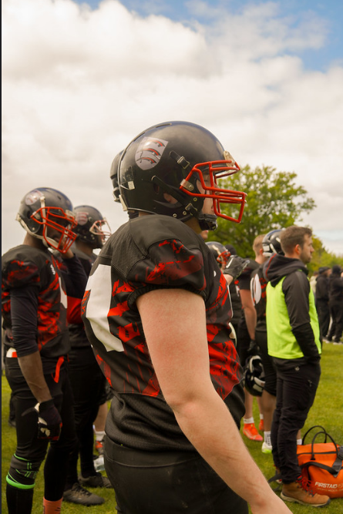
ROLES
President & Treasurer
Together, you have primary responsibility for all your club finances.
You are responsible for paying in money received through events/fundraising and donations.
You are responsible for ensuring all members have paid their membership fees.
Approving expenses (Mainly Treasurer, if the treasurer is claiming an expense the president or SU staff will approve/deny).
Budgeting for the year and ensuring expected income covers outgoings for the year (Equipment, Transport, Social Activity, Member expenses).
Attendance to finance clinics if required.
ENSURING THE CLUB DOES NOT LOSE FUNDS OVER THE YEAR.
FINANCE TRAINING 24/25

Slide 6
Expenses
This year we are introducing a new system for claiming back expenses.
Expense in will be the new software we are using.
This will go live on the 19th September and the old expense process will be deactivated.
All students claiming an expense will need an account, in order to set up an account we need to manually add you – we ask that you complete a typeform that will be circulated with you and added to the sports toolkit so we can create the account.
You will then receive an email notification to complete your account verification.
You can only submit an expense once your account has been verified.
FINANCE TRAINING 24/25

Slide 7
HOW TO SUBMIT AN Expense
Becca is now going to demonstrate how students would submit an expense reclaim form using the new expense in system.
A guide form on how to create your account once you receive the invite will also be available to you.
FINANCE TRAINING 24/25

Slide 8
MILEAGE EXPENSES
Any mileage claims made by students are always sent to the Blades team for approval.
For an expense to be approved the student must have provided a copy of their Driving License (photo of license front and back) and a copy of their Insurance document.
If you know that you are going to be driving for the club this year and want to send these documents in advance so there are no holds-ups when you submit your expense we recommend that you do this.
When submitting a Millage Expense claim, please state the postcode of where your journey started and where it ended, we also need full names of all passengers.
Number of Passengers | Amount per mile
1 Person in car (Driver) | 25p per mile
2 People in car | 30p per mile
3 People in car | 35p per mile
4 People in car | 40p per mile
5 People in car | 45p per mile
FINANCE TRAINING 24/25

Slide 9
'YOUR ACCOUNT'
Everything should go through your official club account.
When you start receiving your weekly finance reports, it’ll look a bit like you have your own bank account.
However, clubs do not actually have their own bank account – just a sub section within the SU’s account.
Clubs cannot open their own bank accounts – this is against the law. If a club does this, there will be consequences faced and you could potentially face closure and further disciplinary action.
Each club is assigned a unique 3 digit finance code. E.g. American Football is AMF to identify your account.
This is not a formal bank account so does not provide a card, chip & pin etc, but allows clubs to make transactions easily.
FINANCE TRAINING 24/25

Slide 10
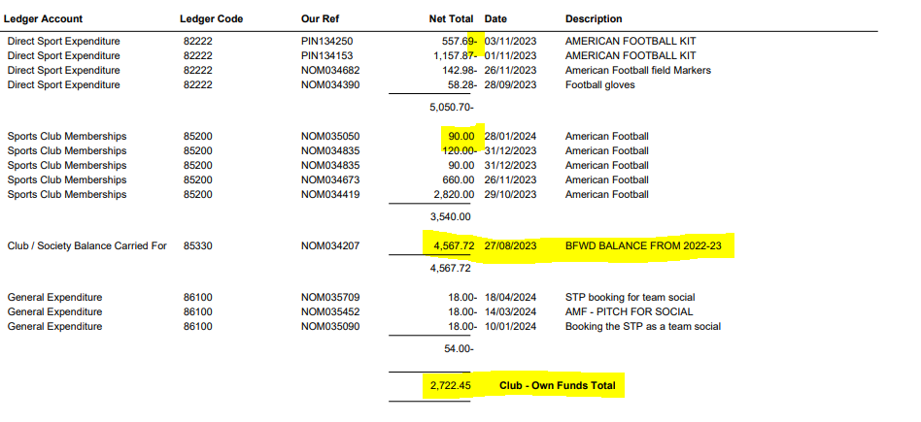
UNDERSTADING YOUR ACCOUNT
FINANCE TRAINING 24/25
Any income from memberships/fundraising etc will be positive.
Any expenditure is negative.
Balance carried forward can be viewed.
View current funds at the bottom.
Aim is keep the 'Own Funds Total' consistent year on year.
Some transactions may appear multiple times, but will often offset to the right balance.
Let us know if something does not appear correct.

Slide 11
UNDERSTADING YOUR ACCOUNT
What is in your account?
Club Balance Carried Forward – This is the balance that has been carried forward from the previous year.
Session / Match Expenditure – Referee/ transport costs. This year all BUCS costs will be visible on your club accounts, in most instances you will not actually be charged. For instance it may appear as 300.00 - followed by 300.00
Sports Clubs Memberships – This is where you can view all income generated by membership funds, any refunded memberships will be shown as a negative.
General Income/ General Expenditure – Any general income or expenditure.
Donations – Any donations e.g from Alumni.
Alumni/CLICK Income – Fundraising/Donations through the Universities CLICK programme.
Tour Income – If you have organised your own trip and members are paying funds into the club, the income from this would appear under this section.
FINANCE TRAINING 24/25

Slide 12
WEEKLY FINANCE REPORTS
These reports are sent to the listed President and Treasurer only starting at the end of September.
If by the middle of October, you aren't receiving these updates please let us know (blades@essex.ac.uk)
The are automatically sent out every weekend.
It’s the responsibility of the treasurer to check these weekly reports and flag any issues – email suexpenses@essex.ac.uk if you notice any concerns.
Any member of your club has the right to view the finance report. They can request to view the weekly finance report by submitting a request in writing (email) to either the President or Treasurer of their club.
FINANCE TRAINING 24/25

Slide 13
Value ADDED TAX (VAT)
UK Value Added Tax (VAT) is currently 20% and added to most purchases, and deducted on general income. Sports Clubs will be treated as Exempt on any products that are directly related to sport (E.g. sports equipment, match officials, sports travel etc.)
Note: Anything not directly related to sport (E.g. socials, tours, general hoodies etc.) WILL be charged VAT and therefore you will need to account for this when collecting income or paying expenses.
Sports club accounts for 2024/25 will be split into the following:
Income:
Sports Club Memberships (85200) - Any membership fees
Session/Match Fees (85300) - Any session or match fees outside of membership
General Income (80010) - Any NON sport-related Income
Donations (80301) - Any Donations (Note: Sponsorship will go through General Income and be VATable)
Alumni CLICK (80302) - Any University CLICK fundraising
Expenses:
Direct Sports Expenditure (82222) - Any Sport-related expenses
General Expenditure (86100) - Any Non Sport-related expenses
Irrecoverable VAT (75120) - Any VAT which is not able to be recovered
BUCS League & Cup Expenditure (85316) - Any BUCS costs for league/cup teams
BUCS Individual & Team Championships (85317) - Any BUCS Individual/Team Championship costs
BUCS Team Entry Fees (85315) - Any Entry costs
FINANCE TRAINING 24/25

Slide 14
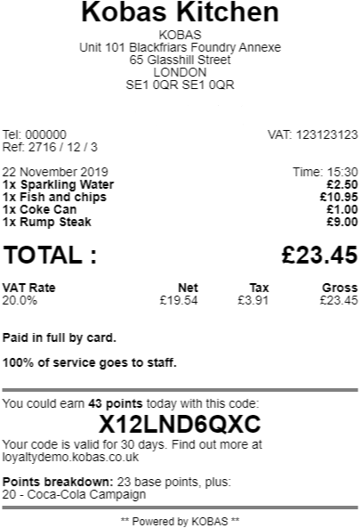
VAT RECEIPT
Always ask for a VAT receipt, not everywhere will be VAT registered, but ask.
The receipt needs to show the
VAT registration number and a
breakdown of VAT.
VAT receipt clearly needs to show what the VAT was for us to reclaim the costs.
Note: For general expenses, non-sport expenses VAT can be reclaimed.
FINANCE TRAINING 24/25

Slide 15
Spending money
Ways to pay/purchase:
Ask for an invoice where possible – most companies will invoice if you email and ask them. Some will ask for a purchase order number, in this instance please speak to us.
Speak to the Essex Blades Sports team if it is a large expense and/or an invoice isn’t possible, potential to pay via a department card in certain circumstances.
Individual members pay for the products and claim back expenses afterwards (if they can afford to do so).
Before any purchase, check with the Treasurer that there are sufficient funds to make the purchase and they agree to what is being purchased.
All purchases should benefit the club as a whole and not a particular individual!
FINANCE TRAINING 24/25

Slide 16
Rag - Raise and give
The SU is a registered charity, and so cannot make direct payments to other charities in the ‘normal’ way.
The RAG account is another branch of the SU’s bank account.
If you are fundraising for an external charity, your money must go into the RAG account and not your own club fund.
Whether you are fundraising online for an external charity, through a card machine, or paying in cash to SU Reception, you have to complete the RAG form.
State the amount you paid in or fundraised, which club on behalf of, which charity the money should be paid to and then the address & bank details of that charity.
If you are fundraising for your club and an external charity, you must clearly state what percentage of proceeds will go where. E.g 50% club, 50% external charity.
FINANCE TRAINING 24/25

Slide 17
Cash payments
In order to take cash payments, you will require a cash float (loose change) to be able to give people change for what they purchase. Get at least one other member of your club to check the amount in the float before you start selling anything so there won’t be any disputes at the end of the day.
If you need help arranging a cash float, ask the blades team who can coordinate with SU finance.
You must pay cash raised for your club into SU Reception as soon as possible.
Take the cash raised to SU Reception and complete a paying in form.
Return the float to SU Finance. In the event of raising money on behalf of a charity/making donation, all funds must be brought to SU Finance.
FINANCE TRAINING 24/25

Slide 18
Cash payments
All income and expenses must go through the club’s account.
Never offset expenses against income and pay in the difference. This avoids VAT and therefore would be illegal.
Always pay everything fundraised into the account and then claim back any expenses afterwards. Never pay any income into your own personal account.
Example: You raise £100 for your club through a bake sale but previously paid £20 of your own money towards ingredients – you need to pay all the £100 in before claiming any expenses. You cannot take £20 out of the £100 raised and then pay £80 in.
FINANCE TRAINING 24/25

Slide 19
Card machines
If you wish to use a card machine for an event, you must book to borrow one from our Student Activities Team.
You cannot use your own card machine under any circumstance.
The SU's card machines are directly linked to the SU club accounts.
The SU Activities team have 5 x card machines to borrow:
Two of which are RAG machines and are designed to collect payments and funds that are going to be donated to another charity.
The other three are designed so that the funds will go to your clubs account.
Please be clear where your income is going.
Please plan ahead as they are allocated on a first come first sevred basis.
FINANCE TRAINING 24/25

Slide 20
Card machines
How to book a card machine:
Email blades@essex.ac.uk with as much notice as possible and state what event you would like to borrow a card machine for and whether you are fundraising for your own club or an external charity. Please supply us with the card machine form and if it is an external charity you are raising funds for, please complete the RAG form.
The Essex Blades Sports team will check availability for the date asked.
If the preferred date is available we will confirm this with you and arrange for collection, please note that the card machines can be used most days during busy periods so only keep hold of the machine for the duration of your event and return as soon as possible afterwards.
If borrowing over the weekend, you will be required to collect Friday and return on Monday.
FINANCE TRAINING 24/25

Slide 21
INVOICES
Invoices are the easiest way for us to make payments directly from your Club's fund and mean you do not have to make large payments from your own personal bank account and wait to be refunded.
Most companies will provide invoices, although some may seem reluctant. Just email or call to explain you are a sports club and ask to pay via invoice.
Examples of when to use an invoice:
Coach transport to a trip (the SU have an account with Roman Coaches, so please ask us for a quote in first instance)
Entry fees for a competition
Accommodation costs
Equipment purchases
FINANCE TRAINING 24/25

Slide 22
INVOICES
Please email any invoices to suinvoices@essex.ac.uk and cc in blades@essex.ac.uk
Club treasurer should deal with invoices.
Must be addressed as follows:
University of Essex Students Union (insert your club name)
Wivenhoe Park
Colchester
Essex
CO4 3SQ
Failure to address correctly, will result in a delay of payment, whilst we wait for a corrected invoice to be sent over.
FINANCE TRAINING 24/25

Slide 23
INVOICES
Please ask the Essex Blades Sports team for advice before agreeing to any invoices you are unsure of.
The Blades team reserves the right to reject any invoice or expense claim (e.g. you cannot claim back the cost of alcohol).
Please check with us before you purchase, if you are unsure whether you will be refunded.
FINANCE TRAINING 24/25

Slide 24
INVOICES
Invoices need to clearly state:
The bank details of whom the money will be sent to
The date in which they provided a service (if applicable)
A good description of what the service was/product list.
If an invoice includes any incorrect details, we have to wait for the supplier to amend the details before processing, which slows down the approval process.
Please make sure to look over these slides again when getting an invoice from someone, so that everything is done as smoothly as possible.
FINANCE TRAINING 24/25

Slide 25
INVOICE deadlines
Invoices should be emailed to suinvoices@essex.ac.uk and blades@essex.ac.uk in order for them to be processed.
Our payment terms for invoices is usually 30 days unless stated otherwise, in exceptional circumstances these can be processed quicker, please note our payment runs are Wednesday only. Many suppliers will require payment upfront, so leave yourselves enough time for invoices to be processed.
Wednesdays – Only authorised Invoices are processed for payment on this day (there is one payment day per week only).
Invoices are classed as authorised once the Treasurer/President/Blades Team signs them off, not once you have submitted it.
Fridays – Recipient will usually receive their payment in their account if it has been processed on the Wednesday.
FINANCE TRAINING 24/25

Slide 26
INVOICE reminders
Allow lots of time to receive an invoice and ensure it is paid before the deadline.
If you have a strict deadline to meet e.g. entry fees, make the Blades team aware and ensure you have followed the timeline for approval.
Please also be wary of sending invoices and expense claims over periods where there may not be staff in, for example between Christmas and New Year. Payments will not be made during this period.
Invoices and delivery address MUST be as below.
University of Essex Students Union (insert your club name)
Wivenhoe Park
Colchester
Essex
CO4 3SQ
FINANCE TRAINING 24/25

Slide 27
DONATIONS
An individual or organisation, may wish to offer a donation to your
club. All they need to do is make the payment into the SU’s bank
account – details on next slide.
When paying into the SU’s account, please make sure you use
a reference that includes: Club finance code (E.g. AMF
for American Football), the first name initial and surname, state that it is a
Donation.
Example: AMF/T.Smith/donation
Email suexpenses@essex.ac.uk and blades@essex.ac.uk to state who has
donated, what organisation they’re from, how much they have
donated, and that it is a ‘charitable donation’. By stating that it is a
charitable donation, the money will not be subject to VAT and the
person/organisation donating is acknowledging that they do not want
anything in return.
FINANCE TRAINING 24/25

Slide 28
DONATIONS
The SU’s bank details are:
LLoyds
Sort Code: 30-92-16
Account Number: 00379913
Remember to include the following reference: (insert club finance
code)/ (insert initial.surname)/Donation
FINANCE TRAINING 24/25

Slide 29
Ordering
If you want to order things like hoodies or shirts that have names on them etc, this comes out of your own individual personal money. The funds should be paid into the club account with a clear description – we can set up tickets on club webpages for these products.
Surridge can then raise an invoice and finance will charge this to your clubs account.
If you want to make a purchase from Surridge, you can order online or email jimmy@sdlgroupltd.com
You can also liaise with us about your Surridge orders or feel free to cc us in any emails with Surridge.
If you would like new equipment (boxing gloves, hockey sticks, etc)
you need to send an order request email to Dominic King, at
dsking@essex.ac.uk along with your updated club equipment inventory - This purchase will also need to be approved by your Treasurer.
THIS USUALLY COMES OUT OF YOUR CLUB FUND!
FINANCE TRAINING 24/25

Slide 30
FINANCE TRAINING 24/25
CLICK Crowd FUNDING
You could get up to £500 match funding thanks to the Universities match funding scheme.
Click is Essex's very own crowdfunding platform which is free for students and alumni to fundraise for their big ideas and projects.
Projects submitted by Essex students are eligible for up to £500 of match funding. Match funding means that the University of Essex agrees to ‘match’ donations received to a project, £1 for £1, up to an agreed limit. For example, £100 of match funding means that every £1 raised will be worth £2, until the project total reaches £200.
Find out more about Click Crowdfunding: Click crowdfunding | University of Essex
The Click Platform - University of Essex (hubbub.net)

Slide 31
SPONSORSHIP
Sports Clubs can be sponsored by external companies however there are some conditions …..
A Club cannot enter into an agreement with a Sponsor that may represent a conflict of interest to either the University, Students’ Union or one of our contractual suppliers. The following are examples of such conflicts:
Local Bars, Pubs (we have SU Bar)
Cinemas (we have Cine 10)
Lettings Agencies (we have SU Homes)
Supermarkets and Convenience Stores (we have SU Stores)
Any suppliers targeted by BDS (Boycott Divestment Sanctions)
Other Universities
Suppliers of soft or alcoholic drinks
Bus transport companies
Organisations that may bring the Union or University into disrepute
The sponsorship agreement begins on page 12 of the document below.
FINANCIAL-POLICIES-PROCEDURES-CLUB-SOCIETY-TREASURERS-1.pdf(essexstudent.com)
Please make sure you have read this through before beginning to fill in the Blank Sponsorship Agreement
On Page 17 is the full blank Sponsorship Agreement that needs to be filled in by both the Club and the Sponsor in order to enter into an agreement with an external sponsor
Once this is done, it still must be signed by the SU – Please email it to us (blades@essex.ac.uk)
FINANCE TRAINING 24/25

Slide 32
Any questions?
YOU NOW HAVE AN OPPORUNITY TO ASK ANY QUESTIONS SHOULD YOU HAVE THEM.
P.S Please do not go anywhere as we have a Moodle test for you to complete.
FINANCE TRAINING 24/25

Slide 33
Moodle test
20 QUESTIONS 16/20 TO PASS
LINK TO ACCESS IN CHAT
PLEASE LEAVE THE CALL ONCE YOU HAVE ACCESS TO THE TEST.
FINANCE TRAINING 24/25

Slide 34
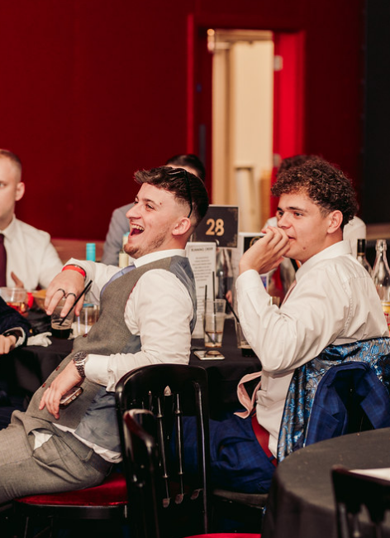
FINANCE TRAINING 24/25
thank you
for LISTENING*
Got Questions?
Email us at blades@essex.ac.uk
Or send us a WhatsApp on 07935134538
*mostly

