Slide 1


FINANCE TRAINING 25/26
Finance Training 25/26
Please take a minute to type your name, club, and exec role in the chat box. This helps us to track attendance.

Slide 2


Introduction – STAFF
EMMA SAINTY
HEAD OF MEMBERSHIP COMMUNITIES
SU SPORTS ASSISTANTS
JESSICA VASSENA
YOYO TANG
HANNAH RASHIDI
ABBY FUNG
ASSISTANT ACCOUNTANTS
ELENA FAIETA
BEN BRAGG
SUFINANCE@ESSEX.AC.UK
HANNAH MORTIER
SPORTS MANAGER
ROB NEALE
SPORTS COORDINATOR
FINANCE TRAINING 25/26
To get in touch with us :
Email blades@essex.ac.uk
WhatsApp 07935 134538 (this is the Blades phone)
or pop by the Sports Office (behind SU Reception on Square 4) during working hours.

Slide 3
SESSION FORMAT
This session is being recorded so please turn your camera off if you do not wish to be in the video.
Ask any questions in the chat, otherwise there will be the opportunity to ask at the end.
You will be required to complete a Moodle test at the end of this presentation to mark your training as completed.
This presentation and recording will be available for you to view afterwards on the Sports Toolkit.
Take notes
FINANCE TRAINING 25/26

Slide 4
Training aims
The purpose of this session is to provide you with essential guidance to ensure the smooth running of your club, specifically financially
and legally.
We will share these slides and the recording with you all afterwards.
Please ask the Societies team for advice before agreeing to any invoices you afore you purchase, if you are unsure whether you will be refunded.
FINANCE TRAINING 25/26

Slide 5
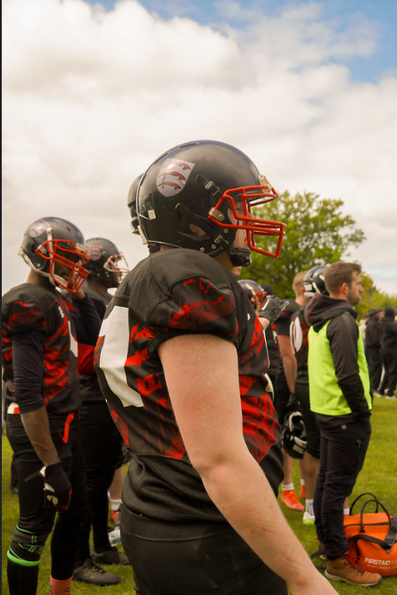
ROLES
President & Treasurer – Key Responsibilities
Share primary responsibility for all club finances.
Ensure all members pay their membership fees.
Pay in income from events, fundraising, and donations.
Approve expenses (Treasurer only).
Budget for the year, ensuring income covers costs (e.g., equipment, transport, socials, member expenses).
Most importantly: ensure the club does not lose money.
FINANCE TRAINING 25/26

Slide 6
Understanding YOUR ACCOUNT
All club finances must go through your official SU club account.
Weekly finance reports may look like a personal bank statement, but clubs do not have their own bank accounts.
Clubs cannot open separate bank accounts – this is illegal and will result in disciplinary action.
Each club has a unique 3-digit finance code (e.g., AMF for American Football) to identify transactions.
This is not a formal bank account (no card, sort code, or account number) but allows clubs to make transactions securely.
FINANCE TRAINING 25/26

Slide 7
Weekly finance reports
Club presidents and treasurers will receive a weekly email that will have a PDF document attached, which is your finance report.
If you aren’t receiving these, please confirm we have the correct details for your club.
It is the treasurer's responsibility to check these weekly finance reports, and if you identify any issues, please email sufinance@essex.ac.uk
Any club member has the right to view the clubs finance report. They can also request to view the weekly finance report by submitting a request in writing (email) to blades@essex.ac.uk.
FINANCE TRAINING 25/26

Slide 8
UNDERSTANDING YOUR FINANCE REPORTS
Income (e.g. memberships, fundraising) = positive
Expenditure = negative
Balance carried forward and current funds shown at bottom
Keep ‘Own Funds Total’ steady year on year
Some transactions may appear more than once but will often balance out
Contact us if anything looks incorrect
If you club funds are under £1000, we will need to work with you to take action and build these back up.
FOR BUCS CLUBS ONLY
BUCS costs go through the club account under ‘BUCS League Expenditure’
These are always reimbursed and shown as ‘ESB FUNDING RE BUCS EXPENDITURE’
Final BUCS balance should always be £0.00
FINANCE TRAINING 25/26

Slide 9
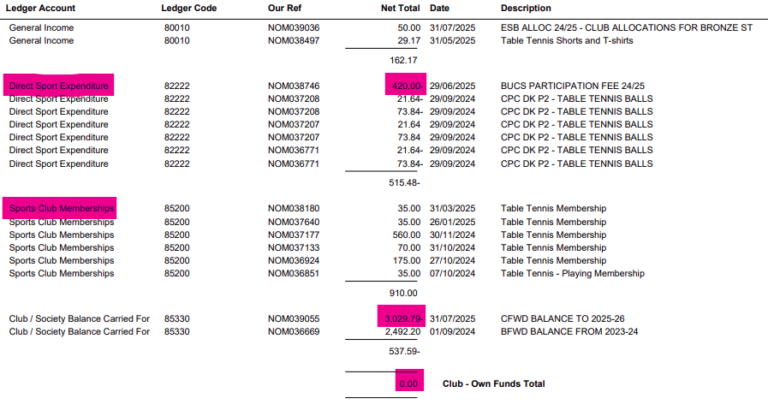
Weekly finance reports
FINANCE TRAINING 25/26

Slide 10
Finance codes
Sports club accounts for 2025/26 will be split into the following:
Income:
Sports Club Memberships (85200) - Any membership fees
Session/Match Fees (85300) - Any session or match fees outside of membership
General Income (80010) - Any NON sport-related Income
Donations (80301) - Any Donations (Note: Sponsorship will go through General Income and be VATable)
Alumni CLICK (80302) - Any University CLICK fundraising
Expenses:
Direct Sports Expenditure (82222) - Any Sport-related expenses
General Expenditure (86100) - Any Non Sport-related expenses
Irrecoverable VAT (75120) - Any VAT which is not able to be recovered
BUCS League & Cup Expenditure (85316) - Any BUCS costs for league/cup teams
BUCS Individual & Team Championships (85317) - Any BUCS Individual/Team Championship costs
BUCS Team Entry Fees (85315) - Any BUCS Entry costs
FINANCE TRAINING 25/26

Slide 11
Spending money
Ways to pay/purchase:
Ask for an invoice where possible, most companies will invoice if you email and ask them. Some will ask for a purchase order number (PO). In this instance, please speak to us, and we can provide you with a PO.
Speak to the Essex Blades Sports Staff team if it is a large expense and/or an invoice isn’t possible, potential to pay via a department card.
Individual members pay for the products and claim back expenses afterwards (if they can afford to do so). We would only recommend this for purchases under £50.
Before any purchase, check with the Treasurer that there are sufficient funds to make the purchase, and they agree to what is being purchased.
All purchases should benefit all club members and not just a particular individual!
FINANCE TRAINING 25/26

Slide 12
Spending money (via department card)
If you would like the Essex Blades Sports Staff Team to make a purchase on your behalf using the department credit card, we require the following information.
Hyperlink to the item/s
Size information
Colour
Quantity
Any other relevant information
FINANCE TRAINING 25/26

Slide 13
Ordering
Personalised items (e.g. hoodies, shirts with names) must be paid for personally into the club account with a clear reference.
Tickets can be set up on your club webpage for easier payment.
Clubs with strong finances may fund up to 50% of committee kit.
Surridge orders:
Invoices charged to your club account.
Order online or email jimmy@sdlgroupltd.com (cc blades@essex.ac.uk).
New equipment requests (e.g. gloves, sticks) must be emailed to blades@essex.ac.uk and approved by your Treasurer before purchase.
FINANCE TRAINING 25/26

Slide 14
Value ADDED TAX (VAT)
UK Value Added Tax (VAT) is currently 20% and added to most purchases, and deducted on general income. Sports Clubs will be treated as Exempt on any products that are directly related to sport (E.g. sports equipment, match officials, sports travel etc.)
Note: Anything not directly related to sport (E.g. socials, tours, general hoodies etc.) WILL be charged VAT and therefore you will need to account for this when collecting income or paying expenses.
You can claim back any VAT you paid when you buy goods, but only if you ask for a VAT receipt when you pay. This may show the VAT registration number and a breakdown of the VAT. (Please note that not all companies are VAT registered).
FINANCE TRAINING 25/26

Slide 15
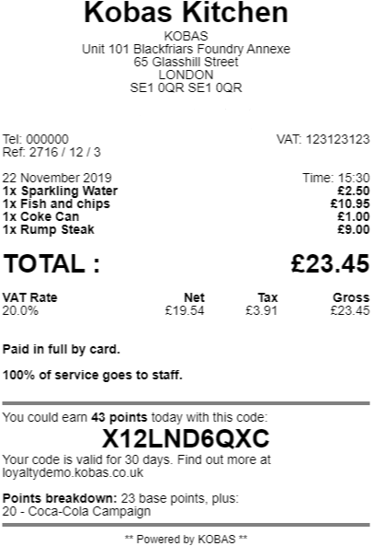
VAT RECEIPT
The receipt needs to show the
VAT registration number and a
breakdown of VAT.
VAT receipt clearly needs to show what the VAT was for us to reclaim the costs.
Note: For general expenses, non-sport expenses VAT can be reclaimed.
FINANCE TRAINING 25/26

Slide 16
How to calculate VAT
Always factor in VAT when budgeting, or you risk a loss.
To calculate VAT deducted: divide the ticket price by 1.2.
Example: £30 ticket → £30 ÷ 1.2 = £25 received in the club account.
To set the correct price (including VAT): multiply your target income by 1.2.
Example: Need £30 → £30 × 1.2 = £36 ticket price.
FINANCE TRAINING 24/25

Slide 17

Expenses
All expenses must go through the ExpenseIn system.
Account Types
Submitting Account – for making claims.
Approval Account – for approving claims.
Key Info
Treasurers automatically receive an approval account.
If a Treasurer also wants to claim expenses, they must create a submitting account.
All other members (incl. Presidents) need a submitting account to claim expenses.
To register: complete the Typeform on the Sports Toolkit.
An email confirmation (not automatic) will be sent within 2–4 working days.
Log in to make your claim once your account is active.
🔎 A step-by-step guide is available on the Sports Toolkit.
FINANCE TRAINING 25/26

Slide 18
Expenses- approval flow
Club member submits an expense.
If the expense is over £50
If the expense is under £50
Sent to Essex Blades Sport Staff to accept/reject
Sent to the club treasurer to accept/reject
Outcome notification sent to the club member.
Outcome notification sent to the club member.
FINANCE TRAINING 25/26

Slide 19
Expenses- approval flow treasurer
Club Treasurer submits an expense on normal account.
The Club Treasurer approves/rejects expense on their approval account
Sent to Blades Sports Staff for secondary and final approval
FINANCE TRAINING 25/26
Outcome notification sent to the club member.

Slide 20
Expense info
You will be able to view the status of any pending expenses on your expense in account.
Students must have paid their sports club membership otherwise claims will be rejected.
Receipts and evidence must be attached, otherwise claims will be rejected.
You cannot claim back the cost of alcohol.
The Blades Staff team reserves the right to reject any expense claim.
FINANCE TRAINING 25/26

Slide 21
MILEAGE EXPENSES
Any mileage claims made by students are always sent to the Blades team for approval.
Photo of Front and Back of Driving License and Insurance documentation must be provided to Blades before expense approval.
If you know that you are going to be driving for the club this year, we recommend that you send these documents in advance so there are no holds-ups when you submit your expense.
When submitting a Mileage Expense claim, please state the postcode of where your journey started (CO4 3SQ) and where it ended. We also require the full names of all eligible passengers*.
*An eligible passenger is defined as another player or match official; spectators are not included.
Number of Passengers | Amount per mile
1 Person in car (Driver) | 25p per mile
2 People in car | 30p per mile
3 People in car | 35p per mile
4 People in car | 40p per mile
5 People in car | 45p per mile
FINANCE TRAINING 25/26

Slide 22
Rag - Raise and give
The SU is a registered charity, so donations to external charities must go through the RAG account (not club funds).
Applies to all fundraising: online, card machine, or cash at SU Reception.
Complete a RAG form with:
Amount raised/paid in
Club name
Charity name, address, and bank details
You may need to contact the charity for bank details.
Donations are on hold until correct details are provided.
FINANCE TRAINING 25/26

Slide 23
Cash payments
Use a cash float (loose change) for sales; have another club member check the float amount before starting.
For help arranging a float, contact the Blades team (who liaise with SU Finance).
Pay all cash raised into SU Reception promptly and complete a paying-in form.
Return the float to SU Finance.
If fundraising for charity, all funds must also go to SU Finance.
FINANCE TRAINING 25/26

Slide 24
Cash payments
All income and expenses must go through the club’s account.
Never offset expenses against income and pay in the difference. This avoids VAT and therefore would be illegal.
Always pay everything fundraised into the account and then claim back any expenses afterwards. Never pay any income into your own personal account.
Example: You raise £100 for your club through a bake sale but previously paid £20 of your own money towards ingredients – you need to pay all the £100 in before claiming any expenses. You cannot take £20 out of the £100 raised and then pay £80 in.
FINANCE TRAINING 25/26

Slide 25
Card machines
If you wish to use a card machine for an event, you must book to borrow one from our Communities Department.
You cannot use your own card machine under any circumstance.
The SU's card machines are directly linked to the SU club accounts.
The SU Communities department has 5 x card machines to borrow:
Two are RAG machines and are designed to collect payments and funds that are going to be donated to another charity.
The other three are designed so that the funds will go to your clubs account.
Please be clear where your income is going.
Please plan ahead as they are allocated on a first come first served basis and get booked regularly.
FINANCE TRAINING 25/26

Slide 26
Card machines
How to book a card machine:
Email blades@essex.ac.uk with event details (provide as much notice as possible) and whether funds are for your club or an external charity.
Attach the Card Machine Form.
If fundraising for a charity, also complete a RAG Form.
The Blades team will confirm availability.
If approved, collect from SU Reception.
Use only for your event and return immediately after.
Weekend bookings: collect Friday, return Monday morning.
FINANCE TRAINING 25/26

Slide 27
INVOICES
Invoices are the easiest way for us to make payments directly from your Club's fund and mean you do not have to make large payments from your own personal bank account and wait to be refunded.
Most companies will provide invoices, although some may seem reluctant. Just email or call to explain you are a sports club and ask to pay via invoice.
Examples of when to use an invoice:
Entry fees for a competition
Accommodation costs
Equipment purchases
FINANCE TRAINING 25/26

Slide 28
INVOICES
Please email any invoices to suinvoices@essex.ac.uk and cc in blades@essex.ac.uk
Club treasurer should deal with invoices.
Must be addressed as follows:
University of Essex Students Union (insert your club name)
Wivenhoe Park
Colchester
Essex
CO4 3SQ
Failure to address correctly, will result in a delay of payment, whilst we wait for a corrected invoice to be sent over.
The Invoice Template can be found here.
FINANCE TRAINING 25/26

Slide 29
INVOICES
Invoices need to clearly state:
The bank details of whom the money will be sent to
The date in which they provided a service (if applicable)
A good description of what the service was/product list.
If an invoice includes any incorrect details, we have to wait for the supplier to amend the details before processing, which slows down the approval process.
Please make sure to look over these slides again when getting an invoice from someone, so that everything is done as smoothly as possible.
FINANCE TRAINING 25/26

Slide 30
INVOICE deadlines
Email invoices to: suinvoices@essex.ac.uk and blades@essex.ac.uk.
Payment terms: usually 30 days (faster only in exceptional cases).
Payment runs: Wednesdays only.
Invoices must be signed off by the Blades Team before payment (submission alone is not authorisation).
Payments processed Wednesday usually reach recipients by Friday.
Many suppliers require upfront payment → request invoices in advance to avoid delays or refusal.
FINANCE TRAINING 25/26

Slide 31
INVOICE reminders
Allow plenty of time for invoices to be raised and paid.
For strict deadlines (e.g. entry fees), notify the Blades Team and follow approval timelines.
No payments are made during closure periods (e.g. Christmas–New Year).
All invoices/deliveries must use this address:
University of Essex Students’ Union (insert your club name here)
Wivenhoe Park Colchester Essex CO4 3SQ
FINANCE TRAINING 25/26

Slide 32
DONATIONS
Donations must be paid into the SU bank account (details on next slide).
Use this reference format: Club code / Initial.Surname / Donation
Example: AMF/T.Smith/Donation
Email suexpenses@essex.ac.uk and blades@essex.ac.uk with:
Donor’s name/organisation
Amount donated
Confirmation it is a charitable donation (no return benefit, VAT exempt).
FINANCE TRAINING 25/26

Slide 33
DONATIONS
The SU’s bank details are:
LLoyds
Sort Code: 30-92-16
Account Number: 00379913
Remember to include the following reference: (insert club finance
code)/ (insert initial.surname)/Donation
FINANCE TRAINING 25/26

Slide 34

FINANCE TRAINING 25/26
CLICK Crowd FUNDING
You could get up to £500 match funding thanks to the Universities match funding scheme.
Click is Essex's very own crowdfunding platform which is free for students and alumni to fundraise for their big ideas and projects.
Projects submitted by Essex students are eligible for up to £500 of match funding. Match funding means that the University of Essex agrees to ‘match’ donations received to a project, £1 for £1, up to an agreed limit. For example, £100 of match funding means that every £1 raised will be worth £2, until the project total reaches £200.
Find out more about Click Crowdfunding: Click crowdfunding | University of Essex
The Click Platform - University of Essex (hubbub.net)

Slide 35
SPONSORSHIP
Clubs can be sponsored by external companies, but not where conflicts exist with the SU, University, or contractual suppliers.
Not permitted:
Local bars/pubs (SU Bar)
Cinemas (Cine 10)
Lettings agencies (SU Homes)
Supermarkets/shops (SU Stores)
BDS-targeted suppliers
Other universities
Soft/alcoholic drink suppliers
Bus transport companies
Any organisation that may damage the SU/University’s reputation
The sponsorship agreement is on the Sports Toolkit.
Read the Financial Policies & Procedures first.
After signing, email to blades@essex.ac.uk for SU approval.
FINANCE TRAINING 25/26

Slide 36
Any questions?
YOU NOW HAVE AN OPPORUNITY TO ASK ANY QUESTIONS SHOULD YOU HAVE THEM.
P.S Please do not leave yet, as we have a Moodle test for you to complete.
FINANCE TRAINING 25/26

Slide 37
Moodle test
20 QUESTIONS 16/20 TO PASS
LINK TO ACCESS IN CHAT
PLEASE LEAVE THE CALL ONCE YOU HAVE ACCESS TO THE TEST.
FINANCE TRAINING 25/26

Slide 38
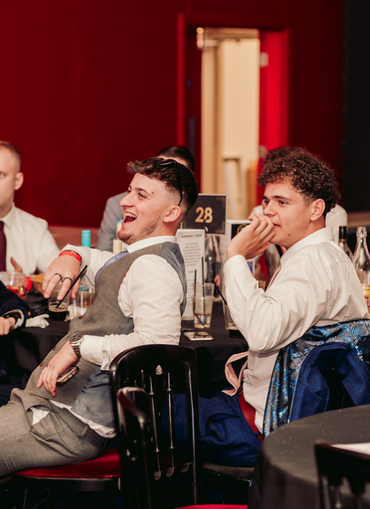

FINANCE TRAINING 25/26
thank you
for LISTENING*
Got Questions?
Email us at blades@essex.ac.uk
Or send us a WhatsApp on 07935134538
*mostly

