Slide 1




EVENTS
How to put an event on the su website / what’s on PAGE

Slide 2
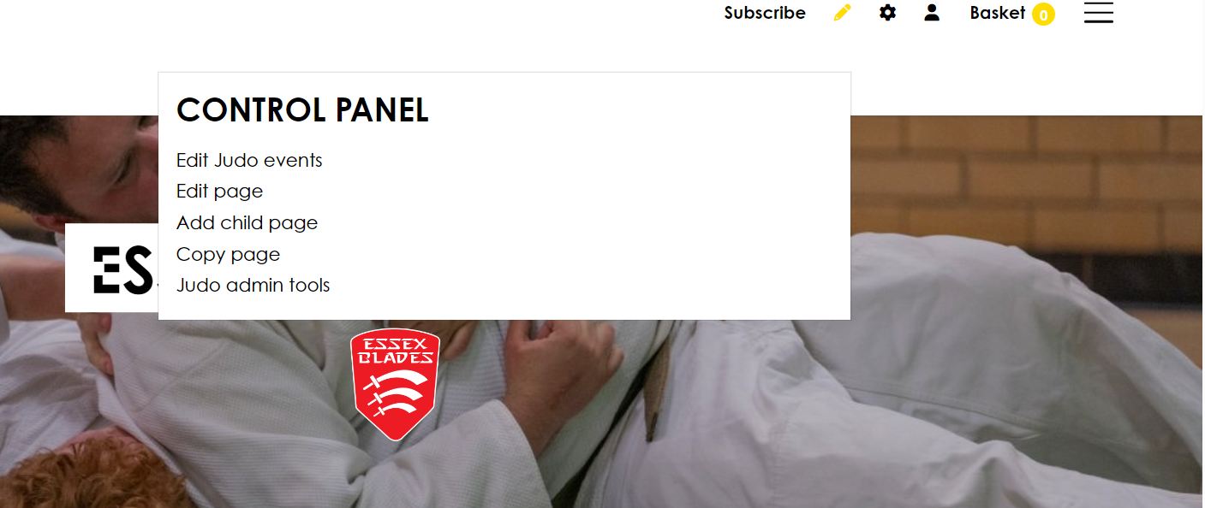
STEP 1 – SELECT THE PEN ICON ON YOUR CLUB’S PAGE.
EVENTS
EVENTS

Slide 3
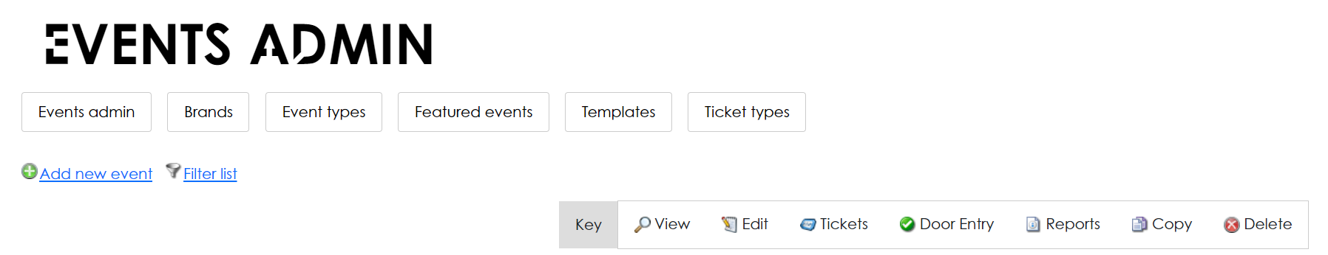
STEP 2 – SELECT EDIT (SPORTS CLUB) EVENTS, IN THIS CASE JUDO.
STEP 3 – SELECT ADD NEW EVENT, THEN SELECT SET UP A NEW EVENT.
EVENTS

Slide 4
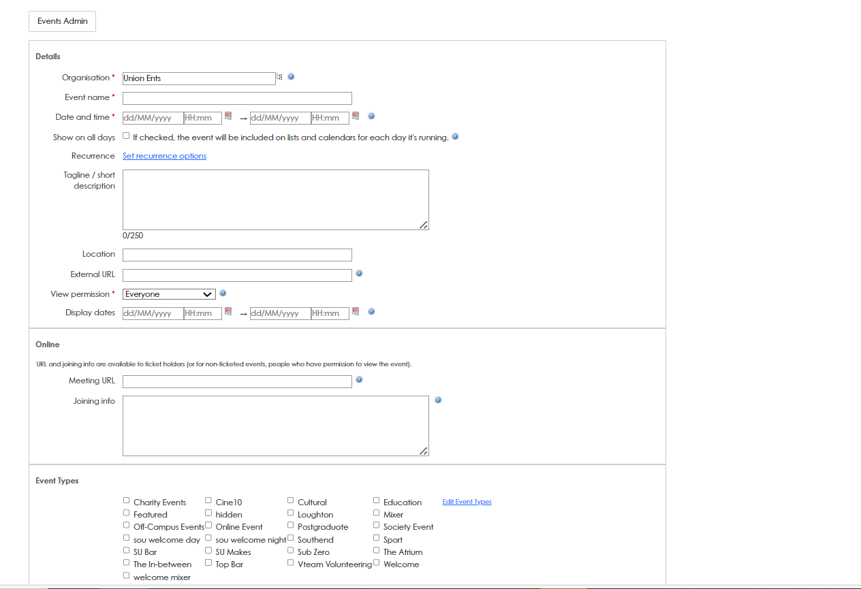
STEP 5 – COMPLETE ALL OF THE RELEVANT INFORMATION ABOUT YOUR EVENT, MAKE SURE YOU SELECT ALL OF THE RELEVANT EVENT TYPES.
EVENTS

Slide 5
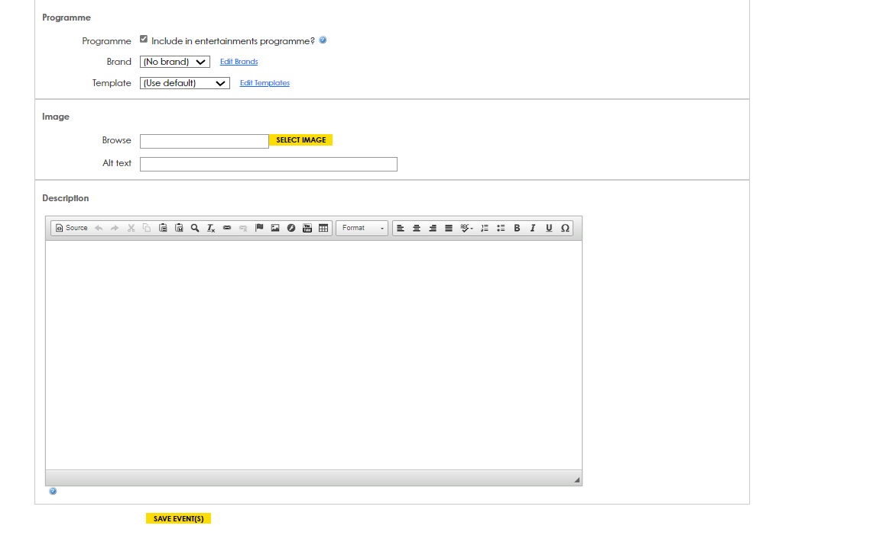
STEP 6 – WE WOULD RECOMMEND ADDING AN IMAGE AND A DESCRIPTION OF YOUR EVENT, ONCE YOU HAVE DONE THIS SELECT ‘SAVE EVENTS’ – YOUR EVENT WILL NOW APPEAR ON THE WHATS ON AND SU WEBPAGE.
EVENTS

