Slide 1
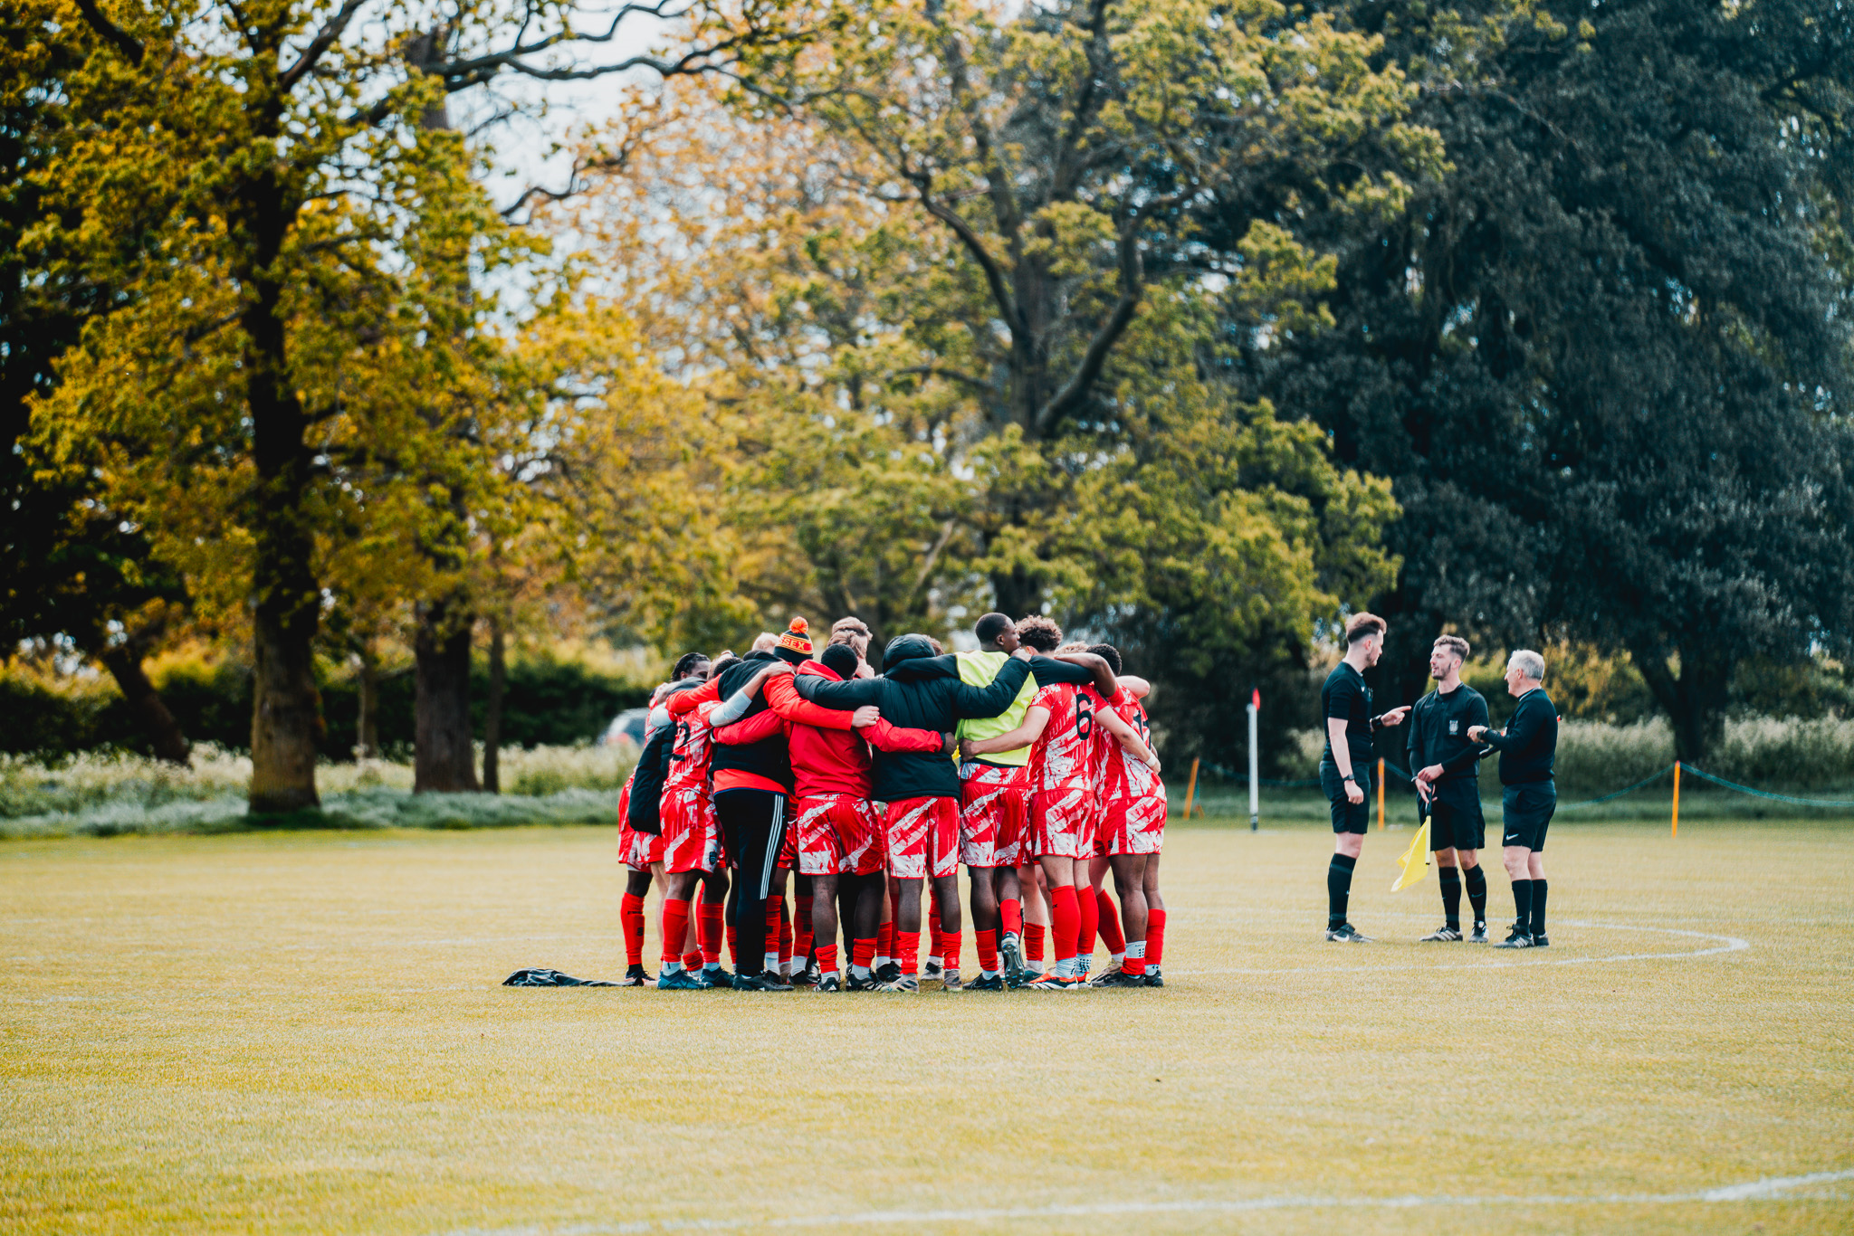
SPORTS CLUB WELFARE
TRAINING 24/25
SPORTS CLUB WELFARE TRAINING 24/25
Please take a minute to type your name, club, and exec role in the chat box. This helps us to track attendance.

Slide 2
SPORTS CLUB WELFARE
TRAINING 24/25
Hannah mortier
(sports activities coordinator)
blades@essex.ac.uk / Hannah.mortier@essex.ac.uk
Nifemi Wilson-adu
(VP welfare 24/25)
vpwelfare@essex.ac.uk

Slide 3
THE BLADES TEAM
DOMINIC KING
HEAD OF STUDENT SPORT
SU SPORTS ASSISTANTS
DHYANA STORY
KATIE GIESS
ABBY FUNG
IAN LAU
VP STUDENT EXPERIENCE
HANNAH MORTIER
SPORTS COORDINATOR
To get in touch with us :
Email blades@essex.ac.uk
WhatsApp 07935 134538 (this is the blades phone)
or pop by the Sports Office (room 5.02) during working hours
EVENTS TRAINING 24/25

Slide 4
SESSION FORMAT
Take notes (please!).
Ask any questions in the chat, otherwise there will be the opportunity to ask at the end.
This session is being recorded so please turn your camera off if you do not wish to be in the video.
You will be required to complete a Moodle test at the end of this presentation to mark your training as completed.
This presentation and recording will be available for you to view afterwards on the Sports Toolkit.
EVENTS TRAINING 24/25

Slide 5
Training aims
What is the point?
The purpose of this session is to provide you with essential guidance to ensure the physical and mental well-being of your members while also maintaining their safety during Sports Club activities. We aim to make you aware of the support services available to students should they require them.
We do not expect you to be therapists.
We will share these slides and the recording with you all afterwards.
EVENTS TRAINING 24/25

Slide 6
Trigger warning
SPORTS CLUB WELFARE
TRAINING 24/25
Please be advised that this training contains some potentially triggering themes including:
Mental health, Sexual Assault and Coercion.

Slide 7
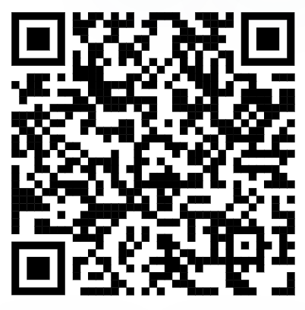
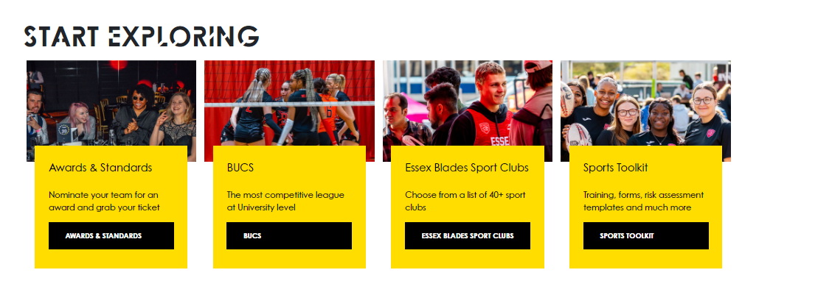
EVENTS TRAINING 24/25
SPORTS TOOLKIT
Access the Sports Toolkit here
(bookmark it!)
On the essexstudent.com webpage, you will have access to the Sports Toolkit, which contains lots of helpful resources, including some wellbeing support and risk assessment help – we will touch more on this later.
On the website go to opportunities on the main menu, and then to Essex Blades Sport.
Notes:
see a substantial increase in first time su engagement
have at least 25 individuals register interest to be trained to be group leaders for following year

Slide 8
WHAT IS A WELFARE OFFICER?
A CORE COMMITTEE POSITION FOR ALL SPORTS CLUBS
Ensure the mental and physical well-being of all members during training, competitions, and any other club activities.
Provide support to members as needed, including referring them to relevant support services when necessary.
Complete accident reports promptly and accurately.
Assist in the production and adherence to risk assessments for all club activities.
SPORTS CLUB WELFARE TRAINING 24/24

Slide 9
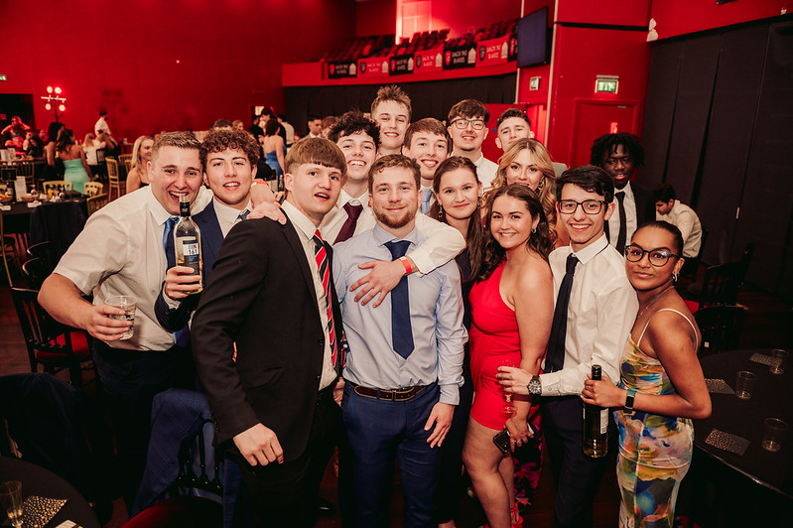
Knowing your members!
Due to GDPR (General Data Protection Regulation) regulations, we are no longer permitted to collect certain personal information from members after they have purchased a membership (such as allergies, medications, emergency contacts, etc.).
We strongly encourage Welfare Officers and Presidents to request that members voluntarily disclose any relevant medical conditions, allergies, or medications—especially those that may be impacted by physical activities or events.
SPORTS CLUB WELFARE TRAINING 24/24

Slide 10
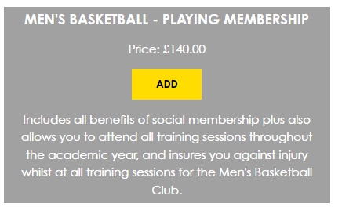
Insurance/membership
All members must purchase the appropriate membership for your sports club, either through the Students' Union website or at the SU reception in Square 3.
Please note that individuals who are not registered members of your sports club will not be insured against injury during matches, training sessions, or competitions.
To ensure all participants are properly registered, use attendance registers to monitor participation and cross-reference with your membership sales report.
SPORTS CLUB WELFARE TRAINING 24/24

Slide 11
RISK ASSESSMENTS
Essential to ensuring the safety of your members. No risk assessment = no activity.
Take a copy of your risk assessment to your come & try/trial sessions, as well as sending it to all members to ensure they have read it.
If you are performing away from your usual location (e.g. on Squares) you must complete an additional risk assessment for this activity. Be sure to consider additional risk such as members of the public, buildings etc.
Additional events will also require a risk assessment submitted to staff with sufficient notice, which for large events should be a minimum of 4 weeks before.
SPORTS CLUB WELFARE TRAINING 24/24

Slide 12
RISK ASSESSMENTS – support
Lots of helpful information about how to complete a risk assessment, and some blank risk assessments can be found on the Sports Toolkit.
SPORTS CLUB WELFARE TRAINING 24/24

Slide 13
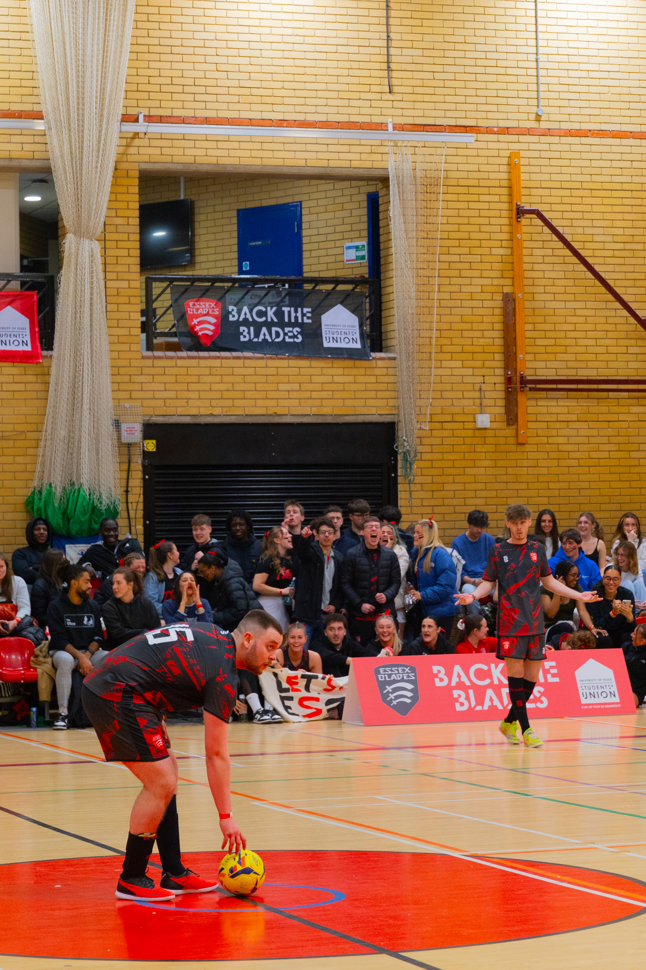
SPORTS CLUB WELFARE TRAINING 24/24
SPECTATOR BEHAVIOUR
Everyone participating in your activities should feel confident that they can do so without fear of abuse or discrimination.
It is advisable to have one or more committee members present among spectators to address any unacceptable behavior promptly.
Any inappropriate behavior should be reported to SU or University staff. We have a zero-tolerance policy for any form of harassment or bullying.
Instead of making negative comments about the opposition, encourage positive support for our team.
SPORTS CLUB WELFARE TRAINING 24/24
Notes:
see a substantial increase in first time su engagement
have at least 25 individuals register interest to be trained to be group leaders for following year

Slide 14
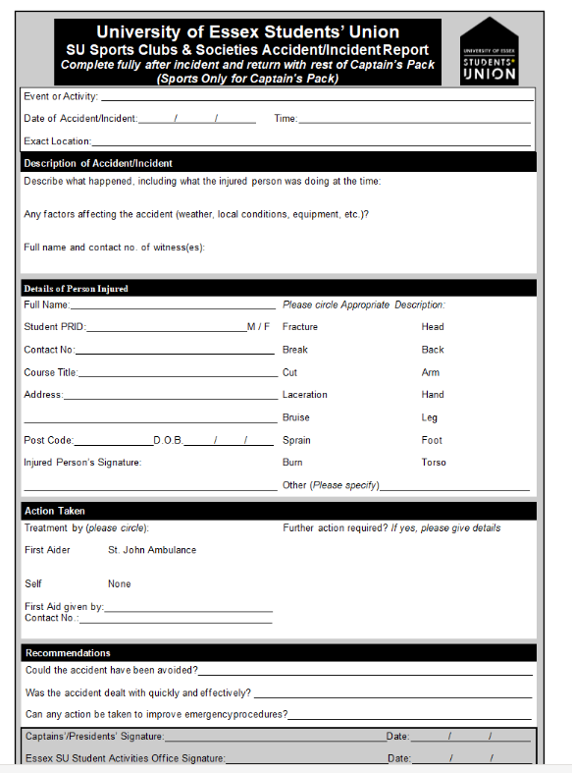
SPORTS CLUB WELFARE TRAINING 24/24
ACCIDENT REPORT FORMS
If an injury occurs during one of your training sessions, matches or events; you must complete an Accident Report Form. They can be found here
This will help determine the cause of the injury and assess whether it could have been prevented.
In the event of a serious injury requiring further medical attention, the form can also provide valuable information to the doctor regarding the initial treatment administered.
Accident forms should be signed and returned to the Students’ Union Reception or emailed to blades@essex.ac.uk/ dsking@essex.ac.uk within 24 hours of the injury occurring.
SPORTS CLUB WELFARE TRAINING 24/24
Notes:
see a substantial increase in first time su engagement
have at least 25 individuals register interest to be trained to be group leaders for following year

Slide 15
SERIOUS ACCIDENT/EMERGENCY PROCEDURE
IF THE ACCIDENT/ EMERGENCY HAPPENS ON CAMPUS
Ensure Safety: Make sure there is no immediate danger to yourself or the casualty.
Stabilize the Casualty: Ensure the casualty is comfortable and safe, but do not attempt to move them.
Contact a First Aider Immediately:
Sports Centre Staff
St John’s Ambulance
Campus Security
Registered Sports Therapy Students
Emergency Contact Protocol: Do not call ‘999’ directly. Instead, contact Campus Security at ‘2222’ (from a University landline) or 01206 872222 from a mobile. They will coordinate with emergency services.
Accompanying the Casualty: If hospital treatment is required, a responsible committee member should accompany the individual and, if possible, inform the injured student’s emergency contact of the situation.
Injured Visitors: If a student from another university is injured while on the University of Essex campus, follow the same procedure and coordinate with their team captain. Additionally, inform the Essex Students’ Union
SPORTS CLUB WELFARE TRAINING 24/24

Slide 16
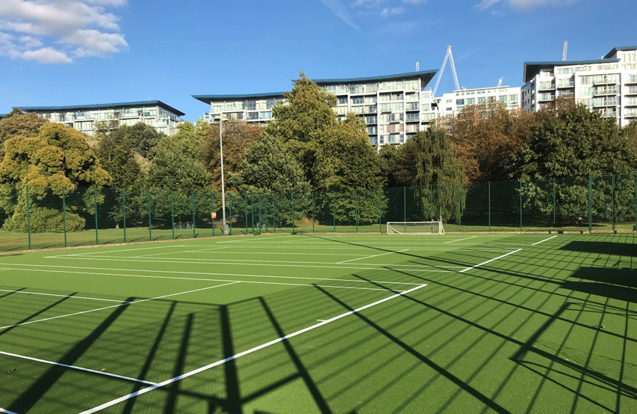
SERIOUS ACCIDENT/EMERGENCY PROCEDURE
IF THE ACCIDENT/ EMERGENCY HAPPENS AWAY FROM CAMPUS
Contact Emergency Services (Dial 999)
Ensure the comfort and safety of the casualty but do not move them.
Ensure the safety of the rest of the group
Contact the University Information Desk 01206 872222 and state:
Your name and where you are calling from
The club/students involved
The nature of the incident
The name of the hospital where the casualty has been taken
The name of any police officer involved
SPORTS CLUB WELFARE TRAINING 24/24

Slide 17
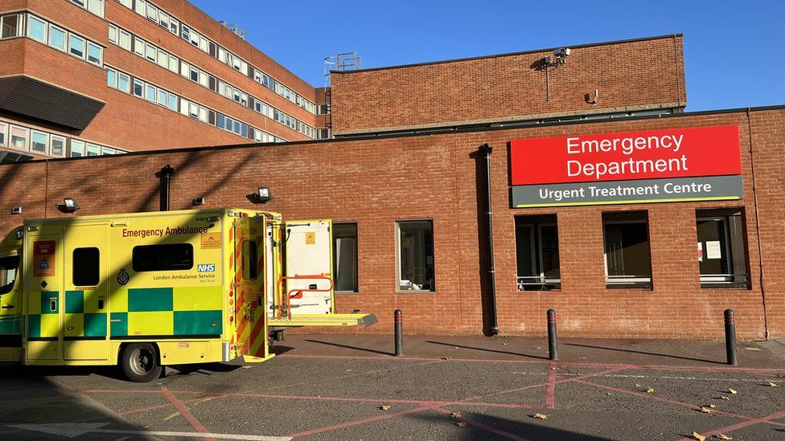
SERIOUS ACCIDENT/EMERGENCY PROCEDURE
IF THE STUDENT REQUIRES HOSPITAL ATTENTION
Ensure a minimum of 2 students stay with the injured person, and accompany them to Hospital. It is recommended that 1 of these individuals is a Captain/Committee member.
A member of the club with a driving license and car should attend the Hospital as well if possible.
Any expenses incurred (e.g. Taxi fare) will be fully refunded as long as a receipt is provided.
The captain or committee member should inform the injured student’s emergency contact of the current situation where possible.
The rest of the club/society should return back to the University at the end of the fixture/event, but maintain contact by phone.
SPORTS CLUB WELFARE TRAINING 24/24

Slide 18
SPORTS CLUB WELFARE TRAINING 24/24
FIRST AID TRAINING
If you have not attended a first aid course then we recommend you do so: we will be running some during term 1 so please keep your eyes out for any information circulated and book onto a course online.
General First Aid advice can be found here: Get first aid advice | St John Ambulance (sja.org.uk)
SPORTS CLUB WELFARE TRAINING 24/24
Notes:
see a substantial increase in first time su engagement
have at least 25 individuals register interest to be trained to be group leaders for following year

Slide 19
SPORTS CLUB WELFARE TRAINING 24/24
MENTAL HEALTH FIRST AID
Mental Health First Aid's 5 step action plan in the event of an emergency: ALGEE
Mental Health Awareness training – You will be notified when we are running these sessions, please book on.
Emergency contacts:
2222 / 01206 872222 – On campus security
999 – NHS Emergency or nearest A&E department.
111 – Non-emergency, professional health advice 24/7
116 123 – Samaritans 24/7 free phone
HEALTH HERO - Student Wellbeing Support Line: A 24-hour phone line for University of Essex students, provided by HealthHero (previously known as Validium). The number is 0800 970 5020 (outside UK: +44 141 271 7168)
Early intervention in Psychosis Teams
Crisis Resolution Home Treatment Teams
Notes:
see a substantial increase in first time su engagement
have at least 25 individuals register interest to be trained to be group leaders for following year

Slide 20
SPORTS CLUB WELFARE TRAINING 24/24
zero tolerance policy
The Students' Union has a zero-tolerance policy including sexual harassment meaning that the Students' Union will take action. Please familiarise yourself with the document below.
Zero-tolerance-policy-V2.pdf
Staff and students are expected to be treated and to treat each other with dignity and respect regardless of:
Gender expression, identity, affirmation or reassignment
Race, ethnic origin or national origin
Age
Socio-economic background
Disability
Religious beliefs or affiliations, or absence of religious beliefs or affiliations
Political beliefs or affiliations
Family circumstances, including maternity and paternity
Marital or civil partnership status
Pregnancy and maternity
Sexual orientation
Sex
SPORTS CLUB WELFARE TRAINING 24/24
Notes:
see a substantial increase in first time su engagement
have at least 25 individuals register interest to be trained to be group leaders for following year

Slide 21
SPORTS CLUB WELFARE TRAINING 24/24
tHE lAW (SEXAL OFFENCES ACT)
It is important that you understand the Sexual Offences Act to ensure that all club activities fall within safe settings to prevent any risk to members.
Understanding Coercion and Controlling Behavior
Coercive Behavior: This involves a persistent pattern of actions or threats aimed at assaulting, intimidating, humiliating, or otherwise abusing someone. These behaviors are designed to harm, punish, or instill fear in the victim.
Controlling Behavior: This includes a series of actions intended to make someone dependent or submissive. It often involves isolating the person from support systems, exploiting them for personal gain, stripping them of independence, and regulating their daily activities to maintain control.
If you witness any of these behaviors, please report them immediately. If you are experiencing them, support services are available to help you.
SPORTS CLUB WELFARE TRAINING 24/24
Notes:
see a substantial increase in first time su engagement
have at least 25 individuals register interest to be trained to be group leaders for following year

Slide 22
SPORTS CLUB WELFARE TRAINING 24/24
tHE lAW (revenge porn)
What is revenge porn - CRIMINAL JUSTICE AND COURTS ACT 2015
Revenge porn is the act of sharing or distributing explicit images or videos of someone without their consent, typically with the intent to embarrass, humiliate, or harm the person depicted. The term "revenge porn" is often used because these images or videos are frequently shared by ex-partners seeking revenge after a breakup, though the motivation can vary.
Key aspects of revenge porn:
Non-consensual: The images or videos are shared without the permission of the person depicted. This is a violation of privacy and can cause significant emotional distress.
Intent to Harm: The act is usually carried out with malicious intent, aiming to damage the reputation, emotional well-being, or personal life of the victim.
Distribution Channels: The content may be shared on social media, pornographic websites, messaging apps, or even sent directly to the victim’s friends, family, or colleagues.
Legal Consequences: Many countries have enacted laws against revenge porn, recognizing it as a form of sexual harassment or cybercrime. Perpetrators can face criminal charges, civil lawsuits, or both.
Impact on Victims: Victims of revenge porn often suffer from severe emotional and psychological trauma, including anxiety, depression, and fear for their safety. It can also have devastating effects on their personal and professional lives.
See it – report it.
Notes:
see a substantial increase in first time su engagement
have at least 25 individuals register interest to be trained to be group leaders for following year

Slide 23
SPORTS CLUB WELFARE TRAINING 24/25
SUPPORT SERVICES
SU ADVICE
SWIS
MIND
SAMARTIANS
CARA
SPORTS CLUB WELFARE TRAINING 24/24
Notes:
see a substantial increase in first time su engagement
have at least 25 individuals register interest to be trained to be group leaders for following year

Slide 24
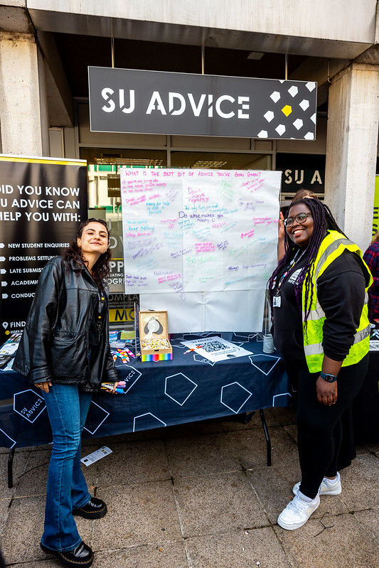
SPORTS CLUB WELFARE TRAINING 24/25
SU advice
SU Advice is a free, confidential, and impartial service available to all students.
They offer guidance and support on a wide range of issues that may impact a student’s welfare, such as academic stress, housing concerns, health and well-being, and cases of bullying or harassment.
While they are not trained counselors, they provide a supportive listening ear and can refer students to the appropriate campus or local services.
If you're concerned about a club member’s well-being and are unsure of the best course of action, SU Advice is available to discuss your concerns with you.
They are located in Square 3 and are available Monday to Friday, 10 am to 4 pm during term time, and 1 pm to 4 pm during non-term time.
Phone: 01206 863211
Email: suadvice@essex.ac.uk
Website: SU Advice (essexstudent.com)
SAM
SPORTS CLUB WELFARE TRAINING 24/24
Notes:
see a substantial increase in first time su engagement
have at least 25 individuals register interest to be trained to be group leaders for following year

Slide 25
SPORTS CLUB WELFARE TRAINING 24/25
SWIS (STUDENT WELLBEING AND INCLUSIVITY SERVICE)
SWIS is a University service which provides access to Wellbeing and Disability support.
SWIS provide confidential support and advice with personal and emotional difficulties and can support with referrals to counselling.
SWIS provide advice and information about disabilities, and specific learning difficulties, including dyslexia, mental health conditions and other medical conditions.
Phone: 01206 873133
Website: Student Wellbeing and Inclusivity Service | University of Essex
Email: wellbeing@essex.ac.uk.
Make An Appointment: Wellbeing Appointments - Student Wellbeing & Inclusivity Service (office.com)
SAM
SPORTS CLUB WELFARE TRAINING 24/24
Notes:
see a substantial increase in first time su engagement
have at least 25 individuals register interest to be trained to be group leaders for following year

Slide 26
SPORTS CLUB WELFARE TRAINING 24/25
MIND
Mind is a mental health charity in England and Wales that offers information and advice to people with mental health problems and lobbies government and local authorities on their behalf.
They have an Infoline, which offers callers confidential help for the price of a local call – 01206 764600 for the Mid and North East Essex line.
They also have a Legal Line, which provides information on mental health related law to the public, service users, family members/carers, mental health professionals and mental health advocates – 0300 466 6463.
Home - Mind
Notes:
see a substantial increase in first time su engagement
have at least 25 individuals register interest to be trained to be group leaders for following year

Slide 27
SPORTS CLUB WELFARE TRAINING 24/25
SAMARTIANS
Samaritans is a registered charity aimed at providing emotional support to anyone in emotional distress, struggling to cope, or at risk of suicide throughout the United Kingdom and Ireland, often through their telephone helpline – 116 123.
Volunteers give up their time 24/7 to listen, be open minded and be non-judgmental to people going through a tough time.
They are not required to give advice to anyone, so this can be really valuable for anyone struggling who simply just wants to talk to someone impartial.
Website: Samaritans | Every life lost to suicide is a tragedy | Here to listen
Email: jo@samaritans.org
Phone: 116 123
SPORTS CLUB WELFARE TRAINING 24/24
Notes:
see a substantial increase in first time su engagement
have at least 25 individuals register interest to be trained to be group leaders for following year

Slide 28
SPORTS CLUB WELFARE TRAINING 24/25
CARA (Centre for Action on Rape and Abuse)
CARA (Centre for Action on Rape and Abuse) works with victims and survivors of sexual violence and child sexual abuse.
CARA provide independent, specialist support and promotes and represents the rights and needs of victims and survivors.
They work with adult women and men, young people (aged 13-19) and children aged 12 and under from across the UK and north Essex, they have a head office in Colchester.
Website: Centre for Action on Rape and Abuse in Essex - CARA (caraessex.org.uk)
Phone: 01206 367881
Email: info@caraessex.org.uk
Online Self-Referral Form: VisiaCloud
SPORTS CLUB WELFARE TRAINING 24/24
Notes:
see a substantial increase in first time su engagement
have at least 25 individuals register interest to be trained to be group leaders for following year

Slide 29
SPORTS CLUB WELFARE TRAINING 24/25
COMPLAINTS PROCEDURE
§If you have been made aware of any internal issues or complaints within your sports club's that you feel cannot be addressed by the committee, please email blades@essex.ac.uk and we will deal with the issue in confidence.
§Please ensure that your members know they can also contact us/ the VP welfare or the VP experience directly if they would like to make a complaint or report an issue.
§The University does also have an anonymous reporting system which you and your members should be aware of: https://reportandsupport.essex.ac.uk/
§See something, say something!
Blades@essex.ac.uk
Vpexperience@essex.ac.uk
Vpwelfare@essex.ac.uk
SPORTS CLUB WELFARE TRAINING 24/24
Notes:
see a substantial increase in first time su engagement
have at least 25 individuals register interest to be trained to be group leaders for following year

Slide 30
SPORTS CLUB WELFARE TRAINING 24/25
ENCOURAGING MENTAL AND PHSYCIAL WELLBEING
The mental and physical wellbeing of your members is crucial. Here are some ways in which you can actively support and enhance their wellbeing.
Mindfulness: Encourage your members to engage in mindfulness practices, which can significantly reduce anxiety and stress. Free apps like Calm and Headspace offer guided meditation and reflection exercises. Additionally, the NHS provides a list of recommended mindfulness resources for further support
Cardiac Screening: Promote the importance of heart health by encouraging members to take advantage of free cardiac screening through the charity "Cardiac Risk in the Young." The Test My Heart initiative offers screenings for individuals aged 14-35 in the UK, providing essential checks that could save lives. Testmyheart – Cardiac screening for anyone aged 14-35 in the UK
SPORTS CLUB WELFARE TRAINING 24/24
Notes:
see a substantial increase in first time su engagement
have at least 25 individuals register interest to be trained to be group leaders for following year

Slide 31
SPORTS CLUB WELFARE TRAINING 24/25
ENCOURAGING MENTAL AND PHSYCIAL WELLBEING
MIND'S 5 ways to wellbeing, offers some simple steps which individuals can do every single day to enhance wellbeing.
CONNECT - Connecting with others can help us feel close to people, and valued for who we are. Being social means different things for different people – you might prefer being in quieter situations with one other person, or you might like being in big groups.
GET ACTIVE - Many people find that physical activity helps them maintain positive mental health.
This doesn't have to mean running marathons or training every day at the gym. There are lots of different things you can do to be a bit more active. I.e. walking
TAKE NOTICE - Reminding yourself to take notice can help you to be aware of how you're feeling. It can help you understand what triggers your feelings of stress or anxiety.
LEARN - We're always learning new things – often without realising it. Feeling like you're learning and developing can boost your self-esteem.
And sometimes, setting goals can help you to feel more productive and more in control of your life.
GIVE - There's been lots of research about the effects of taking part in social and community life. Some studies have shown that people who help others are more likely to rate themselves as happy.
SPORTS CLUB WELFARE TRAINING 24/24
Notes:
see a substantial increase in first time su engagement
have at least 25 individuals register interest to be trained to be group leaders for following year

Slide 32
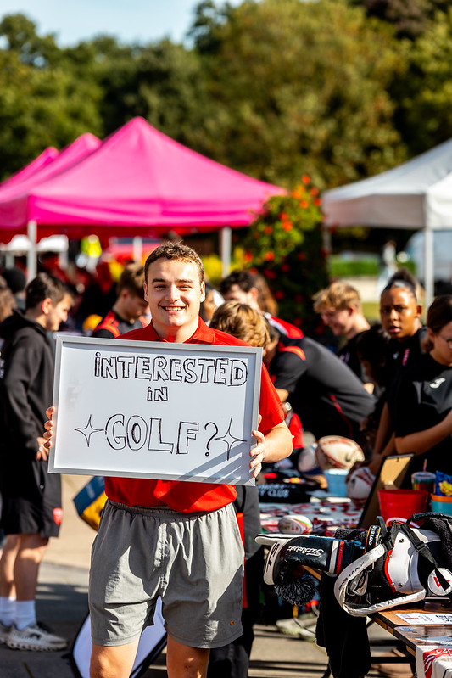
SPORTS CLUB WELFARE TRAINING 24/25
LOOK OUT FOR YOUR MEMBERS
Ensure everyone feels welcome and included in your club. Make a big effort at the start of the year to integrate new members and include them in training/activities and events.
Identify changes in the behaviour of your members. If you notice your members are acting differently or becoming withdrawn, check-in with them. Ask them if they are ok and offer them support.
Encourage your members to use free, confidential support services.
Share your knowledge of the University and local area! Particularly helpful to new students. Show them SU Advice, Student Support, good study spaces, where the launderette is and how to use it, nice places to eat/drink, things to see.
SPORTS CLUB WELFARE TRAINING 24/24
Notes:
see a substantial increase in first time su engagement
have at least 25 individuals register interest to be trained to be group leaders for following year

Slide 33
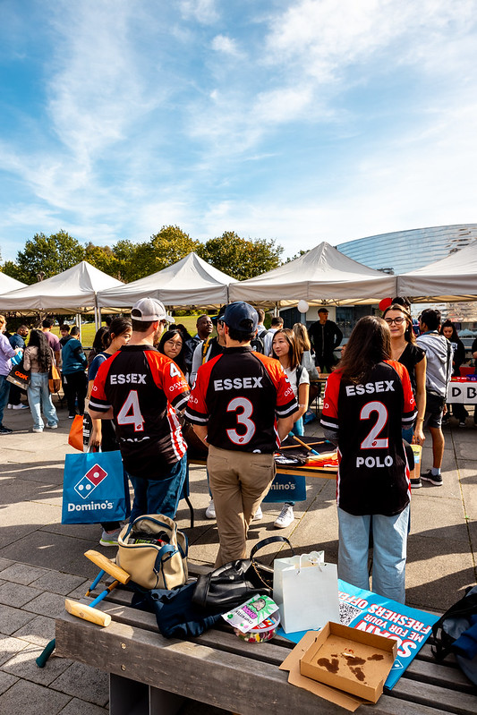
SPORTS CLUB WELFARE TRAINING 24/25
LOOK OUT FOR YOUR MEMBERS
International students – They may still be learning the language or feeling homesick. Sport activity can be a huge comfort for them.
Under 18’s – Some students at the University under 18 years old. Be considerate that they are very young and away from home. Remember legally they may not be able to do things everyone else can! University safeguarding practice applies to under 18’s.
All departments at the University have Designated Safeguarding Officers (DSO’s) as part of University Safeguarding measures. This includes the Students’ Union. If you are ever concerned about one of your members, you can also contact th DSO'S: Sian Lovesy, Chris Moore.
SPORTS CLUB WELFARE TRAINING 24/24
Notes:
see a substantial increase in first time su engagement
have at least 25 individuals register interest to be trained to be group leaders for following year

Slide 34
SPORTS CLUB WELFARE TRAINING 24/25
Mentor scheme
The idea is based on the distribution of responsibility for the health and wellbeing of club members.
Rather than the Welfare Officer being required to check on each member, the mentor scheme allows for other members to care for one another.
The scheme should be set up within the first term, with Executive Committee/other senior club members being responsible for one or two first-year members.
Mentors should be paired by similar subjects and other interests if possible. These members are there to offer support for first years if they may have any questions or issues at all with the club, socials, their subject or university life in general.
Notes:
see a substantial increase in first time su engagement
have at least 25 individuals register interest to be trained to be group leaders for following year

Slide 35
SPORTS CLUB WELFARE TRAINING 24/25
Mentor scheme
It is recommended that you ensure mentors/mentees are having one or two meetings each term in order to make sure members feel supported – these can take place virtually. Check in with how they are finding their course and university life. It is important to make sure that first-years are aware of the systems and the support in place if they need it.
If there are any issues which the mentor feels unable to deal with these should be fed back to the Welfare Officer privately or at a committee meeting if appropriate.
If you have any serious issues which have been presented at all, (e.g. discrimination, bullying) which as a club you do not feel comfortable dealing with please email blades@essex.ac.uk / vpwelfare@essex.ac.uk / suadvice@essex.ac.uk / vpexperience@essex.ac.uk where a member of staff will be able to provide confidential assistance.
Notes:
see a substantial increase in first time su engagement
have at least 25 individuals register interest to be trained to be group leaders for following year

Slide 36
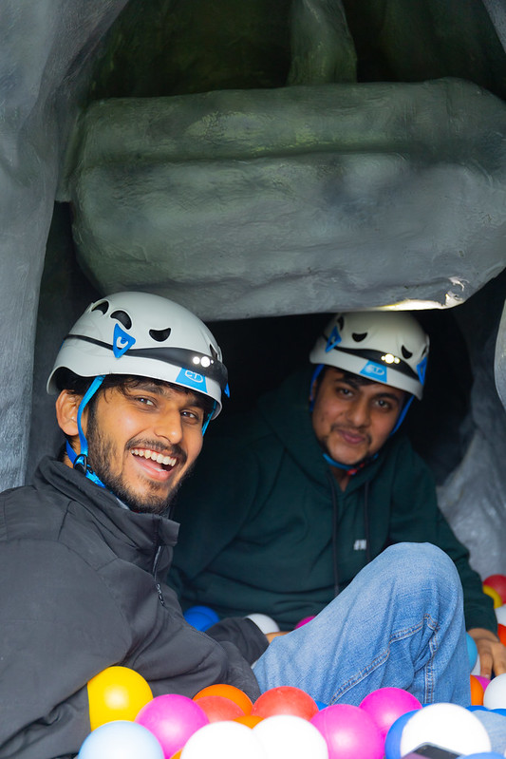
SPORTS CLUB WELFARE TRAINING 24/25
Socials
Socials are one of the best parts of being part of a Sports Club, so make sure everyone feels welcome and enjoys them.
Ensure socials are conducted in a positive, safe and equal environment.
Avoid any controversial and/or possibly offensive games, language and activities.
Ensure that nobody feels forced or pressured into an activity, and that everybody should have the ability to say no to anything, without any consequence.
SPORTS CLUB WELFARE TRAINING 24/24
Notes:
see a substantial increase in first time su engagement
have at least 25 individuals register interest to be trained to be group leaders for following year

Slide 37
SPORTS CLUB WELFARE TRAINING 24/24
Social THEMES
Please also consider the implications of any fancy dress themes. You may not deem them as offensive, but others may do. A list of some potentially offensive themes that we do not endorse our Sports Clubs taking part in are listed below:
White T-Shirt Parties. These are banned by the Students’ Union and all SU venues due to the often discriminatory language written on the T-Shirts.
‘Gender Bender’ – Avoid using offensive terms such as these to label your social event.
Cultural themes – We have a very diverse, international campus and students may be offended seeing their culture associated with drinking, nudity or anti-social behaviour.
Be mindful and recognise that some of your members may not find certain themed events (e.g. Sexual, S&M (Sadism and Masochism)) as humorous as you do.
SPORTS CLUB WELFARE TRAINING 24/24

Slide 38
SPORTS CLUB WELFARE TRAINING 24/24
Socials
As per the Students’ Union Alcohol Policy, which needs to be signed by all Presidents once it has been sent out, the following events and behaviour is not endorsed or condoned by the Students’ Union:
An initiation and/or Mothers and Daughters/Fathers and Sons are events in which members (often new members) of the club are expected to perform any activity as a means of gaining credibility, status or entry into that club.
Any event where peer pressure is placed upon members of a particular club and may involve the consumption of alcohol, eating concoctions of various food, nudity, any behaviour that may be deemed humiliating and any activity which includes physical violence.
SPORTS CLUB WELFARE TRAINING 24/24

Slide 39
SPORTS CLUB WELFARE TRAINING 24/24
SocialS
Although we strongly do not condone initiations and hazing, we are aware that these activities can still happen ‘underground’.
It is important that as committee members you understand why such activities are not endorsed and should not be conducted. You may see it as a harmless welcome for new members, a bit of fun, but that’s not how everyone sees it.
Initiations and hazing can put off potential members/players, create uncomfortable or intimidating atmospheres and ruin someone's experience of that sport or even the University. It can be seen as bullying or abuse, and have serious consequences.
SPORTS CLUB WELFARE TRAINING 24/24

Slide 40
SPORTS CLUB WELFARE TRAINING 24/24
SocialS
There have been cases of students who have been subjected to initiations or hazing leaving University, being arrested/given a criminal record, and in some tragic cases, losing their lives.
The majority of students that arrive at Essex will be 18 years old (or some even younger), just out of full-time education and living away from home for the first time. They may be impressionable and want to show off to senior members of a Sports Club. It is therefore vital that you as senior and committee members are respectful, responsible and welcoming to all.
Please don’t feel the need to conform to ‘tradition’ and hold initiations for new members. It doesn’t matter if you think an initiation has always happened in your club/society and you think it’s normal, it isn’t.
SPORTS CLUB WELFARE TRAINING 24/24

Slide 41
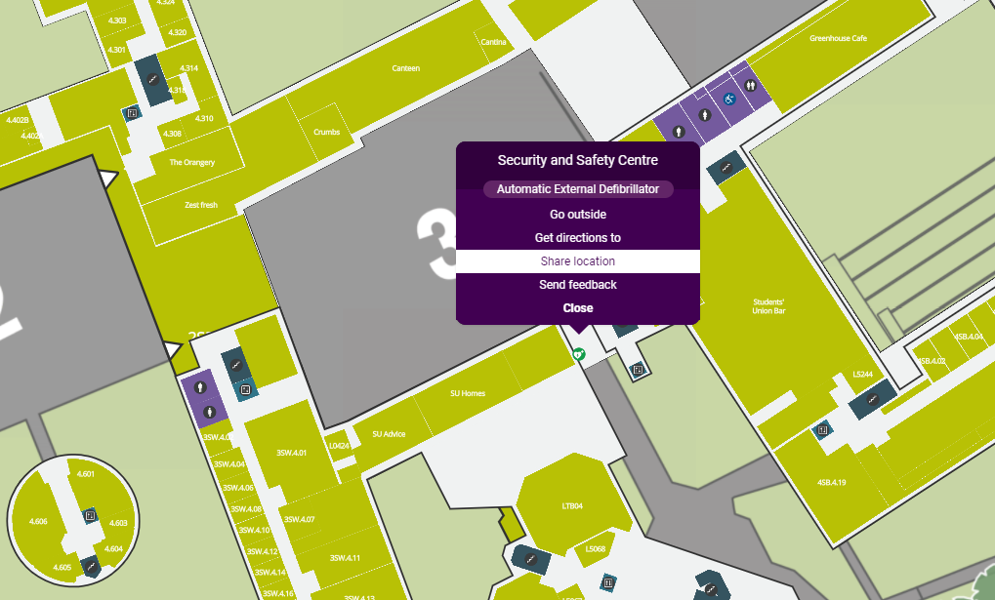
SPORTS CLUB WELFARE TRAINING 24/24
Additional Support
‘Ask for Angela’ - Anyone who is feeling unsafe, vulnerable or threatened can discreetly seek help by approaching staff in venues and asking them for ‘Angela’. This code-phrase will indicate to staff that they require help. This might be through reuniting them with a friend, seeing them to a taxi, or calling campus security.
Security and Safety Centre – Located on Square 3 under the sheltered area – map for reference. The security team provide 24 hour face to face and phone support. You can contact them regarding a range of things.
University anonymous reporting system – You can report things to the University using the anonymous reporting system. All information is treated in the strictest confidence. https://reportandsupport.essex.ac.uk/
SPORTS CLUB WELFARE TRAINING 24/24

Slide 42
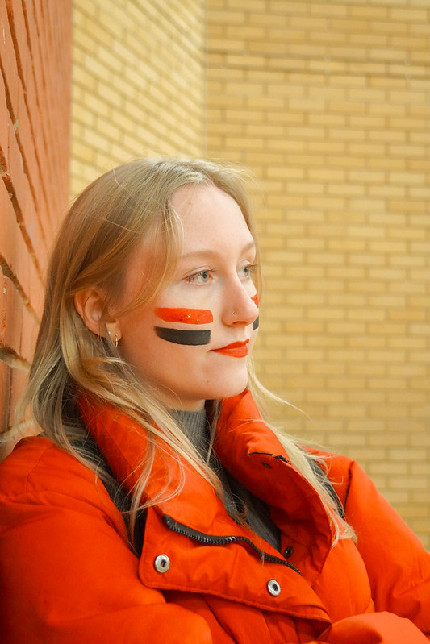
SPORTS CLUB WELFARE TRAINING 24/24
Any questions?
We now have an opportunity for any questions should you have any.
P.S Don't leave yet, we still have a Moodle quiz for you to complete, more information on the next slide.
Blades@essex.ac.uk
Hannah.mortier@essex.ac.uk
Vpwelfare@essex.ac.uk
Suadvice@essex.ac.uk
07935 134538 – Blades phone
01206 863211 – SU Reception
SPORTS CLUB WELFARE TRAINING 24/24

Slide 43
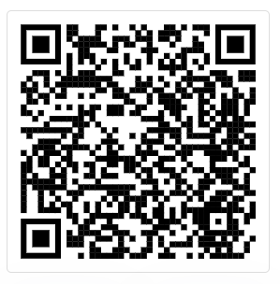
SPORTS CLUB WELFARE TRAINING 24/24
Welfare Moodle quiz
Please all complete the required Moodle Quiz now!
18 Questions
Pass Mark – 14/18
Link is also in the chat
If it says you do not have access let us know and we can enroll you now.
Feel free to leave the call once you have gained access, we will be ending the session in a few minutes.
Scan for Access to the Moodle Quiz
SPORTS CLUB WELFARE TRAINING 24/24

Slide 44
HEADING
thank you
for LISTENING
Blades@essex.ac.uk
Hannah.mortier@essex.ac.uk
Vpwelfare@essex.ac.uk
Suadvice@essex.ac.uk
07935 134538 – Blades phone
01206 863211 – SU Reception

