Slide 1


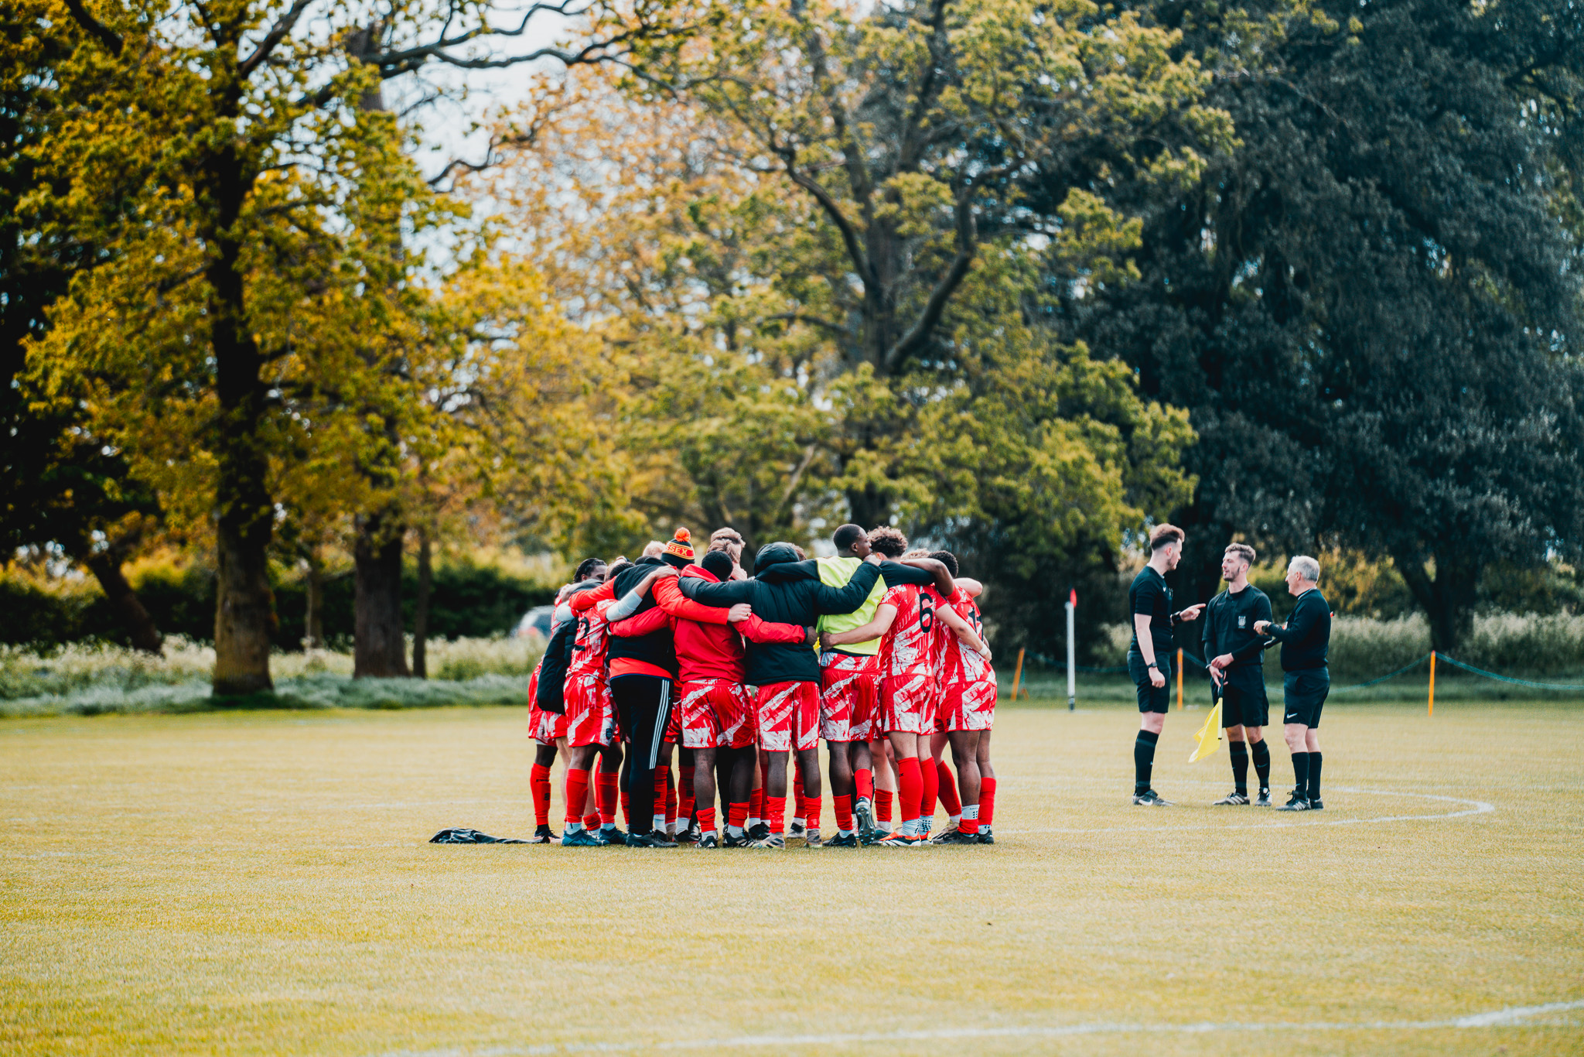

SPORTS CLUB WELFARE
TRAINING 25/26
SPORTS CLUB WELFARE TRAINING 25/26
Please take a minute to type your name, club, and exec role in the chat box. This helps us to track attendance.

Slide 2

SPORTS CLUB WELFARE
TRAINING 25/26
Hannah mortier
(sports manager)
HANNAH.MORTIER@ESSEX.AC.UK
Rob Neale
(Sports Coordinator)
blades@essex.ac.uk
Hareem rehan
(VP welfare 25/26)
vpwelfare@essex.ac.uk

Slide 3

THE BLADES TEAM
HANNAH MORTIER
SPORTS MANAGER
SU SPORTS ASSISTANTS
ABBY FUNG
JESSICA VASSENA
YOYO TANG
HANNAH IIYA BINTI RASHIDI HAZRIN
ATA RAHOOJO
VP ACTIVITIES
ROB NEALE
SPORTS COORDINATOR
EVENTS TRAINING 25/26
To get in touch with us :
Email blades@essex.ac.uk
WhatsApp 07935 134538 (this is the blades phone)
or pop by the Sports Office (Behind SU Reception Square 4) during working hours

Slide 4
SESSION FORMAT
Please take notes during this session.
Feel free to ask any questions in the chat throughout. There will also be time for questions at the end.
This session is being recorded. If you prefer not to appear in the video, please switch off your camera.
You will be required to complete a Moodle test at the end of this presentation in order to mark your training as completed.
This presentation and recording will be available for you to view afterwards on the Sports Toolkit.
EVENTS TRAINING 25/26

Slide 5
Training aims
What’s the point?
This session will give you essential guidance to help keep your members safe, supported, and well - both physically and mentally - during Sports Club activities.
You’ll also learn about the student support services available, so you know where to signpost if needed.
🧠 You’re not expected to be therapists.
📩 The slides and recording will be shared with you after the session.
EVENTS TRAINING 25/26

Slide 6

⚠️Trigger warning
Please be aware that this training session includes discussion of sensitive topics, including:
Mental health, sexual assault, and coercion.
Your well-being is important - please take care of yourself during the session. Step away if needed and seek support if you are affected.

Slide 7
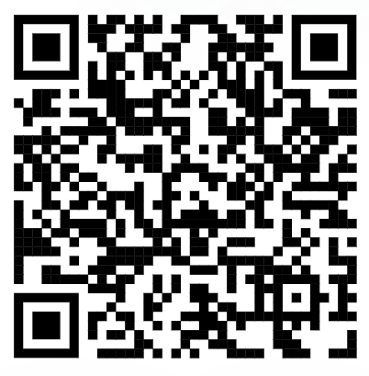

EVENTS TRAINING 24/25
SPORTS TOOLKIT
On the essexstudent.com webpage, you will have access to the Sports Toolkit, which contains lots of helpful resources, including some wellbeing support and risk assessment help – we will touch more on this later.
On the website go to 'Communities' on the main menu, and then to 'Sport'.
Access the Sports Toolkit here
Notes:
Briefly share toolkit and mention certain resources will be covered later (e.g. risk assessments)

Slide 8
WHAT IS A WELFARE OFFICER?
A core committee role required for all Sports Clubs
As a Welfare Officer, your responsibilities include:
Supporting the mental and physical well-being of members during training, competitions, and all club-related activities.
Being a point of contact for welfare concerns- signposting members to relevant support services when needed.
Completing accident reports promptly and accurately.
Assisting with the creation and enforcement of risk assessments for all club activities.
SPORTS CLUB WELFARE TRAINING 25/26

Slide 9
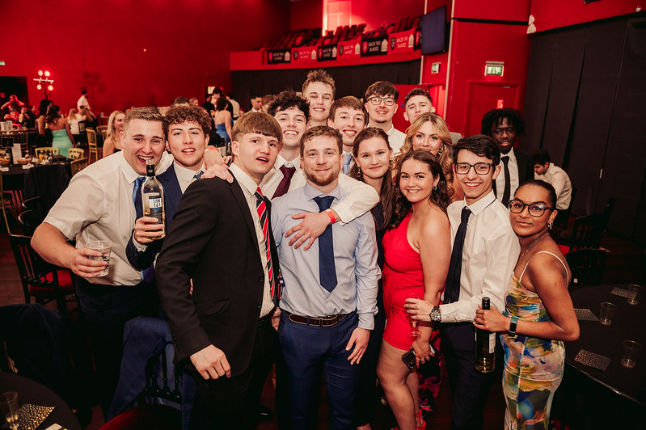
Knowing your members!
Under GDPR (General Data Protection Regulation), we are no longer allowed to collect certain personal information from members once they’ve purchased a membership.
This includes details such as:
Allergies
Medications
Emergency contacts
However, we strongly encourage Welfare Officers and Presidents to ask members to voluntarily share any relevant medical information, including:
Medical conditions
Allergies
Medications
This is especially important for anything that could affect their safety during physical activities or events.
SPORTS CLUB WELFARE TRAINING 25/26

Slide 10
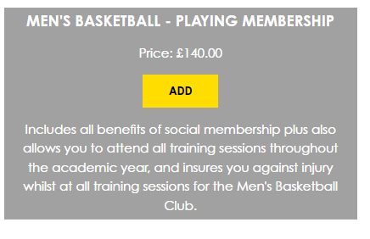
Insurance/membership
All members must purchase the correct membership for your sports club via the relevant sports club's webpage or at the SU Reception in Square 4.
⚠️ Non-members are not insured for injuries sustained during training, matches, or competitions.
To ensure everyone is properly registered:
Use attendance registers at all sessions to monitor participation.
Regularly cross-check with your club’s membership sales report.
SPORTS CLUB WELFARE TRAINING 25/26

Slide 11
RISK ASSESSMENTS
Risk assessment need to be completed before Friday 3rd October.
Members should familiarize themselves with the club's risk assessment.
If your activity takes place away from your usual location (e.g., on Squares), you must complete an additional risk assessment addressing extra risks such as public presence, buildings, etc.
For additional events, submit a risk assessment to staff with sufficient notice - large events require at least 4 weeks' advance submission.
SPORTS CLUB WELFARE TRAINING 25/26

Slide 12
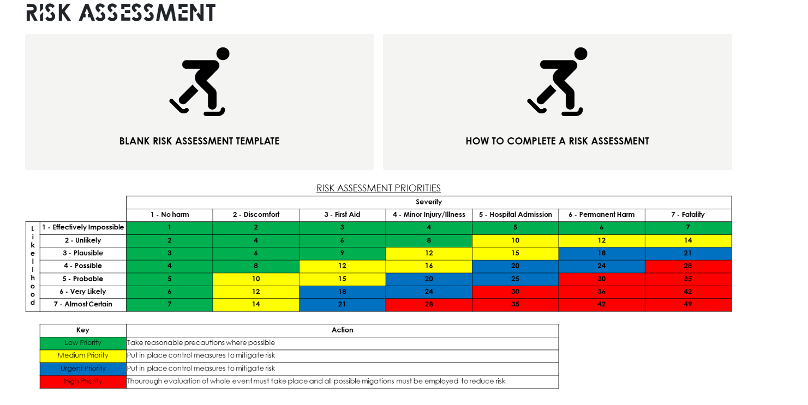

Need help with risk assessments?
You can find guidance on how to complete a risk assessment, along with blank templates, in the Sports Toolkit.
SPORTS CLUB WELFARE TRAINING 25/26
Notes:
Deadline to complete RA and email it over to blades@essex.ac.uk is 02/10/25

Slide 13
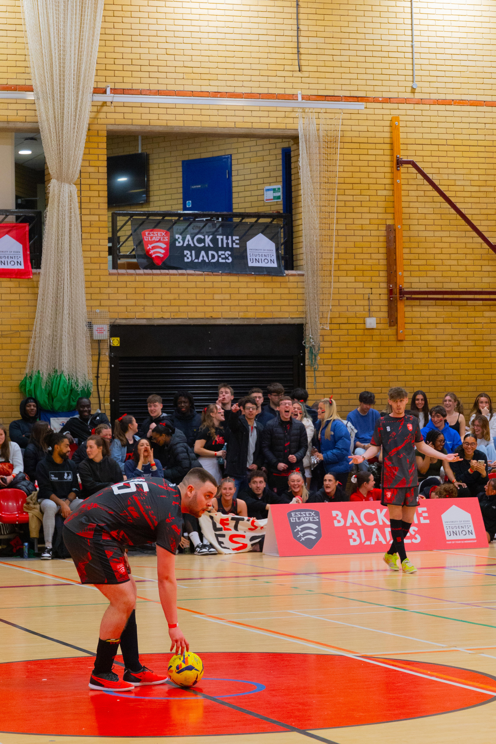
SPORTS CLUB WELFARE TRAINING 25/26
SPECTATOR BEHAVIOUR
Everyone taking part in your activities deserves to feel safe, respected, and free from any form of abuse or discrimination.
✅ Assign Responsibility It’s recommended that at least one committee member is present among spectators to monitor and address behaviour as needed.
🚫 Zero Tolerance for Misconduct Any inappropriate or unacceptable behaviour must be reported to Students' Union or University staff immediately. Harassment, bullying, or discrimination will not be tolerated.
💬 Promote Positive Support Instead of negative comments towards the opposition, focus on cheering positively for our team. Let’s foster a supportive and inclusive environment.
SPORTS CLUB WELFARE TRAINING 24/24

Slide 14
SPORTS CLUB WELFARE TRAINING 25/26
ACCIDENT REPORT FORM
If an injury occurs during a training session, match, or event, a digital Accident Report Form must be completed.
If the accident has occurred at a BUCS match at home and an SRES First aider has dealt with the incident, no form is required. The SRES team would have completed it.
Forms must be completed through typeform. The link can be found on the Sports Toolkit, under the Health, Safety and Wellbeing section.

Slide 15
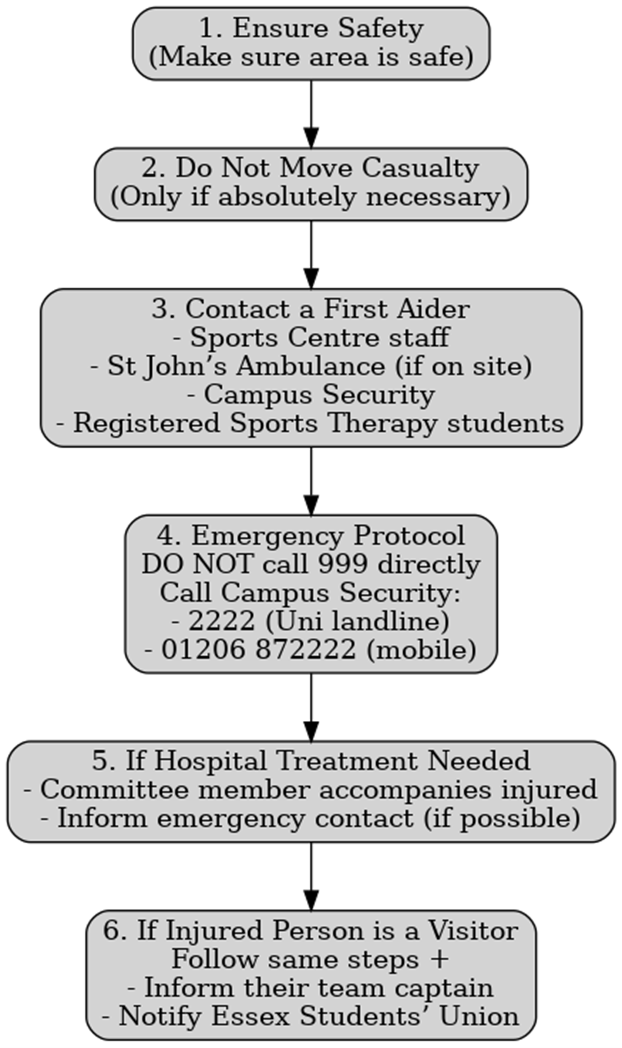
SERIOUS ACCIDENT/EMERGENCY PROCEDURE
IF THE ACCIDENT/ EMERGENCY HAPPENS ON CAMPUS
SPORTS CLUB WELFARE TRAINING 25/26

Slide 16
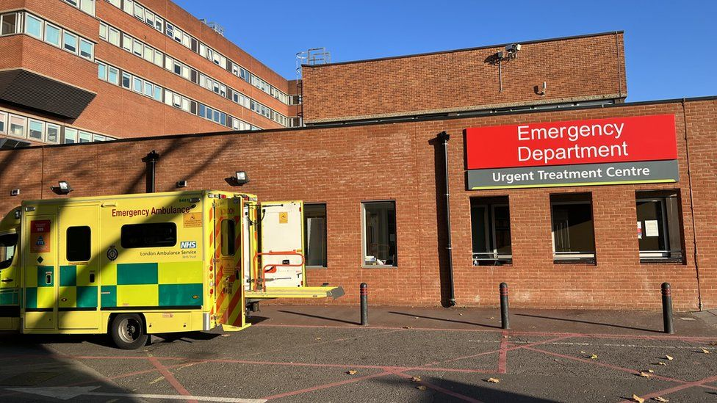
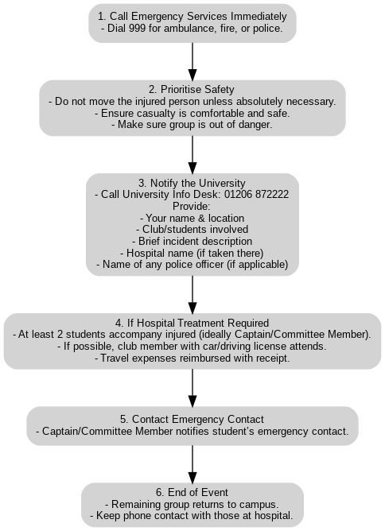
SERIOUS ACCIDENT/EMERGENCY PROCEDURE
SPORTS CLUB WELFARE TRAINING 25/26

Slide 17

SPORTS CLUB WELFARE TRAINING 25/26
FIRST AID TRAINING
If you have not attended a first aid course then we recommend you do so: Clubs are required to have a minimum of 2 committee members first aid trained.
We are running sessions on the following dates
Wednesday 1st October 16:30-18:30
Tuesday 7th October 16:30-18:30
Thursday 16th October 16:30-18:30
Please book your free ticket on What's On.
General First Aid advice can be found here: Get first aid advice | St John Ambulance (sja.org.uk)
SPORTS CLUB WELFARE TRAINING 24/24
Notes:
Two dates: 01/10/25 & 07/10/25 16:30 – 18:30 – flag with audience if not sold out

Slide 18
SPORTS CLUB WELFARE TRAINING 25/26
zero tolerance policy
The University has a zero-tolerance policy including sexual harassment meaning that the Students' Union will take action. Please familiarise yourself with the document below.
zero tolerance.pdf
Staff and students are expected to be treated and to treat each other with dignity and respect regardless of:
Gender expression, identity, affirmation or reassignment
Race, ethnic origin or national origin
Age
Socio-economic background
Disability
Religious beliefs or affiliations, or absence of religious beliefs or affiliations
Political beliefs or affiliations
Family circumstances, including maternity and paternity
Marital or civil partnership status
Pregnancy and maternity
Sexual orientation
Sex
SPORTS CLUB WELFARE TRAINING 24/24

Slide 19
SPORTS CLUB WELFARE TRAINING 25/26
tHE lAW and safeguarding
(Key Risks You Must Know)
🚩 Coercive & Controlling Behaviour (Sexual Offences Act 2003)
Threats, intimidation, or humiliation used to harm or instill fear.
Isolating or exploiting someone, restricting their independence.
Illegal and unsafe in any club activity.
🚩 Revenge Porn (Criminal Justice & Courts Act 2015)
Sharing explicit images/videos without consent.
Usually intended to embarrass, humiliate, or harm.
Illegal – perpetrators face criminal charges and civil action.
Severe emotional/psychological impact on victims.
✅ What to Do
If you witness these behaviours → report immediately.
If you experience them → support services are available

Slide 20

SPORTS CLUB WELFARE TRAINING 25/26
MENTAL HEALTH FIRST AID
In a mental health emergency, follow ALGEE – the 5-step action plan:
Emergency Contacts
📞 Campus Security (on campus): 2222 (from University phones) / 01206 872222
🚑 NHS Emergency Services: 999 (life-threatening emergencies) 111 (24/7 non-emergency medical advice)
🧠 HealthHero – Student Wellbeing Support Line Available 24/7 for University of Essex students:
0800 970 5020 (UK)
+44 141 271 7168 (Outside UK)
🧩 Specialist Mental Health Teams (NHS)
Early Intervention in Psychosis Teams
Crisis Resolution & Home Treatment Teams

Slide 21
SPORTS CLUB WELFARE TRAINING 25/26
SUPPORT SERVICES
SU ADVICE
SWIS
SHOUT
SAMARTIANS
CARA
SPORTS CLUB WELFARE TRAINING 24/24
Notes:
CARA – Centre for Action on Rape and Abuse

Slide 22
SPORTS CLUB WELFARE TRAINING 25/26
SU advice
SAM
Support | Contact | What to expect/ What they do | Location
Free, confidential, impartial service for all students | Phone: 01206 863211 Email: suadvice@essex.ac.uk Website: SU Advice | Guidance on welfare issues including academic stress, housing, well-being, bullying and harassment Listening ear and referrals to specialist services | Square 3

Slide 23
SPORTS CLUB WELFARE TRAINING 25/26
SWIS (STUDENT WELLBEING AND INCLUSIVITY SERVICE)
SAM
Support | Contact | What to expect/ What they do | Location
Access to wellbeing and disability support | Phone: 01206 873133 Email: wellbeing@essex.ac.uk Website: Student Wellbeing and Inclusivity Service | University of Essex Appointments: Wellbeing Appointments (office.com) | Confidential advice for personal and emotional difficulties. Referrals to counselling Support with disabilities, learning difficulties, mental health, and medical conditions | University of Essex
SPORTS CLUB WELFARE TRAINING 24/24

Slide 24
SPORTS CLUB WELFARE TRAINING 25/26
SHOUT - 85258
Support | Contact | What to expect/ What they do | Location
Free, 24/7 confidential mental health support by text | Text SHOUT to 85258 | Support for stress, anxiety, suicidal thoughts etc. Anonymous, safe listening by trained volunteers | UK-wide (by text)

Slide 25
SPORTS CLUB WELFARE TRAINING 25/26
SAMARITANS
Support | Contact | What to expect/ What they do | Location
Emotional support for anyone in distress or at risk of suicide | Phone: 116 123 Email: jo@samaritans.org Website: Samaritans | Every life lost to suicide is a tragedy | Here to listen | 24/7 listening service by volunteers Non-judgmental and confidential Not advice-based, but a safe space to talk | UK & Ireland
SPORTS CLUB WELFARE TRAINING 24/24

Slide 26
SPORTS CLUB WELFARE TRAINING 25/26
CARA (Centre for Action on Rape and Abuse)
Support | Contact | What to expect/ What they do | Location
Specialist support for victims and survivors of sexual violence and child sexual abuse | Phone: 01206 367881 Email: info@caraessex.org.uk Website: Centre for Action on Rape and Abuse in Essex - CARA Online Self-Referral: VisiaCloud | Independent, confidential support Work with adults, young people (13–19), and children (12 and under) Advocacy for rights and needs of survivors | Head office in Colchester, services across UK & North Essex
SPORTS CLUB WELFARE TRAINING 24/24

Slide 27

SPORTS CLUB WELFARE TRAINING 25/26
ENCOURAGING MENTAL AND PHSYCIAL WELLBEING
🧠 Mindfulness
Use free apps (Calm, Headspace, EAP) or NHS resources for guided meditation.
Helps reduce stress and anxiety.
❤️ Cardiac Screening
Promote heart health with free checks (ages 14–35) via Cardiac Risk in the Young.
Screenings can save lives → [https://www.testmyheart.org.uk/].
🌟 MIND’s 5 Ways to Wellbeing
Connect – Build positive relationships.
Get Active – Stay physically active in ways that suit you.
Take Notice – Be mindful of feelings and triggers.
Learn – Try new skills and set goals.
Give – Helping others boosts happiness.

Slide 28
SPORTS CLUB WELFARE TRAINING 25/26
COMPLAINTS PROCEDURE
If you have been made aware of any internal issues or complaints within your sports clubs that you feel cannot be addressed by the committee, please email blades@essex.ac.uk and we will deal with the issue in confidence.
Please ensure that your members know they can also contact us/ the VP Welfare or the VP Activities directly if they would like to make a complaint or report an issue.
The University does also have an anonymous reporting system which you and your members should be aware of: https://reportandsupport.essex.ac.uk/
See something, say something!
Blades@essex.ac.uk
Vpactivities@essex.ac.uk
Vpwelfare@essex.ac.uk

Slide 29
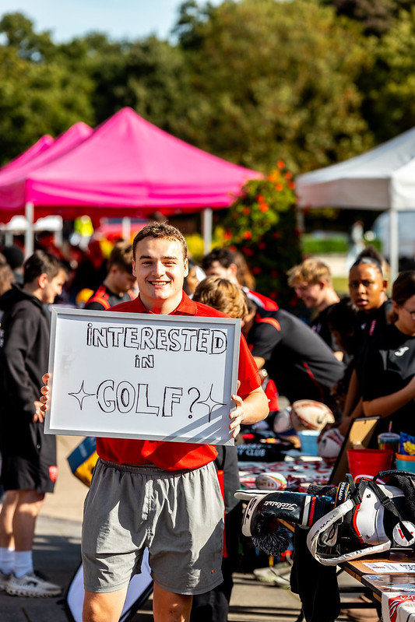
SPORTS CLUB WELFARE TRAINING 25/26
LOOK OUT FOR YOUR MEMBERS
Ensure everyone feels welcome and included in your club. Make a big effort at the start of the year to integrate new members and include them in training/activities and events.
Identify changes in the behaviour of your members. If you notice your members are acting differently or becoming withdrawn, check-in with them. Ask them if they are ok and offer them support.
Encourage your members to use free, confidential support services.
Share your knowledge of the University and local area! Particularly helpful to new students. Show them SU Advice, Student Support, good study spaces, where the launderette is and how to use it, nice places to eat/drink, things to see.
SPORTS CLUB WELFARE TRAINING 24/24
Notes:
see a substantial increase in first time su engagement
have at least 25 individuals register interest to be trained to be group leaders for following year

Slide 30
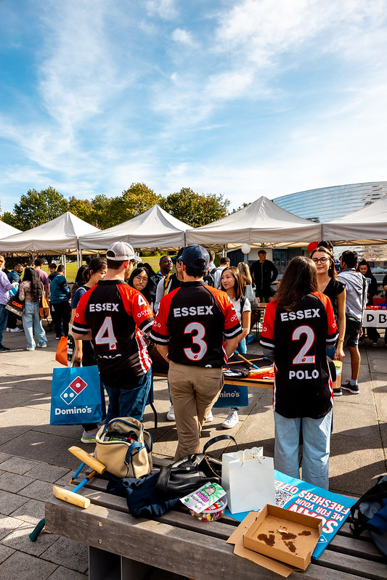
SPORTS CLUB WELFARE TRAINING 25/26
LOOK OUT FOR YOUR MEMBERS
🌍 International Students
They may be adjusting to a new culture, language, or feeling homesick. Your club can offer a valuable sense of community and comfort — be welcoming and supportive.
🧒 Under-18s
Some university students may be under 18.
Be mindful that they are still legally minors.
Certain activities may not be suitable or legally permitted for them.
Always follow the University’s safeguarding policies when interacting with under-18s.
🛡 University Safeguarding Support
Every department, including the Students’ Union, has Designated Safeguarding Officers (DSOs) to support students and ensure their wellbeing.
If you're ever concerned about the safety or wellbeing of a member, contact a DSO:
Sian Lovesy
Chris Moore
Don’t hesitate to reach out — safeguarding is everyone’s responsibility.

Slide 31

SPORTS CLUB WELFARE TRAINING 25/26
Mentor scheme
Purpose
Promotes shared responsibility for members’ health & wellbeing.
Encourages peer-to-peer support, building a connected and inclusive club environment.
How It Works
Set up in Term 1.
Exec Committee / senior players paired with 1–2 first-year members.
Pairings ideally based on shared subjects or interests.
Mentors support members with:
Club involvement
Socials
Academic life
Settling into university
Expectations
Meet once or twice per term (virtual or in-person).
Check how first-years are finding university and ensure they know support systems.
Escalate issues beyond your role → Welfare Officer or committee.
Serious concerns (e.g., discrimination): email 📧 blades@essex.ac.uk | vpwelfare@essex.ac.uk | suadvice@essex.ac.uk | vpactivities@essex.ac.uk

Slide 32
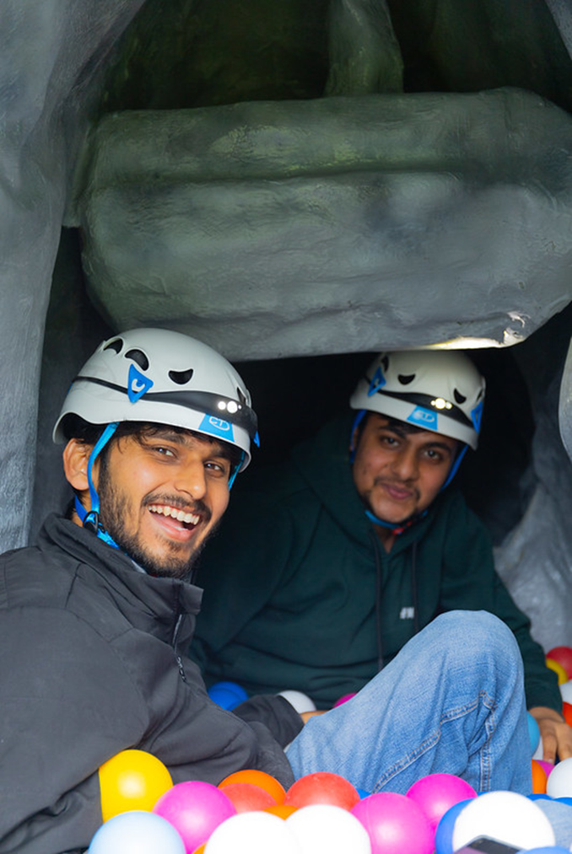
SPORTS CLUB WELFARE TRAINING 25/26
Safe & Inclusive socials
Socials should be positive, safe, and welcoming for all members.
Everyone must feel free to say “no” without consequence.
Respect diversity; not all members share the same humor.
SPORTS CLUB WELFARE TRAINING 24/24

Slide 33

SPORTS CLUB WELFARE TRAINING 25/26
Socials: What's not allowed
Initiations, hazing, or peer-pressure events.
Activities involving:
Forced alcohol consumption
Eating unpleasant food
Nudity or humiliation
Violence
Avoid controversial or offensive games, language, or activities.
Be mindful of themes:
❌ White T-shirt parties
❌ “Gender Bender”
❌ Cultural or sexual/S&M themes
⚠️ Why it Matters Many new students are young & impressionable. Lead by example: make socials fun, safe, and inclusive.
⚖️ Union Policy Such activities violate Union policy and may result in disciplinary action.
Notes:
Cultural themes – We have a very diverse, international campus and students may be offended seeing their culture associated with drinking, nudity or anti-social behaviour.
All Presidents must sign the Students’ Union Alcohol Policy once distributed.

Slide 34
SPORTS CLUB WELFARE TRAINING 25/26
creating a safe SOCIAL environment
Your Role
Don’t feel pressured by “tradition”, if it’s harmful, it isn’t normal.
Lead by example: make socials fun, safe, and inclusive for all.
If you are planning a social and unsure of the appropriateness of it, please get in touch with us and we can advise and support.

Slide 35
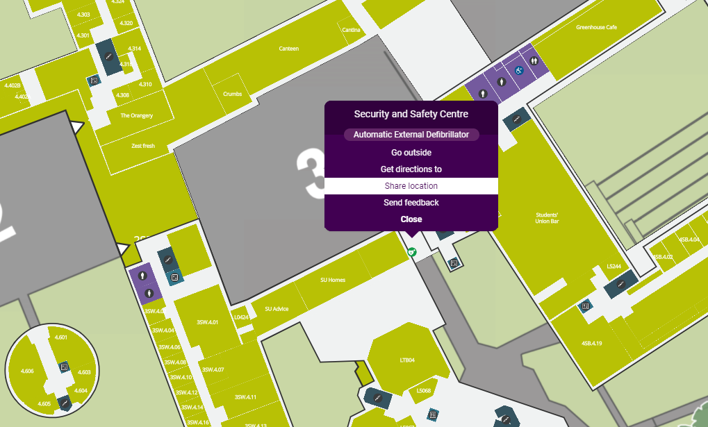
SPORTS CLUB WELFARE TRAINING 25/26
Additional Support
‘Ask for Angela’ - Anyone who is feeling unsafe, vulnerable or threatened can discreetly seek help by approaching staff in venues(Sub-Zero, SU Bar) and asking them for ‘Angela’. This code-phrase will indicate to staff that they require help. This might be through reuniting them with a friend, seeing them to a taxi, or calling campus security.
Security and Safety Centre – Located on Square 3 under the sheltered area – map for reference. The security team provide 24 hour face to face and phone support. You can contact them regarding a range of things.
SU Shuttle Bus – If an individual is not in a fit state to make their own way back to their accommodation, they can make use of the Shuttle Bus Service, which provides transport around the local area. (3 alternative routes). More Info Here.
Welfare Assistants at Sub-Zero – If someone needs support on a night out at Sub-Zero, welfare assistants are on hand in the welfare room to help you.
SPORTS CLUB WELFARE TRAINING 24/24
Notes:
Give verbal reminder of report and support.

Slide 36
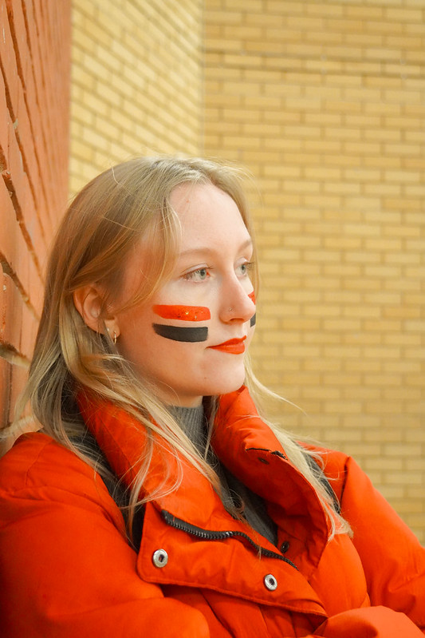
SPORTS CLUB WELFARE TRAINING 25/26
Any questions?
We now have an opportunity for any questions should you have any.
P.S Don't leave yet, we still have a Moodle quiz for you to complete, more information on the next slide.
Blades@essex.ac.uk
Hannah.mortier@essex.ac.uk
Vpactivities@essex.ac.uk
Suadvice@essex.ac.uk
07935 134538 – Blades phone
01206 863211 – SU Reception
SPORTS CLUB WELFARE TRAINING 24/24

Slide 37
SPORTS CLUB WELFARE TRAINING 25/26
Welfare Moodle quiz
Please all complete the required Moodle Quiz now!
18 Questions
Pass Mark – 14/18
Link is also in the chat
If it says you do not have access let us know and we can enroll you now.
Feel free to leave the call once you have gained access, we will be ending the session in a few minutes.
SPORTS CLUB WELFARE TRAINING 24/24

Slide 38

thank you
for LISTENING
Blades@essex.ac.uk
Hannah.mortier@essex.ac.uk
Vpactivities@essex.ac.uk
Vpwelfare@essex.ac.uk
Suadvice@essex.ac.uk
07935 134538 – Blades phone
01206 863211 – SU Reception

