Slide 1
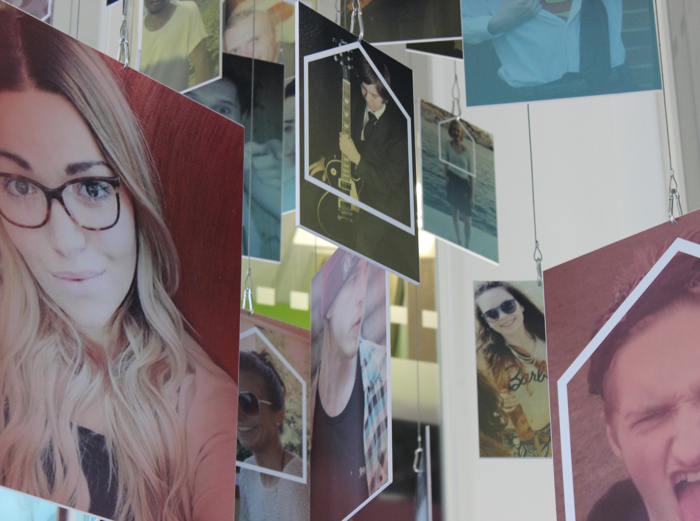
HI, THIS IS A TITLE SLIDE*
* YOU CAN USE A SMALL-PRINT MESSAGE HERE TO REINFORCE OUR TONE OF VOICE
Notes:
This is a title slide. Simple photo with a title and a house silhouette. Also small-print if you’re feeling confident – make it good/funny/snappy/all of the above.

Slide 2
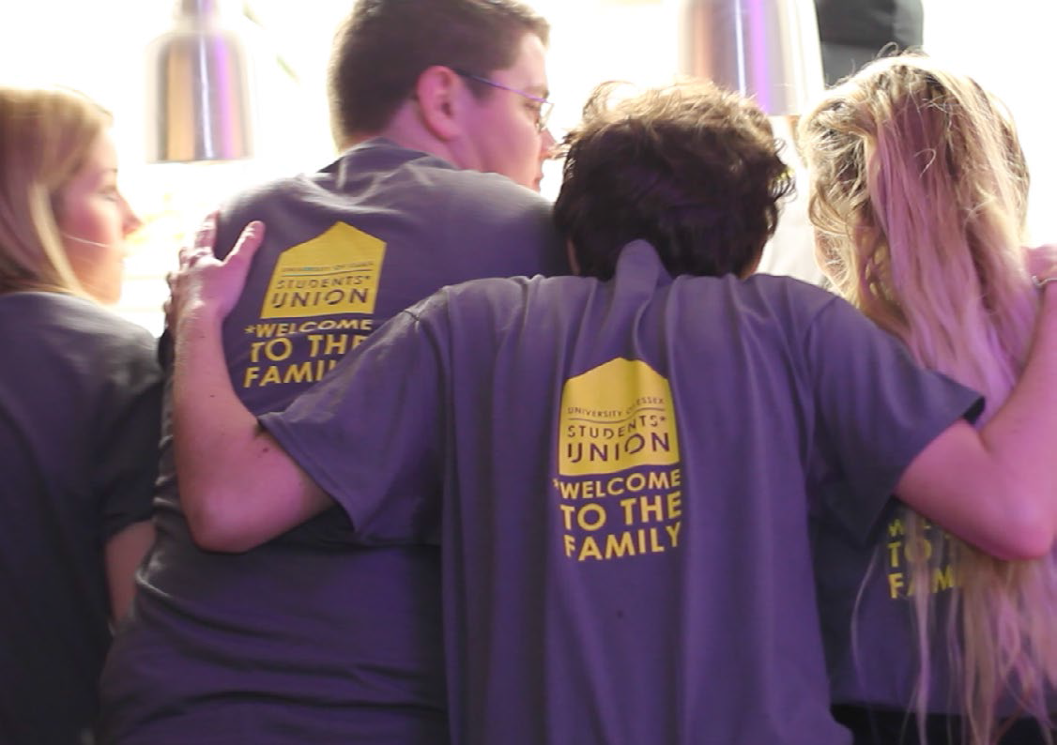
STANDARD SLIDE: BIG, BOLD, SIMPLE

Slide 3
PHOTOS OF REAL ESSEX STUDENTS
Notes:
We’ve got lots of great photos so let’s use them, not some cheesy stock images of students in an american uni sitting on a hill, smiling.

Slide 4
STUDENTS DOING REAL THINGS

Slide 5
SIMPLE TO CREATE
Notes:
Just find an image from our image library (or your own) and add a heading

Slide 6
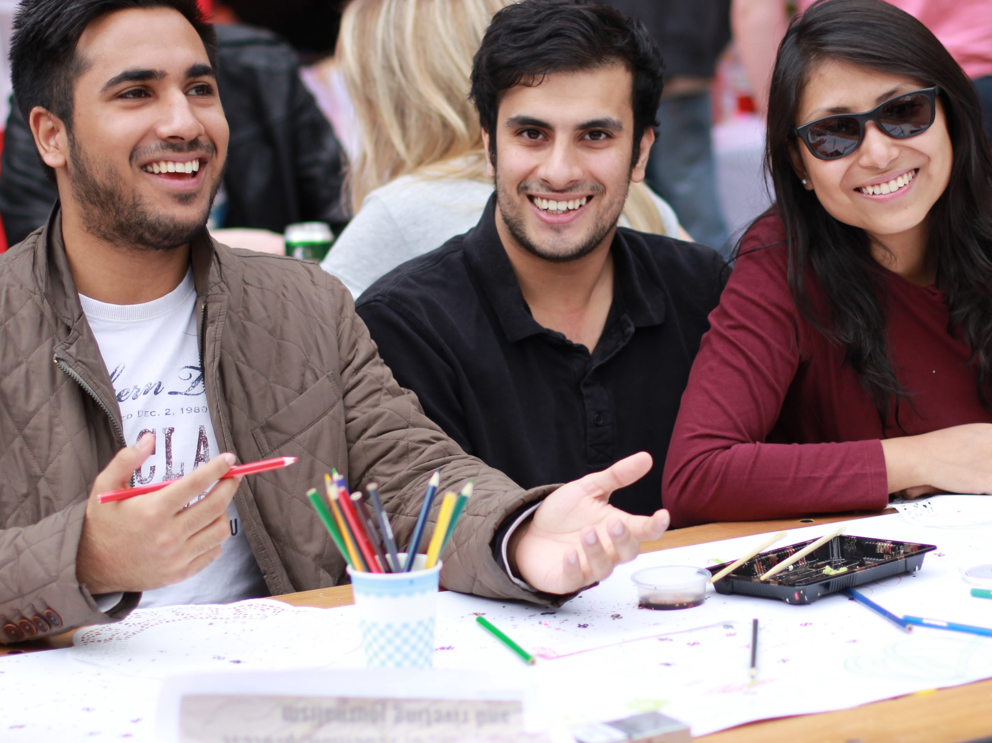
THESE GUYS.
Notes:
Add a simple headline and you’ve got a great slide.

Slide 7
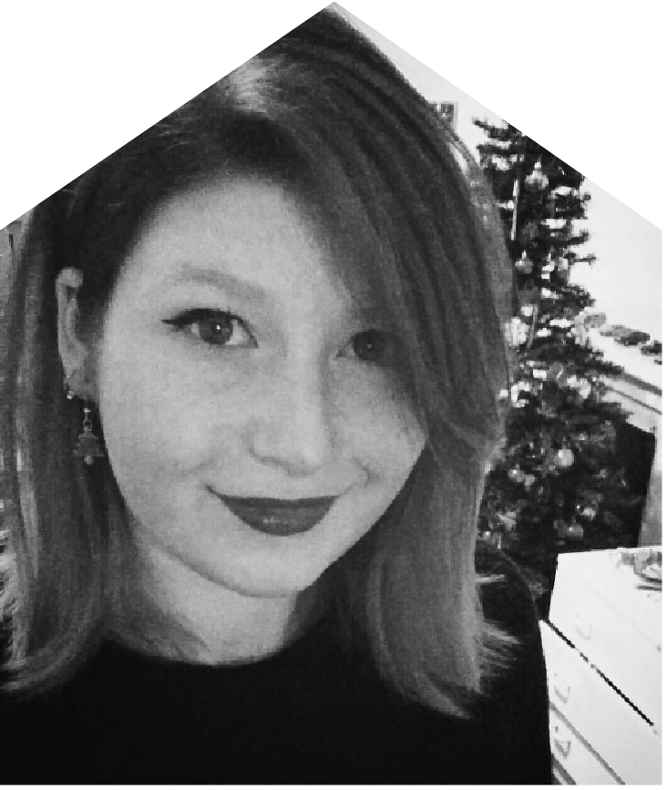
“Quote slides are great for showing student voice and reinforce that our members are behind every idea”
NAME JOB TITLE

Slide 8
Notes:
Our tattoos, in case you need them

